Slide 1

Declarative Network Path Queries
Srinivas Narayana
May 13, 2016
Advisor: Prof. Jennifer Rexford
Notes:
1
How to simplify network management using a declarative system

Slide 2

Management = Measure + Control
Network Controller
Measure
Control
Software-Defined Networking (SDN)
Notes:
Knowing what’s going on is harder than knowing what to do about it

Slide 3
Enabling Easier Measurement Matters
Networks are asked to do a lot!
Partition-aggregate applications
Growth in traffic demands
Stringent performance requirements
Avoid expensive outages
Difficult to know where things go wrong!
Humans are slow in troubleshooting
Human time is expensive
Can we build programmatic tools to help?

Slide 4

Example: Where’s the Packet Loss?
Suspect: Faulty network device(s) along the way.
A
B
1000 pkts
850 pkts ☹

Slide 5


Example: Where’s the Packet Loss?
Idea: “Follow” the path of packets through the network.
Packet rewrite
ip.src==a & ip.dst==b
ip.src==a &
ip.dst==b’
A
B
1000 pkts
850 pkts ☹
Switch ACL counters
NetFlow
Sampling Inaccuracy
ip.src==a & ip.dst==b → count
ip.dst==b → fwd port 2
Notes:
HSA/VeriFlow → can we talk about that?

Slide 6

Example: Where’s the Packet Loss?
Complex & Inaccurate Join
with multiple datasets: traffic, forwarding, topology
High Overhead
of collecting (unnecessary) data to answer a given question

Slide 7

Example: Where’s the Packet Loss?
Complex & Inaccurate Join
with multiple datasets: traffic, forwarding, topology
High Overhead
of collecting (unnecessary) data to answer a given question

Slide 8
Pattern: Combining Traffic & Forwarding
Traffic matrix
Uneven load balancing
DDoS source identification
Port-level traffic matrix
Congested link diagnosis
Slice isolation
Loop detection
Middlebox traversal order
Incorrect NAT rewrite
Firewall evasion
...
Resource management
Policy enforcement
Problem diagnosis
Sources: Feldman et al 2001, Patel et al 2013, Savage et al 2000, Varghese and Estan 2004, Duffield and Grossglauser 2001, Kazemian et al 2012, Fayazbakhsh et al 2014, Handigol et al 2014, Zhu et al 2015, and conversations with network operators at Microsoft and Amazon
Notes:
Yet, challenging:
Accuracy: Hard to infer trajectories in data plane
Efficiency: bandwidth, packet bits, rules
Composition: measurements with forwarding

Slide 9

Approach
Path Query System
Declarative Query Specification
Query-Driven Measurement
Independent of Forwarding
Independent of Other Measurements
Independent of Hardware Details
Accurate Answers
Pay Exactly For What You Query
Commodity (“Match-Action”) Hardware
Path Query Language
Query Run-Time System
Notes:
Mention the term match-action here?

Slide 10

Approach
1. Path Query Language
Query Expressions
Forwarding
Statistics
3. Optimizations
2. Query Run-Time System
SDN controller
Payloads
Statistics

Slide 11
Approach
1. Path Query Language
Expressive measurement specification
3. Optimizations
2. Query Run-Time System
Efficient measurement
Accurate data plane measurement

Slide 12
Contributions
Regular-expression-based language for traffic monitoring
With SQL-like aggregation and capture locations
Run-Time: Deterministic finite state automata on packets using match-action switch rules
Collect exactly those packets that satisfy queries
Compiler optimizations: to speed up or completely remove expensive overlapping actions on packets
Result: Debug networks with practical overheads

Slide 13
How to design general measurement primitives
… that are efficiently implemented
in the network?

Slide 14
Measurement Use Cases
Traffic matrix
Uneven load balancing
DDoS source identification
Port-level traffic matrix
Congested link diagnosis
Slice isolation
Loop detection
Middlebox traversal order
Incorrect NAT rewrite
Firewall evasion
...
What are the common patterns?
Sources: Feldman et al 2001, Patel et al 2013, Savage et al 2000, Varghese and Estan 2004, Duffield and Grossglauser 2001, Kazemian et al 2012, Fayazbakhsh et al 2014, Handigol et al 2014, Zhu et al 2015, and conversations with network operators at Microsoft and Amazon
Notes:
“We looked at a wide variety of measurement use cases, and we came up with the following abstractions”
Yet, challenging:
Accuracy: Hard to infer trajectories in data plane
Efficiency: bandwidth, packet bits, rules
Composition: measurements with forwarding

Slide 15

(I) Path Query Language
Test predicates on packets at single locations:
srcip=10.0.0.1
port=3 & dstip=10.0.1.10
Combine tests with regular expression operators!
sw=1 ^ sw=4
srcip=A ^ true* ^ sw=3
ingress() ^ ~(sw=firewall)* ^ egress()
ingress
egress
ingress
egress
ingress
egress
Notes:
-- Remove before or after

Slide 16
(I) Path Query Language
Aggregate results with SQL-like grouping operators
in_group(ingress(), [sw])
^ true*
^ out_group(egress(), [sw])
Return packets, counters, or samples (NetFlow/sFlow)
ingress() switch | #pkts
S1 | 1000
S2 | 500
S5 | 700
... | ...
(ingress(), egress()) switch pairs | #pkts
(S1, S2) | 800
(S1, S5) | 200
(S2, S5) | 300
... | ...

Slide 17
(I) Path Query Language
Capture upstream, downstream or midstream
Match predicates at switch ingress, egress or both
in_atom(dstip=128.1.2.3)
in_out_atom(dstip=128.1.2.3, dstip=10.1.2.3)
Upstream
Midstream
Downstream
Packet flow on query path

Slide 18
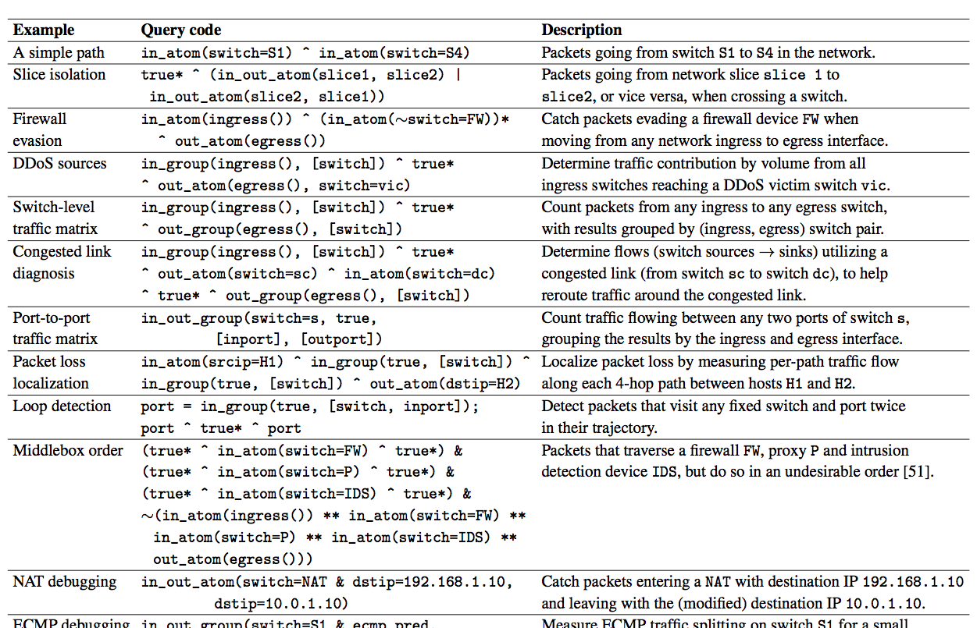
(I) Evaluation: Query Examples
Sources: Feldman et al 2001, Patel et al 2013, Savage et al 2000, Varghese and Estan 2004, Duffield and Grossglauser 2001, Kazemian et al 2012, Fayazbakhsh et al 2014, Handigol et al 2014, Zhu et al 2015, and conversations with network operators at Microsoft and Amazon

Slide 19
(I) Language: Related Work
Primitive | Description | Prior Work | Our Extensions
Atomic Predicates | Boolean tests on located packets | [Foster11] [Monsanto13] | Switch input and output differentiation
Packet Trajectories | Regular expressions on atomic predicates | [Tarjan79], [Handigol14] | Additional regex operators (&, ~)
Result Aggregation | Group results by location or header fields | SQL groupby, [Foster11] | Group anywhere along a path
Capture Location | Get packets before or after queried path | -- | N/A
Capture Result | Actions on packets satisfying queries | [Monsanto13] | Sampling (sFlow); path-based forwarding
Notes:
Fast algorithms for solving path problems. Robert Tarjan. Stanford technical report, 1979. http://infolab.stanford.edu/pub/cstr/reports/cs/tr/79/734/CS-TR-79-734.pdf

Slide 20
How do we implement
path queries efficiently?
In general, switches don’t know prior or future packet paths.
Notes:
Yet, challenging:
Accuracy: Hard to infer trajectories in data plane
Efficiency: bandwidth, packet bits, rules
Composition: measurements with forwarding

Slide 21

Match-Action Packet Processing
(Ternary) Bit Pattern, e.g.,
srcip=A
Forward/Drop/Modify
dstip←B;
fwd(2)
match1 ➔ action1
match2 ➔ action2
...
Multiple but limited # stages (e.g., 16)
Limited # rules per stage (e.g., 2K)
21

Slide 22

How to observe pkt paths downstream?
Analyze packet paths in the data plane itself
Write path information into packets!
Pros: accurate path information ☺
Cons: too much per-packet information ☹
Cons: can’t match regular expressions on switches
[{sw: S1
port: 1
srcmac: ...
srcip: ...
...}]
[{sw: S1, ...},
{sw: S2
port: 3
srcmac: ...
...}]
[{sw: S1, ...},
{sw: S2, ...},
{sw: S3
port: 2
...}]

Slide 23
Reducing Path Information on Packets
Observation 1: Queries already tell us what’s needed!
Only record path state needed by queries
Observation 2: Queries are regular expressions
Regular expressions ➔ Finite automaton (DFA)
Distinguish only paths corresponding to DFA states
Notes:
Running a distributed DFA on the network

Slide 24
Reducing Path Information on Packets
Record only DFA state on packets (1-2 bytes)
Use existing “tag” fields! (e.g., VLAN)

Slide 25
(II) Query Run-Time System
(sw=1 & srcip=A) ^ (sw=4 & dstip=B)
sw=1 & srcip=A
sw=4 & dstip=B
Q0
Q1
Q2
Switch 1:
state=Q0 & srcip=A ➔ state=Q1
Switch 4:
state=Q1 & dstip=B ➔ state=Q2
AND count!
Notes:
At the end, ”in other words, if you only collect packets accepted by queries, you pay for what you query”
Don’t say ”AND” for concatenation!!

Slide 26
(II) Query Run-Time System
Each packet carries its own DFA state
Query DFA transitions distributed to switches
… as match-action rules!
Packet satisfies query iff it reaches accepting states
“Pay for what you query”
Notes:
Nuance: cost in the data plane itself… refer to paper?
Packet collection is only one measure of cost. “in the paper we also look at the number of forwarding rules”

Slide 27
(II) You Pay For What You Query

Slide 28
(II) Run-Time: Deterministic Transitions
p1: sw=S1
p2: dstip=10.0.0.2
Q1
accept p2
dstip 10.0.0.2
dstip 10.0.0.2
Q0
sw=S1
Q2
accept p1
Switch S1

Slide 29
(II) Run-Time: Deterministic Transitions
p1: sw=S1
p2: dstip=10.0.0.2
Trouble: Packet should only be in one automaton state!
Q1
accept p2
dstip 10.0.0.2
dstip 10.0.0.2
Q0
sw=S1
Q2
accept p1
Switch S1

Slide 30
(II) Run-Time: Deterministic Transitions
p1: sw=S1
p2: dstip=10.0.0.2
Solution: Split predicates into disjoint parts
Q1
accept p1 only
p1 & ~p2
~p1 & p2
dstip 10.0.0.2
Q2
accept p2 only
Q0
p1 & p2
Q3
accept p1 and p2
~p1 & ~p2
Switch S1
Q4
dead

Slide 31
(II) Run-Time: Composition
DFA-Transitioning
)
(
>>
Forwarding
+
DFA-Accepting
All acting on the same data plane packets!
Use policy composition operators and compiler
Composing software-defined networks. Monsanto et al., 2013
A fast compiler for NetKAT. Smolka et al., 2015
Notes:
Why does this composed policy make sense? Explain.

Slide 32
(II) Run-Time: Composition
DFA-Transitioning
)
(
>>
Forwarding
+
DFA-Accepting
dstip=A ➔ fwd(1)
dstip=B ➔ fwd(2)
dstip=C ➔ fwd(3)
...
state=Q0 & switch=S1 & srcip=A ➔ state←Q1
state=Q1 & switch=S4 & dstip=A ➔ state←Q2
>>
state=Q0 & switch=S1 & srcip=A & dstip=B
➔ state←Q1, fwd(2)
Openflow 1.0
(for example)
Composing software-defined networks. Monsanto et al., 2013
A fast compiler for NetKAT. Smolka et al., 2015
Notes:
Why does this composed policy make sense? Explain.

Slide 33
(II) Run-Time: Generate Switch Rules
Bit pattern:
state=Q0 & switch=S1 & srcip=A & dstip=B
Forward/Drop/Modify
state←Q1;
fwd(2)
match1 ➔ action1
match2 ➔ action2
...
Result: unified switch rules for forwarding and measurement
33

Slide 34
(II) Run-Time: Other details in paper…
Handle groupby aggregation
Testing predicates before and after forwarding
Upstream query compilation
Notes:
Maybe add netflow support?

Slide 35
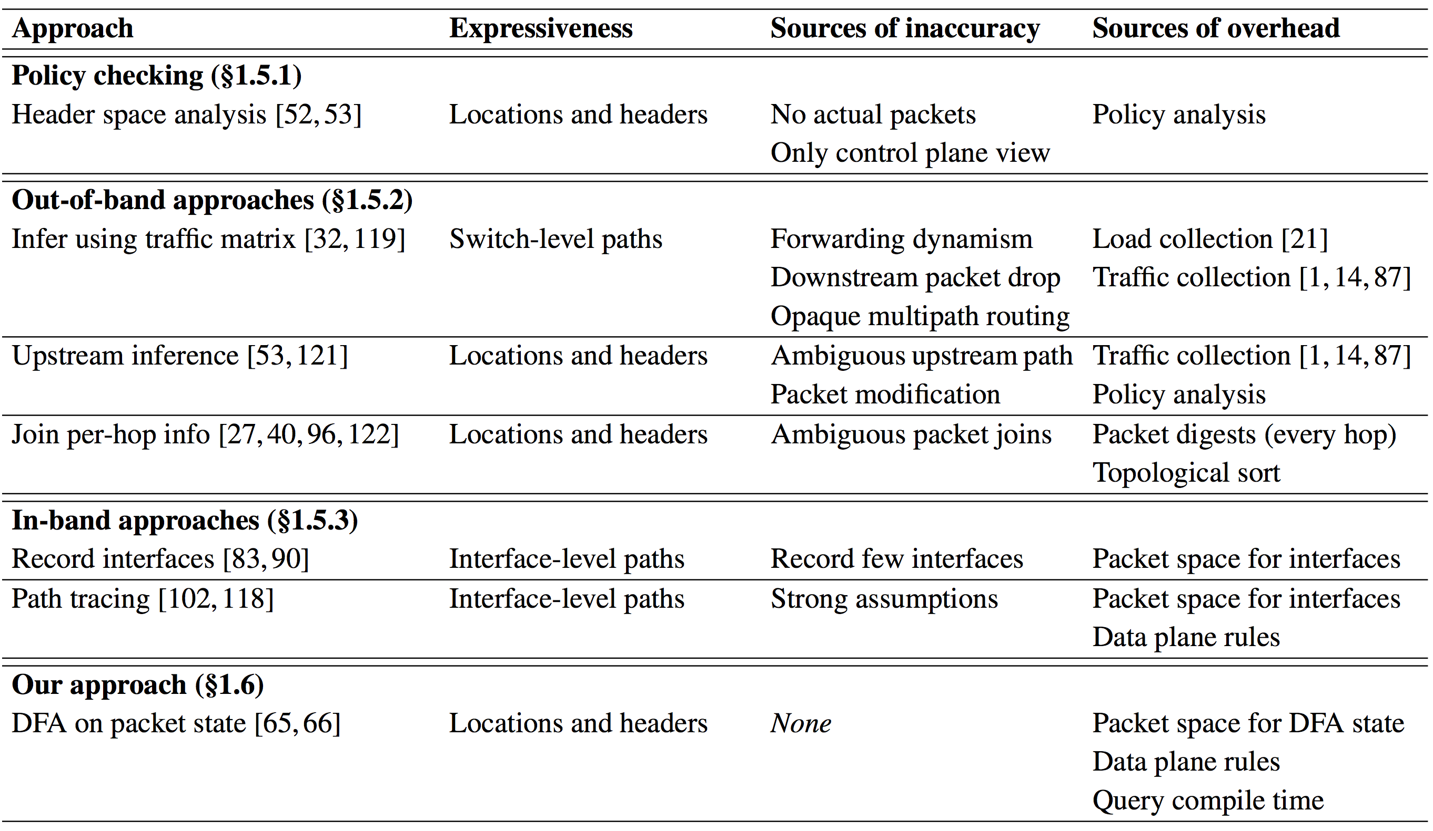
(II) Run-Time: Related Work

Slide 36
How well does it work?
Notes:
Yet, challenging:
Accuracy: Hard to infer trajectories in data plane
Efficiency: bandwidth, packet bits, rules
Composition: measurements with forwarding

Slide 37
Evaluation of initial prototype
Prototype on Pyretic + NetKAT + OpenVSwitch
Publicly available: http://frenetic-lang.org/pyretic/
Queries: traffic matrix, DDoS detection, per-hop packet loss, firewall evasion, slice isolation, congested link
Run all queries together on Stanford backbone
Compile time: > 2 hours
Switch rules: (estimated per switch) 1M
Packet state: 10 bits

Slide 38
Problem: Cross-Products
DFA-Transitioning
)
(
>>
Forwarding
+
DFA-Accepting
dstip=A ➔ fwd(1)
dstip=B ➔ fwd(2)
dstip=C ➔ fwd(3)
...
state=Q0 & switch=S1 & srcip=A ➔ state←Q1
state=Q1 & switch=S4 & dstip=A ➔ state←Q2
>>
state=Q0 & switch=S1 & srcip=A & dstip=B
➔ state←Q1, fwd(2)
Notes:
Why does this composed policy make sense? Explain.

Slide 39
Problem: Cross-Products
p1: sw=S1
p2: dstip=10.0.0.2
Q1
accept p1 only
p1 & ~p2
Q1
accept p2
dstip 10.0.0.2
~p1 & p2
Q2
accept p2 only
Q0
Q0
p1 & p2
Q3
accept p1 and p2
sw=S1
Q2
accept p1
~p1 & ~p2
Q4
dead

Slide 40
Complexity From Overlaps

Slide 41
Complexity From Overlaps

Slide 42
(III) Optimizations: Reduce Pkt Overlap
Construct non-overlapping policies
Use structure of generated Pyretic policies
Remove overlapping actions on packets
Use pipelined packet processing
Speed up detection of overlapping actions
Use better data structures & caching
Notes:
Emphasize that the highlighted optimizations are among the most non-obvious of the optimizations here. Also, significant gains.

Slide 43
(III) Optimizations: Summary
Optimization | # Rules? | Time? | # States?
Separate query & forwarding actions into separate stages
Optimize conditional policy compilation
Integrate tagging and capture policies
Pre-partition predicates by flow space
Cache predicate overlap decisions
Decompose query predicates into multiple stages
Detect predicate overlaps with Forwarding Decision Diagrams
Notes:
// table of optimizations + intended metrics that should be reduced

Slide 44
(III) Optimizations: Summary
Optimization | # Rules? | Time? | # States?
Separate query & forwarding actions into separate stages
Optimize conditional policy compilation
Integrate tagging and capture policies
Pre-partition predicates by flow space
Cache predicate overlap decisions
Decompose query predicates into multiple stages
Detect predicate overlaps with Forwarding Decision Diagrams
Notes:
// table of optimizations + intended metrics that should be reduced

Slide 45
(III) Separate Queries from Forwarding
(DFA-Transition >> Forwarding) + DFA-Accept
==
(DFA-Transition + DFA-Accept) >> Forwarding
dfa-transition
+
dfa-accept
forwarding

Slide 46
(III) Separate Queries from Forwarding
(DFA-Ingress-Transitioning >> Forwarding >> DFA-Egress-Transitioning) +
(DFA-Ingress-Accepting)
+
(DFA-Ingress-Transitioning >> Forwarding >> DFA-Egress-Accepting)
==
(DFA-Ingress-Transitioning + DFA-Ingress-Accepting)
>>
Forwarding
>>
(DFA-Egress-Transitioning + DFA-Egress-Accepting)

Slide 47
(III) Separating Queries
Could we run queries in a pipelined fashion?
Set of queries
Another set of queries
…

Slide 48
(III) Separating Queries
p1: sw=S1; p2: dstip=10.0.0.2; p3: dstip=10.0.0.3
p1
p2
p3

Slide 49
(III) Separating Queries
p1: sw=S1; p2: dstip=10.0.0.2; p3: dstip=10.0.0.3
Problem: Limited # table stages & rules per stage
p1
p2
p3

Slide 50
(III) Separating Queries
p1: sw=S1; p2: dstip=10.0.0.2; p3: dstip=10.0.0.3
Idea: Group queries by their “similarity”
p1 in one stage, p2 and p3 in another
sw=S1 ➔ ...
dstip=10.0.0.2➔...
dstip=10.0.0.3➔...

Slide 51
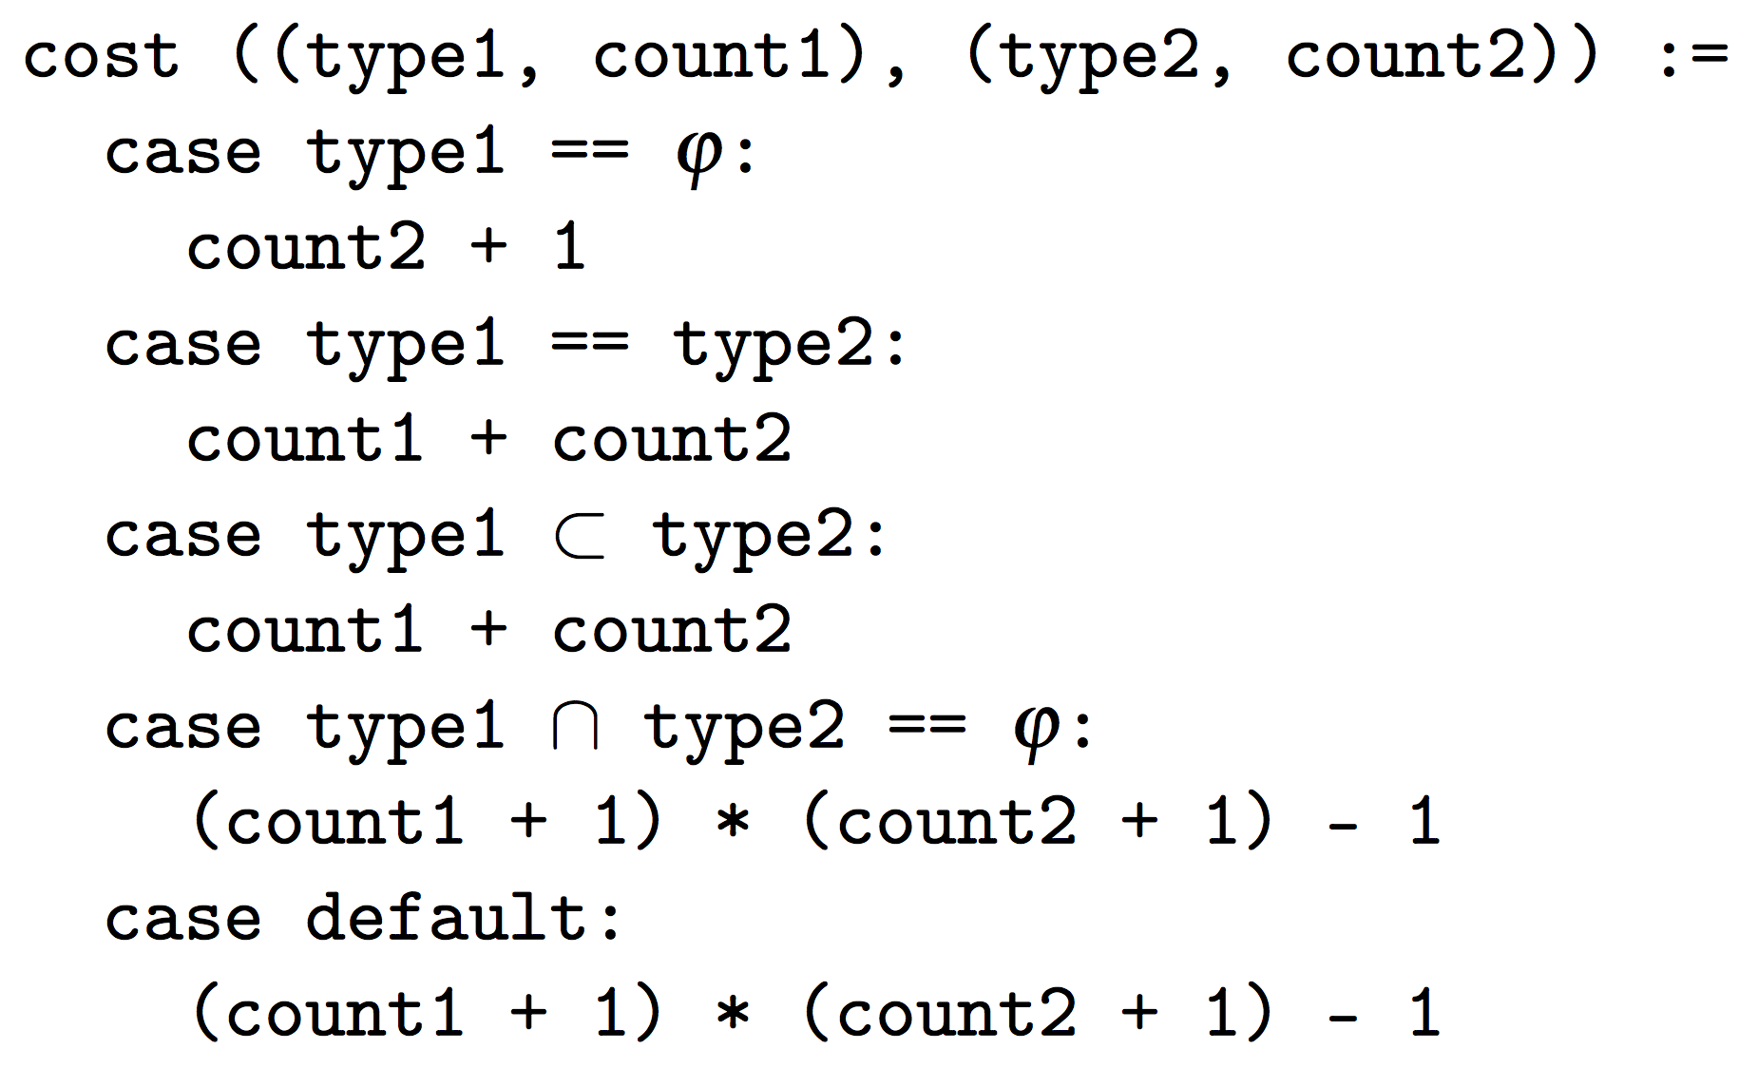
(III) Cost Function for Query Similarity
Input: a set of queries
Output: estimate # rules if queries in same table stage
Predicate-similarity-aware rule space estimation
Concurrent NetCore: From policies to pipelines. Schlesinger et al., 2014
Compiling packet programs to reconfigurable swithces. Jose et al., 2015

Slide 52




(III) Cost-Aware Query Grouping
Minimize total # stages
Subject to:
Rule space per stage
Total number of stages
One query ➔ one stage
Variables (binary integers)
Stage j assigned
Query i assigned to j

Slide 53
Evaluation
Prototype on Pyretic + NetKAT + OpenVSwitch
Publicly available: http://frenetic-lang.org/pyretic/
Queries: traffic matrix, DDoS detection, per-hop packet loss, firewall evasion, slice isolation, congested link
Run all queries together on Stanford backbone
Compile time: > 2 hours ➔ 5 seconds
Switch rules: (estimated) 1M ➔ (actual) ~1K
Packet state: 10 bits ➔ 16 bits
Notes:
Rule space estimation for DNF cases.
Stanford forwarding policy has 3840 rules overall – that’s 240 per device on average. Almost all rules match on destination ip address, which almost none of the queries actually match on. This means the best-case reduction applies: ~240 times or two orders of magnitude reduction of rule count going from single-stage to multi-stage tables.
Then there’s at least a factor of 6.6 from the instances that _do_ terminate. Together, that’s 7 * 240 = 1680, or three orders of magnitude reduction in rule space from the unoptimized case.

Slide 54
Benefit of Optimizations (Stanford)
Cumulative Optimization | Time (s) | # Rules | # State Bits
None | > 7900 | DNF | DNF
Separate query & forwarding actions into separate stages | > 4920 | DNF | DNF
Optimize conditional policy compilation | > 4080 | DNF | DNF
Integrate tagging and capture policies | 2991 | 2596 | 10
Pre-partition predicates by flow space | 56.19 | 1846 | 10
Cache predicate overlap decisions | 35.13 | 1846 | 10
Decompose query predicates into multiple stages | 5.467 | 260 | 16
Notes:
Rule space estimation for DNF cases.
Stanford forwarding policy has 3840 rules overall – that’s 240 per device on average. Almost all rules match on destination ip address, which almost none of the queries actually match on. This means the best-case reduction applies: ~240 times or two orders of magnitude reduction of rule count going from single-stage to multi-stage tables.
Then there’s at least a factor of 6.6 from the instances that _do_ terminate. Together, that’s 7 * 240 = 1680, or three orders of magnitude reduction in rule space from the unoptimized case.

Slide 55
Scalability Trends
Five synthetic ISP (Waxman) topologies at various network sizes
At each network size, run mix of queries from before
Averaged metrics across queries & topologies

Slide 56
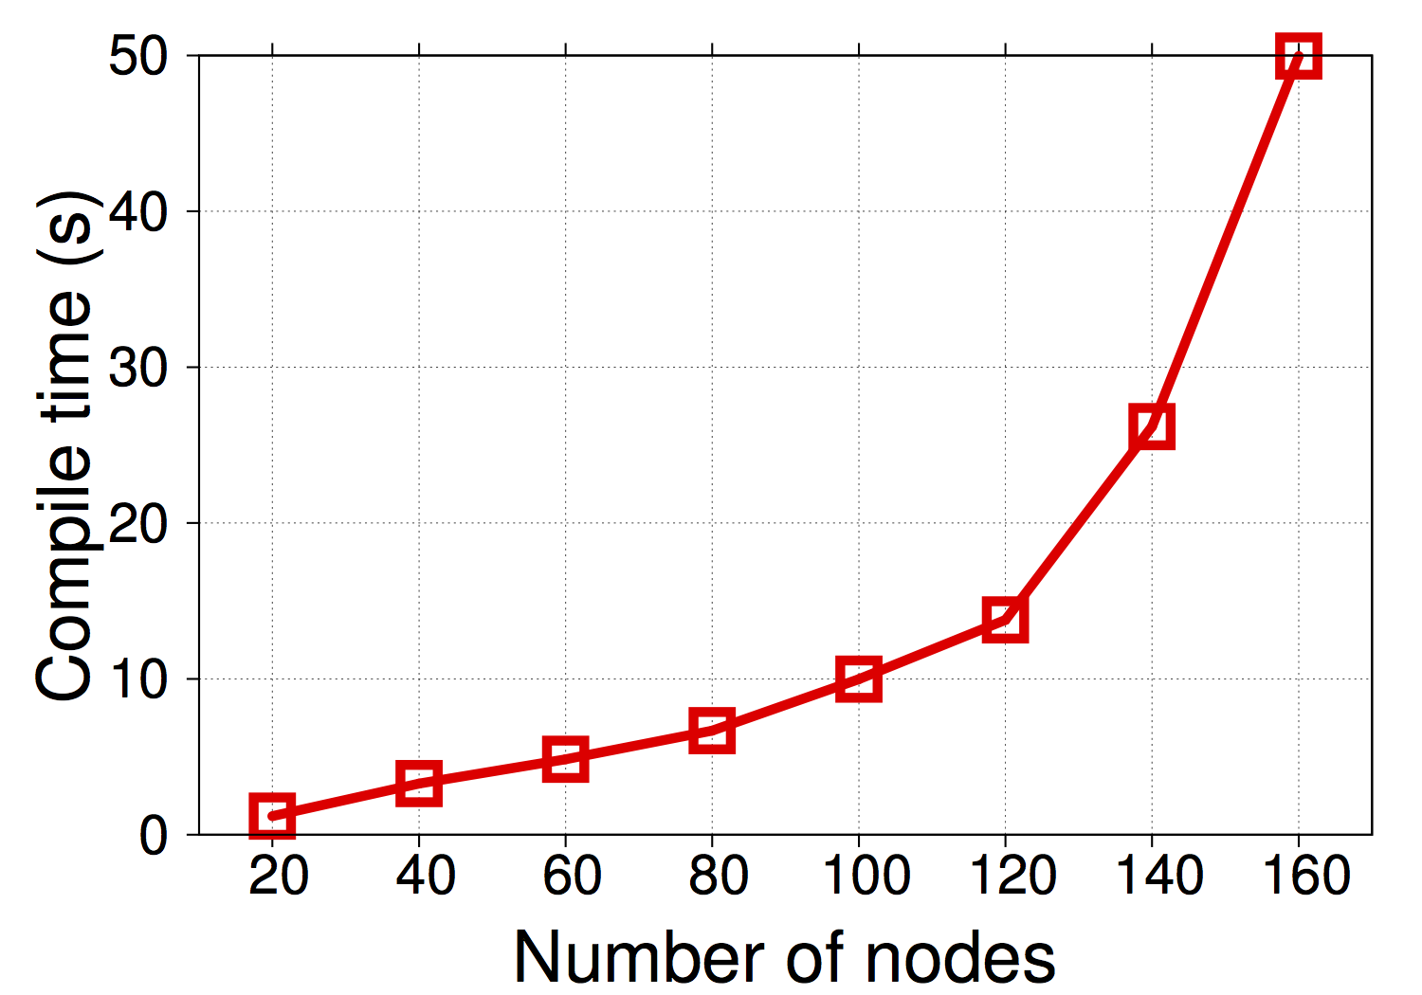
Evaluation: Scaling
Interactive problem solving (~ 15s)
Miller, “Response time in man-computer conversational transactions”
Notes:
Number of data plane rules – mention that you say in the paper
Don’t dwell too much on citation

Slide 57
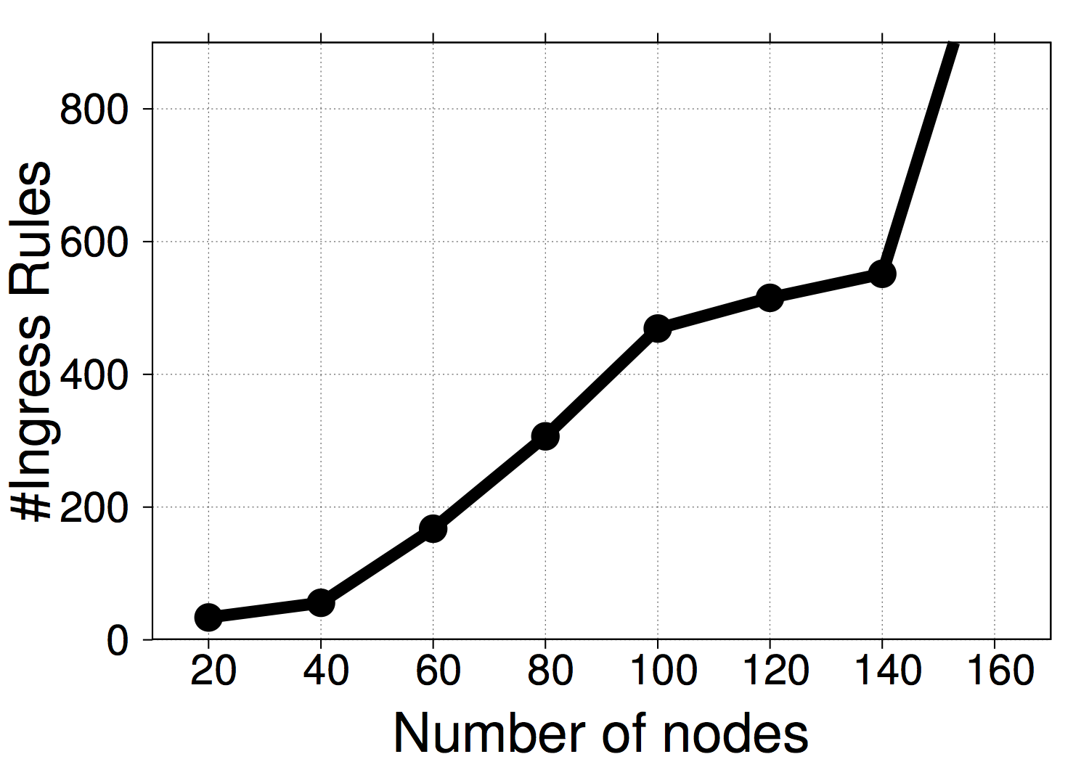
II. Rule Count
Switch TCAM capacity: 2K-4K rules

Slide 58
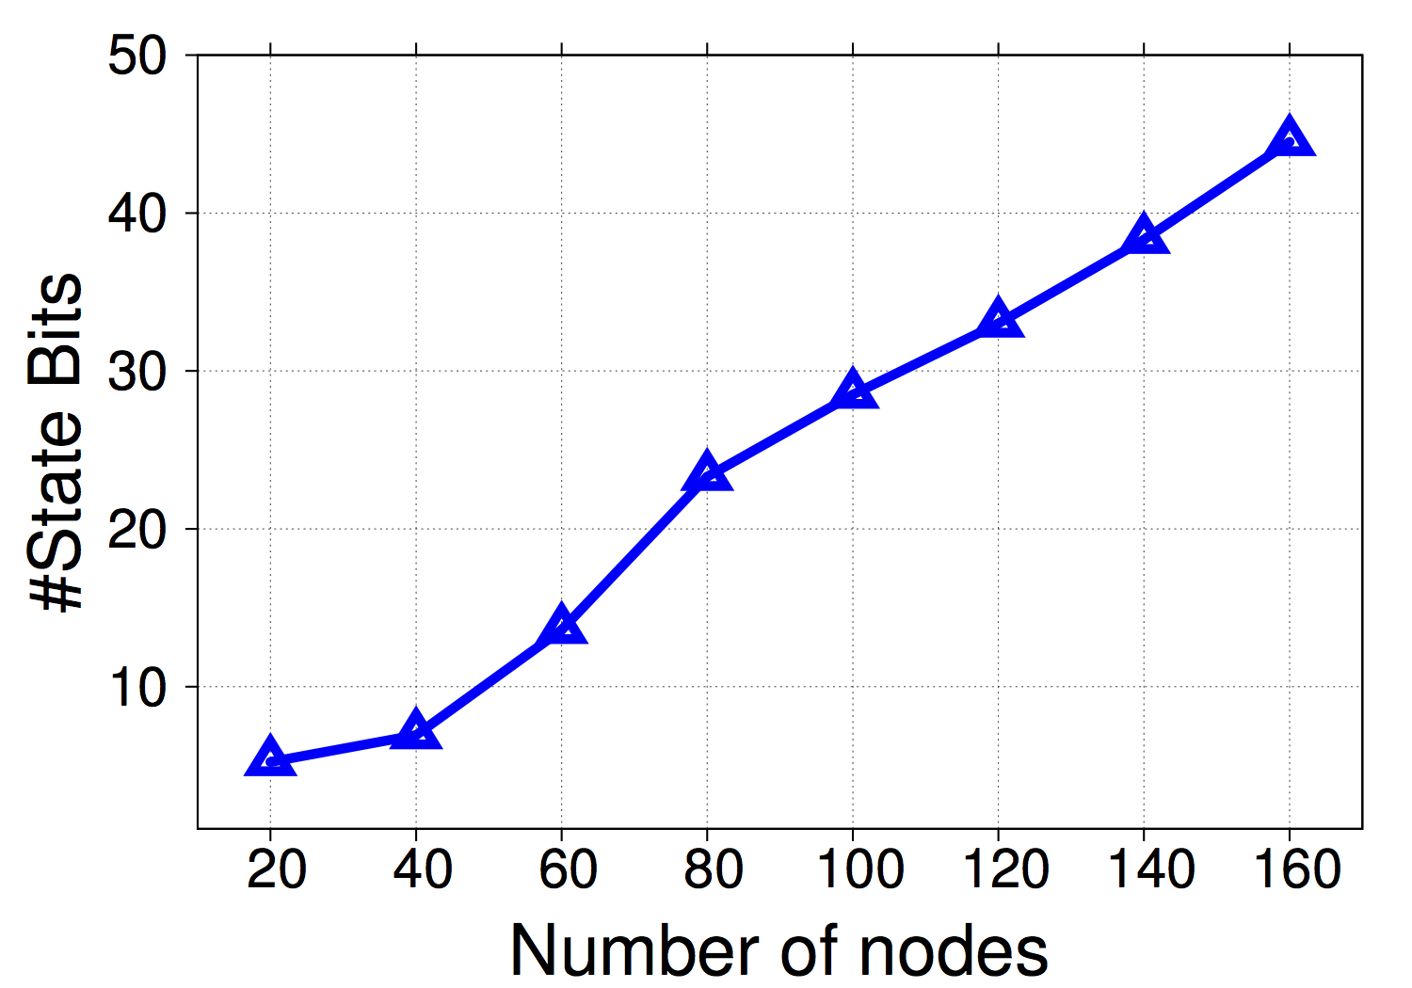
III. Packet State Bits
MPLS
VLAN

Slide 59
Conclusions
We need good abstractions to measure networks
Abstractions must be efficiently implementable
Query-driven measurement: a useful principle
Improves accuracy; and
Reduces overheads
Challenge: finding sufficiently general families of questions with efficient solution techniques
Path queries can simplify network management!

Slide 60






Thanks! ☺

Slide 62
Demo: Where’s the Packet Loss?
A
B
1000 pkts
850 pkts ☹

Slide 63
Demo: Where’s the Packet Loss?
https://youtu.be/VxOaN9iGPWc

Slide 64
Discussion: Questions
Control plane versus data plane checking
Switch performance impact (throughput, delay…)
Table stages
Memory on the switch
Memory on the packet
Comparison to existing SDN approaches
System evaluation

Slide 65
Discussion: Extensions
Multi-packet queries?
Performance, security, …
What language abstractions? What hardware?
Post-facto queries
Improving compiler performance

Slide 66
Approach 1: Join Traffic & Forwarding
Ambiguity between identical packets downstream
??
Dynamic
Timestamps not aligned!
Traffic dataset
e.g., NetFlow, SNMP
Forwarding updates
e.g., OF/routing protocol updates
X
Packet traceback for software-defined networks. Zhang et al., 2015

Slide 67

Approach 1: Join Traffic & Forwarding
Packet rewriting compounds the ambiguity!
Ambiguity between identical packets downstream
??
Dynamic
Timestamps not aligned!
Traffic dataset
e.g., NetFlow, SNMP
Forwarding updates
e.g., OF/routing protocol updates
X
Trajectory sampling for direct traffic observation. Duffield et al., 2001

Slide 68
Approach 2: Collect at Every Hop
Using packet histories to troubleshoot networks. Handigol et al., 2014
Hash-based IP traceback. Snoeren et al., 2001
Packet-level telemetry in large data-center networks. Zhu et al., 2015

Slide 69
Approach 2: Collect at Every Hop
Too expensive to collect up front!
Using packet histories to troubleshoot networks. Handigol et al., 2014
Hash-based IP traceback. Snoeren et al., 2001
Packet-level telemetry in large data-center networks. Zhu et al., 2015

Slide 70
Approach 2: Collect at Every Hop
Too expensive to collect up front!
Sampling to reduce overhead may miss the packets you care about…
Trajectory sampling for direct traffic observation. Duffield et al., 2001

Slide 71
Approach 3: Write Path into Packet
Switches have very accurate info on prior packet path ☺
Match-action HW can’t match regexes :-(
Too much info on packet! :-(
sw: S1,
srcip: ___,
dstip: ___,
...
sw: S3, ...;
sw: S2, ...;
sw: S1, ...;
sw: S2,
srcip: ___,
dstip: ___;
sw: S1, ...;
IP record route, RFC 791. Postel, 1981
Tracing packet trajectory in data-center networks. Tammana et al., 2015

Slide 72
Reachability Testing for Accepted Pkts
??
policy p
Static checking for networks, Kazemian et al. NSDI ‘12

Slide 73
Reachability Testing for Accepted Pkts
??
state=accepted(q)
“Effective” policy after
downstream compilation of query q
Static checking for networks, Kazemian et al. NSDI ‘12

Slide 74
Complexity from Overlaps

