Slide 1


PacketScope: Monitoring the Packet Lifecycle Within a Switch
Ross Teixeira (Princeton)
Rob Harrison (United States Military Academy)
Arpit Gupta (UC Santa Barbara)
Jennifer Rexford (Princeton)
Notes:
Rob Harrison, NOW at US Military Academy
Arpit Gupta, NOW at UC Santa Barbara
Jen Rexford at Princeton

Slide 2
Outline
Peeking Inside the Switch
Packet Lifecycle Query Language
Efficient Query Compilation
PacketScope Prototype

Slide 3
Outline
Peeking Inside the Switch
Packet Lifecycle Query Language
Efficient Query Compilation
PacketScope Prototype

Slide 4
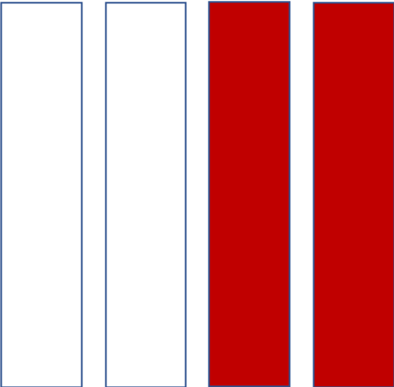


What Happens Inside a (Programmable) Switch?
Packets are modified in the switch
Multiple pipelines
Access Control List (ACL) drops
Queues cause delays and loss
Queues
Ingress
Egress
Notes:
Switches are complex devices that perform multiple types of processing on packets.
Modifications
* TTL value
* Flags may be set
* NAT box - address
- MULTIPLE PIPELINES!!!
ACL Drops
Queues can fill up, causing packets to be delayed or even lost

Slide 5
Prior Systems Don’t Peek Inside
Switch monitoring is important
Want to adapt dataflow monitoring systems
map, filter, reduce operators on incoming tuples
Prior systems only capture arriving packets[1,3]
Or only provide queuing delay info[2]
Queues
Switch Pipeline
Ingress
Egress
[1] Sonata (SIGCOMM ‘18), [2] Marple (SIGCOMM ‘17), [3] Gigascope (SIGMOD ‘03)
Notes:
Queuing LOSS

Slide 6

Introducing PacketScope
Monitoring the packet lifecycle
Packet modifications
ACL drops
Queuing delays/loss
Queues

Slide 7
Outline
Peeking Inside the Switch
Packet Lifecycle Query Language
Efficient Query Compilation
PacketScope Prototype

Slide 8
The Life of a Packet
Queues
port_in,
headers_in,
time_in
port_intent,
headers_mid
port_out,
headers_out
queuing _in/_out
(length, time)
(Could be modified/
dropped!)
(Could be modified/
dropped!)
(Could be delayed!)
Ingress() tuples
Egress() tuples
Notes:
PRESS TWICE FOR EACH. MODIFIED/DROPPED
Ingress – seen by switch
egress – successfully queued and enter egress processing

Slide 9
Example Query
Count un-dropped SSH packets that traverse a NAT
undropped_SSH_NAT = egress()
.filter(tcp.srcPort_in == 22)
.filter(ipv4.srcIP_in != ipv4.srcIP_out)
.filter(port_out != -1)
1
2
3
4
Not Lost
SSH Packets
Crossing a NAT
Not Dropped
Notes:
egress() - only packets are not dropped due to queuing loss

Slide 10
How To Track Queuing Loss?
Queues
X
Ingress
Loss happens outside ingress/egress processing
We can’t process individual packets
But over time, we can track aggregate counts by keeping state
.lost(groupby_fields, epoch_ms) operator
count packets grouped by groupby_fields every epoch_ms
Notes:
Lost operator, which counts lost packets grouped by a set of fields specified by the query, and reports results for epochs defined in milliseconds split by packet arrival times.

Slide 11
Outline
Peeking Inside the Switch
Packet Lifecycle Query Language
Efficient Query Compilation
PacketScope Prototype

Slide 12
Compilation: “Tag Little, Compute Early”
Execute
Queues
Metadata: ipv4.srcIP_in = X
Packet: ipv4.srcIP = X
Packet: ipv4.srcIP = Y
Packet: ipv4.srcIP = ??
E.g. Queries across ports?
.filter(ipv4.srcIP_in != ipv4.srcIP_out)
A: Tag packet with metadata
Notes:
TAG LITTLE
1. Because of we need the final value of a packet's source IP, we have to execute at the *CLICK* end of the egress pipeline.
2. *CLICK* But we need to save the original value of the source IP so we can use it at the end of processing.
3. *CLICK* The solution is to tag the packet with metadata as it moves. through the switch. So *CLICK* if the value of the source IP changes, we maintain access to it at the end of the pipeline.

Slide 13
Compilation:“Tag Little, Compute Early”
Queues
Metadata: ipv4.srcIP_in
Metadata: ?
Metadata:
Packet
ipv4.srcIP = X
Where to place computation?
.filter(ipv4.srcIP_in != ipv4.srcIP_mid)…
A: As early as possible!
Notes:
COMPUTE EARLY
Sometimes, queries don't need to be processed at the end of the pipeline. For example, this query checks if the IP is modified on ingress processing. So we can compute at the end of ingress processing. *CLICK TO NEW SLIDE*

Slide 14
Compilation:“Tag Little, Compute Early”
Execute
Queues
Metadata: ipv4.srcIP_in
Metadata:
Packet:
ipv4.srcIP = Y
Where to place computation?
.filter(ipv4.srcIP_in != ipv4.srcIP_mid)…
A: As early as possible!
Metadata can be reused for future processing.
Notes:
COMPUTE EARLY 2
This
This way, metadata can be reused for future processing.

Slide 15
How To Compile Lost Operator?
Queues
State
State
X
Ingress
Egress
.lost([ipv4.srcIP], 10ms)
Compile as a join of two queries:
Count by ipv4.srcIP on ingress
Count by ipv4.srcIP on egress
Report difference every 10ms of packet arrival times
Gory details in paper

Slide 16
Outline
Peeking Inside the Switch
Packet Lifecycle Query Language
Efficient Query Compilation
PacketScope Prototype

Slide 17
PacketScope Prototype
We built a prototype[1] in Python and P4 with:
Support for packet modifications, queuing delays
Tag little, compute early compilation
We also built a queuing loss query prototype
Uses the BMv2 software model
More details and future work in paper
[1] As an extension to Sonata (SIGCOMM ‘18)
Notes:
Currently, PacketScope exists as an extension to the Sonata dataflow monitoring system, with added support for:..

Slide 18
Conclusion
PacketScope is a network telemetry system
Using a dataflow programming model (map, filter, reduce)
That supports queries on the full packet lifecycle:
Packet modifications
ACL drops
Queuing delays/loss
And compiles efficiently to programmable switches
Queues
18
Notes:
And as the world is currently fighting a pandemic, for those you love and those you've never met, please, stay safe and stay home. Thanks you.

