Slide 1
Network-Wide Heavy-Hitter Detection for Real-Time Telemetry
Qizhe Cai
Advisor: Jennifer Rexford
Notes:
My name is Qizhe Cai. Today I like to present my MSE work -> network-wide heavy hitter for real-time Telemetry.

Slide 2
Heavy-Hitter Flows
Flows are sets of similar packets grouped by header(s)
(srcIP, dstIP, protocol, srcPort, dstPort)
(srcIP, dstIP)
(dstIP)
…
FlowID | Count
Green | 101
Blue | 30
Red | 10
Heavy-Hitters exceed some
threshold of packets or bytes
> 100
Notes:
While network switches process packet flows all the time, we are usually most interested in those flows that are *heavy-hitters*.
Flows are defined as sets of similar packets grouped by a tuple of headers such as a five-tuple microflow, or simply just as a destination IP address,
Heavy hitters are flows that exceed some threshold on packet count or bytes.
[*build*] In this table, we see that of the three packet flows differentiated by color, the green flow is the heavy hitter.
Detecting heavy-hitter flows is important because their presence could indicate conditions that require immediate attention such as [*build*] attack, misconfiguration, or failure.

Slide 3
Heavy Hitter Detection on Single Switch
FlowID | Count
Green | 101
Blue | 30
Red | 10
Hashpipe, FlowRadar, Univmon, Opensketch
Much prior work focused on these constraints.
Notes:
Detecting heavy-hitters on a single switch, is itself challenging, because
[*build*] we have to fit the data structures and perform the computations to calculate these heavy hitters on network switches which are significantly constrained in both memory and computation
[*build*]
Detecting heavy hitters on a single switch given these constraints has been the focus of much prior work.

Slide 4
Network-Wide Heavy-Hitter Detection
Collector
Switches
…
1. Maintain high accuracy on a short-time scale
2. Reduce the communication cost
Notes:
But In reality, our networks consist of far more than a single switch, and to diagnose some problems like Denial of Service attack or TCP Incast, just performing single-switch heavy hitters at each location won’t suffice.
A strawman solution is to forward each packet to the central collector. However, it will result in too many samples and overburn the collector.
The goal for this project is to design a heavy-hitter algorithm that maintains high accuracy on a shot-time scale and reduces the communication cost.

Slide 5

Sampled Central Collection
Sample Packets
Collector
Flow | Count
$$\frac{1}{n}$$
Blue
❌
Inaccurate at low sampling rates and short intervals
Notes:
Current network-wide heavy-hitter detection used by the industry is sampling, such as sflow and netflow.
one might sample [*build*] the original flows [*build*] at some rate such as 1/n packets . Reducing the number of packets sent would avoid [*build*] crushing the collector, but at the cost of decreased accuracy [*build*] especially on short time intervals.

Slide 6
Continuous Distributed Monitoring Model
[Cormode et al ‘08]
Coordinator
Global Threshold (T)
…
Switches
Flow | Count | Threshold
f | c | t
Notes:
We can reason about the amount of coordination required to achieve accuracy in the context of the continuous distributed monitoring model. This model has been widely used for previous network-wide heavy hitter algorithm.
Here, [*build*] we have n switches, forwarding packets.
[*build*] A central coordinator tries to determine when a [*build*] global threshold (T_sub_g) has been met for some flow by listening for reports from the switches.
These switches maintain [*build*] a current count (c) for each flow and then report [*build*] to the coordinator when the count meets the local threshold (t) at each of the switches.
After receiving some number of reports from the switches, the coordinator determines that the flow has exceeded the global threshold

Slide 7
CMY Approach
[Cormode et al ‘08]
Coordinator
Global Threshold (T)
…
Switches
Switches (n) = 4, Global Threshold (𝜏_{g}) = 64
Flow | Count | Threshold
f | c | t
Round 1 | Round 2 | Round 3 | Round 4
8 | 4 | 2 | 1
= 4
= 8
= T/2^{j}·n
Notes:
A number of ways exist to combine local thresholds and reporting conditions that are both inaccurate and inefficient, but the best known deterministic solution to this problem [*build*] that maintains 100% accuracy we call the CMY approach.
In this method, switches adjust their local thresholds in a fixed sequence of rounds; local thresholds [*build*] are set as a function of the the global threshold, the number of switches, and the current round.
For example, [*build*] consider a network of consisting of 4 switches with a global threshold of 64. This scenario would result in [*build*] 4 rounds with the local thresholds for each round shown in the table.
In the first round, [*build*] all local thresholds would be set to eight. After, [*build*] the coordinator receives n reports in a round, [*build*] it sends a message to each switch to proceed to the next round.
When the controller receives the last report in the last round, it determines that the flow has exceeded the global threshold.
This approach has provable upper bounds on the amount of communication required to achieve 100% accuracy.

Slide 8
Spatial Locality in Networks
Internet
External Ingress
Border
Internal
Ingress
ToR
Servers
Notes:
However, the existing CDM work does not adapt to natural differences in the portions of the traffic that enter (or leave) the network at different locations.
we can exploit the property of spatial locality in networks. If we look at this topology, we see that external traffic entering this datacenter network can only do so at one of a few ingress points. Similarly, internal traffic [*build*] also enters the network, at a greater number of ingress points, but a finite number nonetheless, and the set of all these potential ingress nodes is smaller than the set of all nodes in the network.

Slide 9
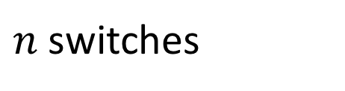

Selective Edge Monitoring
Coordinator
Global Threshold (T)
…
$$L_{f}=2$$
$n$ switches
Notes:
The original CDM model treats each switch equally and deploying the same algorithm to all edge switches.
In this graph, CDM deploy the same algorithm in all n switches in the network.
Based on the spatial locality we found,
we introduce a new symbol L sub flow to augment the CDM model,
L sub f refers to the number of edge monitoring switches for the flow f.
Each flow has its own L.
In this figure, the rightmost two switches in the green rectangle actually observe the flow f.
So in this case L = 2;
By selectively choosing the right edge switches based on the history of the traffic.
We design two algorithms to lower the communication overhead while maintaining high accuracy.
A font bigger for a global threshold;
Too quick
Add some animation ; number of monitoring switches;
Notion of L; L

Slide 10
Adaptive Local Thresholds
Coordinator
Flow | s₁ | s₂ | s₃ | s_{n}
f_{t} | c₁ | c₂ | c₃ | c_{n}
Flow | Estimate | Threshold
f | e = n·(t-1) | T
f_{t+1} | c₁ | c₂ | c₃ | c_{n}
…
…
Switches
Flow | Count | Threshold
f | c | t
= EWMA_{i}/∑_{n}(EWMA)
= T/n
Increase where flow is heavy, decrease where it is not
Notes:
If we modify the CMY approach just a bit, we can adapt the local thresholds to account for this locality. Rather than proceeding to update local thresholds in a fixed sequence of rounds, we will continuously update local thresholds over successive time windows of a specified duration.
[*build*] Assuming that we don't know anything about the distribution of the flow among the switches a priori, we start with the local thresholds set as a fair share of the global threshold. If we do have prior knowledge of the flow distribution across the switches, we start with better tuned local thresholds. This information would improve our approach, but it is not required for correctness.
When the count at a switch [*build*] exceeds the local threshold, it generates a report to the coordinator.
The coordinator [*build*] maintains an estimate of the global count, and it updates that estimate after receiving a report from a switch. In the absence of a report, the coordinator overestimates and assumes that the current count of any non-reporting switch is (local_threshold -1).
When the coordinator's estimate exceeds the global threshold, it polls [*build*] the other switches, which reply with their true count. With these [*build*] and subsequent true count reports, the coordinator is able to calculate an exponentially weighted moving average, or EWMA, of the count for each switch over time. With these averages, the coordinator can [*build*] adjust each switch’s local threshold as a fraction of the total count as calculated by the averages.
Adjusting the threshold by EWMA does two things, [*build*]. First, it increases thresholds where flows are heavy which decreases reports sent to the coordinator. Second, it helps us to get the number of L. Once the local threshold of a switch has to be tuned to be zero, we know this switch is not the monitoring switch and decrement the L by one. By knowing the L, we can send global poll requests only to L switches, rather than all switches in the network.

Slide 11








Probabilistic Reporting
Flow | Count | Threshold
f
Coordinator
$\frac{C}{ε}$
$$10$$
…
Switches
Switches (n) = 4,
T = 1000;
Flow | Count | Threshold | Reporting Rate
f | c
$\frac{ε∗T}{n}$
$\frac{1}{n}$
$$25$$
$$1/4$$
$L_{f}$
$L_{f}$
Std. Deviation => overhead and accuracy
Notes:
When the number of switches increases, the saving of adaptive local threshold becomes less pronounced.
Fortunately, we can use probabilistic reporting to reduce the communication cost in a large network.
Let me give you a simple example.
There are four switches in the network and the global threshold is 1000.
we set local threshold to 25. Once the count of a flow equals to the local threshold, the switch reset the counter and reporting packets in a reporting rate ¼. When the coordinator sees 10 signals for the flow, flow is a heavy hitter.
In probabilistic reporting approach, we have an approximation factor called epsilon and communication factor C.
The local threshold is set as a function of epsilon , global threshold and the number of switches. Once the count of a flow equals to the local threshold, the switch reset the counter and reporting packets in a reporting rate 1/n. When the controller receives C/ epsilon signals, the flow is a heavy hitter.
we augment the approach by adding a new parameter L.
L again refers to the number of monitoring switches that observes a flow.
Reporting rate changes to 1/Lk, rather than 1/n and the local threshold is now ε∗upper case T /L.
Comparing to old approach, the new approach has higher accuracy and lower communication cost.
The underlying reason is related to the standard deviation of the reporting signals distribution.
By changing n to L, we essentially decrease the standard deviation, therefore saving the overhead and increase
Math Issue
More words more text; display some texts; highlight;
Tiny portion -> large portion
Add Emphasis

Slide 12
Implementation and Evaluation
P4 Implementation
~200 LoC, BMV2 and Tofino
Heavy Hitter Flow Query
Five-tuple Flows
Real-World Packet Traces
2016 CAIDA Internet Traces
One-Big-Switch Simulation
Map sources to switches with probability (p)
Notes:
We created [*build*] a prototype solution that implements the switch level logic in approximately 200 lines of P4 code.
To evaluate this technique, [*build*] we ran experiments that determine the heavy-hitter five-tuple flows from network traces.
[*build] We ran this query using real-world packet traces form CAIDA that contain about 64 million packets per minute and approximately 6.4 million packets per monitoring interval.
Because this dataset contains packet traces from a single point-to-point link, we simulate a one-big-switch network by assigning each source in the packet trace to some ingress switch with a variable probability.
We then calculate the coordination overhead in each experiment while varying a few key parameters.
precision = tp / (tp + fp)
Recall = tp / (tp + fn)

Slide 13
Parameter: Threshold
66.1%
70.8%
Notes:
The first graph I like to show is : regardless of global threshold chosen to monitor, we see about 60-70% reduction in the coordination required for the CMY upper bound.
In this experiment,
Keep the number of switches to be four, flows enters the network through two ingress switches which are determined by hashing their src IP addresses. We increase the global threshold from 200 to 1000. When the global threshold to be set as 1000, essentially we are picking top-1000 heavy hitters.

Slide 14
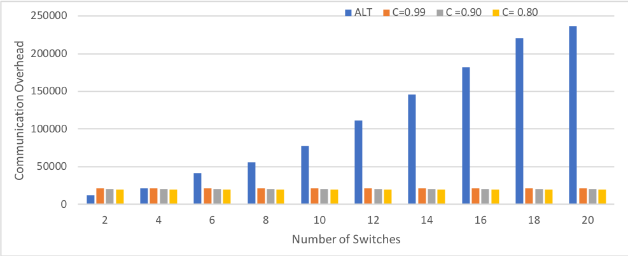
Parameter: Number of Switches
ALT
Probabilitistic Reporting
 | ALT | C=0.99 | C=0.9 | C=0.8
Precision | 100% | 90% | 85% | 78%
Notes:
In the second figure, we compare the performance of the adaptive local threshold to probabilistic reporting approach, measured in the number of messages received by the coordinator, when the number of switches increases.
In this figure, blue bar represents the performance of the adaptive local threshold approach. All other three color bars show the performance of probabilistic reporting approaches with varied values of communication factorC. In the probabilistic reporting approach, C determines the number of signals that require the coordinator to identify the flow as a heavy hitter. In one sentence, large value C increases the overhead; Increasing 10 percent of C, roughly increase the overhead 5%.
The precision in the table:

Slide 15
Summary and Ongoing Work
Network-wide, heavy-hitter detection
Use Adaptive Local Threshold Approach
Achieve perfect accuracy in a small network
Use Probabilistic Reporting Approach
Balance accuracy and cost in a large network
Memory-efficiency on switches
Filter mice flows to reduce per-key state
Learning Monitoring Switches Algorithm
Learn L to better tune the local thresholds
Notes:
[*build*] In summary, I presented two network-wide heavy hitter detection technique that uses spatial locality to reduce the communication overhead while maintaining high accuracy.
[*build*] We would also like to improve the switch-level memory-efficiency of this technique by filtering out mice flows with approximate data structures, such that we don’t have to keep per-key state for all flows, but only the potential heavy-hitters.
2. We also design a Learning Monitoring algorithm which can be used to tune the local thresholds for the probabilistic reporting approach.

Slide 16
Q&A
Question ?
Notes:
[*build*] In summary, I presented two network-wide heavy hitter detection technique that uses spatial locality to reduce the communication overhead while maintaining high accuracy.
[*build*] We would also like to improve the switch-level memory-efficiency of this technique by filtering out mice flows with approximate data structures, such that we don’t have to keep per-key state for all flows, but only the potential heavy-hitters.
2. We also design a Learning Monitoring algorithm which can be used to tune the local thresholds for the probabilistic reporting approach.

