Slide 1
Joint Optimization for Robust Network Design and Operation
Jennifer Gossels
Princeton University
19 February 2020

Slide 2
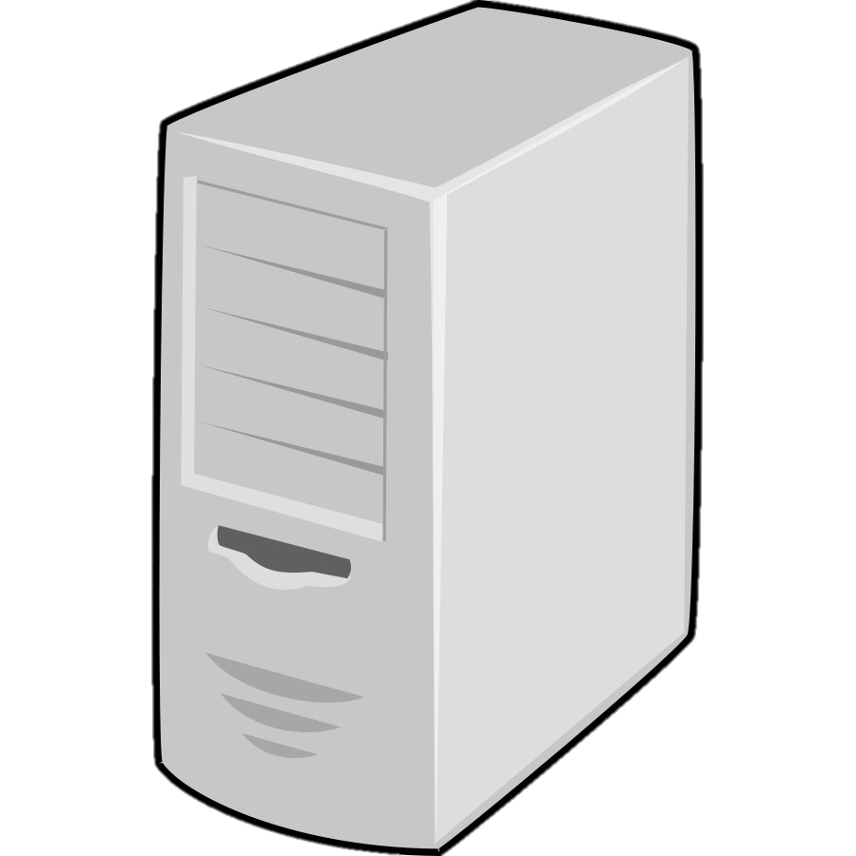
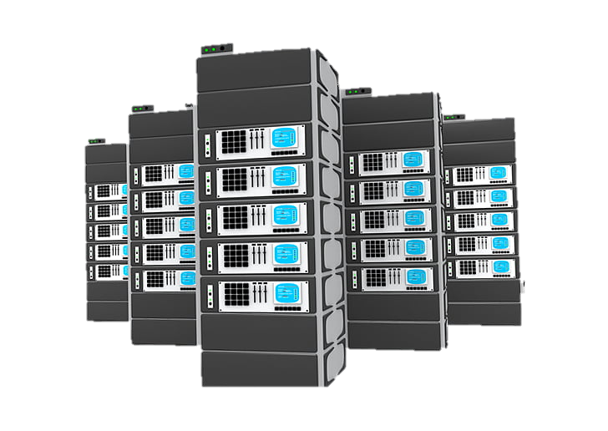
The Internet
Tier 1 ISP
Tier 1 ISP
IXP
IXP
Problem
Links and Switches Sometimes Fail
Regional ISP
Regional ISP
Regional ISP
Access ISP
Access ISP
Access ISP
Access ISP
Access ISP
Enterprise
Home
Home
Data Center
Enterprise
Notes:
The Internet plays an integral role in nearly all aspects of modern life, and Internet Service Provider (ISP) backbone networks play an integral role in the functioning of the Internet. The Internet is a hierarchical “network of networks,'' and these ISP backbones sit at the top of the hierarchy. End systems such as laptops, cell phones, web servers, and mail servers connect to home, enterprise, or data center networks, which in turn connect to one or more access ISP networks. Regional ISP networks join together several of these access ISP networks, and regional ISPs in turn communicate with each other via Tier 1 ISPs or directly by connecting at Internet exchange points (IXPs). Tier 1 ISPs such as AT&T and Verizon maintain backbone networks that span an entire country and serve as the “glue” connecting thousands of these smaller networks.
Thus, given their position at the top of the hierarchy, Tier 1 ISP backbones carry traffic from millions of users each day. These users rely on these networks to provide reliable, rapid communication at all times --- a surgeon simply can't afford for the Internet to “break” in the midst of a procedure, nor can a Red Sox fan streaming an important playoff game tolerate a disruption. Unfortunately for ISPs, the physical links and switches comprising their networks sometimes do fail.

Slide 3
ISP Backbone Networks
ISP wants to limit
  congestion
  disruptions from failures
One solution: extreme overprovisioning
Problem: too expensive
Notes:
An ISP’s challenge is to make these failures as transparent to its customers as possible. One solution is to dramatically overprovision the network; if the ISP builds, say, two extra, redundant links for every link it actually needs, that network will probably not get too congested or disturbed by failures. But, buying all this equipment to provision this network is extremely costly for the ISP.

Slide 4
Challenge
Design and operate networks that are robust to failures while minimizing costs
Notes:
So, the ISP’s challenge is not just to design and operate robust networks but to find the optimal balance between minimizing costs and limiting congestion, even in the presence of failures.

Slide 5
Design and Operation
equipment placement
months
Network Design
IP link placement
Network Operation
minutes
IP routing
seconds
Notes:
So, what are the network design and operation problems?
An ISP makes some decisions, such as how much and what type of equipment to purchase and where to place this equipment, on large timescales on the order of months, and other decisions, such as exactly how to route packets from a given flow, on small timescales on the order of seconds. We say that these large-timescale decisions constitute network design, and these small-timescale decisions constitute network operation.

Slide 6
Design and Operation
equipment placement
Network Design
months
Network Operation
seconds
IP routing
Notes:
The network design and operation problems are intertwined; we can’t solve the network design problem without simultaneously solving many different instances of the network operation as a subproblem.
What do I mean by this?
The long-timescale decisions about where to place edge and core nodes affect how traffic can be routed <click>. So, we need the long-timescale network design to be solved before we can make short-timescale network operation decisions. But, to optimally place edge and core nodes, we need a sense of how traffic will be routed <click>, so we know how much capacity we need in different regions.

Slide 7
Equipment Failures
equipment placement
Network Design
overprovisioning
months
Network Operation
adjusting routing
seconds
IP routing
Notes:
The situation gets even more complicated if we consider the possibility of failures.
On a long timescale, the ISP must provision its network so that if some components
fail, there will still be enough capacity to carry all packets without too much congestion
<click>. On a short timescale, the ISP needs to immediately adjust routing to avoid dropping
packets in flight <click>. How much is enough capacity to provision depends on how
the routing will be adjusted <click>, and how the routing will be adjusted depends on how
the network has been provisioned <click>.
At a high level, what must happen is that the ISP solves the network operation problem as an “inner loop” within the network design computation; for each candidate network design, it determines the optimal routing for the topology remaining under each failure scenario. Of course, this is not what happens mathematically, as an algorithm that searches through every possible network design as its outer loop would be completely intractable. An important part of the challenge of generating an ideal network design and associated routing plan is to formulate the problems in a way that can be solved relatively efficiently.

Slide 8

Opportunities to Innovate
New technology
Realization that we can make use of “smart” interior switches
Opportunity for better solutions
  If we solve new, more
  complicated problems
new optimal
old optimal
Notes:
The network design and operation problems are not new. How do we propose to improve the state-of-the-art?
Put simply, we figure out ways to making use of whatever technology and resources are available.

Slide 9
Network Design: Tomorrow
Reconfigurable optical equipment
IP link placement moves from design to operation
equipment placement
months
Network Design
IP link placement
Network Operation
minutes
IP routing
seconds
SOX: Strategic Optical/IP X-Layer Network Design
Notes:
More specifically, our first innovation is to take advantage of new, reconfigurable optical equipment, which allows reconfiguring IP links on the fly, during network operation. Traditionally, the network design problem has amounted to placing IP links. Equipment placement was also part of network design, but ISPs didn't need to solve for it directly, because IP links were permanently tied to their underlying optical and electrical equipment; equipment placement followed directly from a solution to the IP link placement problem. If an ISP did want to modify its IP topology, it needed to deploy workers to the relevant sites to manually make the changes. In these traditional networks, because IP links were permanently tied to their underlying components, the IP topology needed to be robust to failures. Thus, all that remained for the network operation problem was IP routing.
Now, reconfigurable optical equipment allows remotely reconfiguring the IP topology in the matter of minutes, so it can be done during network operation, and specifically as part of a failure recovery mechanism <click>. But, this changing role of IP link placement fundamentally changes the network design optimization problem, because equipment can now be reused in different ways across different failure scenarios. In the first part of this talk, we formulate and solve this new problem.

Slide 10
Network Operation: Tomorrow
Existing network operation (routing) models assume all-nodes-equal or smart-edge-dumb-interior
Not all networks fall into one of these two categories!
We take advantage of heterogeneous nodes
  “From each [switch] according to its abilities…
Red: A Communist Approach to Network Operation
Notes:
Our second innovation focuses on network operation. Existing network operation models generally assume that all nodes are equal, and require complex packet processing from *every* node in the network, or they assume that all edge switches are capable of this complex packet processing but all interior nodes are “dumb.” But, not all networks fit one of these two descriptions. We formulate and solve a network operation and failure recovery scheme that takes advantage of the resources of *whichever* interior nodes happen to be “smart.”

Slide 11

Contributions: Red + SOX
Adapt multicommodity flow (MCF) for network design and operation problems
Heuristics to improve scalability
Evaluation

Slide 12
Red + SOX
SOX focuses on design but addresses operation
Vice versa for Red
Not necessarily supposed to be applied to same network
Notes:
Two other brief notes about how the two projects fit together, before I go into each of them in detail: First, I’ve said that SOX focuses on network design, while Red focuses on network operation. But, as we’ve seen, design and operation are intertwined. Therefore, we must address network operation as part of SOX, and we must take network design into account in our work on Red. Second, although these two projects could be used together to design and then run a particular network, we are not necessarily advocating that they should be. Rather, we present these works as applications of similar intellectual ideas to two similar but distinct problems in networking.

Slide 13
SOX: Strategic Optical/IP X-Layer Network Design
Notes:
Let’s dive in now to how ISPs have traditionally designed their networks at the physical and IP layers.

Slide 14


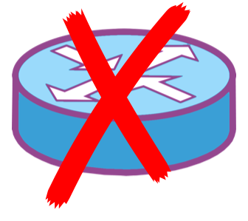
Network Design
Network design
$
to minimize cost
while carrying all traffic
even in the presence of failures

Slide 15
Constrained Optimization
traffic matrix
PoP/fiber locations
failure scenarios
Inputs
Network Design
carry all traffic
minimize costs
Constraints
Objective
Output
Notes:
To put it more precisely, the ISP must solve a constrained optimization problem <click>. The inputs comprise a traffic matrix of demands from edge routers, the fiber topology that has been laid in the ground, the set of cities where the ISP has points of presence and can install IP routers or optical switches, and a set of failure scenarios defining which pieces of equipment might fail and in which combinations <click>. The ISP is constrained by the need to carry all traffic, or in some cases nearly all traffic. The solution must be the specification of a network topology, including answers to the following questions:
At which points of presence different pieces of equipment should be placed?
How should the PoPs should be connected with IP links?
What paths should those links should take over the optical layer?
The ISP’s objective is to produce a minimal cost topology.

Slide 16
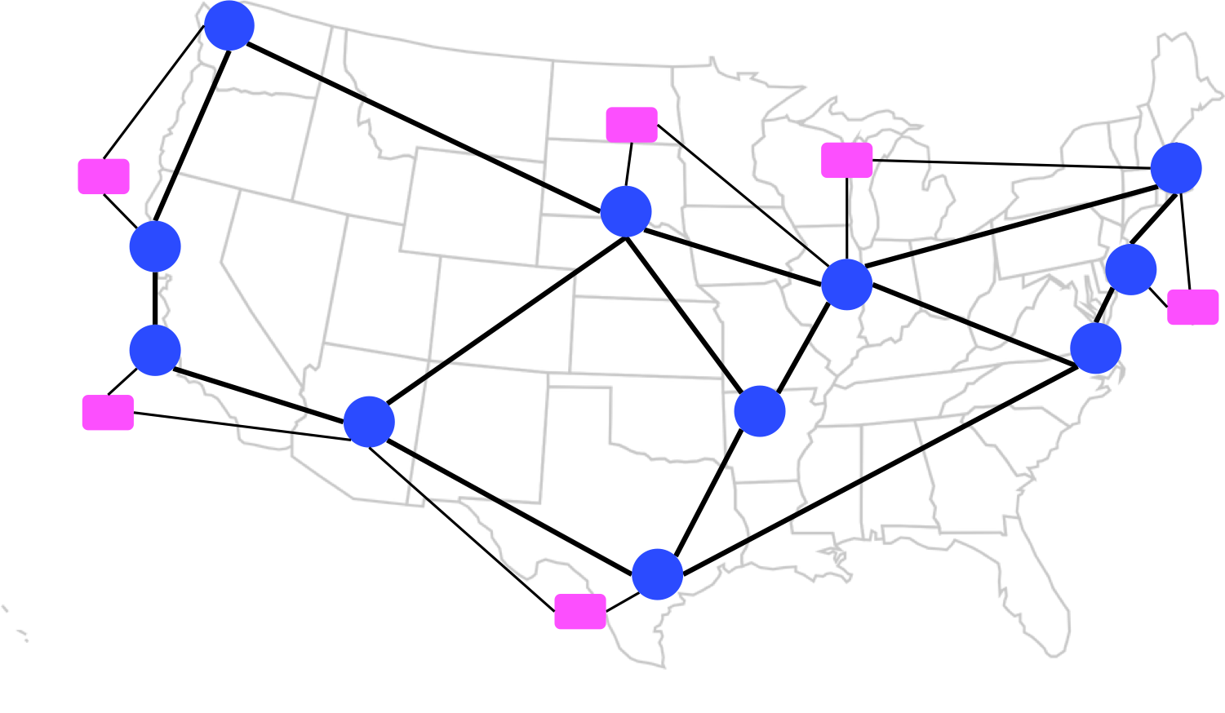
How is This Done Today?
✗
equipment placement
Network Design
IP link placement
Network Operation
IP routing
Notes:
How is this done today? Without reconfigurable optical technology, to meet the constraint of carrying all traffic, even in the presence of failures, our output topology needs to be overprovisioned such that it requires a good deal of equipment that is only needed during rare failures. This is an optimal solution given the restrictions of legacy technology, but we’d like something better that doesn’t require the ISP to pay for so much expensive equipment.

Slide 17
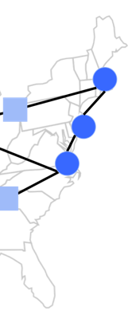
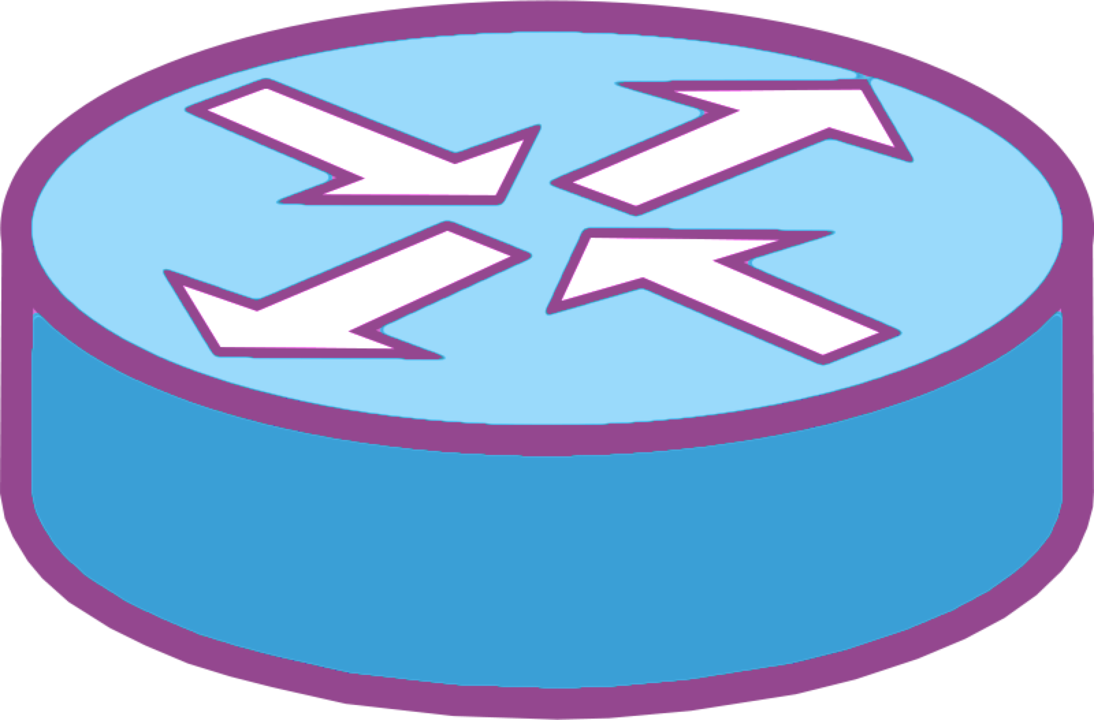
Failure Recovery: Fixed IP Links
✗
P
✗
+ Robust
- Expensive
- Not Robust
Notes:
Our network design approach takes advantage of reconfigurable optical equipment to do exactly this.
To explain exactly how our solution improves upon the existing methods, I’ll start with an example of how network design solutions currently handle equipment failures.
Suppose the router at the New York end of the (Boston, New York) IP link fails. Then the router port serving as the other endpoint, labeled P in this example, no longer serves any purpose. If we want this network to be robust to any router failure, we need to provision eight total router ports.
The fundamental problem here is that this functioning router port is locked in to being used with the now failed components; the decision was made at network design time to connect two ports in an IP link, and neither of those ports can be repurposed later.

Slide 18
Failure Recovery: Reconfigurable
✗
B1
B2
✗
NY1
NY2
Notes:
Recent advances in optical technology allow ISPs greater flexibility in reconfiguring their networks during operation. With these modern components, we can delay the decision about where to place IP links. At design time, we just specify that we want one port on each of two separate routers in Boston and the same in New York. Then, at runtime we decide how to connect those ports into IP links. Suppose we start with this setup, and then, being unreliable as New York is wont to be, router NY1 fails <click>. We now have a quick, programmable mechanism to switch the NY1 end of the IP link to router NY2 while leaving its other endpoint at B1. Therefore, we now only need four total ports to cover any single router failure, which is half of what we need in the traditional setting.

Slide 19
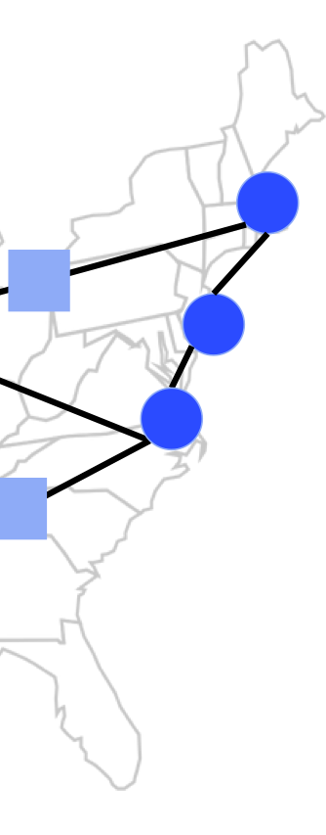
Network Components: Tails
B1
B2
tail
IP router
port
opt. transponder
IP node
IP node
NY1
NY2
Notes:
Thus far, I’ve been vague about what, exactly, these network components are that we need to place. As I said previously, we’re *not* talking about laying new fiber in the ground; ISPs have already laid plenty of fiber, but the fiber can’t be used for active IP links without some additional equipment. The cost of this additional equipment is the relevant expense an ISP must consider when designing a network.
As we saw in the example, one of these additional components is router ports. However, this is only part of the story. Technically, we need both a router port and an optical transponder at each endpoint of an IP link <click>, so we’re actually placing both of them together, even though we previously just mentioned the router port. Because a router port and an optical transponder are always paired together, we use the shorthand tail to refer to both together. So, tails are one type of component we need to place, and we can place zero or more tails on each IP router. One or more IP routers are housed at an IP node, which is an ISP’s point-of-presence in a major city <click>. Returning to our previous example, routers B1 and B2 were both contained within the Boston IP node, and likewise NY1 and NY2 were in the New York node.

Slide 20
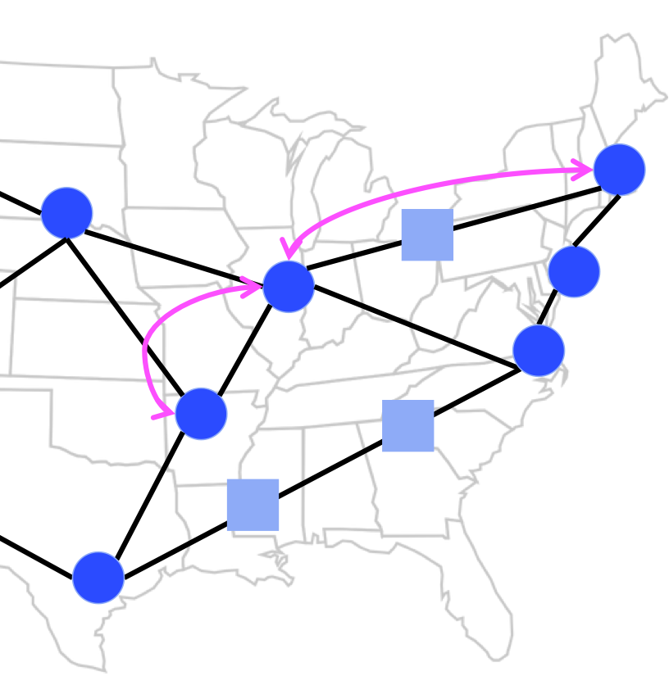
Network Components: Regens
IP link (with regen)
IP node
IP link (no regen)
# tails?
# regens?
# regens?
opt. node
Notes:
The other relevant network component are optical regenerators, or regens. We need to place regens no more than 1000 miles apart along each IP link’s path. Regens can be placed at optical-only nodes located between IP nodes, or they can be placed at IP nodes.
Both tails and regens come in discrete units, generally 100 Gbps. We can place multiple tails and regens together to create a faster link, but we can’t place fractions of tails or regens. This constraint ends up making the placement problem far more computationally complex.

Slide 21

Tails and Regens are Expensive!
Tails and regens are 50-80% of capex cost
Reducing tails/regens by 10-20% →
save $100 million over 2-3 years
Notes:
ISPs care about minimizing the total number of tails and regens because these components are a major expense. To give some ballpark numbers, for a network whose fiber is already in the ground, tails and regens comprise somewhere between 50 and 80 percent of the capital costs. If we can reduce the number of tails and regens by 10-20 percent, the ISP can save about $100 million over 2-3 years.

Slide 22
Finding the Optimal Solution:
ILP Joint Optimization
Network Design
tail/regen placement
months
IP link placement
minutes
Network Operation
IP routing
seconds
Notes:
To find the minimum cost network design that still carries all traffic, even with failures, we formulate and solve an integer linear program, or ILP. As I explained before, we can’t solve for the optimal tail and regen placement without considering how IP links will be adjusted during network operation, and also how routing will be adjusted over those links. Therefore, our ILP actually jointly solves for the optimal network design and also the optimal network operation setup to use in any given failure scenario.

Slide 23
Failure Scenarios
Any combination of router and optical span failures
No structure to exploit
In our experiments, all single router failures + all single optical span failures
Notes:
What is a failure scenario? Our technique can handle any combination of router and optical span failures as a single failure scenario, just as long as the resulting optical topology is specified. We choose to make our technique extremely flexible in this way, though at the cost of exploiting some structure that a more narrow definition of failure scenarios might add to the problem. In our experiments, we use as the set of failure scenarios any single router failure and any single optical span failure.

Slide 24
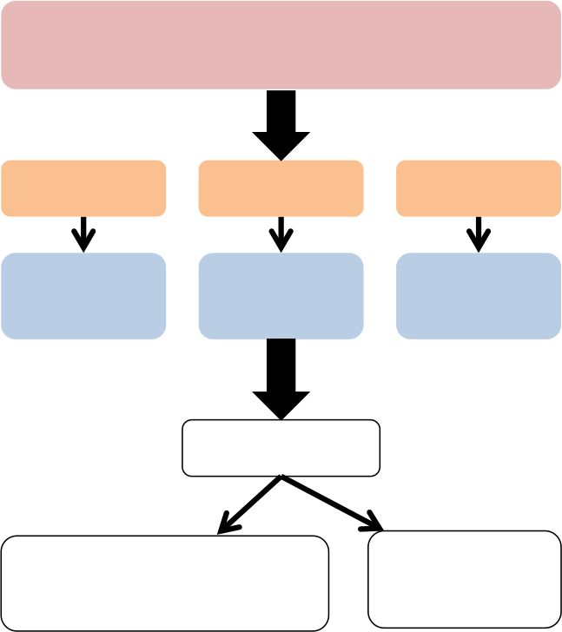
Joint Optimization Intuition
candidate tail/regen placement₁
failure₁
…
failure_{M}
optimal
IP/routing
optimal
IP/routing
optimal
IP/routing
All feasible?
yes
no
remember placement₁ and its cost
discard placement₁
choose least expensive
24
Notes:
Before I go into detail about the math of our opimization, I’ll give some high level intuition about how we end up jointly solving the network design problem along with many versions of the network operation problem. Here’s one way to get a sense of the search space we need to optimize over: <click> Suppose we have a candidate placement of tails and regens <click>. Then, for each failure scenario, we find the optimal IP link configuration and the optimal routing over those IP links given the placement of tails and regens and the failure condition <click>. If it’s possible to route all offered traffic in all failure scenarios with this candidate tail/regen placement, then remember this placement and its cost <click>. Then repeat this entire process for *all* other possible tail and regen placements in a similar manner, and <click> choose the one with the lowest cost that still allows building an IP topology that can carry all the offered traffic. Of course, we actually solve the ILP in a more efficient manner than this method of exhaustive search, but it gives the intuition about what our ILP is jointly optimizing over.

Slide 25
ILP: Inputs and Outputs
Inputs
Locations of:
  IP nodes
  IP routers
  optical-only nodes
  optical fiber spans
Traffic demand matrix
Failure scenarios
Outputs
# tails at each router
# regens at each node
For each failure scenario:
  IP link placement
  traffic routing
optimal tail/regen placement
failure₁
…
failure_{M}
optimal
IP/routing
optimal
IP/routing
optimal
IP/routing
Notes:
Now that we understand the joint optimization problem at a high level, let’s look at the ILP in some more detail. I explained the inputs and outputs of the network design problem in general before, but now we understand the roles of tails and regens and how our formulation differs from the traditional approach. So, to put it concretely, our inputs are (1) the locations of IP nodes and their associated IP routers, optical-only nodes, and optical fiber spans; (2) a matrix of traffic demands; and (3) a set of possible failure scenarios <click>. Any solution must produce as outputs (1) the optimal placement of tails and regens at nodes such that the network can carry all traffic under any one of the possible failure scenarios; (2) the optimal mapping of IP links to the optical infrastructure for any given failure scenario; and (3) the optimal routing of the offered traffic over the IP topology.

Slide 26
ILP: Objective and Constraints
Objective: minimize cost while carrying all traffic under all failure scenarios
Constraints:
  dynamic IP link creation and routing
  robust tail and regen placement
Notes:
As I said earlier, our objective is to minimize the combined costs of tails and regens while carrying all offered traffic under all failure scenarios.
Our constraints fall into two categories: those governing dynamic IP link creation and routing and those governing robust tail and regen placement. The IP link and routing constraints are extensions of the traditional multicommodity flow problem, so I’m not going to show them all here. I am going to show the tail constraints and the regen constraints.

Slide 27
Robust Tail Placement
Notes:
The tail constraints just require that each IP router has enough tails for all the IP links it terminates in any failure scenario.

Slide 28
Relative Positions of Regens
1350 miles
450 miles
1350 miles
1350 miles
✗
✓
Notes:
Regen placement, on the other hand, is tricky, because what matters are their positions *relative to each other* and *across failure scenarios*. For example, let’s look at this simple example of a single IP link that passes through four intermediate optical-only nodes, and all nodes are 450 miles apart. Any of the three regen placements on the left is allowed, because these leave no stretch of IP link longer than 1000 miles without passing through a regen. Any of the three placements on the right is not allowed, however.

Slide 29
Where to Place Regens?
o₁
✗
400 miles
400 miles
initial IP link
A
B
o₃
o₂
400 miles
400 miles
400 miles
IP link for failure (o₁, o₃)
Indifferent between o₂ and o₃?
Indifferent between o₁ and o₃?
Notes:
Further, we need to jointly consider all failure scenarios to know which legal placement is optimal. Suppose we have this network, with the no failure IP link between A and B going through o1 and o3 <click>. Looking at this picture alone, we’re indifferent about where to place the single regen we need. But, if we also consider what happens when the (o1, o3) link fails, then we see there’s one right answer <click>. We want to place the regen at o3, because then this single regen suffices in either case. If we originally choose o1, then we still need another regen at either o2 or o3 after the failure.

Slide 30
Robust Regen Placement
Solve for R_{u}, number of regens to place at u
Introduce auxiliary variable R_{αβuvf}
R_{αβuvf} = # regens at u
for link between routers (α, β)
in failure scenario f
such that next regen traversed will be at node v
R_{αβuvf}
α
β
u
v
Notes:
How do we encode the difference between legal regen configurations and illegal ones, and also how the different failure scenarios fit together? Ultimately, we want to solve for R_u, a single number that tells us how many regens to place at node u. This number does not depend on the failure scenario, because we can’t move regens on the fly when switches and links fail. But, to solve for R_u, we introduce an auxiliary variable R_alpha beta uvf. R_alpha beta uvf gives the number of regens at u for the IP link between routers alpha and beta in failure scenario f such that the next regen traversed will be at node v.

Slide 31
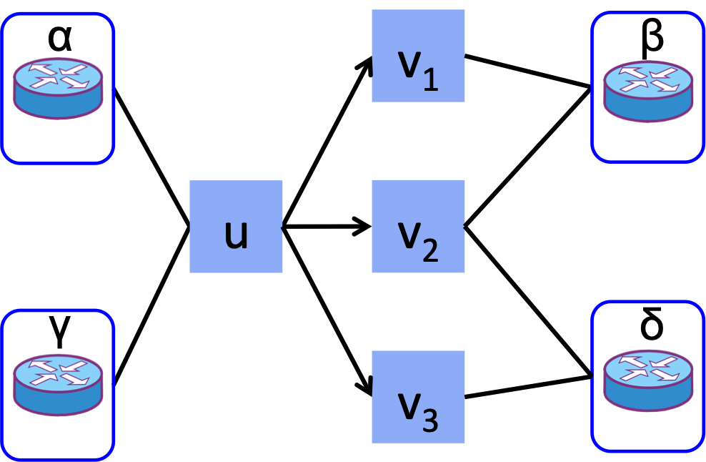
Robust Regen Placement
Description R_{u} = # regens at u
Math
Need IP links for:
α β
γ δ
Notes:
At least, that’s what we want R_alpha beta uvf to mean in our optimization. To ensure that it actually does, we need constraints connecting it to R_u and also the rest of the problem. First, we say that R_u must be greater than or equal to the sum over R_alpha beta uvf for all IP links and all next-hops v for every failure scenario f <click>. For example, in this picture, we have IP links (alpha, beta) and (gamma, delta). We’ll only consider the no failure case. R_u needs to be greater than or equal to the number of regens for IP link (alpha, beta) that next go through v1 plus the number of regens for IP link (alpha, beta) that next go through v2 plus the number of regens for IP link (gamma, delta) that next go through v2 plus the number of regens for IP link (gamma, delta) that next go through v3.

Slide 32
Robust Regen Placement
Description regens no more than REGEN_DIST apart
Math
Notes:
Next, we don’t let any node v be the next-hop regen for u if v is more than REGEN_DIST away from u. This constraint ensures we don’t end up with configurations like those on the right hand side in our example earlier.

Slide 33
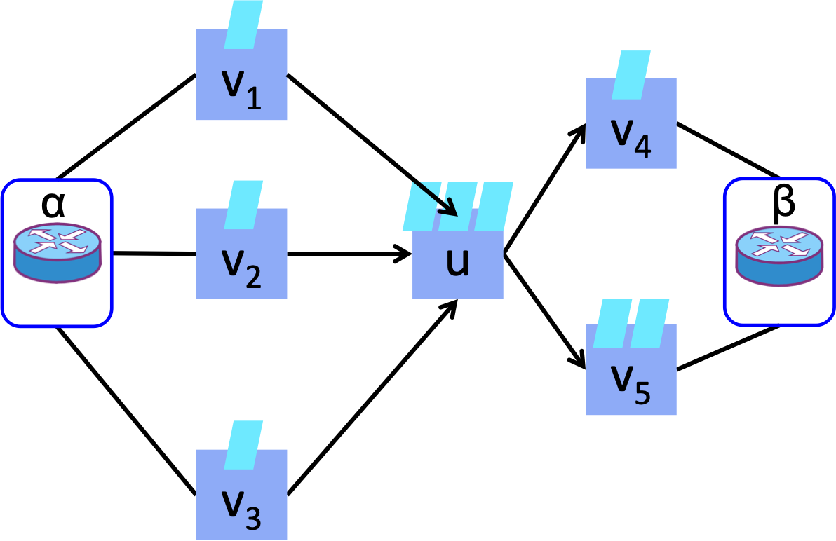
Robust Regen Placement
Description IP link’s regens form contiguous path
Math
Notes:
Next, we require that the regens comprising a particular IP link for a particular failure scenario form a contiguous path. For any node u that’s not the IP source or IP destination, its total number of regens is equal to the sum over all other nodes v for which u is the next hop. And, this number is equal to the sum over all next-hops from u <click>. In this example, u is the next hop for v1, v2, and v3. Together they have three regens, so u must have three regens. u’s next hops are v4 and v5, so together they must have three regens, also.

Slide 34
Robust Regen Placement
Description sufficient regens at src IP node a
and with dst IP node b as next-hop
a (IP node)
Math
α (router)
Notes:
The previous constraint applied to all nodes except the IP source and destination. The constraints for those nodes connect the number of regens to the capacity of the IP links they terminate. For node a housing router alpha we need enough regens dedicated to IP link (alpha, beta), summed over all next-hops u, for the capacity of link (alpha, beta). Likewise for IP node b housing router beta, this node needs to be the next-hop for enough regens, summed over all nodes u.

Slide 35
Robust Regen Placement
Description no regens at b or with a as next-hop
Math
Notes:
Finally, the destination node b can’t have any regens, and the source IP node a can’t be the next-hop for any regens, since it’s by definition first.

Slide 36
Scalable Heuristics
failure₁
…
failure_{M}
failure₁
optimal, feasible
placement/routing
optimal, feasible
placement/routing
optimal, feasible
placement/routing
…
Greedy
…
union of sets of placed tails and regens
…
failure_{M}
Simple
optimal, feasible
placement/routing
placed tails and regens
Notes:
Our ILP gives the optimal network design but doesn’t scale well to networks of any reasonable size. The problem is that the number of failure scenarios acts as a multiplicative factor on the complexity of the problem, because any tail and regen placement must come with the optimal IP link configuration and routing for each failure scenario. We’d like a way to separate these two factors. As a simple, strawman approach, we can solve the tail/regen placement problem separately for each failure scenario and take the union of the results. Unfortunately, this approach misses even some obvious opportunities to reuse tails and regens <click>. A better heuristic, which we call Greedy, is to solve for each failure scenario in sequence, taking into account where components were placed during previous iterations.

Slide 37
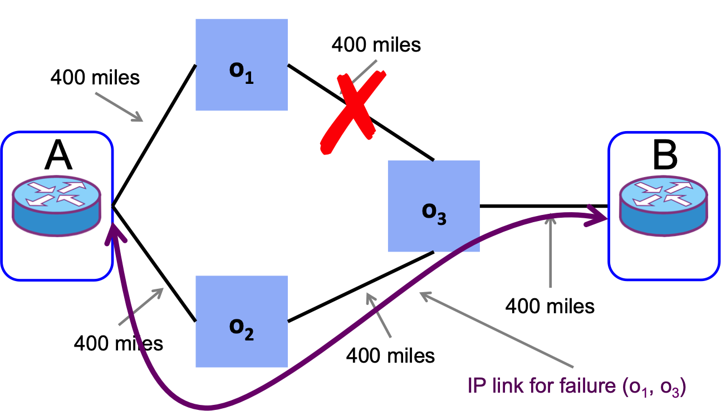
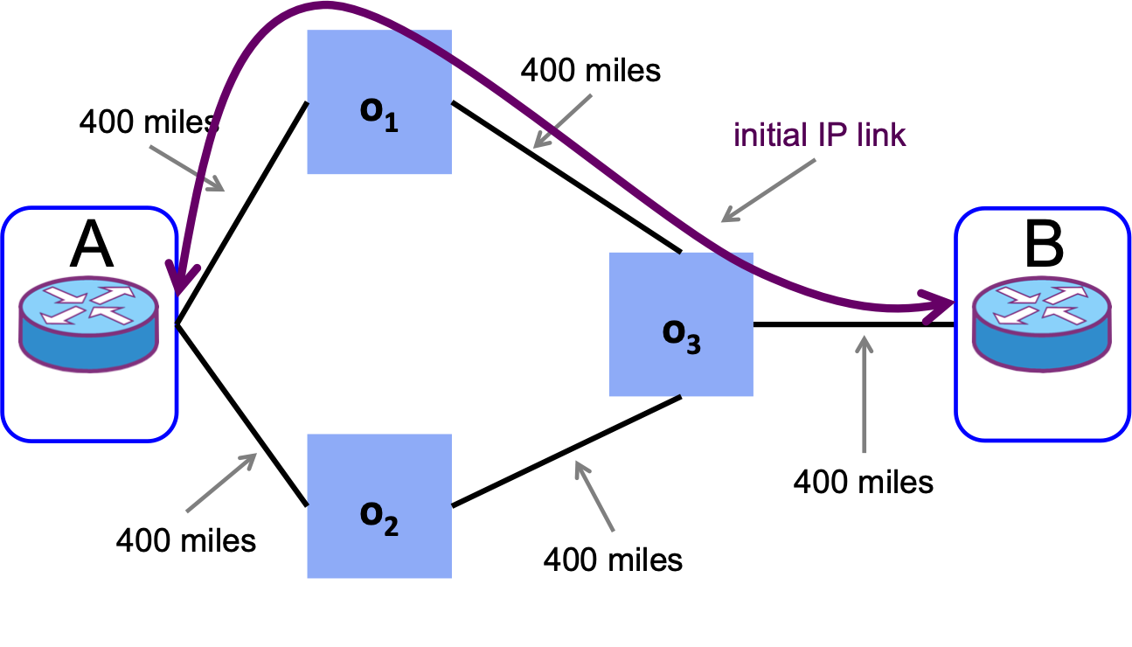
Simple
No failure: Indifferent between o₁ and o₃; arbitrarily choose o₃
(o₁, o₃) fails: Indifferent between o₂ and o₃; arbitrarily choose o₂
Result: Regens at o₂ and o₃
Notes:
Here’s an example illustrating the difference between Simple and Greedy. Going back to our same setup from before, if we only consider the no failure case, then we’re indifferent between placing a regen at o1 or o3. Suppose we arbitrarily choose o3 <click>. Then, according to Simple, we consider the (o1, o3) link failure case completely separately <click>. Now, we’re indifferent between placing a regen at o2 and o3, so we might arbitrarily choose o2 <click>. As a result, we need to buy two regens, one for o2 and one for o3.

Slide 38
Greedy
No failure: Indifferent between o₁ and o₃; arbitrarily choose o₃
(o₁, o₃) fails: Remember already placed at o₃; no more needed
Result: Regen at o₃
Notes:
Greedy starts the same way, and again suppose we arbitrarily choose o3 <click>. But, now when we consider the (o1, o3) failure case <click>, we remember that we’ve already placed a regen at o3. We see that simply reusing this regen suffices, and we know we don’t need any additional regens. As a result, we get away with only one regen.

Slide 39
Evaluation
Experiments with small but realistic topology and traffic matrix
How much does reconfigurability matter?
How good are heuristics?

Slide 40
Experiment Setup: Topology
4 edge nodes | 4 IP nodes | 5 optical-only nodes

Slide 41
Experiment Setup: Topology
6 edge nodes | 6 IP nodes | 9 optical-only nodes

Slide 42
Experiment Setup: Topology
9 edge nodes | 9 IP nodes | 16 optical-only nodes

Slide 43
How much does reconfigurability matter?
A LOT!
ILP costs up to 29% less than Legacy
Notes:
* greater savings on 600 mile topologies, because 450 mile graphs don’t require regens, and regens more so than tails offer opportunities for reuse

Slide 44
How good are heuristics?
Greedy uses at most 1.3% more tails/regens than ILP
Greedy: great!
Simple: eh
Notes:
(Mention that one of the main points of formalizing the exact optimization is to be able to evaluate the effectiveness of heuristics, be they ours or the ones ISPs are currently using.)

Slide 45
Scaling to a Realistic Backbone
Combine two routers collocated at an IP node
Prevent links from taking circuitous paths
Simplify traffic matrix
Relax LP solver’s error tolerance
Provide solver with (partial) initial solution

Slide 46
Related Work
 | Tail/Regen Placement | IP Link Reconfiguration
SOX | ✓ | ✓
Owan [SIGOMM 2016] | ✗ | ✓
Multi-Layer Capacity Planning for IP-Optical Networks [IEEE Communications Magazine Jan. 2014] | ✗ | ✓
Constraint Routing and Regenerator Site Concentration in ROADM Networks [JOCN Nov. 2013] | ✓ | ✗

Slide 47
Related Work
Failure Recovery
  R3: Resilient Routing Reconfiguration [SIGCOMM 2010]
    purely traffic engineering recovery; no consideration of reconfiguring IP links
Robust Optimization
  K-Adaptability in Two-Stage Robust Binary Programming [Operations Research 2015]
  Robust Validation of Network Designs under Uncertain Demands and Failures [NSDI 2017]
  Kulfi: Robust Traffic Engineering Using Semi-Oblivious Routing [Computing Research Repository abs/1603.01203 2016]

Slide 48
SOX Conclusion
New opportunity for ISPs to design less expensive networks
Formulation and solution to this joint optimization
Effective, scalable heuristic
Notes:
We’ve seen that new, reconfigurable optical technology provides the opportunity for ISPs to design less expensive networks. I’ve presented both an optimal solution to this new network design problem and a more scalable greedy heuristic.

Slide 49

Red: A Communist approach to Network OPEration
“From each [switch] according to its abilities…”
Notes:
transition: SOX doesn’t address immediate speed of recovery, transient disruptions

Slide 50
Network Operation: Today
Switches store forwarding tables
When packet arrives, match on header fields and take forwarding action
Notes:
I said earlier that the network operation problem is essentially choosing how to route packets over the IP layer. How is this done today?

Slide 51
Network Operation: Today
Two models, depending on which header fields switches match on
Hop-by-hop forwarding: all switches match on full header
Match | Action
dst IP prefix = 3.0.0.0/24 | fwd A
dst IP prefix = 1.0.0.0/30 | fwd C
… | …
Notes:
<elaborate on text on slide, and then add the following>
The underlying assumption of the hop-by-hop forwarding model is that all switches are equally capable.

Slide 52
Network Operation: Today
Edge-to-edge tunneling: ingress edge switch matches on full header and pushes label
  Interior nodes forward by label
Match | Action
dst IP prefix = 3.0.0.0/24 | push A
dst IP prefix = 1.0.0.0/30 | push C
… | …
Match | Action
label A | fwd A
label C | fwd C
… | …
Edge
Interior
Notes:
<elaborate on text on slide, and then add the following>
The underlying assumption of the edge-to-edge tunneling model is that all edge switches are “smart” -- they can store large forwarding tables to allow for any possible destination IP prefix and can also push labels -- and all interior switches are “dumb”, with limited rule table space

Slide 53
Traditional Approach:
Faulty Assumptions
Hop-by-hop assumes all nodes equally “smart”
Edge-to-edge assumes “smart” edge, “dumb” interior
Not always the case!
  Incremental upgrades
Notes:
General, conceptual problems with traditional approach

Slide 54
Traditional Approach:
Faulty Assumptions
Hop-by-Hop
Expensive; requires all nodes to be “smart”
  Need large forwarding tables
Edge-to-Edge
Failure recovery either slow or requires significant overhead
Both
Limited path diversity
Notes:
Concrete limitations of the two existing routing schemes

Slide 55
Our Approach: Red
Allow for heterogeneous nodes mixed throughout the network
Tunnel “smart” Big Node to “smart” Big Node
Hybrid of hop-by-hop and edge-to-edge

Slide 56

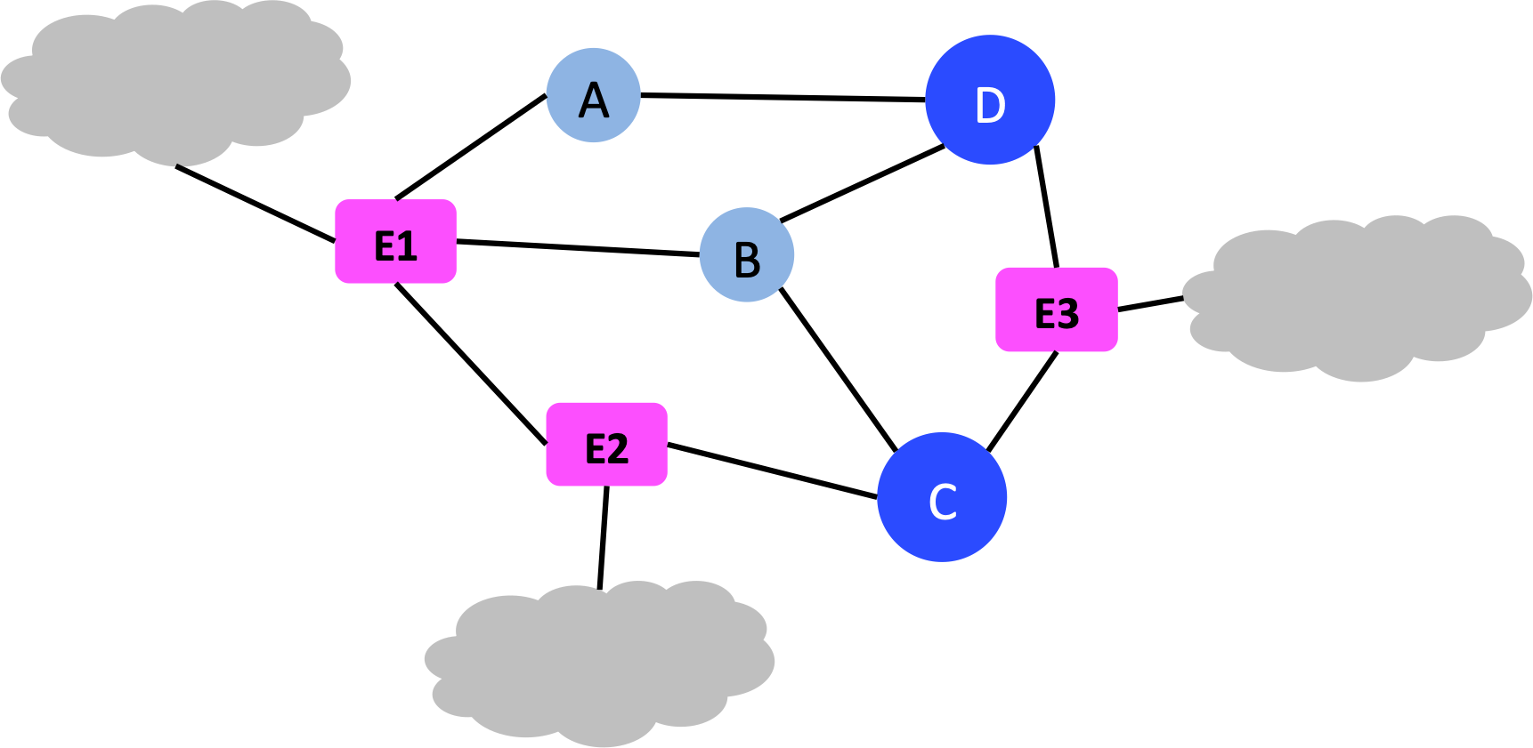
Red Architecture
central controller
Big Node
Little Node
Notes:
I’ll more formally explain our proposed architecture. We have three main players: a central controller, big nodes, and little nodes.
First, we assume a central controller runs whatever computation is necessary to populate all switches’ rule tables and installs those rules on the switches.

Slide 57
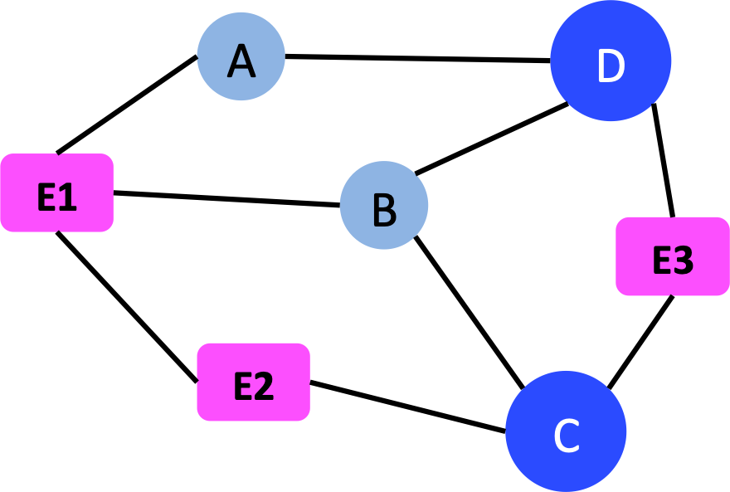
Red Architecture: Big Nodes
Match | Action | Split Fraction
dst IP prefix = 3.0.0.0/24 | push label D | 0.3
 | push label C | 0.7
... |  | …
k₁ = 2
E1 Table Pipeline
Match | Action | Split Fraction
label D | fwd B | 0.5
label D | fwd A | 0.5
label C | fwd A | 0.3
label C | fwd E2 | 0.1
label C | fwd B | 0.6
… |  | …
k₂ = 3
Notes:
Then, as I said before, rather than modeling network switches as “edge” or “interior,” with Red we decouple switches’ capabilities from their location in the network; we have big nodes and little nodes. big nodes play the role of traditional edge switches, and little nodes are analogous to interior switches. Specifically, each big node processes packets via a two-phased pipeline of match-action tables.
Match on dst IP prefix; choose one of k1 next-hop big nodes.
Push label specifying next-hop big node.
Match on assigned next-hop big node; choose one of k2 physical next-hops.
In contrast, each little node just matches on a next-hop big node label and forwards to that next-hop big node via a single physical next hop.

Slide 58
Our Approach: Benefits
Design | Operation Model | Inexpensive Equipment | Fast Failure Rec. w/ Ltd. Overhead | Diverse Paths
all-nodes-equal | hop-by-hop | ✗ | ✓+ | ✗
smart-edge-dumb-interior | edge-to-edge | ✓+ | ✗ | ✗
heterogeneous nodes | Red | ✓ | ✓ | ✓
Notes:
Going back to the concrete limitations that we just saw for the two existing common network operation methods, we see that Red combines the positive attributes of each and avoids their drawbacks.

Slide 59
Constrained Optimization
traffic matrix
topology
failure scenarios
Inputs
link bandwidths
Network Operation
minimize congestion
node capabilities
Objective
Constraints
routing
Output
Notes:
Now, I’ll go into the details of Red. Unlike with SOX, in which failure recovery was baked into the optimization, with Red we first optimize routing over the failure-free network, and we have a separate failure recovery scheme to specify how the network should adjust this routing in response to any failure.
Red’s initial routing computation, like our network design solution, is a constrained optimization problem. Again, we have as inputs the traffic matrix and the set of failure scenarios. But, here the third input is the full topology specified as an output of the network design problem <click>. Our constraints are the link bandwidths of the topology and the big node/little node capabilities of switches <click>. Our outputs are a routing of packets over the network <click> , and our objective is to minimize congestion.
The math corresponding to this picture is a fairly straightforward adaptation of multicommodity flow, so in the interest of time I’m not going to go into any more detail. Instead, I’m going to move on to describing our failure recovery technique.

Slide 60
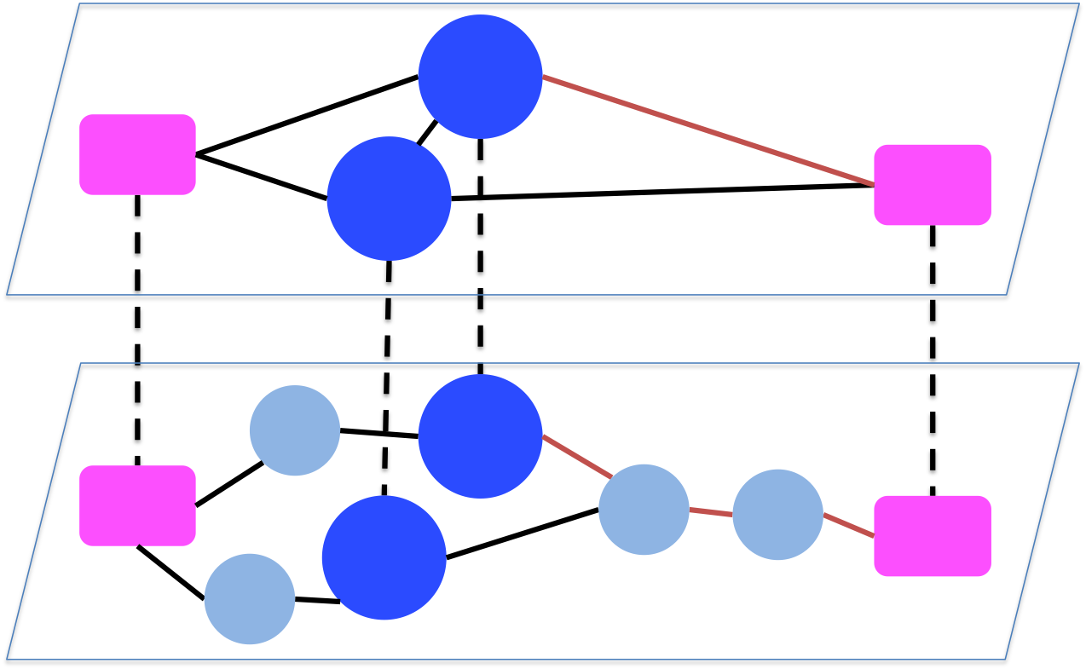
Red Architecture: Virtual Overlay
virtual nodes = all Big Nodes
virtual edge if path exists without traversing another Big Node
virtual edge
physical path
Notes:
Before I can do that, I need to explain how we formalize the notion of big node-to-big node tunneling: We define a virtual overlay graph that maps to the physical network. All physical big nodes are present in the overlay, but no little nodes. Two big nodes have an edge in the virtual graph if there exists a physical path between them that doesn’t traverse another big node. Then big node-to-big node tunneling is just forwarding on this virtual graph; edges in the virtual graph are big node-to-big node tunnels. The important takeaway from this picture is the notion of “neighbor big nodes,” which are big nodes that are connected in the virtual overlay graph.

Slide 61
Red Failure Recovery
Overall objective: localize impact
Specifics depend on location of failure
  Local recovery almost always possible
Notes:
Neighbor big nodes are important because the overarching objective of Red’s failure recovery protocol is to localize the process as much as possible, which makes recovery faster and limits the number of live links asked to take on more load. The specific response depends on the location of the failed link or node in relation to the path of a given flow. In most cases, the closest big node preceding the failed link, i.e., the closest preceding neighbor big node, can renormalize its flow splitting ratios to avoid the failure; we say these are instances of local recovery, because the central controller isn’t involved. In the few situations when local recovery isn’t possible, the controller computes new paths only for the specific flows that can’t be recovered locally.

Slide 62
Local Recovery 1
W1 has at least one live path to W2
renormalize across remaining paths
✗
A
B
Path | Volume
P1 | X
P2 | 17
P3 | 83
Path | Volume
P1 | 40
P2 | 10
P3 | 50
W1
W2
Notes:
I’ll now explain the failure recovery protocol in detail, using an example of a flow f whose non-failure path includes [W1, A, B, W2]. W1 and W2 are big nodes and A and B are little nodes. Link (A, B) fails. Remember that W1 and W2 are big nodes but not necessarily edge nodes. The failed component may be a link or a switch.
Local recovery comprises two sub cases.
1. W1 has at least one live path to W2.
In this case, W1 renormalizes its splitting ratios across its
remaining live paths to W2.
<omit if running out of time>
For example, suppose W1 initially sends 100 units of traffic to W2 on paths
(p1 , p2 , p3 ) in volumes (40, 10, 50). Then, p1 fails. The remaining live paths together initially accounted for
60 units of traffic, with p2 responsible for 10. Therefore, p2 takes an additional 10/60 · 􏰀1 − (60/100)􏰁 = 0.067
fraction of total demand. p3 takes the other 50/60 · 􏰀1 − (60/100)􏰁 = 0.333, giving new weights of (p1 , p2 , p3 ) =
(0, 0.167, 0.833) and new volumes (0, 17, 83).
</omit>
If W1 has remaining live paths to W2 but none of these paths was initially assigned any traffic, then W1
splits its demand equally among them.

Slide 63
Local Recovery 2
W1 has virtual link to at least one eligible next-hop Big Node
renormalize across remaining next-hop Big Nodes
✗
W2
B
A
Next-Hop Big Node | Volume
W2 | 40
W3 | 10
W4 | 50
Next-Hop Big Node | Volume
W2 | X
W3 | 17
W4 | 83
W1
W3
W4
Notes:
2. W1 has no live paths to W2 but still has a virtual link to at least one eligible next-hop big node for f.
In this case, W1 renormalizes its splitting ratios across its remaining next-hop big nodes for f; the computation is analogous to that described above for renormalizing across remaining paths to a given destination big node.

Slide 64
Global Recovery
As described thus far, local recovery could create forwarding loops
Solution: don’t allow Big Nodes to send to previously unused neighbor Big Nodes
✗
A
B
C
D
A
B
C
D
initial forwarding
loop if (C, D) fails
Notes:
As described thus far, local recovery should always be possible. However, as described thus far local recovery also can create forwarding loops, if we allow a big node to send to a previously unused neighbor big node, as we see here.
<omit if running out of time>
For ease of explanation, this network is all big nodes; the physical and overlay graphs are identical. Suppose Red’s initial optimization routes all (A, D) flow along the route [A, B, C, D]. <click> Then, link (C, D) fails. Further, assume k1 = 2, so both B and D are initially possible next-hop big nodes for C to reach D. If C is allowed to recover from the (C, D) failure by sending to any next-hop big node in its initial set, then C can forward the traffic it receives from B right back to B. And, B will continue to send to C, because (by design) B doesn’t know about the (C, D) failure. Hence, packets will loop between B and C if B is allowed to remain in C’s set of possible next-hop big nodes.
</omit>
To avoid this problem, immediately after computing the initial routing and before the network gets up and running, we remove any big node U1 from the set of next-hop big nodes for any big node U2 en route to edge node E if the initial routing doesn’t send any traffic on this overlay link.

Slide 65
Global Recovery
Problem: local recovery sometimes impossible
Solution: global recovery in those cases
Controller recomputes paths for affected flows
Notes:
This measure is sufficient to ensure that our failure recovery protocol will never create loops. We know that the initial optimal routing won’t include loops, and by removing unused next-hop big nodes, we confine ourselves to the assuredly safe set of overlay links chosen by the LP solution. However, the cost of pruning the set of next-hop bignodes is that W1 may have no remaining virtual links to any *eligible* next-hop bignode, even if W1 isn’t physically partitioned from t. Hence arises the possible need for global recovery.
If global recovery is necessary for a particular flow, the controller reoptimizes to choose a completely new route for it.

Slide 66
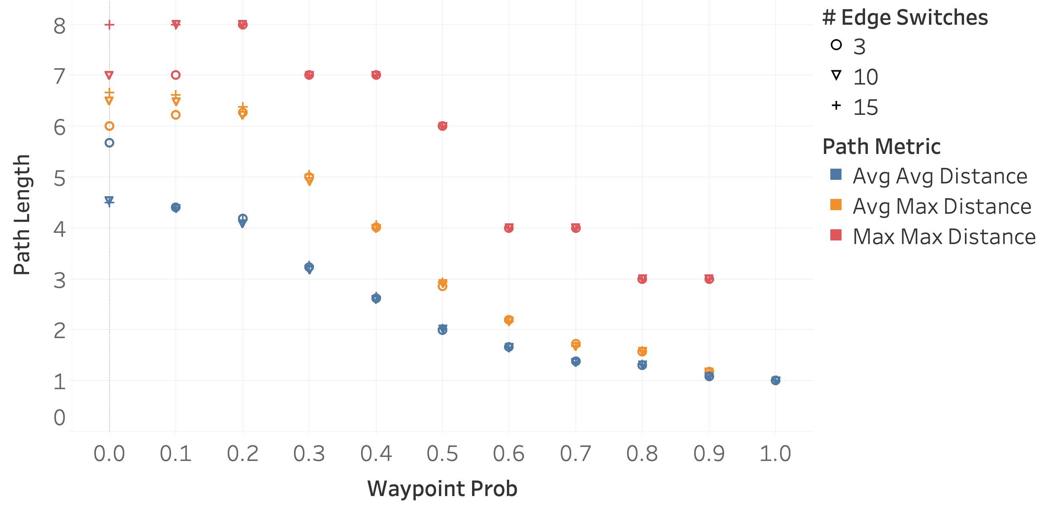
Evaluation
Can recover more quickly from failures than edge-to-edge tunneling

Slide 67
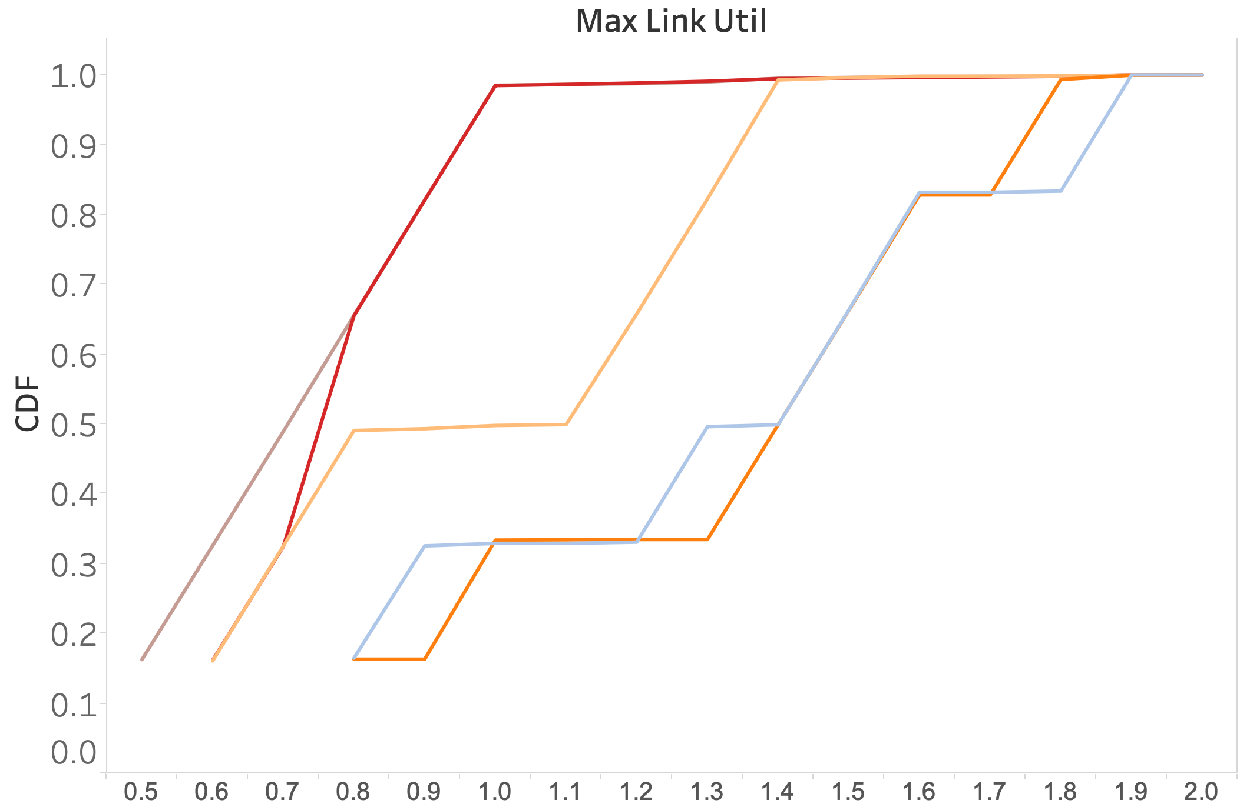
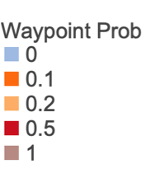
Evaluation
Minimal impact on reducing congestion
k₁ = 2, k₂ = 1
Notes:
We evaluate the impact of interior waypoints on traffic engineering by randomly assigning nodes to be waypoints or little nodes according to varying probabilities and then computing the maximum link utilization. We refer to the parameter controlling the probability that any given interior node is a waypoint as waypoint prob. This figure shows of the fraction of failure scenarios for which the maximum link utilization is at most a certain value, averaged across multiple trials with different demands. We plot separate lines for waypoint prob in {0.0, 0.1, 0.2, 0.5, 1.0}. In this figure we assume that each big node can split flows between two next-hop big nodes and use only one physical path to reach each next-hop big node (k1 = 2, k2 = 1).
If big node-to-big node tunneling has a significant impact on reducing congestion, the colored lines should appear far apart. In particular, the blue line for waypoint prob = 0 should be far to the right, and then the lines for successively higher values of waypoint prob should fall farther and farther left.

Slide 68
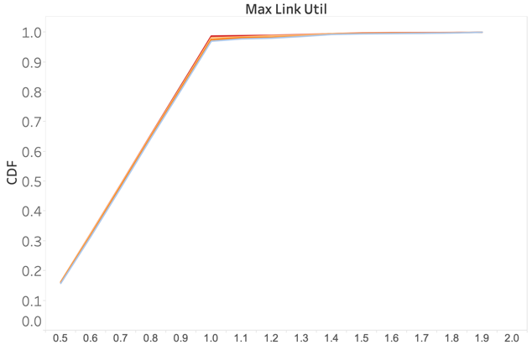
Evaluation
Minimal impact on reducing congestion
k₁ = 3, k₂ = 3
Notes:
If we relax the splitting restrictions on big nodes even to k1 = 3, k2 = 3, then Red doesn’t reduce congestion much compared to edge-to-edge tunneling. We thought these results were counterintuitive, but they’re actually consistent with what other researchers have found. So, it turns out that it’s not actually particularly important that a routing scheme can take advantage of the path diversity available in the network, at least from the perspective of limiting congestion.

Slide 69
Related Work
TE and Failure Recovery: Established Standards
Tunnel Based
MPLS
Segment routing
Hop-by-Hop
Link state
  OSPF
  IS-IS
Distance vector
  RIP

Slide 70
Related Work
TE and Failure Recovery: Research Proposals
Tunnel Based
Fabric: A Retrospective on Evolving SDN
Congestion-Aware Single Link Failure Recovery in Hybrid SDN Networks
Accelerating the Development of Software-Defined Network Optimization Applications Using SOL
Multipath Protocol for Delay-Sensitive Traffic
Traffic Engineering with Forward Fault Correction
many more

Slide 71
Related Work
Incremental Deployment
Traffic Engineering in Software Defined Networks
Congestion-Aware Single Link Failure Recovery in Hybrid SDN Networks
Incremental Deployment of SDN in Hybrid Enterprise and ISP Networks

Slide 72
Red Conclusion
Tunnel Big Node-to-Big Node, rather than edge-to-edge
Allows network to recover more quickly after failures
Not helpful for minimizing congestion in no-failure case

Slide 73
Conclusion
New design and operation architectures to minimize the effects of equipment failures
  SOX: Move IP link placement from design to operation
  Red: Take advantage of heterogeneous nodes

Slide 74
Thank You
Questions?

