Slide 1

Refactoring Router Software to Minimize Disruption
Eric Keller
Advisor: Jennifer Rexford
Princeton University
Final Public Oral - 8/26/2011

Slide 2

User’s Perspective of The Internet
Documents
Videos
Photos
2

Slide 3

The Actual Internet
Real infrastructure with real problems

Slide 4
Change Happens
Network operators need to make changes
  Install, maintain, upgrade equipment
  Manage resource (e.g., bandwidth)

Slide 5

Change is Painful
Network operators need to deal with change
  Install, maintain, upgrade equipment
  Manage resource (e.g., bandwidth)

Slide 6
Change is Painful -- Loops
Network operators need to deal with change
  Install, maintain, upgrade equipment
  Manage resource (e.g., bandwidth)

Slide 7
Change is Painful -- Blackholes
Network operators need to deal with change
  Install, maintain, upgrade equipment
  Manage resource (e.g., bandwidth)

Slide 8
Change is Painful -- Bugs
Single update partially brought down Internet
  8/27/10: House of Cards
  5/3/09: AfNOG Takes Byte Out of Internet
  2/16/09: Reckless Driving on the Internet
[Renesys]

Slide 9
Degree of the Problem Today
Tireless effort of network operators
  Majority of the cost of a network is management [yankee02]

Slide 10
Degree of the Problem Today
Tireless effort of network operators
  Majority of the cost of a network is management [yankee02]
Skype call quality is an order of magnitude worse
(than public phone network) [CCR07]
  Change as much to blame as congestion
  20% of unintelligible periods lasted for 4 minutes

Slide 11
The problem will get worse

Slide 12
The problem will get worse
More devices and traffic
  Means more equipment, more networks, more change

Slide 13






The problem will get worse
More devices and traffic
More demanding applications
e-mail → social media → streaming (live) video

Slide 14
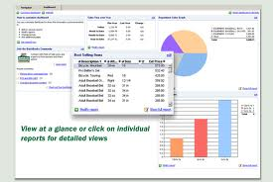
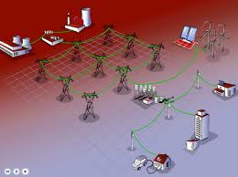
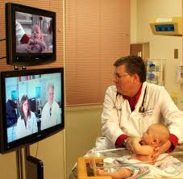
The problem will get worse
More devices and traffic
More demanding applications
e-mail → social media → streaming (live) video
More critical applications
business software → smart power grid → healthcare

Slide 15
Minimizing the Disruption
Goal:
Make change pain free
(minimize disruption)

Slide 16
Refactoring Router Software to Minimize Disruption
Goal:
Make change pain free
(minimize disruption)
Refactoring router software
Approach:

Slide 17
Change without…
Unnecessary
reconvergence
events

Slide 18
Change without…
Unnecessary
reconvergence
events
Triggering
bugs

Slide 19
Change without…
Coordination
with neighbor
Unnecessary
reconvergence
events
Triggering
bugs

Slide 20
Change without…
Coordination
with neighbor
Unnecessary
reconvergence
events
Internet 2.0
An Internet-wide
Upgrade
Triggering
bugs

Slide 21
Refactor Router Software?

Slide 22

Hiding Router Bugs
Physical network
Bug Tolerant
Router
Router software
BGP
OSPF
Route Distributer
Bad message

Slide 23
Decouple Physical and Logical
IP network
VROOM
Physical network

Slide 24
Unbind Links from Routers
Internet (network of networks)
Router
Grafting
IP network

Slide 25
Outline of Contributions
Bug Tolerant Router | VROOM | Router Grafting
Hide (router bugs) | Decouple (logical and physical) | Break binding (link to router)
Software and Data Diversity | Virtual Router Migration | Seamless Edge Link Migration
[CoNext09] | [SIGCOMM08] | [NSDI10]

Slide 26
Part I:
Hiding Router Software Bugs with the Bug Tolerant Router
With Minlan Yu, Matthew Caesar, Jennifer Rexford
[CoNext 2009]

Slide 27
Outline of Contributions
Bug Tolerant Router | VROOM | Router Grafting
Hide (router bugs) | Decouple (logical and physical) | Break binding (link to router)
Software and Data Diversity | Virtual Router Migration | Seamless Edge Link Migration
[CoNext09] | [SIGCOMM08] | [NSDI10]

Slide 28
Dealing with Router Bugs
Cascading failures
Effects only seen after serious outage

Slide 29
Dealing with Router Bugs
Cascading failures
Effects only seen after serious outage
Stop their effects before they spread

Slide 30
Avoiding Bugs via Diversity
Run multiple, diverse instances of router software
Instances “vote” on routing updates
Software and Data Diversity used in other fields

Slide 31
Approach is a Good Fit for Routing
Easy to vote on standardized output
  Control plane: IETF-standardized routing protocols
  Data plane: forwarding-table entries
Easy to recover from errors via bootstrap
  Routing has limited dependency on history
  Don’t need much information to bootstrap instance
Diversity is effective in avoiding router bugs
  Based on our studies on router bugs and code

Slide 32
Approach is Necessary for Routing
Easy to vote on standardized output
  Control plane: IETF-standardized routing protocols
  Data plane: forwarding-table entries
Easy to recover from errors via bootstrap
  Routing has limited dependency on history
  Don’t need much information to bootstrap instance
Diversity is effective in avoiding router bugs
  Based on our studies on router bugs and code
60% of bugs do not crash the router

Slide 33
Achieving Diversity
Type of diversity | Examples
Execution Environment | Operating system, memory layout
Data Diversity | Configuration, timing of updates/connections
Software Diversity | Version (0.98 vs 0.99), implementation (Quagga vs XORP)

Slide 34
Achieving Diversity
Type of diversity | Examples
Execution Environment | Operating system, memory layout
Data Diversity | Configuration, timing of updates/connections
Software Diversity | Version (0.98 vs 0.99), implementation (Quagga vs XORP)

Slide 35
Effectiveness of Data Diversity
Taxonomized XORP and Quagga bug database
Diversity Mechanism | Bugs avoided (est.)
Timing/order of messages | 39%
Configuration | 25%
Timing/order of connections | 12%
Selected two from each to reproduce and avoid

Slide 36
Effectiveness of Software Diversity
Sanity check on implementation diversity
  Picked 10 bugs from XORP, 10 bugs from Quagga
  None were present in the other implementation
Static code analysis on version diversity
  Overlap decreases quickly between versions
  75% of bugs in Quagga 0.99.1 are fixed in 0.99.9
  30% of bugs in Quagga 0.99.9 are newly introduced
Vendors can also achieve software diversity
  Different code versions
  Code from acquired companies, open-source

Slide 37
BTR Architecture Challenge #1
Making replication transparent
  Interoperate with existing routers
  Duplicate network state to routing instances
  Present a common configuration interface

Slide 38
Architecture
Protocol
daemon
Protocol
daemon
Protocol
daemon
Routing
table
Routing
table
Routing
table
“Hypervisor”
REPLICA
MANAGER
FIB
VOTER
UPDATE
VOTER
Interface 1
Forwarding table (FIB)
Iinterface 2

Slide 39
Replicate Incoming Routing Messages
Protocol
daemon
Protocol
daemon
Protocol
daemon
Routing
table
Routing
table
Routing
table
Update
“Hypervisor”
12.0.0.0/8
REPLICA
MANAGER
FIB
VOTER
UPDATE
VOTER
Interface 1
Forwarding table (FIB)
Iinterface 2
No protocol parsing – operates at socket level

Slide 40
Vote on Forwarding Table Updates
Protocol
daemon
Protocol
daemon
Protocol
daemon
Routing
table
Routing
table
Routing
table
Update
“Hypervisor”
12.0.0.0/8
REPLICA
MANAGER
FIB
VOTER
UPDATE
VOTER
Interface 1
Forwarding table (FIB)
Iinterface 2
12.0.0.0/8 → IF 2
Transparent by intercepting calls to “Netlink”

Slide 41
Vote on Control-Plane Messages
Protocol
daemon
Protocol
daemon
Protocol
daemon
Routing
table
Routing
table
Routing
table
“Hypervisor”
Update
12.0.0.0/8
REPLICA
MANAGER
FIB
VOTER
UPDATE
VOTER
Interface 1
Forwarding table (FIB)
Iinterface 2
12.0.0.0/8 → IF 2
Transparent by intercepting socket system calls

Slide 42
Hide Replica Failure
Protocol
daemon
Protocol
daemon
Protocol
daemon
Routing
table
Routing
table
Routing
table
“Hypervisor”
REPLICA
MANAGER
FIB
VOTER
UPDATE
VOTER
Interface 1
Forwarding table (FIB)
Iinterface 2
12.0.0.0/8 → IF 2
Kill/Bootstrap instances

Slide 43
BTR Architecture Challenge #2
Making replication transparent
  Interoperate with existing routers
  Duplicate network state to routing instances
  Present a common configuration interface
Handling transient, real-time nature of routers
  React quickly to network events
  But not over-react to transient inconsistency

Slide 44
Simple Voting Mechanisms
Master-Slave: speeding reaction time
  Output Master’s answer
  Slaves used for detection
  Switch to slave on buggy behavior
Continuous Majority : handling transience
  Voting rerun when any instance sends an update
  Output when majority agree (among responders)

Slide 45
Evaluation with Prototype
Prototype
  Built on Linux with XORP, Quagga, and BIRD
  No modification of routing software
  Simple hypervisor (hundreds of lines of code)
Evaluation
  Which algorithm is best?
  What is the processing overhead?
Setup
  Inject bugs with some frequency and duration
  Evaluated in 3GHz Intel Xeon
  BGP trace from Route Views on March, 2007

Slide 46
Which algorithm is best?
Depends… there are tradeoffs
Voting algorithm | Avg wait time (sec) | Fault rate
Single router | - | 0.06600%
Master-slave | 0.020 | 0.00060%
Continuous-majority | 0.035 | 0.00001%

Slide 47
What is the processing overhead?
Overhead of hypervisor
  1 instance ==> 0.1%
  5 routing instances ==> 4.6%
  5 instances in heavy load ==> 23%
  Always, less than 1 second
Little effect on network-wide convergence
  ISP networks from Rocketfuel, and cliques
  Found no significant change in convergence
  (beyond the pass through time)

Slide 48
Bug tolerant router Summary
Router bugs are serious
  Cause outages, misbehaviors, vulnerabilities
Software and data diversity (SDD) is effective
Design and prototype of bug-tolerant router
  Works with Quagga, XORP, and BIRD software
  Low overhead, and small code base

Slide 49
Part II:
Decoupling the Logical from Physical with VROOM
With Yi Wang, Brian Biskeborn,
Kobus van der Merwe, Jennifer Rexford
[SIGCOMM 08]

Slide 50
Outline of Contributions
Bug Tolerant Router | VROOM | Router Grafting
Hide (router bugs) | Decouple (logical and physical) | Break binding (link to router)
Software and Data Diversity | Virtual Router Migration | Seamless Edge Link Migration
[CoNext09] | [SIGCOMM08] | [NSDI10]

Slide 51
(Recall) Change Happens
Network operators need to make changes
  Install, maintain, upgrade equipment
  Manage resource (e.g., bandwidth)

Slide 52
(Recall) Change is Painful
Network operators need to deal with change
  Install, maintain, upgrade equipment
  Manage resource (e.g., bandwidth)

Slide 53
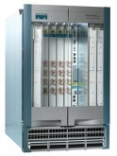
The Two Notions of “Router”
IP-layer logical functionality & the physical equipment
Logical
(IP layer)
Physical

Slide 54
The Tight Coupling of Physical & Logical
Root of many network adaptation challenges
Logical
(IP layer)
Physical

Slide 55
Decouple the “Physical” and “Logical”
Whenever physical changes are the goal, e.g.,
  Replace a hardware component
  Change the physical location of a router
A router’s logical configuration stays intact
  Routing protocol configuration
  Protocol adjacencies (sessions)

Slide 56
VROOM: Breaking the Coupling
Re-map the logical node to another physical node
Logical
(IP layer)
Physical

Slide 57
VROOM: Breaking the Coupling
Re-map the logical node to another physical node
VROOM enables this re-mapping of logical to physical through virtual router migration
Logical
(IP layer)
Physical

Slide 58
Example: Planned Maintenance
NO reconfiguration of VRs, NO disruption
VR-1
A
B

Slide 59

Example: Planned Maintenance
NO reconfiguration of VRs, NO disruption
A
VR-1
B

Slide 60
Example: Planned Maintenance
NO reconfiguration of VRs, NO disruption
A
VR-1
B

Slide 61
Virtual Router Migration: the Challenges
Migrate an entire virtual router instance
  All control plane & data plane processes / states
data plane
control plane
Switching
Fabric

Slide 62
Virtual Router Migration: the Challenges
Migrate an entire virtual router instance
Minimize disruption
  Data plane: millions of packets/second on a 10Gbps link
  Control plane: less strict (with routing message retransmission)

Slide 63
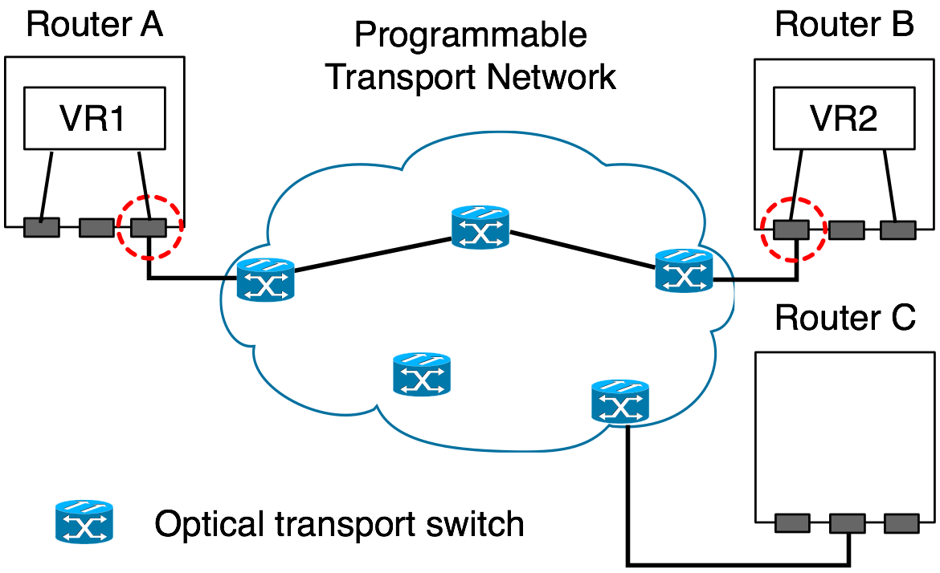
Virtual Router Migration: the Challenges
Migrate an entire virtual router instance
Minimize disruption
Link migration

Slide 64
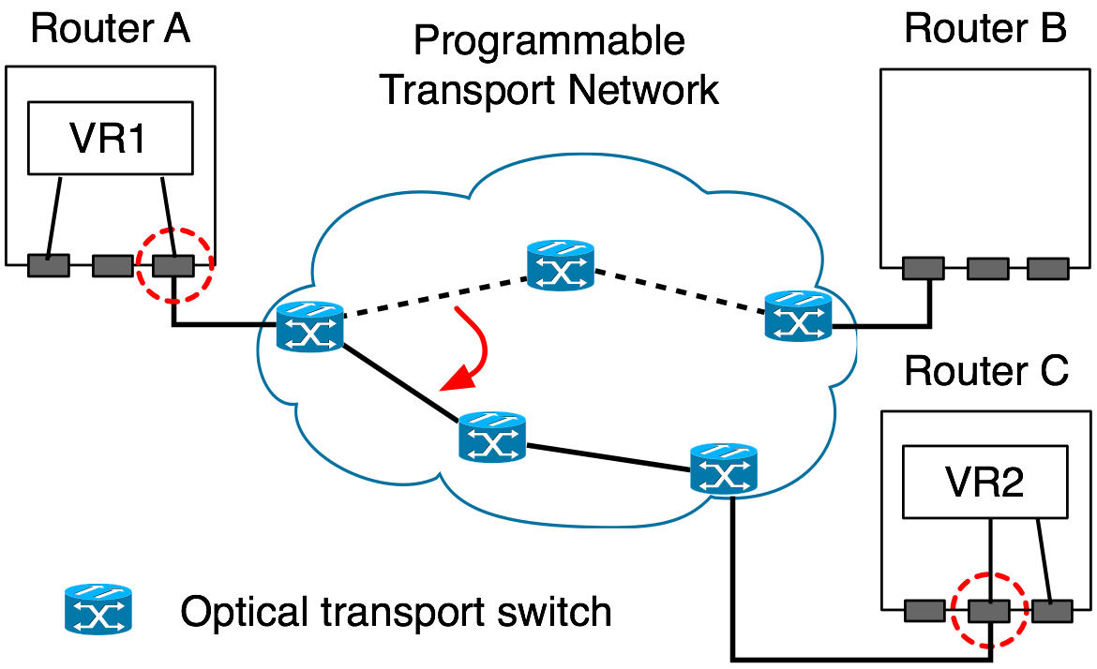
Virtual Router Migration: the Challenges
Migrate an entire virtual router instance
Minimize disruption
Link migration

Slide 65
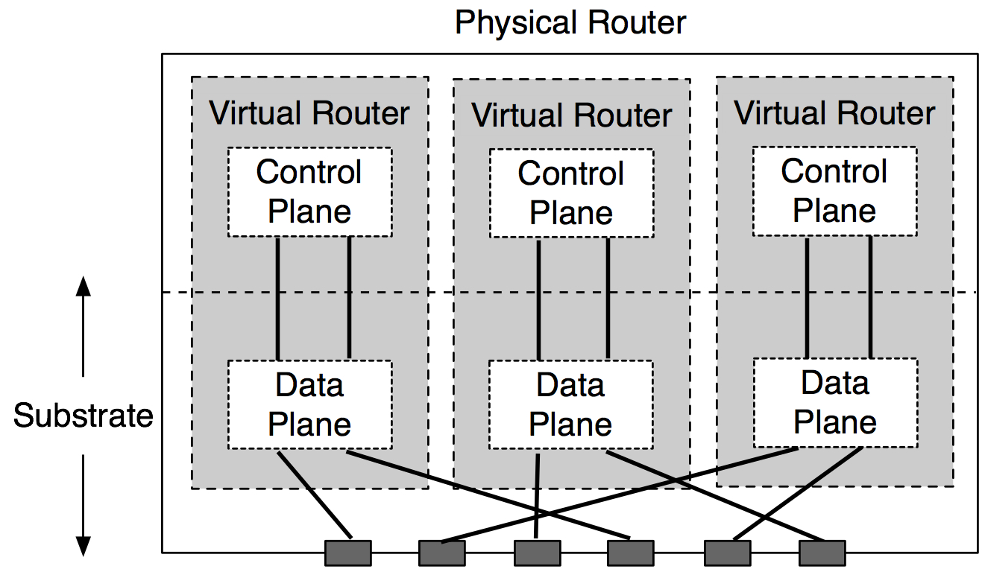
VROOM Architecture
Data-Plane Hypervisor
Dynamic Interface Binding

Slide 66
VROOM’s Migration Process
Key idea: separate the migration of control and data planes
Migrate the control plane
Clone the data plane
Migrate the links

Slide 67
Control-Plane Migration
Leverage virtual server migration techniques
Router image
  Binaries, configuration files, etc.

Slide 68
Control-Plane Migration
Leverage virtual server migration techniques
Router image
Memory
  1st stage: iterative pre-copy
  2nd stage: stall-and-copy (when the control plane is “frozen”)

Slide 69
Control-Plane Migration
Leverage virtual server migration techniques
Router image
Memory
CP
Physical router A
DP
Physical router B

Slide 70
Data-Plane Cloning
Clone the data plane by repopulation
  Enable migration across different data planes
Physical router A
DP-old
CP
Physical router B
DP-new
DP-new

Slide 71
Remote Control Plane
Data-plane cloning takes time
  Installing 250k routes takes over 20 seconds*
The control & old data planes need to be kept “online”
Solution: redirect routing messages through tunnels
Physical router A
DP-old
CP
Physical router B
DP-new
*: P. Francios, et. al., Achieving sub-second IGP convergence in large IP networks,
ACM SIGCOMM CCR, no. 3, 2005.

Slide 72
Remote Control Plane
Data-plane cloning takes time
  Installing 250k routes takes over 20 seconds*
The control & old data planes need to be kept “online”
Solution: redirect routing messages through tunnels
Physical router A
DP-old
CP
Physical router B
DP-new
*: P. Francios, et. al., Achieving sub-second IGP convergence in large IP networks,
ACM SIGCOMM CCR, no. 3, 2005.

Slide 73
Double Data Planes
At the end of data-plane cloning, both data planes are ready to forward traffic
DP-old
CP
DP-new

Slide 74
Asynchronous Link Migration
With the double data planes, links can be migrated independently
A
DP-old
B
CP
DP-new

Slide 75
Prototype Implementation
Control plane: OpenVZ + Quagga
Data plane: two prototypes
  Software-based data plane (SD): Linux kernel
  Hardware-based data plane (HD): NetFPGA
Why two prototypes?
  To validate the data-plane hypervisor design (e.g., migration between SD and HD)

Slide 76
Evaluation
Impact on data traffic
  SD: Slight delay increase due to CPU contention
  HD: no delay increase or packet loss
Impact on routing protocols
  Average control-plane downtime: 3.56 seconds (performance lower bound)
  OSPF and BGP adjacencies stay up

Slide 77
VROOM Summary
Simple abstraction
No modifications to router software
(other than virtualization)
No impact on data traffic
No visible impact on routing protocols

Slide 78
Part III:
Seamless Edge Link Migration with Router Grafting
With Jennifer Rexford, Kobus van der Merwe
[NSDI 2010]

Slide 79
Outline of Contributions
Bug Tolerant Router | VROOM | Router Grafting
Hide (router bugs) | Decouple (logical and physical) | Break binding (link to router)
Software and Data Diversity | Virtual Router Migration | Seamless Edge Link Migration
[CoNext09] | [SIGCOMM08] | [NSDI10]

Slide 80
(Recall) Change Happens
Network operators need to make changes
  Install, maintain, upgrade equipment
  Manage resource (e.g., bandwidth)
Move Link

Slide 81
(Recall) Change is Painful
Network operators need to deal with change
  Install, maintain, upgrade equipment
  Manage resource (e.g., bandwidth)
Move Link

Slide 82
Understanding the Disruption (today)
Reconfigure old router, remove old link
Add new link, configure new router
Establish new BGP session (exchange routes)
updates
BGP updates
delete neighbor 1.2.3.4
Add neighbor 1.2.3.4

Slide 83
Understanding the Disruption (today)
Reconfigure old router, remove old link
Add new link, configure new router
Establish new BGP session (exchange routes)
Downtime (Minutes)

Slide 84
Breaking the Link to Router Binding
Send state
Move link

Slide 85
Breaking the Link to Router Binding
Router Grafting enables this breaking apart a router (splitting/merging).

Slide 86
Not Just State Transfer
Migrate session
AS300
AS100
AS200
AS400

Slide 87
Not Just State Transfer
Migrate session
AS300
AS100
The topology changes
(Need to re-run decision processes)
AS200
AS400

Slide 88
Challenge: Protocol Layers
A
B
BGP
Exchange routes
BGP
TCP
Deliver reliable stream
TCP
IP
Send packets
IP
Physical Link
Migrate
State
C
Migrate
Link

Slide 89
Physical Link
A
B
BGP
Exchange routes
BGP
TCP
Deliver reliable stream
TCP
IP
Send packets
IP
Physical Link
Migrate
State
C
Migrate
Link

Slide 90
Physical Link
Unplugging cable would be disruptive
Move
Link
neighboring network
network making change

Slide 91
Physical Link
Unplugging cable would be disruptive
Links are not physical wires
  Switchover in nanoseconds
Optical Switches
mi
Move
Link
neighboring network
network making change

Slide 92
IP
A
B
BGP
Exchange routes
BGP
TCP
Deliver reliable stream
TCP
IP
Send packets
IP
Physical Link
Migrate
State
C
Migrate
Link

Slide 93
Changing IP Address
IP address is an identifier in BGP
Changing it would require neighbor to reconfigure
  Not transparent
  Also has impact on TCP (later)
mi
1.1.1.2
1.1.1.1
Move
Link
neighboring network
network making change

Slide 94
Re-assign IP Address
IP address not used for global reachability
  Can move with BGP session
  Neighbor doesn’t have to reconfigure
mi
1.1.1.1
Move
Link
1.1.1.2
neighboring network
network making change

Slide 95
TCP
A
B
BGP
Exchange routes
BGP
TCP
Deliver reliable stream
TCP
IP
Send packets
IP
Physical Link
Migrate
State
C
Migrate
Link

Slide 96
Dealing with TCP
TCP sessions are long running in BGP
  Killing it implicitly signals the router is down
BGP graceful restart and TCP migrate are possible workarounds
  Requires the neighbor router to support it
  Not available on all routers

Slide 97
Migrating TCP Transparently
Capitalize on IP address not changing
  To keep it completely transparent
Transfer the TCP session state
  Sequence numbers
  Packet input/output queue (packets not read/ack’d)
app
recv()
send()
TCP(data, seq, …)
ack
OS
TCP(data’, seq’)

Slide 98
BGP
A
B
BGP
Exchange routes
BGP
TCP
Deliver reliable stream
TCP
IP
Send packets
IP
Physical Link
Migrate
State
C
Migrate
Link

Slide 99
BGP: What (not) to Migrate
Requirements
  Want data packets to be delivered
  Want routing adjacencies to remain up
Need
  Configuration
  Routing information
Do not need (but can have)
  State machine
  Statistics
  Timers
Keeps code modifications to a minimum

Slide 100
Routing Information
Migrate-from router send the migrate-to router:
The routes it learned
  Instead of making remote end-point re-announce
The routes it advertised
  So able to send just an incremental update
mi
mi
Send routes
advertised/learned
Move
Link
Incremental
Update

Slide 101
Migration in The Background
Migration takes a while
  A lot of routing state to transfer
  A lot of processing is needed
Routing changes can happen at any time
Migrate in the background
mi
mi
Move
Link

Slide 102
Prototype
Added grafting into Quagga
  Import/export routes, new ‘inactive’ state
  Routing data and decision process well separated
Graft daemon to control process
SockMi for TCP migration
Graftable Router
Emulated
link migration
Unmod.
Router
Modified
Quagga
graft
daemon
Handler
Comm
Quagga
SockMi.ko
click.ko
Linux kernel 2.6.19.7
Linux kernel 2.6.19.7-click
Linux kernel 2.6.19.7

Slide 103
Evaluation
Mechanism:
Impact on migrating routers
Disruption to network operation
Application:
Traffic engineering

Slide 104
Impact on Migrating Routers
How long migration takes
  Includes export, transmit, import, lookup, decision
  CPU Utilization roughly 25%
Between Routers
0.9s (20k)
6.9s (200k)

Slide 105
Disruption to Network Operation
Data traffic affected by not having a link
  nanoseconds
Routing protocols affected by unresponsiveness
  Set old router to “inactive”, migrate link, migrate TCP, set new router to “active”
  milliseconds

Slide 106
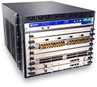

Traffic Engineering (traditional)
* adjust routing protocol parameters based on traffic
Congested link

Slide 107
Traffic Engineering w/ Grafting
* Rehome customer to change where traffic enters/exits

Slide 108
Traffic Engineering Evaluation
Setup
  Internet2 topology and 1 week of traffic data
  Simple greedy heuristic
Findings
  Network can handle more traffic (18.8%)
  Don’t need frequent re-optimization (2-4/day)
  Don’t need to move many links (<10%)

Slide 109
Router Grafting Summary
Enables moving a single link with…
  Minimal code change
  No impact on data traffic
  No visible impact on routing protocol adjacencies
  Minimal overhead on rest of network
Applying to traffic engineering…
  Enables changing ingress/egress points
  Networks can handle more traffic

Slide 110
Part IV:
A Unified Architecture

Slide 111
Grafting
Seamless
Link
Migration
BGP1
(Router
Grafting)

Slide 112
Grafting + BTR
Multiple
Diverse
Instances
Instance
Instance
BGP1
(Router
Grafting)
BGP2
(Router
Grafting)
Control-plane hypervisor
(BTR)

Slide 113
Grafting + BTR + VROOM
Virtual
Router
Migration
Virtual Router
Virtual Router
Instance
Instance
Instance
Instance
BGP1
(Router
Grafting)
BGP2
(Router
Grafting)
BGP1
(Router
Grafting)
BGP2
(Router
Grafting)
Control-plane hypervisor
(BTR)
Control-plane hypervisor
(BTR)
Data-plane Hypervisor
(VROOM)

Slide 114
Summary of Contributions
New refactoring concepts
  Hide (router bugs) with Bug Tolerant Router
  Decouple (logical and physical) with VROOM
  Break binding (link to router) with Router Grafting
Working prototype and evaluation for each
Incrementally deployable solution
  “Refactored router” can be drop in replacement
  Transparent to neighboring routers

Slide 115
Final Thoughts
Documents
Videos
Photos
115

Slide 116
Questions

