Slide 1

PARIS: ProActive Routing In Scalable Data Centers
Dushyant Arora, Theophilus Benson, Jennifer Rexford
Princeton University

Slide 2
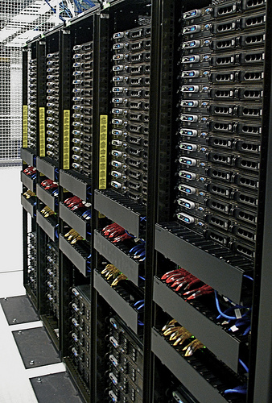
Data Center Network Goals
Scalability
Notes:
Support large number of tenants and VMs. Larger the number of tenants/VMs better chances for multiplexing → resource efficiency and cost savings

Slide 3
Data Center Network Goals
Scalability
Virtual machine migration
Notes:
Multipathing is required for improved bisection bandwidth. Take advantage of high-capacity network interconnects like Fat-tree, Clos.
In Layer 3 this is easy because you have ECMP. In Openflow switches you have group tables.
In Layer 2 this is a problem because spanning tree protocol disables links to avoid forwarding loops.

Slide 4
Data Center Network Goals
Scalability
Virtual machine migration
Multipathing
Notes:
Live Migration is needed for fault tolerance and to achieve high host utilization. Bring VMs close to storage/ VMs which send high east-west traffic closer together.
Migrating VMs should not change their IP addresses as doing so will break their pre-existing TCP connections.
Requires Layer 2 adjacency. Is possible at Layer 3 if you are willing to modify end hosts/rewrite applications.

Slide 5
Data Center Network Goals
Scalability
Virtual machine migration
Multipathing
Easy manageability
Notes:
An administrator should not need to configure any switch before deployment. No manual configuration of DHCP or OSPF → human errors.

Slide 6
Data Center Network Goals
Scalability
Virtual machine migration
Multipathing
Easy manageability
Low cost
Notes:
Low cost by exploiting commodity components

Slide 7
Data Center Network Goals
Scalability
Virtual machine migration
Multipathing
Easy manageability
Low cost
Multi-tenancy
Notes:
BYOIP → No restrictions on the tenant’s choice of L2/L3 address

Slide 8
Data Center Network Goals
Scalability
Virtual machine migration
Multipathing
Easy manageability
Low cost
Multi-tenancy
Middlebox policies
Notes:
MB is a network appliance that transforms, inspects, filters packets. Enterprises want to migrate their operations to the cloud but cannot do so because of lack of support for MBs in the cloud. The data center must allow tenants to specify network policies and realize it by forwarding traffic through desired sequences of middleboxes. For example:
Dest port 80 go through a firewall and a load balancer.

Slide 9
Data Center Network Goals
Scalability
Virtual machine migration
Multipathing
Easy manageability
Low cost
Multi-tenancy
Middlebox policies
Notes:
MB is a network appliance that transforms, inspects, filters packets. Enterprises want to migrate their operations to the cloud but cannot do so because of lack of support for MBs in the cloud. The data center must allow tenants to specify network policies and realize it by forwarding traffic through desired sequences of middleboxes. For example:
Dest port 80 go through a firewall and a load balancer.

Slide 10
Let’s try Ethernet
Notes:
Pros
Zero configuration
Seamless virtual machine (VM) migration
Topology independence
Cons
Not scalable (flooding based learning)
Spanning tree limits available bandwidth
Large L2 tables (flat MAC addresses)
Broadcasts limit scalability

Slide 11
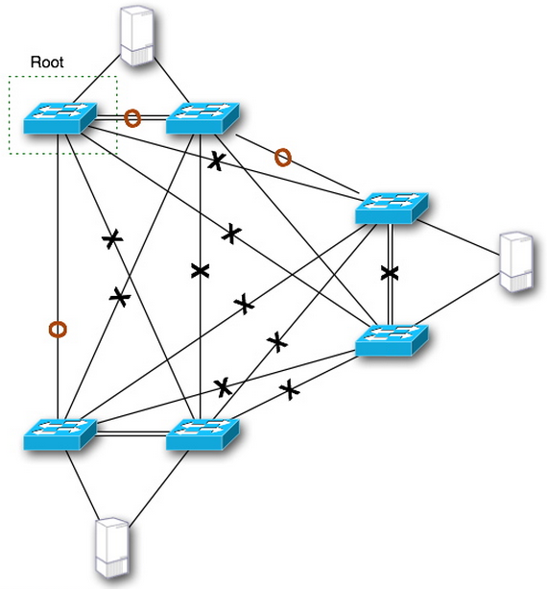
Let’s try Ethernet
SCHEME | SCALABILITY | MULTIPATHING | VM MIGRATION | MANAGEABILITY | LOW COST
ETHERNET | ✗ | ✗ | ✓ | ✓ | ✓
B
A
Notes:
Pros
Zero configuration
Seamless virtual machine (VM) migration
Topology independence
Cons
Not scalable (flooding based learning)
Spanning tree limits available bandwidth
Large L2 tables (flat MAC addresses)
Broadcasts limit scalability

Slide 12
Mix some IP into it
SCHEME | SCALABILITY | MULTIPATHING | VM MIGRATION | MANAGEABILITY | LOW COST
ETHERNET | ✗ | ✗ | ✓ | ✓ | ✓
Notes:
Pros
Scalable (aggregation)
Equal-cost multi-path (ECMP) routing
Cons
Configuration overhead (error prone)
Subnetting limits host mobility

Slide 13
Mix some IP into it
CORE
POD
POD
10.16.0/22
10.16.0/22
AGGREGATION
10.16.1/22
10.16.1/22
10.16.0/24
10.16.1/24
10.16.2/24
10.16.3/24
EDGE
10.16.4/24
10.16.5/24
10.16.6/24
10.16.7/24
Virtual Switch
Virtual Switch
10.16.0.1
10.16.0.5
10.16.0.9
10.16.6.2
10.16.6.4
10.16.6.7
SERVER
SERVER
Notes:
Use ECMP in edge-agg and agg-core links. Our work is limited to hierarchical topologies which are typical of data centers today.
Hierarchical DCN (Leaf and spine, Fat tree)
Layers and Pod. Physical servers with hypervisor (and virtual switch)

Slide 14
Mix some IP into it
SCHEME | SCALABILITY | MULTIPATHING | VM MIGRATION | MANAGEABILITY | LOW COST
ETHERNET | ✗ | ✗ | ✓ | ✓ | ✓
ETHERNET+IP | ✓ | ✓ | ~ | ✗ | ✗
Notes:
Pros
Scalable (aggregation)
Equal-cost multi-path (ECMP) routing
Cons
Configuration overhead (error prone)
Subnetting limits host mobility

Slide 15

Thought Bubble
What if we treat IP as flat address?
Notes:
Treat IP as flat address (no topological significance)

Slide 16
Thought Bubble
What if we treat IP as flat address?
Have each switch store forwarding information for all hosts beneath it

Slide 17
Thought Bubble
CORE
POD
POD
AGGREGATION
EDGE
Virtual Switch
Virtual Switch
Virtual Switch
10.0.0.1
10.0.0.2
10.1.0.2
10.2.0.4
10.3.0.2
10.1.0.5
10.0.0.4
10.2.0.7
10.3.0.9
Notes:
Use group table with group type select for implementing this. Openflow 1.3 spec says it is an optional group type. Can be done both per-flow or per-packet. Depends on the switch. Well known tradeoff for both policies. Per packet – better load balancing. Lesser chance of hotspots. Higher bisection bandwidth. Packet reordering.

Slide 18
Thought Bubble
What if we treat IP as flat address?
Have each switch store forwarding information for all hosts beneath it
Scales within a pod but not at the core layer

Slide 19
Thought Bubble
So, Aggregate!
What if we treat IP as flat address?
Have each switch store forwarding information for all hosts beneath it
Scales within a pod but not at the core layer

Slide 20
Thought Bubble
What if we treat IP as flat address?
Have each switch store forwarding information for all hosts beneath it
Scales within a pod but not at the core layer
Virtual prefixes (VP)
Divide host address space eg. /14 into 4 /16 prefixes

Slide 21
Thought Bubble
What if we treat IP as flat address?
Have each switch store forwarding information for all hosts beneath it
Scales within a pod but not at the core layer
Virtual prefixes (VP)
Appointed Prefix Switch (APS)
Each VP has an APS in the core layer
APS stores forwarding information for all IP addresses within its VP

Slide 22
Virtual Prefix & Appointed Prefix Switch
10.0.0.0/16
10.1.0.0/16
10.2.0.0/16
10.3.0.0/16
CORE
POD
POD
AGGREGATION
EDGE
Virtual Switch
Virtual Switch
Virtual Switch
10.0.0.1
10.0.0.2
10.1.0.2
10.2.0.4
10.3.0.2
10.1.0.5
10.0.0.4
10.2.0.7
10.3.0.9
Notes:
Use group table with group type select for implementing this. Openflow 1.3 spec says it is an optional group type. Can be done both per-flow or per-packet. Depends on the switch. Well known tradeoff for both policies. Per packet – better load balancing. Lesser chance of hotspots. Higher bisection bandwidth. Packet reordering.

Slide 23
Thought Bubble
What if we treat IP as flat address?
Have each switch store forwarding information for all hosts beneath it
Scales within a pod but not at the core layer
Virtual prefixes (VP)
Appointed Prefix Switch (APS)
Notes:
Speed breaker

Slide 24
Thought Bubble
What if we treat IP as flat address?
Have each switch store forwarding information for all hosts beneath it
Scales within a pod but not at the core layer
Virtual prefixes (VP)
Appointed Prefix Switch (APS)
Proactive installation of forwarding state
Notes:
Proactive installation of forwarding state using controller

Slide 25
No-Stretch
DIP: 10.0.0.1 → 5
DIP: 10.0.0.2 → 5
DIP: 10.1.0.2 → 5
DIP: 10.2.0.4 → 7
DIP: 10.3.0.2 → 7
DIP: 10.1.0.5 → 7
….
Low priority
DIP: 10.0.0.0/16 → 1
DIP: 10.1.0.0/16 → 2
DIP: 10.2.0.0/16 → 3
DIP: 10.3.0.0/16 → 4
DIP: 10.3.0.2 → 2
DIP: 10.3.0.9 → 4
….
….
DIP: 10.0.0.4 → 7
DIP: 10.2.0.7 → 7
DIP: 10.3.0.9 → 7
…
…
Low priority
DIP: 10.0.0.0/16 → 1
DIP: 10.1.0.0/16 → 2
DIP: 10.2.0.0/16 → 3
DIP: 10.3.0.0/16 → 4
10.0.0.0/16
10.1.0.0/16
10.2.0.0/16
10.3.0.0/16
CORE
1
2
3
4
DIP: 10.0.0.1 → 3
DIP: 10.0.0.2 → 3
DIP: 10.1.0.2 → 3
…
Low priority
IP → {1,2}
1
2
2
3
4
3
AGGREGATION
1
4
DIP: 10.0.0.4 → 3
DIP: 10.2.0.7 → 3
DIP: 10.3.0.9 → 3
Low priority
IP → {1,2}
5
8
5
8
6
7
6
7
1
2
EDGE
1
2
3
3
Virtual Switch
Virtual Switch
Virtual Switch
10.0.0.1
10.0.0.2
10.1.0.2
10.2.0.4
10.3.0.2
10.1.0.5
10.0.0.4
10.2.0.7
10.3.0.9
Src IP: 10.0.0.1, Dst IP: 10.3.0.9
Notes:
Use group table with group type select for implementing this. Openflow 1.3 spec says it is an optional group type. Can be done both per-flow or per-packet. Depends on the switch. Well known tradeoff for both policies. Per packet – better load balancing. Lesser chance of hotspots. Higher bisection bandwidth. Packet reordering.
Say DIP = Destination IP

Slide 26
No-Stretch
SCHEME | SCALABILITY | MULTIPATHING | VM MIGRATION | MANAGEABILITY | LOW COST
ETHERNET | ✗ | ✗ | ✓ | ✓ | ✓
ETHERNET+IP | ✓ | ✓ | ✗ | ✗ | ✗
NO-STRETCH | ✓ | ~ | ✓ | ✓ | ✓
Notes:
Pros
Scalability
Host mobility
Cons
Doesn’t utilize all aggregation-core layer links
Coarse-grained partition of traffic
Failure handling: Have multiple core switches and use ECMP among them. Or sub-divide its VP into smaller prefixes and store them on other core-layer switches.
To address this limitations we build another design

Slide 27
We want Multipathing!
10.0.0.0/16
10.1.0.0/16
10.2.0.0/16
10.3.0.0/16
CORE
AGGREGATION
EDGE
Notes:
Use group table with group type select for implementing this. Openflow 1.3 spec says it is an optional group type. Can be done both per-flow or per-packet. Depends on the switch. Well known tradeoff for both policies. Per packet – better load balancing. Lesser chance of hotspots. Higher bisection bandwidth. Packet reordering.
Say DIP = Destination IP

Slide 28
We want Multipathing!
10.1.0.0/16
CORE
10.0.0.0/16
10.2.0.0/16
10.3.0.0/16
AGGREGATION
EDGE
Notes:
Instead of having disjoint switches in the core, we connect them to form a full mesh. We choose a full-mesh because it has low diameter and multiple paths for fault tolerance and load balancing.

Slide 29
We want Multipathing!
10.1.0.0/16
CORE
10.0.0.0/16
10.2.0.0/16
10.3.0.0/16
AGGREGATION
EDGE
Notes:
Instead of having disjoint switches in the core, we connect them to form a full mesh. We choose a full-mesh because it has low diameter and multiple paths for fault tolerance and load balancing.

Slide 30
High-Bandwidth
DIP: 10.0.0.1 → 4
DIP: 10.0.0.2 → 5
DIP: 10.0.0.4 → PUSH_MPLS(25), 3
…..
Low priority
DIP: 10.1.0.0/16 → 1
DIP: 10.2.0.0/16 → 2
DIP: 10.3.0.0/16 → 3
DIP: 10.3.0.2 → 4
DIP: 10.3.0.9 → 5
MPLS(25) → POP_MPLS(0x800), 5
…..
Low priority
DIP: 10.0.0.0/16 → 1
DIP: 10.1.0.0/16 → 2
DIP: 10.2.0.0/16 → 3
10.1.0.0/16 C1
DIP: 10.0.0.1 → 3
DIP: 10.0.0.2 → 3
DIP: 10.1.0.2 → 3
DIP: 10.2.0.4 → 5
DIP: 10.3.0.2 → 5
DIP: 10.1.0.5 → 5
….
Low priority
IP → {1,2}
1
CORE
10.0.0.0/16
C0
2
10.2.0.0/16
C2
4
3
2
5
1
3
4
5
10.3.0.0/16
C3
DIP: 10.0.0.1 → 3
DIP: 10.0.0.2 → 3
DIP: 10.1.0.2 → 3
…
Low priority
IP → {1,2}
1
2
AGGREGATION
3
6
4
5
1
2
EDGE
3
Virtual Switch
Virtual Switch
Virtual Switch
10.0.0.1
10.0.0.2
10.1.0.2
10.2.0.4
10.3.0.2
10.1.0.5
10.0.0.4
10.2.0.7
10.3.0.9
Src IP: 10.0.0.1, Dst IP: 10.3.0.9
Notes:
Instead of having disjoint switches in the core, we connect them to form a full mesh. We choose a full-mesh because it has low diameter and multiple paths for fault tolerance and load balancing.

Slide 31
Multipathing in the Core Layer
Notes:
Volatile data center traffic pattern

Slide 32
Multipathing in the Core Layer
Implement Valiant Load Balancing (VLB)
Better link utilization through randomization
Notes:
Volatile data center traffic pattern

Slide 33
Multipathing in the Core Layer
Implement Valiant Load Balancing (VLB)
How do we implement VLB?
APS
INGRESS
EGRESS
Notes:
Say this is particularly suitable for our approach.
Tunneling and Group table (select) in core layer
Bounce via a random router

Slide 34
Multipathing in the Core Layer
Implement Valiant Load Balancing (VLB)
How do we implement VLB?
First bounce
Ingress core switch to APS
APS
INGRESS
EGRESS
Notes:
Say this is particularly suitable for our approach.
Tunneling and Group table (select) in core layer
Bounce via a random router

Slide 35
Multipathing in the Core Layer
Implement Valiant Load Balancing (VLB)
How do we implement VLB?
First bounce
Ingress core switch to APS
APS
V
V
V
INGRESS
EGRESS
Notes:
Say this is particularly suitable for our approach.
Tunneling and Group table (select) in core layer
Bounce via a random router

Slide 36
Multipathing in the Core Layer
Implement Valiant Load Balancing (VLB)
How do we implement VLB?
First bounce
Ingress core switch to APS
Second bounce
APS to egress core switch
APS
INGRESS
EGRESS
Notes:
Say this is particularly suitable for our approach.
Tunneling and Group table (select) in core layer
Bounce via a random router

Slide 37
Multipathing in the Core Layer
Implement Valiant Load Balancing (VLB)
How do we implement VLB?
First bounce
Ingress core switch to APS
Second bounce
APS to egress core switch
APS
V
EGRESS
INGRESS
V
V
Notes:
Say this is particularly suitable for our approach.
Tunneling and Group table (select) in core layer
Bounce via a random router

Slide 38
High-Bandwidth
SCHEME | SCALABILITY | MULTIPATHING | VM MIGRATION | MANAGEABILITY | LOW COST
ETHERNET | ✗ | ✗ | ✓ | ✓ | ✓
ETHERNET+IP | ✓ | ✓ | ✗ | ✗ | ✗
NO-STRETCH | ✓ | ~ | ✓ | ✓ | ✓
HIGH-BW+VLB | ✓ | ✓ | ✓ | ✓ | ✓
Notes:
Pros
Scalability
Host mobility
Multipathing and better bisection bandwidth
Cons
Slightly higher latency

Slide 39
Performance Evaluation
Compare No-Stretch and High-BW+VLB on Mininet-HiFi
32 hosts, 16 edge, 8 aggregation, and 4 core switches (no over-subscription)
106 and 126 µs inter-pod RTT
Link bandwidth
Host-switch: 1Mbps
Switch-Switch: 10Mbps
Random traffic pattern
Each host randomly sends to 1 other host
Use iperf to measure sender bandwidth
Notes:
RTT increases as average path length increases

Slide 40
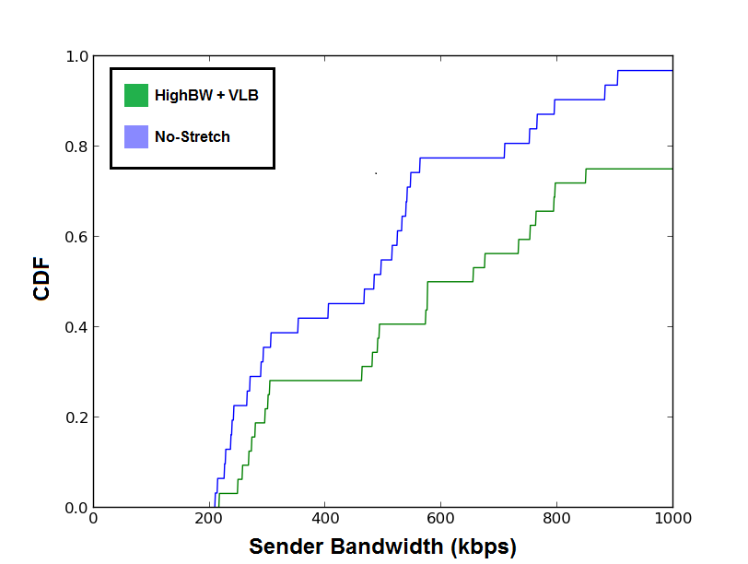
Performance Evaluation
Avg: 477 kbps
Median: 483 kbps
Avg: 633 kbps
Median: 654 kbps

Slide 41
Data Center Network Goals
Scalability
Virtual machine migration
✓ Multipathing
✓ Easy manageability
Low cost
Multi-tenancy
Middlebox policies

Slide 42
Multi-tenancy
Notes:
BYOIP → No restrictions on the tenant’s choice of L2/L3 address. Two tenant VMs can have the same IP address.
Layer 2.5 header
Stress on the fact that papers leave this out. Middlebox traversal papers don’t talk about the data center network and scalable data center network papers don’t talk supporting middleboxes. As enterprises move their network to the cloud the data center network needs to be able to support MB policies from multiple tenants and do this in a scalable fashion.
VLANs are limited (4094)

Slide 43
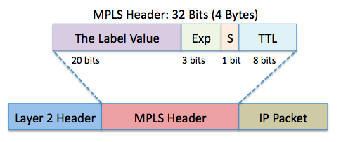
Multi-tenancy
Each tenant is given a unique MPLS label
Notes:
BYOIP → No restrictions on the tenant’s choice of L2/L3 address. Two tenant VMs can have the same IP address.
Layer 2.5 header
Stress on the fact that papers leave this out. Middlebox traversal papers don’t talk about the data center network and scalable data center network papers don’t talk supporting middleboxes. As enterprises move their network to the cloud the data center network needs to be able to support MB policies from multiple tenants and do this in a scalable fashion.
VLANs are limited (4094)

Slide 44
MPLS Label = 16
MPLS Label = 17
MPLS Label = 18
10.0.0.0/16
10.1.0.0/16
10.2.0.0/16
10.3.0.0/16
CORE
POD
POD
AGGREGATION
EDGE
Virtual Switch
Virtual Switch
Virtual Switch
10.0.0.1
10.0.0.2
10.1.0.2
10.2.0.4
10.3.0.2
10.1.0.5
10.0.0.4
10.2.0.7
10.3.0.9

Slide 45
Multi-tenancy
Each tenant is given a unique MPLS label
Server virtual switches push/pop MPLS header

Slide 46
Multi-tenancy
Each tenant is given a unique MPLS label
Server virtual switches push/pop MPLS header
All switches match on both MPLS label and IP address
Notes:
So, this way we can distinguish between tenant VMs with same IP

Slide 47
MPLS Label = 16
MPLS Label = 17
MPLS Label = 18
10.0.0.0/16
10.1.0.0/16
10.2.0.0/16
10.3.0.0/16
CORE
High priority
in_port:2, DIP: 10.1.0.2 → 4
in_port:4, DIP: 10.0.0.1 → 2
Default
in_port: 2 → PUSH_MPLS(16), 1
in_port: 3 → PUSH_MPLS(17), 1
in_port: 4 → PUSH_MPLS(16), 1
in_port: 1, MPLS(16), DIP:10.0.0.1 → POP_MPLS(0x800), 2
in_port: 1, MPLS(17), DIP:10.0.0.2 → POP_MPLS(0x800), 3
in_port: 1, MPLS(16), DIP:10.1.0.2 → POP_MPLS(0x800), 4
AGGREGATION
EDGE
1
Virtual Switch
Virtual Switch
Virtual Switch
2
3
4
10.0.0.1
10.0.0.2
10.1.0.2
10.2.0.4
10.3.0.2
10.1.0.5
10.0.0.4
10.2.0.7
10.3.0.9
Src IP: 10.0.0.1, Dst IP: 10.0.0.4

Slide 48
Multi-tenancy
Each tenant is given a unique MPLS label
Server virtual switches push/pop MPLS header
All switches match on both MPLS label and IP address
Forwarding proceeds as usual

Slide 49
Data Center Network Goals
Scalability
Virtual machine migration
✓ Multipathing
✓ Easy manageability
Low cost
✓ Multi-tenancy
Middlebox policies

Slide 50
Middlebox Policies
Notes:
Remind briefly what are MBs and what a policy is
78% of downtime in data center is cause by misconfiguration. This is because of human involvement in implementing the middlebox policies in a data center. Typical methods used to ensure correct MB traversal are: 1) Overloading path selection mechanisms (adjusting weights in spanning tree protocol) 2) Put MBs at choke points 3) Place MBs at all possible choke points/ incorporate MB functionality in switches - costly. Problems 1) Ad-hoc practices like overloading existing path selection mechanisms are hard to configure and maintain (think link/switch failure). Other practices: remove links to create choke points: complex and we lose fault tolerance, separate VLANs with MB at inter-connection points: violates efficiency, can no longer do seamless VM migration. 2) Inefficiency - packet should not traverse MBs it is not supposed to - this wastes resources and can also cause incorrect behavior. 3) Inflexibility - New instances of MB can be deployed to balance load (how to make this automatic) or policy changes in future. Doing this will require human intervention - leads to errors. 4) If MB fails this leads to network partition (since MBs are placed at choke points) What we need 1) Correctness - Tra ffic should traverse middleboxes in the sequence specfi ed by the network administrator under all network conditions. 2) Flexibility - The sequences of middleboxes should be easily recon figured as application requirements change. 3) Efficiency - Traffic should not traverse unnecessary middleboxes

Slide 51
Middlebox Policies
Place MBs off the physical network path
Installing MBs at choke points causes network partition on failure
Data centers have low network latency

Slide 52
MPLS Label = 16
MPLS Label = 17
MPLS Label = 18
10.0.0.0/16
10.1.0.0/16
10.2.0.0/16
10.3.0.0/16
FIREWALL
CORE
AGGREGATION
LOAD BALANCER
EDGE
Virtual Switch
Virtual Switch
Virtual Switch
10.0.0.1
10.0.0.2
10.1.0.2
10.2.0.4
10.3.0.2
10.1.0.5
10.0.0.4
10.2.0.7
10.3.0.9

Slide 53
Policy Implementation
Place MBs off the physical network path

Slide 54
Policy Implementation
Place MBs off the physical network path
Use source routing
Notes:
Install rules in the virtual switch (more space)
Changing policies is fast and simple.
To modify a policy we simply change the rule installed on a virtual switch (in the hypervisor). All packets either follow the old policy or the new policy

Slide 55
Policy Implementation
Place MBs off the physical network path
Use source routing
Install policies in server virtual switch
Notes:
Install rules in the virtual switch (more space)
Changing policies is fast and simple.
To modify a policy we simply change the rule installed on a virtual switch (in the hypervisor). All packets either follow the old policy or the new policy

Slide 56
Policy Implementation
Place MBs off the physical network path
Use source routing
Install policies in server virtual switch
Virtual switches can support big flow tables
Notes:
Install rules in the virtual switch (more space)
Changing policies is fast and simple.
To modify a policy we simply change the rule installed on a virtual switch (in the hypervisor). All packets either follow the old policy or the new policy

Slide 57
Policy Implementation
Place MBs off the physical network path
Use source routing
Install policies in server virtual switch
Virtual switches can support big flow tables
Provides flexibility
Notes:
Install rules in the virtual switch (more space)
Changing policies is fast and simple.
To modify a policy we simply change the rule installed on a virtual switch (in the hypervisor). All packets either follow the old policy or the new policy

Slide 58
Policy Implementation
Place MBs off the physical network path
Use source routing
Use MPLS label stack for source routing
Notes:
Ek Log Vk. Also, MPLS label is 20 bits. So, can support large number of MBs.

Slide 59
Policy Implementation
Place MBs off the physical network path
Use source routing
Use MPLS label stack for source routing
Each MB is assigned a unique MPLS label (2²⁰-1 max)
Notes:
Each MB is assigned a unique MPLS label. We have 20 bit MPLS label value. So, enough space.

Slide 60
Policy Implementation
Place MBs off the physical network path
Use source routing
Use MPLS label stack for source routing
Each MB is assigned a unique MPLS label (2²⁰-1 max)
Edge and Aggregation switches store forwarding information for MBs beneath them
Notes:
Each MB is assigned a unique MPLS label. We have 20 bit MPLS label value. So, enough space.

Slide 61
Policy Implementation
Place MBs off the physical network path
Use source routing
Use MPLS label stack for source routing
Each MB is assigned a unique MPLS label (2²⁰-1 max)
Edge and Aggregation switches store forwarding information for MBs beneath them
Aggregate flat MPLS labels in core layer

Slide 62
MPLS Label = 16
MPLS Label = 17
MPLS Label = 18
10.0.0.0/16
32/17
10.1.0.0/16
40/17
10.2.0.0/16
48/17
10.3.0.0/16
56/17
FIREWALL (46)
CORE
AGGREGATION
LOAD BALANCER (33)
EDGE
Virtual Switch
Virtual Switch
Virtual Switch
10.0.0.1
10.0.0.2
10.1.0.2
10.2.0.4
10.3.0.2
10.1.0.5
10.0.0.4
10.2.0.7
10.3.0.9

Slide 63
Policy Implementation
Place MBs off the physical network path
Use source routing
Use MPLS label stack for source routing
Notes:
Speedbreaker.

Slide 64
Policy Implementation
Place MBs off the physical network path
Use source routing
Use MPLS label stack for source routing
Pre-compute sequence of MBs for each policy and install rules proactively
Notes:
Be proactive and install rules for each virtual switch. Modified Dijkstra’s algortihm. Takes Ek Log Vk time.

Slide 65
MPLS Label = 16
MPLS Label = 17
MPLS Label = 18
{TID:16, DIP: 10.16.0.17:80} → 46 → 33 → WebServer
{TID:16, DIP: 10.16.0.17:80} → FW → LB → WebServer
10.0.0.0/16
32/17
10.1.0.0/16
40/17
10.2.0.0/16
48/17
10.3.0.0/16
56/17
FIREWALL (46)
CORE
Highest priority
in_port:2, DIP: 10.16.0.17 → PUSH_MPLS(16), PUSH_MPLS(33), PUSH_MPLS(46), 1
….
High priority
in_port:2, DIP: 10.1.0.2 → 4
….
Default
in_port: 2 → PUSH_MPLS(16), 1
….
in_port: 1, MPLS(16), DIP:10.0.0.1 → POP_MPLS(0x800), 2
AGGREGATION
LOAD BALANCER (33)
EDGE
1
Virtual Switch
Virtual Switch
Virtual Switch
2
3
4
10.0.0.1
10.0.0.2
10.1.0.2
10.2.0.4
10.3.0.2
10.1.0.5
10.0.0.4
10.2.0.7
10.3.0.9
Src IP: 10.0.0.1, Dst IP: 10.16.0.17:80

Slide 66
Conclusion
Proposed new data center addressing and forwarding schemes
✓ Scalability
✓ Multipathing
✓ Virtual machine migration
✓ Easy manageability
Low cost
✓ Multi-tenancy (independent)
✓ Middlebox policies (independent)
NOX and Openflow software switch prototype
Notes:
MPLS prefix matching is just like LPM for IPv4 addresses

Slide 67
Related Work
SCHEME | SCALABILITY | MULTIPATHING | VM MIGRATION | MANAGEABILITY | LOW COST | MULTI-TENANCY | MIDDLEBOX
NO STRETCH | ✓ | ~ | ✓ | ✓ | ✓ | ✓ | ✓
HIGH BW+VLB | ✓ | ✓ | ✓ | ✓ | ✓ | ✓ | ✓
VL2 | ✓ | ✓ | ✓ | ~ | ✓ | ? | ?
PORTLAND* | ✓ | ✓ | ✓ | ✓ | ✓ | ✓ | ?
TRILL | ✗ | ✓ | ✓ | ✓ | ✓ | ✓ | ?
SPAIN | ✗ | ✓ | ✓ | ✓ | ✓ | ✓ | ?
Notes:
Both VL2 and Portland require directory servers and gateway servers
VL2 uses OSPF
Portland is limited to Fat-trees
SEATTLE is not scalable. Has manageability issue. Also, not a low cost solution

Slide 68
Thank You
Questions?

Slide 69
Scalability Evaluation
512 VMs/tenant
64 VMs/physical server
~40% of network appliances are middleboxes
64 x 10Gbps Openflow switches
NOX controller
Notes:
Number of tenants = Number of hosts/512

Slide 70
No-Stretch Scalability Evaluation
128 ports*
Notes:
The data above shows for a given flow table size what are the maximum number of hosts a particular scheme can support

Slide 71
High-BW+VLB Scalability Evaluation
Notes:
The data above shows for a given flow table size what are the maximum number of hosts a particular scheme can support

Slide 72
POLICY
{TID:16, DIP: 10.16.0.17:80} → FW → LB → WebServer
10.0.0.0/16
32/17
10.1.0.0/16
40/17
10.2.0.0/16
48/17
10.3.0.0/16
56/17
FIREWALL (46)
CORE
Virtual Switch
5
2
6
4
3
1
Highest priority
in_port:2, DIP: 10.16.0.17 → PUSH_MPLS(16), PUSH_MPLS(33), PUSH_MPLS(46), 1
….
High priority
in_port:2, DIP: 10.1.0.2 → 4
….
Default
in_port: 2 → PUSH_MPLS(16), 1
….
in_port: 1, MPLS(16), DIP:10.0.0.1 → POP_MPLS(0x800), 2
7
AGGREGATION
MPLS_BOTTOM(16) → MPLS_POP(0x8847), 5
MPLS_BOTTOM(17) → MPLS_POP(0x8847), 1
MPLS_BOTTOM(18) → MPLS_POP(0x8847), 3
in_port:2 → 7
in_port:4 → 7
in_port:6 → 7
LOAD BALANCER (33)
Virtual Switch
EDGE
1
Virtual Switch
Virtual Switch
Virtual Switch
2
3
4
10.0.0.1
10.0.0.2
10.1.0.2
10.2.0.4
10.3.0.2
10.1.0.5
10.0.0.4
10.2.0.7
10.3.0.9
Src IP: 10.0.0.1, Dst IP: 10.16.0.17:80

Slide 73
Performance Evaluation
Compare No-Stretch and High-BW+VLB on Mininet-HiFi
64 hosts, 32 edge, 16 aggregation, and 8 core switches (no over-subscription)
106 and 126 µs inter-pod RTT
Link bandwidth
Host-switch: 1Mbps
Switch-Switch: 10Mbps
Random traffic pattern
Each host randomly sends to 1 other
Use iperf to measure sender bandwidth
Notes:
RTT increases as average path length increases

Slide 74
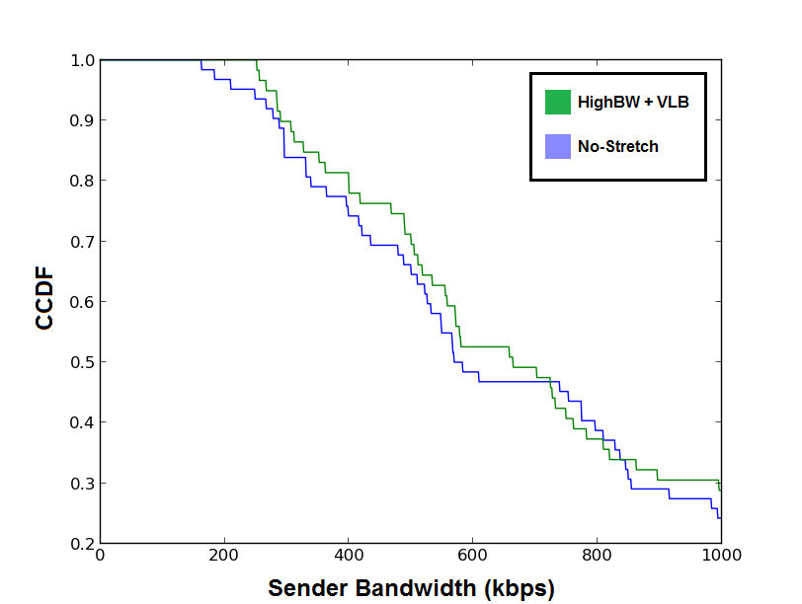
Performance Evaluation
Avg: 681 kbps
Median: 663 kbps
Avg: 652 kbps
Median: 582 kbps

Slide 75
Performance Evaluation
Compare three forwarding schemes using Mininet-HiFi
No-Stretch, High-BW and High-BW+VLB
64 hosts, 32 edge, 16 aggregation, and 8 core switches
106, 116, 126 µs inter-pod RTT
Link bandwidth
Host-switch: 10Mbps
Switch-Switch: 100Mbps
Random traffic pattern
Each host randomly sends to 4 other
Senders send @ 4096 kbps for 10s
Notes:
RTT increases as average path length increases

Slide 76
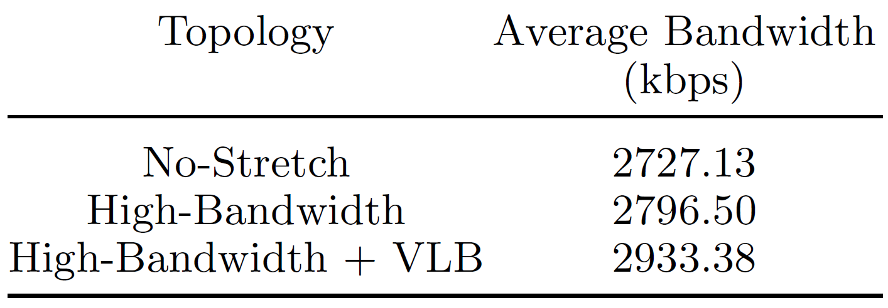
Evaluation

Slide 77
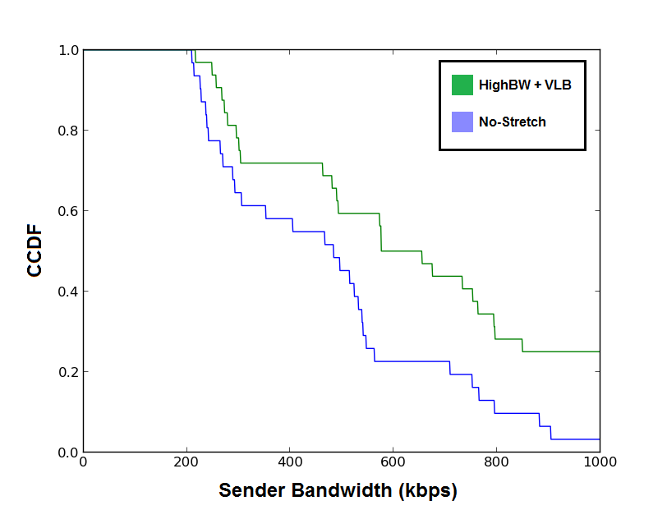
Performance Evaluation
Avg: 633 kbps
Median: 654 kbps
Avg: 477 kbps
Median: 483 kbps

