Slide 1
Accurate Traffic Splitting on Commodity Switches
ACM Symposium on Parallelism in Algorithms and Architectures (SPAA) 2018
Ori Rottenstreich Yossi Kanizo Haim Kaplan Jennifer Rexford
Technion Tel-Hai College Tel Aviv University Princeton University

Slide 2
Traffic Load Balancing
Link speed
10 Gbps
Over multiple paths
Among servers
Resources are not necessarily identical
  Requested distribution is not necessarily uniform
Load
Balancer
Destination
1 Gbps
100 Ghz
Load
Balancer
50 Ghz
200 Ghz
CPU

Slide 3
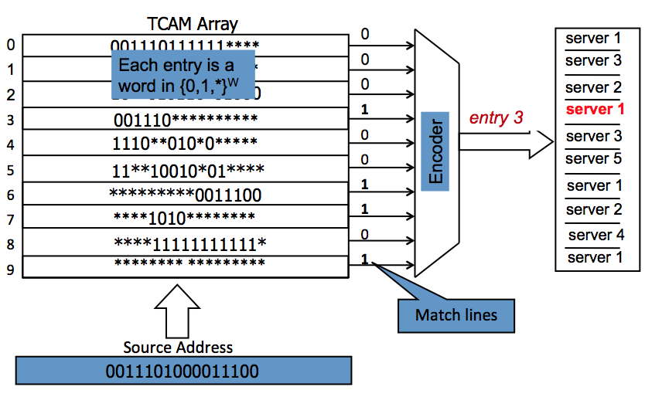
Traffic Split in Commodity Switches with TCAMs
Ternary content addressable memory (TCAM)
TCAMs are highly available in switches, typically used for classification of traffic
Matching is based on fields from the traffic header (e.g., source or destination ports)
Parallel search in all entries
Rules are ordered in decreasing priority, first match implies the output
TCAMs have high power consumption
  Kang et al., ACM CoNext, 2015

Slide 4
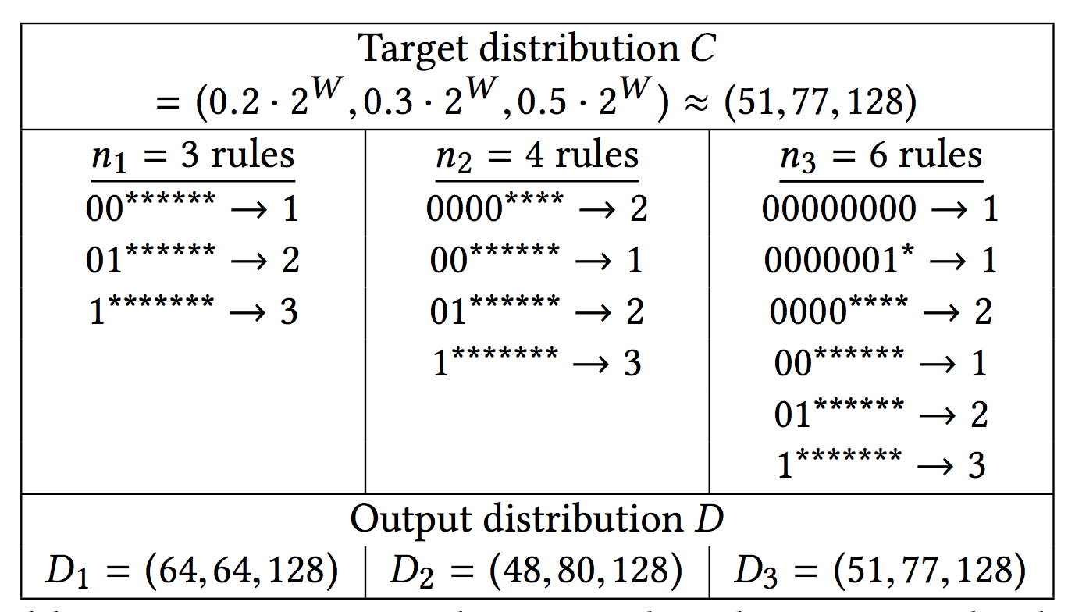
Realizing a Traffic Distribution
Uniformly distributed inputs of W=8 bits
Allowed number of rules determines achievable accuracy

Slide 5
Optimization Problems
Problem 1: For a given distribution, find the minimal size set of rules that exactly describes the distribution
Problem 2: For a given distribution and a number of allowed rules, find a set of rules that minimizes the dissimilarity to the distribution
Dissimilarity metrics between distributions:
  Maximal redundant traffic in a server
  Average error (absolute value) among servers

Slide 6

Encoding of a Function vs. a Distribution
Existing optimal algorithms for finding a concise encoding of a given function
  Suri et al., 2003: Based on dynamic programming, starting from leaves
  Assumption: Prefix rules (wildcards appear as a suffix)
For a given distribution, there can be several corresponding functions
  C = (2,6) can also be described by (00*➔server 1, ***➔server 2)
For a distribution, what can be an easy function to implement?
server 1
server 1
server 2
000
001
010
011
100
101
110
111

Slide 7
Representation of Integers
A positive integer can be described as a sum of powers of two
  Unique representation
  E.g., 57 = 32 + 16 + 8 + 1 = 2⁵+2⁴+2³+2⁰
Signed bit representation: Integers can also be described as a sum of signed powers of two
  E.g., (again) 57 = 32 + 16 + 8 + 1 = 2⁵ + 2⁴ + 2³+ 2⁰
  Also, 57 = 64 – 8 + 1 = 2⁶ – 2³ + 2⁰
  Multiple representations for the same number with variable number of powers
Representation weight: Number of powers in the sum

Slide 8
Signed-Bit Representations
Non-adjacent form: A sum of powers of two with no two adjacent powers
Example:
  2⁵ – 2² + 2⁰ = 29 = 2⁴ + 2³ + 2² + 2⁰
  2⁷ - 2⁵ + 2² – 2⁰ = 99 = 2⁶ + 2⁵ + 2¹ + 2⁰
Every integer has a non-adjacent representation
Can be calculated from the regular binary representation (with positive powers)
Representation is unique
Representation has minimal weight among all signed-bit representations
non-adjacent
adjacent

Slide 9
Intuition: How are integer representations related to TCAMs?
Each TCAM rule refers to a power of two addresses based on the number of wildcards
A rule eliminates traffic from an overlapping rule of lower priority
  Example: (0011100➔server 1, 00111**➔server 2, 00*****➔server 1 , *******➔server 2)
    (*******➔server 2) (0,128)
    (00*****➔server 1 , *******➔server 2) (32,128-32) = (32,96)
    (00111**➔server 2, 00*****➔server 1 , *******➔server 2)
      (32-4,128-32+4) = (28,100)
    (0011100➔server 1, 00111**➔server 2, 00*****➔server 1 , *******➔server 2) (32-4+1,128-32+4-1) = (29,99)
  Implemented distribution C=(29,99) = (2⁵-2²+2⁰, 2⁷-2⁵+2²-2⁰)
    - Distribution encoded by four rules

Slide 10
Cost of a Target Distribution
How many rules are required to exactly follow a distribution?
Function φ(x) – minimal number of powers in a signed-bit representation
  Equals the number in the non-adjacent signed bit representation
  Example: φ(y) = 1 if y is a power of two
Theorem: The number of rules required to exactly follow a distribution C=(c₁, c₂) is OPT_{C} = min(φ(c₁), φ(c₂)) + 1
Example:
  29 = 2⁵ – 2² + 2⁰ = 32 – 4 + 1 ➔ φ(29) = 3
  99 = 2⁷ - 2⁵ + 2² - 2⁰ = 128 – 32 + 4 - 1 ➔ φ(99) = 4
for C=(29,99)
OPT_{C}=min(3,4)+1=4

Slide 11
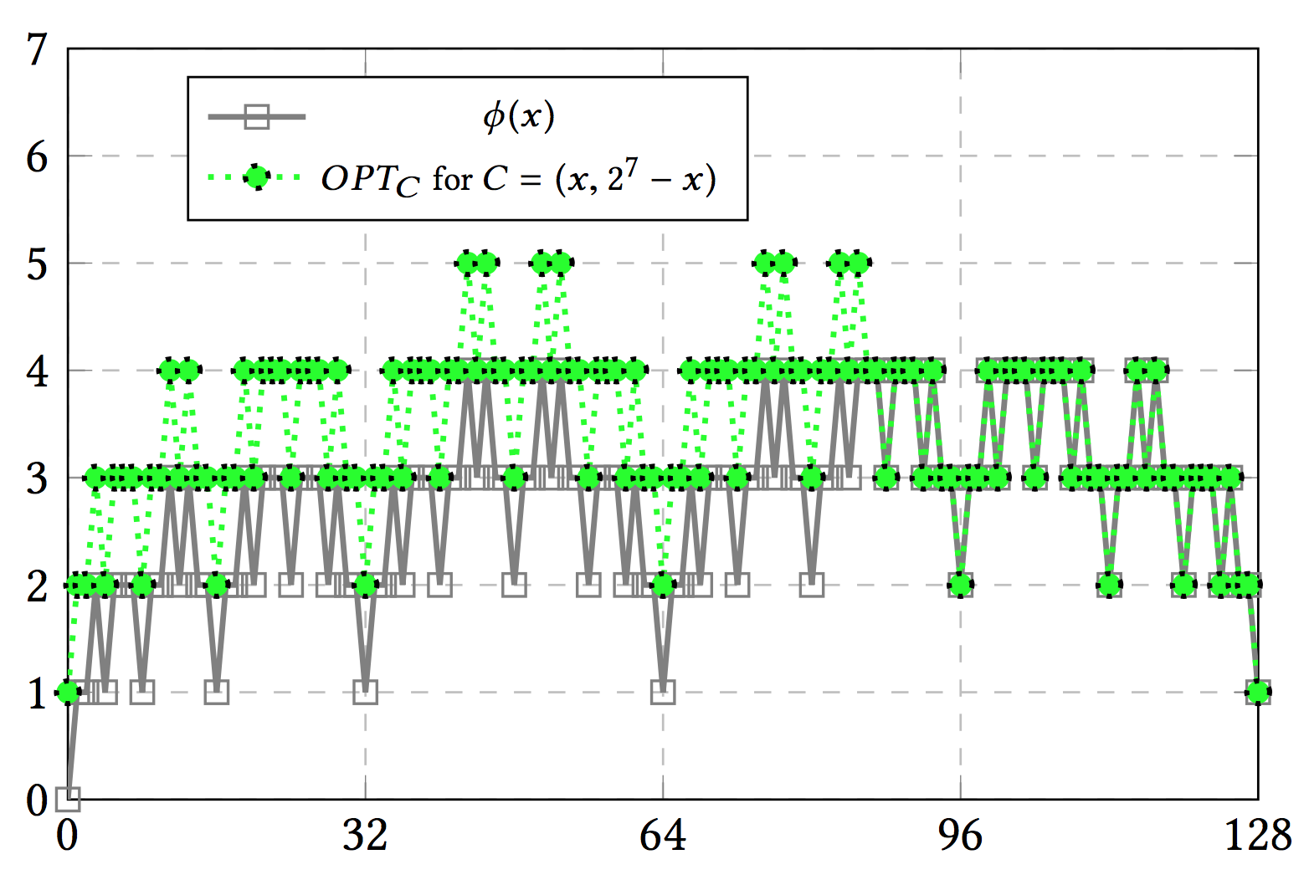
Distribution Representation Cost
  Example: φ(29) = 3, φ(99) = 4 and OPT_{C} = min(3,4)+1 = 4 for C=(29,99)

Slide 12
Describing the Exact Distribution
What function is it easy to implement?
Theorem: A distribution C=(c₁,c₂) defined for two servers can be implemented by defining a simple range function:
  F(x) = server 1 for x in [0,c₁-1] and F(x) = server 2 for x in [c₁,2^{W}-1]
Reminder: For a given function, the most concise representation can be found by dynamic programming

Slide 13
Finding an Approximated Distribution
How to find the most similar distribution that can be implemented within a limited number of rules n?
Dissimilarity metrics between distributions C=(c₁,c₂) and D=(d₁,d₂):
  Maximal redundant traffic in a server G = max(d₁-c₁, d₂-c₂)
  Average error (absolute value) among servers H = 0.5 (|d₁-c₁| + |d₂-c₂|)
Observation: For two servers the two metrics are equivalent
Idea: Find the most similar distribution D with min(φ(d₁), φ(d₂)) + 1=OPT_{D} ≤n

Slide 14
Finding an Approximated Distribution (2)
Idea: Find the most similar distribution D with min(φ(d₁), φ(d₂)) + 1=OPT_{D} ≤n
Lemma: For an integer y = x•2ª, let U_{a} = 2^{a-2}+2^{a-4}+ 2^{a-6} + … . Then,
  min{φ(y – U_{a}), …, φ(y), …, φ(y + U_{a})} = φ(y) = φ(x)
Algorithm: We distinguish between four cases
  d₁ ≥c₁ and φ(d₁)=min(φ(d₁), φ(d₂))
  d₁ ≤c₁ and φ(d₁)=min(φ(d₁), φ(d₂))
  d₁ ≥c₁ and φ(d₂)=min(φ(d₁), φ(d₂))
  d₁ ≤c₁ and φ(d₂)=min(φ(d₁), φ(d₂))
  For each case we examine W+1 ranges for d_{i} and consider ranges with an allowed minimal cost min{φ(y – U_{a}), …, φ(y), …, φ(y + U_{a})} = φ(y) ≤ n

Slide 15
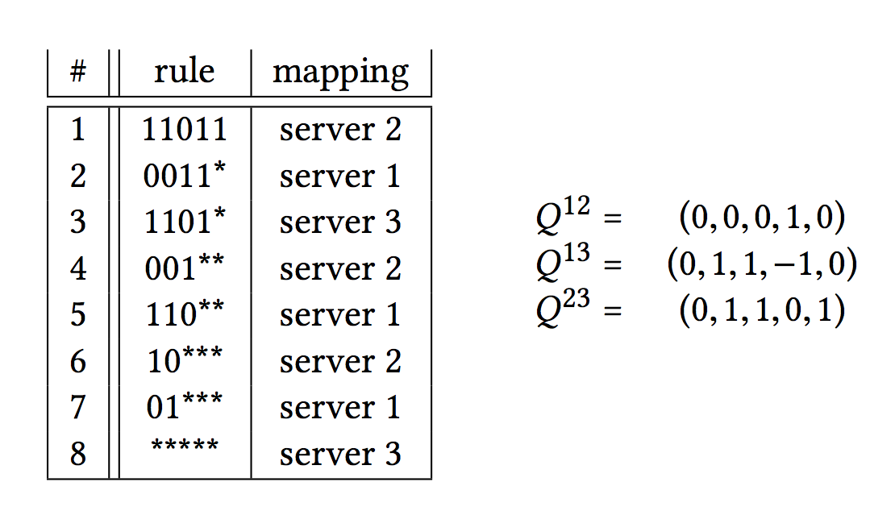
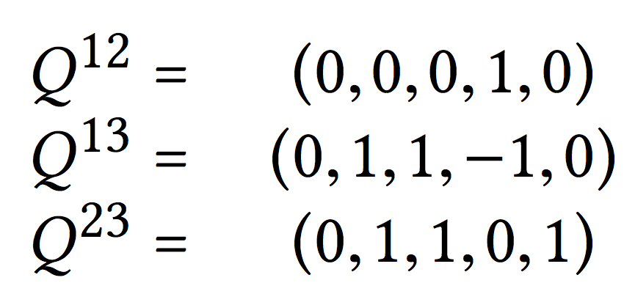
Distributions for Multiple Servers
For a set of rules, we describe the interaction between any pair of servers through a binary vector of powers of two
The vector set: A vector Q^{ij} describes the amount of traffic server i eliminates from server j with overlapping higher-priority rules
Example: Vector set for rules implementing distribution D = (12, 11, 9)
Distribution D = (d₁, d₂, d₃) can be calculated from the vector set:
  d₁ = 2³ + 2² + 2¹ – 2¹= 12 d₂ = 2³ + 2² - 2¹ + 2⁰ = 11 d₃ = 2⁵ -2³ -2³ – 2² – 2² + 2¹ -2⁰ = 9
default server

Slide 16
Partial Sums of a Vector Set
For a given vector set, we can refer to the distribution implied by some number of most significant bits of the vector set each server
Example: D = (12,11,9)
With a single bit: (0,0,2⁵) = (0,0,32)
With two bits: (2³, 2³, 2⁵-2³-2³) = (8,8,16)
With three bits: (2³+2², 2³+2²,2⁵-2³-2³-2²-2²) = (12,12,8)
With four bits: (2³+2² +2¹–2¹, 2³+2²-2¹, 2⁵-2³-2³-2²-2²+2¹) = (12,10,10)
With five bits: (2³+2² +2¹–2¹, 2³+2²-2¹ + 2⁰, 2⁵-2³-2³-2²-2²+2¹ - 2⁰) = (12,11,9) = D
Property: For a given vector set, implied by a set of rules, partial sums have non-negative values for each of the servers

Slide 17
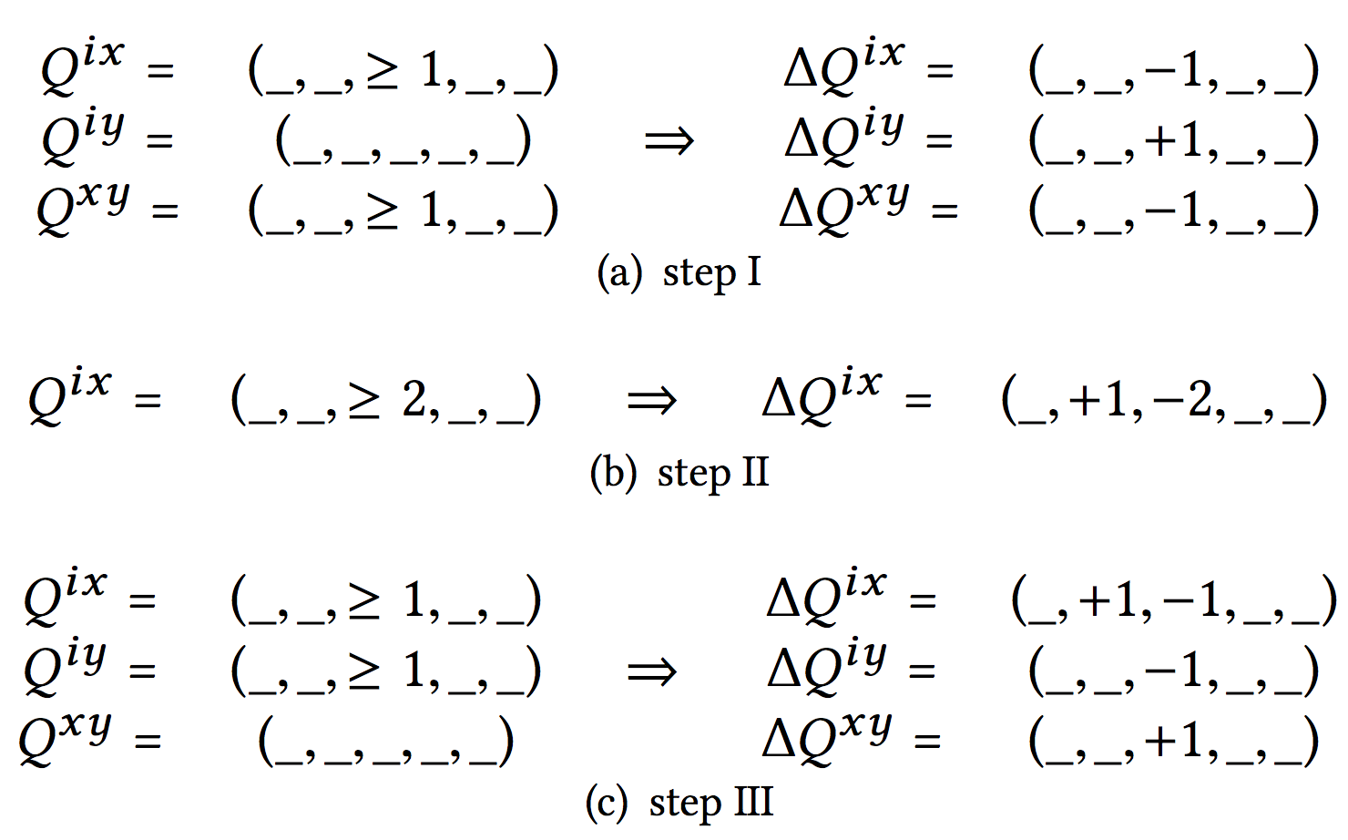
Vector Set Processing
Theorem: A vector set can be processed while keeping its distribution such that
  Partial sums remain non-negative
  Vector values are -1, 0 and 1
  In each bit level t, a server has at most one non zero value: q^{ix}_{t} ≠ 0 then q^{ij}_{t} = 0 for j≠x
When can a vector set be realized to a set of rules?
Theorem: A vector set with the three properties can be realized to a set of rules
Number of (non-default) rules is determined by the number of non-zero values

Slide 18
Solution for Multiple Servers
Idea: For a given distribution C, find a realizable vector set by considering options for the high significant bits in the vector set
Notation: Let c_{i} be a distribution value and let c_{i}(t) ≤ c_{i} be the value when taking powers of two of at least 2^{t} in the binary representation of c_{i}
  Example: If c_{i} = 25 = 16 + 8 + 1 = 2⁴ + 2³ + 2⁰ then c_{i}(4)=2⁴=16
  and c_{i}(3)=2⁴+2³=16+8 = 24 and c_{i}(0)=2⁴ + 2³ + 2⁰ = 16 + 8 + 1 = 25 = c_{i}
Property: Let c_{i} be a value of a distribution C. Let d_{i}(t) be the partial value implied by a realizable vector set implementing C. Then, d_{i}(t) = c_{i}(t) or d_{i}(t) = c_{i}(t) + 2^{t} .
Server state for power t:
  Zero state: d_{i}(t) = c_{i}(t) and d_{i}(t) = c_{i}
  Negative state: d_{i}(t) = c_{i}(t) and d_{i}(t) < c_{i}
  Positive state: d_{i}(t) = c_{i}(t) + 2^{t}, this implies c_{i} <d_{i}(t)

Slide 19
Algorithm Intuition
Super state – representing states for all servers
Initial super state (vector set of only 0s):
  Default server in a positive state.
  Other servers in negative state
Iterations over decreasing powers of two 2^{t}:
  Calculate the set of reachable super states with minimal costs
  The new state of a server i is determined by:
    Its previous state
    The corresponding bit in the binary representation of c_{i}
    Existence of a rule involving server i (taking or adding 2^{t} to server i)
  Example: c_{i} = 99 = 2⁶ + 2⁵ + 2¹ + 2⁰
  99 = 2⁷ – 2⁶ + 2⁵ + 2² – 2⁰
      99 = 2⁷ - 2⁵ + 2² – 2⁰
      99 < 2⁷ + 2⁶ ….
    99 = 2⁶ + 2⁵ + 2² – 2⁰
    99 > 2⁶ + 0 + …
  Balanced transitions between two super states
Solution: Superstate with zero states for the power 2⁰ of a minimal cost

Slide 20
Conclusion
Representation of distributions in switch memories
  Integer representations
Two servers
  Exact cost of a distribution
  Optimal algorithms for the two problems
Multiple servers
  Vector set representation
  Processing and realization of a vector set
  Algorithm for a minimal size exact representation
Questions? Thank You

