Slide 1


It Takes Two to Tango: Cooperative Edge-to-Edge Routing
Henry Birge-Lee
Maria Apostolaki, and Jennifer Rexford

Slide 2
Is today's Internet is good enough for real-time applications?

Slide 3
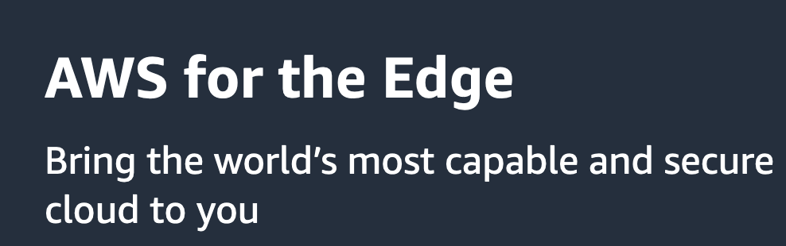
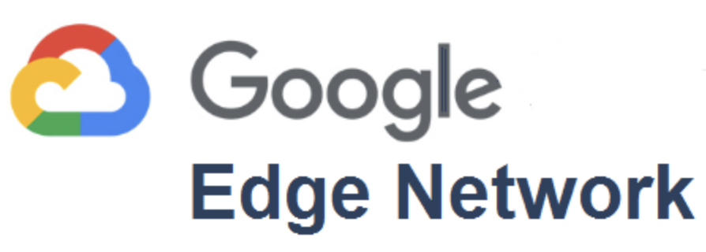


Network performance is offered as a paid service
Edge computing: performance-critical services placed close to edge networks
Network-as-a-Service (NaaS): on-demand products offering reliable, reserved bandwidth point-to-point links.

Slide 4
Network performance is offered as a paid service
increasing consolidation

Slide 5
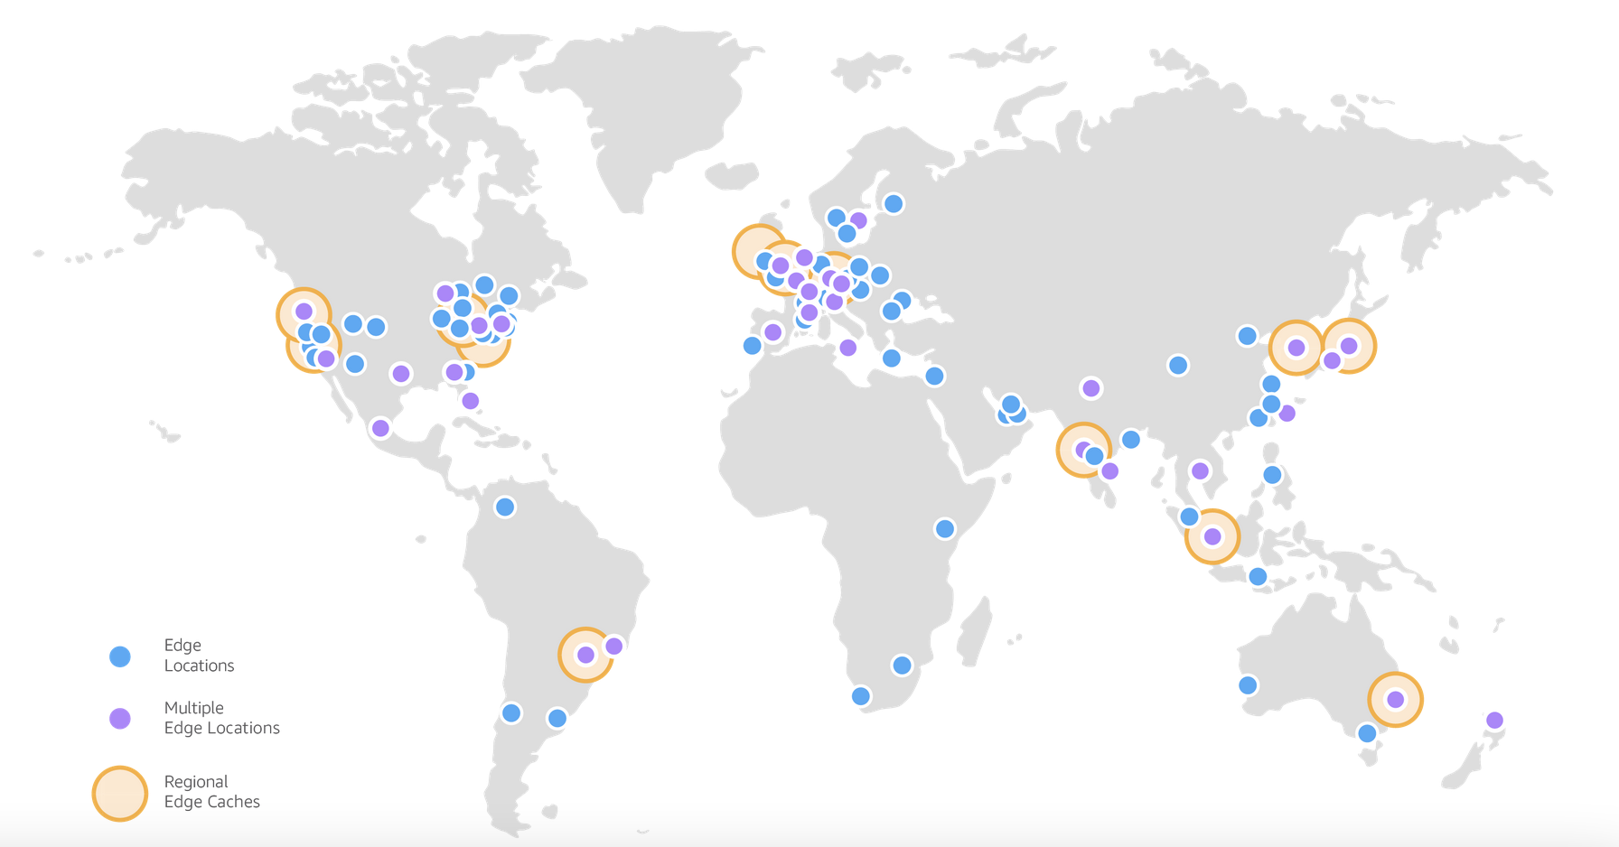
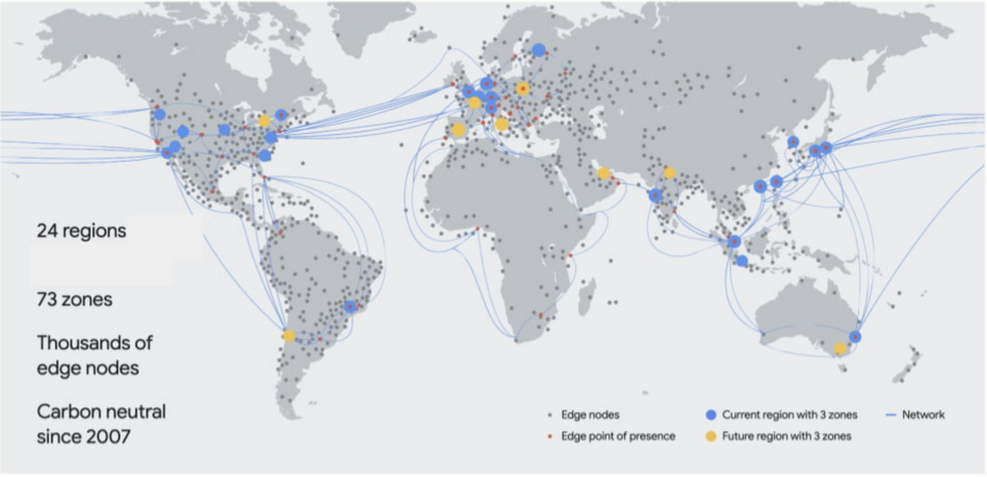
Network performance is offered as a paid service
increasing consolidation
AWS:
Google:
Only hypergiants can afford vast numbers of edge nodes

Slide 6
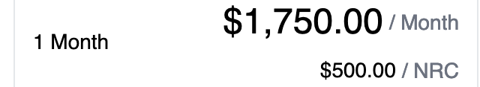
Network performance is offered as a paid service
increasing consolidation
AWS:
Google:
Only hypergiants can afford vast numbers of edge nodes
Packet Fabric:
Network-as-a-Service can get pricey

Slide 7
What would it take for the Internet to serve real-time apps?

Slide 8
What would it take for the Internet to serve real-time apps?
path diversity

Slide 9
Traditional Internet Routing (BGP) does not expose all paths
  Edge 1 only has a single upstream thus a single path exported by AS 5
AS 1
AS 2
Edge 1
AS 5
Edge 2
AS 3
AS 4

Slide 10
Traditional Internet Routing (BGP) does not expose all paths
  Edge 2 is multi-homed but only influences a single hop, not the whole route
AS 1
AS 2
Edge 1
AS 5
Edge 2
AS 3
AS 4

Slide 11
What would it take for the Internet to serve real-time apps?
path diversity
accurate measurement

Slide 12




Edge networks can’t reliably measure performance of different paths
Edge

Slide 13
Edge networks can’t reliably measure performance of different paths
Edge

Slide 14
Edge networks can’t reliably measure performance of different paths
Edge
  An edge network only sees round-trip-time (RTT) not one-way-delay

Slide 15
Edge networks can’t reliably measure performance of different paths
Edge
  An edge network only sees round-trip-time (RTT) not one-way-delay
  RTT includes edge network delays

Slide 16

Edge networks can’t reliably measure performance of different paths
Edge
  An edge network only sees round-trip-time (RTT) not one-way-delay
  RTT includes edge network delays
  RTT monitoring requires understanding end host and L4 protocol behavior

Slide 17
What would it take for the Internet to serve real-time apps?

Slide 18
What would it take for the Internet to serve real-time apps?
Tango

Slide 19
What would it take for the Internet to serve real-time apps?
AS 1
AS 2
Tango
AS 5
Tango
AS 3
AS 4
Tango
Cooperative edge-to-edge routing with Tango

Slide 20
Cooperative edge-to-edge routing with Tango
Path diversity:
Edges collaboratively use BGP tricks to coax additional paths out of the Internet core

Slide 21
Exposing path diversity through cooperation
AS 1
AS 2
abcd:1::/48
abcd:2::/48
abcd:3::/48
abcd:4::/48
Edge 1
AS 5
Edge 2
AS 3
AS 4
Destination Tango nodes can announce multiple IP prefixes along different paths using BGP communities
Source Tango node can select which path to use by selecting a prefix to reach the destination

Slide 22
Cooperative edge-to-edge routing with Tango
Path diversity:
Edges collaboratively use BGP tricks to coax additional paths out of the Internet core
Accurate Measurements:
protocol-agnostic monitoring by encapsulating packets with Tango headers
one-way measurements by monitoring at two ends
edge-to-edge measurements by measuring before the access-network uncertainty

Slide 23
Improved measurements through cooperation
Programmable Switches at the edge of the Internet can add a measurement header
Measurements only include one-way, wide-area component
Measurements do not rely on application behavior
Tango
Tango

Slide 24
Cooperative edge-to-edge routing with Tango
Path diversity:
Edges collaboratively use BGP tricks to coax additional paths out of the Internet core
Accurate Measurements:
protocol-agnostic monitoring by encapsulating packets with Tango headers
one-way measurements by monitoring at two ends
edge-to-edge measurements by measuring before the access-network uncertainty
Incremental deployment:
Two edge switches work together without cooperation from the core

Slide 25
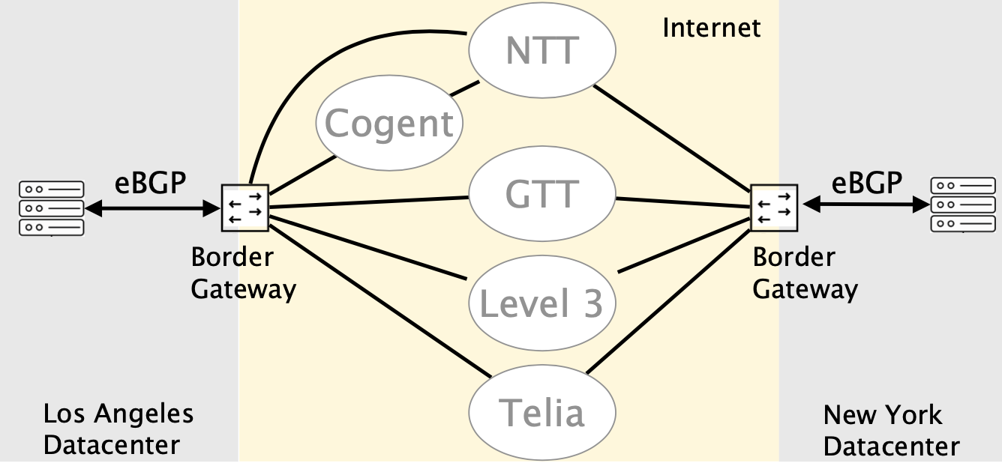
Our Tango prototype is real
Made BGP announcements with communities to explore available paths
Found 4 paths in each direction between LA and NY datacenters
Used eBPF to attach measurement headers and measure one-way-delays

Slide 26
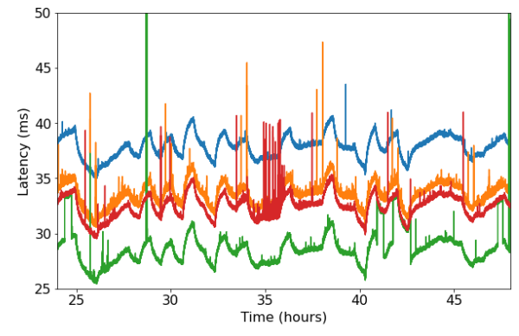
BGP default path had 30% higher latency than optimal path
Default BGP path
Path found wit Tango

Slide 27
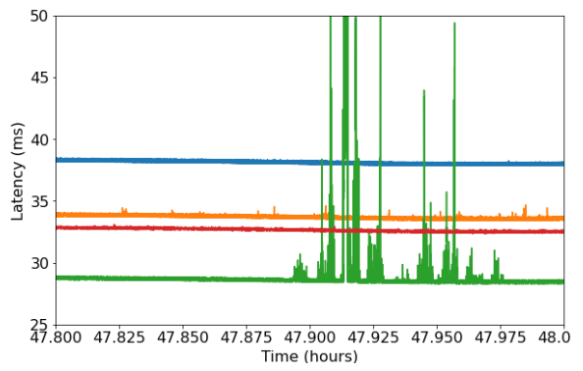
Periods of network instability can be avoided
Alternate Stable Path
Period of Instability

Slide 28
Conclusion
Two ends cooperatively can get more out of the Internet
  Path diversity through hacking BGP communities
  Accurate measurements through edge-to-edge monitoring
Preliminary results show the advantage of dynamically optimizing routing
Tango

Slide 29
Questions?
Thank you for your time
Henry Birge-Lee
birgelee@princeton.edu

