Slide 1


CacheFlow: Dependency-Aware Rule-Caching for Software-Defined Networks
Naga Katta
Omid Alipourfard*, Jennifer Rexford, David Walker
Princeton University, *USC

Slide 2

Inadequate Switching Gear
Notes:
Let’s begin with some news – We have seen recently how when network devices run out of data-plane memory, really bad things can happen. In this particular case, the entire internet was effected adversely because of too many routes being pushed to routers. SDN is no exception.

Slide 3
SDN Promises Flexible Policies
Controller
Switch
TCAM
Notes:
While SDN promises implementation of flexible network policies, this involves the controller sending a lot of fine-grained rules to the switches in the network. However, limited rule space in the ASIC means that the programs break when they are faced with small rule table space or we need to fall back to coarse-grained policies. In this scenario, we ask if there is a way to get around the problem of limited switch rule-table space.

Slide 4
SDN Promises Flexible Policies
Lot of fine-grained rules
Controller
Switch
TCAM

Slide 5
SDN Promises Flexible Policies
Lot of fine-grained rules
Controller

Slide 6
SDN Promises Flexible Policies
Lot of fine-grained rules
Controller

Slide 7
SDN Promises Flexible Policies
Lot of fine-grained rules
Controller

Slide 8
SDN Promises Flexible Policies
Controller
Limited rule space!

Slide 9
SDN Promises Flexible Policies
What now?
Controller
Limited rule space!

Slide 10
State of the Art
 | Hardware Switch | Software Switch
Rule Capacity | Low (~2K-10K) | High
Lookup Throughput | High (>400Gbps) | Low (~40Gbps)
Port Density | High | Low
Cost | Expensive | Relatively cheap
Notes:
We can categorize switches available today into two broad categories – hardware switches that have TCAM based ASIC and software switches that run on generic x86 architectures. While hardware switches have high throughput and high port density, software switches have practically infinite rule space and are relatively cheaper.

Slide 11
TCAM as cache
Controller
CacheFlow
Software Switches
S₁
S₂
TCAM
Notes:
In this scenario our aim is to bring the best of both worlds into a solution where the TCAM acts as a cache and a bunch of software switches are used to process the cache-misses. By storing a small number of heavy-hitting rules in the TCAM, we have high-throughput and by making sure we store all the rules in the software switches, we provide high-rule space to implement large rule-tables. This leads to the desirable mixture of high-throughput and large-rule space.

Slide 12
TCAM as cache
Controller
CacheFlow
<5% rules cached
S₁
S₂
TCAM
Notes:
In this scenario our aim is to bring the best of both worlds into a solution where the TCAM acts as a cache and a bunch of software switches are used to process the cache-misses. By storing a small number of heavy-hitting rules in the TCAM, we have high-throughput and by making sure we store all the rules in the software switches, we provide high-rule space to implement large rule-tables. This leads to the desirable mixture of high-throughput and large-rule space.

Slide 13
TCAM as cache
Controller
CacheFlow
low expected cache-misses
S₁
S₂
TCAM

Slide 14
TCAM as cache
  High throughput + high rule space
Controller
CacheFlow
S₁
S₂
TCAM

Slide 15
TCAM as cache
  High throughput + high rule space
Controller
Flexible Deployment
CacheFlow
S₁
S₂
TCAM
Notes:
The interesting thing is that our system design allows flexible deployment options in that the software switches can either be on (i) local processor in the data plane (as many switches have), (ii) local agent in the hardware switch, (iii) separate software switches attached to or near the HW switch, or (iv) the controller

Slide 16
A Correct, Efficient and Transparent Caching System
Abstraction of an “infinite” switch
  Correct: realizes the policy
  Efficient: high throughput & large tables
  Transparent: unmodified applications/switches
Notes:
While the idea of rule caching itself is not new, in the context of SDN where you have rules which are markedly different from typical IP prefix rules, we wanted to ensure that our abstraction can still provide potentially infinite rule space and processes packets correctly while maintaining high throughput. Our solution works with unmodified control applications and switches. Thus we aim for a correct, efficient and transparent caching system.

Slide 17
1. Correct Caching
Notes:
Ok, let’s see why correctness is tricky compared to say traditional IP rule caching.

Slide 18
Caching under constraints
Rule | Match | Action | Priority | Traffic
R1 | 110 | Fwd 1 | 3 | 10
R2 | 100 | Fwd 2 | 2 | 60
R3 | 101 | Fwd 3 | 1 | 30
Easy: Cache rules greedily
Notes:
Caching rules that match the packet header bits exactly like the ones shown here is easy. We greedily cache the rules that hit the most traffic – in this case R2 will be cached if there is space for one rule in the TCAM.

Slide 19
Caching Ternary Rules
Rule | Match | Action | Priority | Traffic
R1 | 11* | Fwd 1 | 3 | 10
R2 | 1*0 | Fwd 2 | 2 | 60
R3 | 10* | Fwd 3 | 1 | 30
Greedy strategy breaks rule-table semantics
Notes:
However, if the rules have ternary rules which have don’t care bits, then greedily caching rule R2 in this rule table is going to break the rule table semantics – by that we mean that the packets will be processed incorrectly in the TCAM. This is because the matches of R1 and R2 overlap and hence packets that are supposed to hit R1 will hit R2 in the TCAM. Therefore, we need to take care of such dependencies across rules. A dependency usually dictates which rules should be cached together.

Slide 20
Caching Ternary Rules
Rule | Match | Action | Priority | Traffic
R1 | 11* | Fwd 1 | 3 | 10
R2 | 1*0 | Fwd 2 | 2 | 60
R3 | 10* | Fwd 3 | 1 | 30
Rules Overlap!
Greedy strategy breaks rule-table semantics

Slide 21
Caching Ternary Rules
Rule | Match | Action | Priority | Traffic
R1 | 11* | Fwd 1 | 3 | 10
R2 | 1*0 | Fwd 2 | 2 | 60
R3 | 10* | Fwd 3 | 1 | 30
Rules Overlap!
Greedy strategy breaks rule-table semantics
Beware of switches that claim large rule tables

Slide 22
Dependency Graph
Rule | Match | Action | Priority | Traffic
R1 | 0000 | Fwd 1 | 6 | 10
R2 | 000* | Fwd 2 | 5 | 20
R3 | 00** | Fwd 3 | 4 | 90
R4 | 111* | Fwd 4 | 3 | 5
R5 | 11** | Fwd 5 | 2 | 10
R6 | 1*** | Fwd 6 | 1 | 120
R1
R4
R2
R5
R3
R6
(*)
Notes:
In the paper, we describe an algorithm to compute a compact data structure that depicts the dependencies across all the rules in a given rue table. I do not have time to get into detail but we look at the symbolic set of packets that match a rule and track all the rules that these symbolic packets may hit if that rule is removed from the rule table. The DAG that you see to your right is what you get after such an analysis. An arrow between two rules means that there is a direct dependency between the two rules – in that they should be cached together.

Slide 23
How to get the dependency graph?
For a given rule R
  Find all the rules that its packets may hit if R is removed
R
R1
R2
R3
R4
R ∧ R1 != φ
Notes:
Let’s see how to get this dependency graph. Supposing you have a rule table that looks like this in the order of priority and you want to find all the rules that the rule R depends on. We then do the following. We first see if R intersects with R1. suppose it does, then we find what is left out of the packet space defined by R. let’s call it R’. Then we proceed to the next rule to see if R’ intersects with R2. If it doesn’t, we just keep moving on. Let’s say R’ does intersect R3. Then we find the rest of R’ that will flow down the table. If it is empty, then we are done!. This process is done for each rule in the rule table to get all the dependencies like the one shown on the right.

Slide 24
How to get the dependency graph?
For a given rule R
  Find all the rules that its packets may hit if R is removed
R
R1
R2
R3
R4
R ∧ R1 != φ

Slide 25
How to get the dependency graph?
For a given rule R
  Find all the rules that its packets may hit if R is removed
R
R1
R2
R3
R4
R’ = R – R1

Slide 26
How to get the dependency graph?
For a given rule R
  Find all the rules that its packets may hit if R is removed
R
R1
R2
R3
R4
R’ ∧ R2 == φ

Slide 27
How to get the dependency graph?
For a given rule R
  Find all the rules that its packets may hit if R is removed
R
R1
R2
R3
R4
R’ ∧ R3 != φ

Slide 28
How to get the dependency graph?
For a given rule R
  Find all the rules that its packets may hit if R is removed
R
R1
R2
R3
R4
R’ ∧ R3 != φ

Slide 29
How to get the dependency graph?
For a given rule R
  Find all the rules that its packets may hit if R is removed
R
R1
R2
R3
R4
R’’ = R’ – R3

Slide 30
How to get the dependency graph?
For a given rule R
  Find all the rules that its packets may hit if R is removed
R
R1
R2
R3
R4
R’’ == φ
(End of dependencies originating from R)

Slide 31
Dependency Graph
Rule | Match | Action | Priority | Traffic
R1 | 0000 | Fwd 1 | 6 | 10
R2 | 000* | Fwd 2 | 5 | 20
R3 | 00** | Fwd 3 | 4 | 90
R4 | 111* | Fwd 4 | 3 | 5
R5 | 11** | Fwd 5 | 2 | 10
R6 | 1*** | Fwd 6 | 1 | 120
R1
R4
R2
R5
R3
R6
(*)
Notes:
In the paper, we describe an algorithm to compute a compact data structure that depicts the dependencies across all the rules in a given rue table. I do not have time to get into detail but we look at the symbolic set of packets that match a rule and track all the rules that these symbolic packets may hit if that rule is removed from the rule table. The DAG that you see to your right is what you get after such an analysis. An arrow between two rules means that there is a direct dependency between the two rules – in that they should be cached together.

Slide 32
Multi-field ternary match -> complex DAG
Rule | (dst_ip, dst_port) | Ternary Match | Action | Priority
R1 | (10.10.10.10/32, 10) | 000 | Fwd 1 | 6
R2 | (10.10.10.10/32, *) | 00* | Fwd 2 | 5
R3 | (10.10.0.0/16, *) | 0** | Fwd 3 | 4
R4 | (11.11.11.11/32, *) | 11* | Fwd 4 | 3
R5 | (11.11.0.0/16, 10) | 1*0 | Fwd 5 | 2
R6 | (11.11.10.10/32, *) | 10* | Fwd 6 | 1
R1
R4
000
110
R2
111
R5
00*
100
R3
110
R6
0**
10*
(*)
Notes:
In the paper, we describe an algorithm to compute a compact data structure that depicts the dependencies across all the rules in a given rue table. I do not have time to get into detail but we look at the symbolic set of packets that match a rule and track all the rules that these symbolic packets may hit if that rule is removed from the rule table. The DAG that you see to your right is what you get after such an analysis. An arrow between two rules means that there is a direct dependency between the two rules – in that they should be cached together.

Slide 33
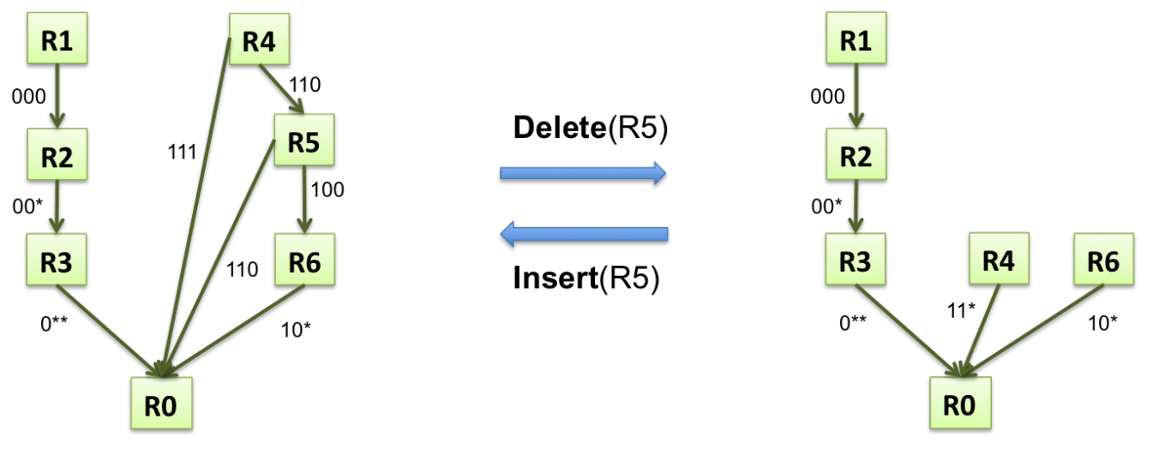
Incremental Updates
Notes:
In addition, we also discuss ways to incrementally add and delete rules from a given dependency graph without the need to calculate the DAG from scratch. This means crawling the DAG efficiently in order to make the necessary changes instead of having to touch all the nodes in the graph. The key idea is to crawl the edges whose packet metadata overlaps with the rule that is being added or deleted.

Slide 34
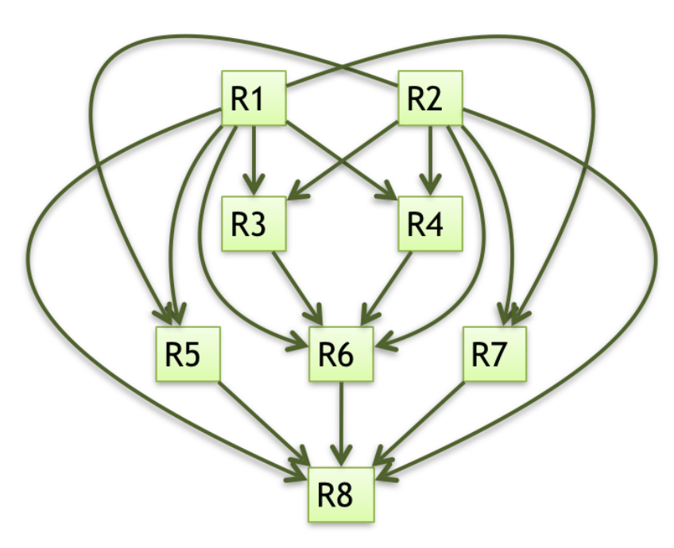
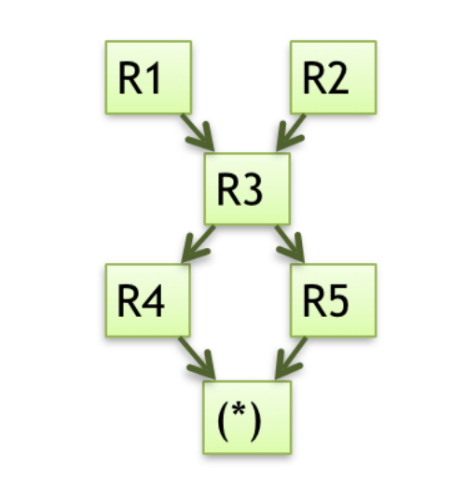
Complex dependencies in the wild
Reanzz Network
CoVisor (NSDI’15)
Notes:
Where do you see these complex dependency graphs in the wild? The first graph here shows the dependencies in part of the OF policy that was deployed in the software defined exchange point of the Reanzz educational network in New Zealand. These were typically rules that had fine grained matches on packet headers as part of their ACL policy. The second is the result of policy composition in the CoVisor paper from last year NSDI where two policies – one monitoring and one routing, where both had simple dependencies when composed gave rise to complex dependencies like these.

Slide 35
Dependency-aware Caching
Notes:
Now, given such a dependency graph, when you want to cache a rule, you need to cache all the descendants as well to maintain correctness. In this case, if you want to cache R6, we also need to cache $R4$ and $R5$ along with it to process packets correctly in the TCAM. We call this the dependent-set caching algorithm.

Slide 36
Dependent-Set Caching
  All descendants in DAG are dependents
  Cache dependent rules for correctness
R1
R4
R2
R5
R3
R6
(*)
Notes:
Now, given such a dependency graph, when you want to cache a rule, you need to cache all the descendants as well to maintain correctness. In this case, if you want to cache R6, we also need to cache $R4$ and $R5$ along with it to process packets correctly in the TCAM. We call this the dependent-set caching algorithm.

Slide 37
2. Efficient Caching
Notes:
Now let’s see if we can make this caching algorithm more efficient in terms of rule space.

Slide 38
Dependent-Set Overhead
Too Costly?
R1
R4
R2
R5
R3
R6
(*)
Notes:
While dependent-set caching is correct, we have to incur the extra rule space cost for all the dependents of a heavy-hitting rule. For example, as we discussed, in order to cache the heavy-hitting rule R6, we need to incur rule space cost of 3 for rules R4, R5 and R6. This could prove to be very costly if we have long dependency chains where the large number of dependents hit near zero traffic.

Slide 39
Cover-Set
Rule | Match | Action
R1 | 000 | Fwd 1
R2 | 00* | Fwd 2
R3 | 0** | Fwd 3
R4 | 11* | Fwd 4
R5 | 1*0 | Fwd 5
R5^ | 1*0 | To_SW
R6 | 10* | Fwd 6
(*) | *** | To_SW
R4
R1
R5
R2
R5^
R3
R6
(*)
Cover rule
Notes:
Fortunately, given the way we construct the dependency graph, we can splice the long dependency chains easily into smaller chains by creating dummy rules that sort of cover all the unimportant dependents. For example, to cache rule $R6$ we create a dummy rule R5* that is a clone of R5 and sends all the packets hitting dependent rules to the software-switch. This reduces the cost we pay for caching a rule. We call this algorithm the cover-set algorithm.

Slide 40
Dependency Splicing reduces rule cost!
Dependent-Set
Cover-Set
Rule Space Cost
Notes:
In general, a cover-set is formed by the immediate dependents of a heavy-hitter rule while the dependent set is formed by all the dependent rules. This is why the cover-set algorithm which splices long dependency chains utilizes the TCAM space more efficiently compared to the dependent set.

Slide 41
Mixed Set: Best of both worlds
CacheFlow
R4
R1
R5
R2
R5^
R3
R6
(*)
Notes:
However, there is still the overhead of these dummy rules that we made up and they are not even processing traffic in the hardware as the case was in dependent set. They are simply punting traffic to the software switches. Therefore, sometimes you may want to combine both – this is what we call the mixed set algorithm. In this algorithm, where it makes sense to just cache the dependent set of one rule makes more sense than caching the cover set of another – because the dependent set hits more traffic together than the cover set, we will pick the dependent set. In this case, for example, If the combination of R1 and R2 hits more traffic than R6 alone, we cache the dependent set of rule R2.

Slide 42
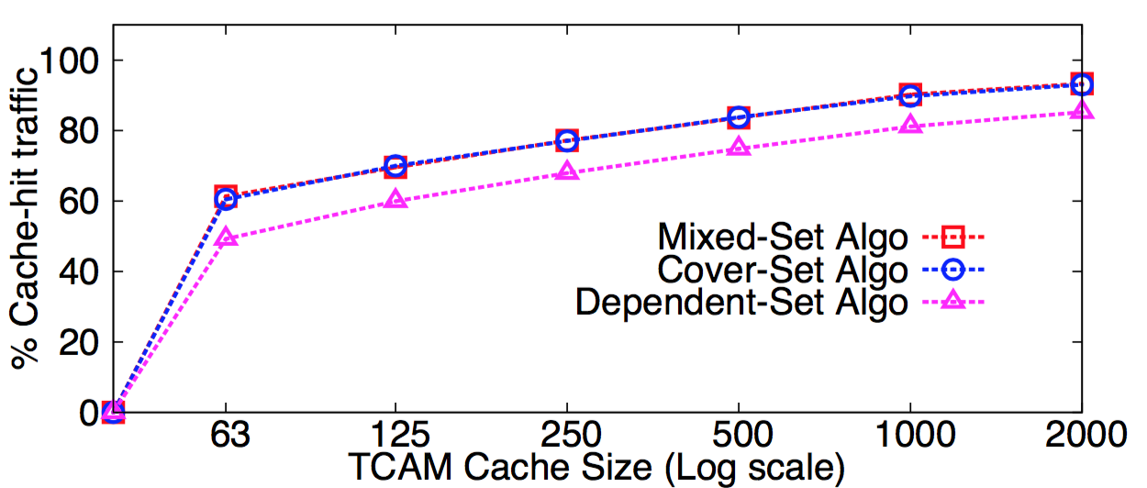
Dependency Chains – Clear Gain
CAIDA packet trace
3% rules
85% traffic
Notes:
To demonstrate the effectiveness of our caching algorithms, we ran our prototype on a CAIDA packet trace taken from the equinox datacenter in Chicago. The packet trace had a total of 610 million packets sent over 30 minutes. Since CAIDA does not publish the corresponding policy, we created a routing policy that matches this traffic and then composed it with a small ACL policy of depth 5. This resulted in 70K OF rules. The mixed-set and cover-set algorithms have sim- ilar cache-hit rates and do much better than the dependent- set algorithm consistently because they splice every single dependency chain in the policy. But more importantly, all three algorithms achieve at least an 85% cache-hit rate at 2000 rules (3% of the rule table) which is the capacity of the Pica8 switch used here.

Slide 43
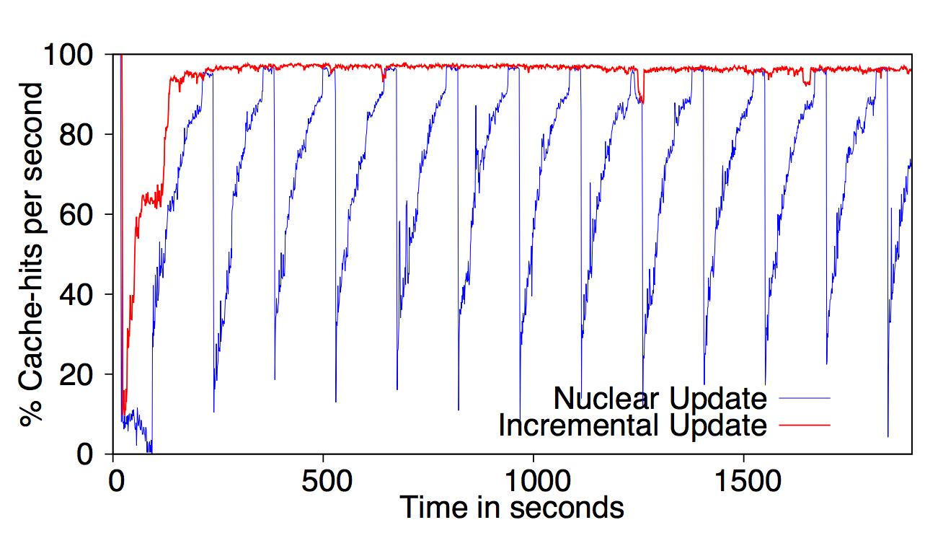
Incremental update is more stable
Notes:
We also ran other experiments, for example to see the effectiveness of the incremental algorithms. Here is an experiment where the CAIDA packet trace is replayed and two algorithms were studied. One is the nuclear option, where whenever there is a change in the traffic counters, the rules in the TCAM were deleted and the updated cache is installed. The other uses our incremental way of updating the dependent and cover sets in the TCAM. As you can see, the incremental algorithm achieves 95% cache-hit rate in less than 3 minutes while the nuclear option hits near zero traffic whenever its cache has to be updated.

Slide 44
3. Transparent Caching

Slide 45
3. Transparent Design
Controller
OpenFlow
Datapath
CacheFlow
S₁
S₂
S₃
S₄
HW_Cache (TCAM)
Notes:
CacheFlow is designed so that it can work with unmodified controller applications. The CacheFlow layer provides the abstraction of one big virtual switch to the controller. The controller sends the rules to the virtual switch which are then intercepted by CacheFlow and distributed among the underlying physical switches appropriately. In order to preserve the semantics of the entire OpenFlow specification, CacheFlow also simulates packet counters, barriers and rule timeouts for the virtual switch abstraction.

Slide 46
3. Transparent Design
Controller
OpenFlow
Datapath
CacheFlow
Virtual switch
S₁
S₂
S₃
S₄
HW_Cache (TCAM)

Slide 47
3. Transparent Design
Emulates counters, barriers, timeouts etc.
Controller
OpenFlow
Datapath
CacheFlow
Virtual switch
S₁
S₂
S₃
S₄
HW_Cache (TCAM)

Slide 48
Conclusion
Rule caching for OpenFlow rules
  Dependency analysis for correctness
  Splicing dependency chains for efficiency
  Transparent design
Notes:
To conclude, we describe a rule-caching solution for Software-Defined Networking that implements large rule tables correctly and efficiently. Our system also preserves the semantics of Openflow so that it can work with unmodified control applications.

Slide 49
Conclusion
Rule caching for OpenFlow rules
  Dependency analysis for correctness
  Splicing dependency chains for efficiency
  Transparent design
Get ready for infinite Ca$hflow!
Notes:
To conclude, we describe a rule-caching solution for Software-Defined Networking that implements large rule tables correctly and efficiently. Our system also preserves the semantics of Openflow so that it can work with unmodified control applications.

Slide 50
Thank You

Slide 51
Backup Slides

Slide 52
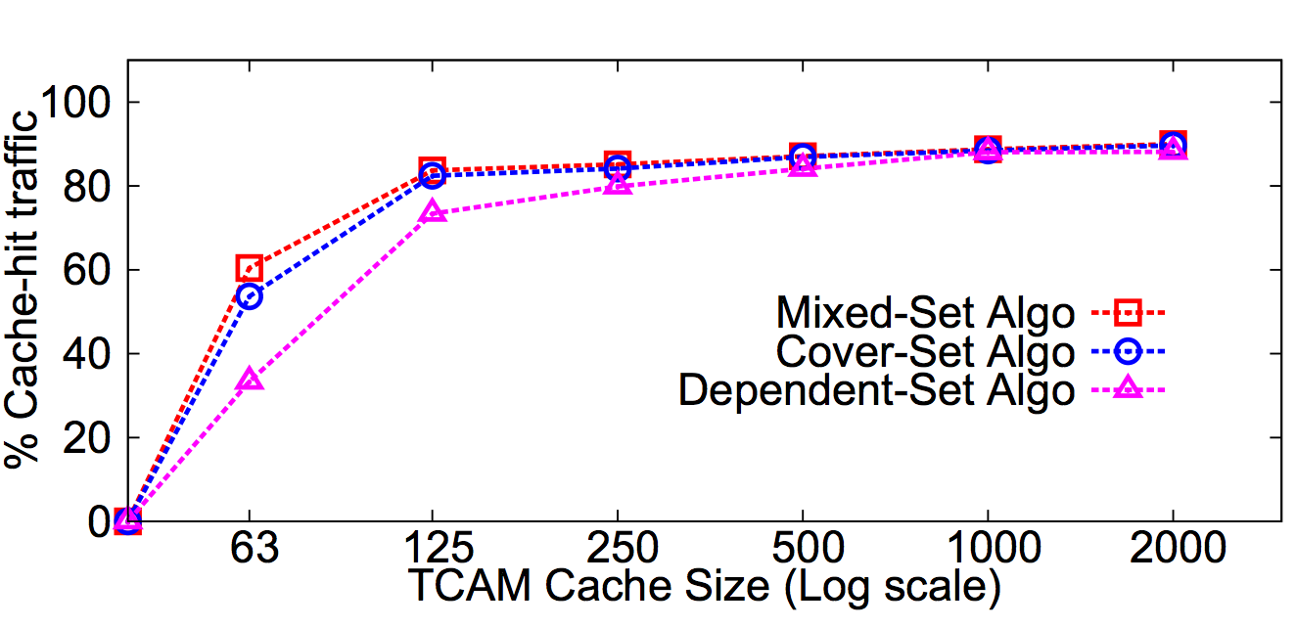
Dependency Chains – Clear Gain
Stanford Backbone Router Config

