Slide 1

Memory-Efficient Performance Monitoring on Programmable Switches with Lean Algorithms
Alan (Zaoxing) Liu
Samson Zhou, Ori Rottenstreich, Vladimir Braverman, Jennifer Rexford

Slide 2



Network performance issues are pervasive
Users experience:
Lags in gaming
Interruptions in video streaming
Internet Service Provider
Observations: Network performance issues can happen anytime, anywhere in the network

Slide 3

Where to monitor network performance?
End-hosts
End-users
Network
End-hosts: Need to modify the OS’ network stack.
In the network: No end-host access

Slide 4
What performance statistics we care about?
Packet latency (TCP)
Packets received
Packets sent
1
2
3
4
5
6
7
8
9
1
2
3
4
5
6
7
8
9
Acknowledgements sent
1
2
3
4
5
6
7
8
9
Latency:
|time( ) – time( )|
Sender
Receiver

Slide 5
What performance statistics we care about?
Packet loss
1
2
3
4
5
6
7
8
9
1
3
4
6
8
9
Sender
Lost packets: 3
Receiver

Slide 6
What performance statistics we care about?
Out-of-order packets
1
2
3
4
5
6
7
8
9
1
3
2
5
4
6
7
8
9
Sender
Receiver
Out-of-order packets: 4

Slide 7
What performance statistics we care about?
Retransmitted packets
1
2
3
4
5
6
7
8
9
1
2
3
4
5
6
7
8
9
1
2
2
3
3
4
5
6
7
8
9
Sender
Receiver
Retransmitted packets: 2

Slide 8
Performance statistics are useful in network diagnosis
Faulty network links
Slow TCP rates
“Flows with high packet loss”
“Flows with high latency”
Incorrect Quality of Service
Congested network
“Flows with high out-of-order packets”
“Lost, retransmitted packets”
Network diagnosis needs various performance statistics

Slide 9

Performance monitoring: A streaming problem
g(f_{i})
f₁
f₂
Network packets
f₃
f_{n}
g-heavy hitters: Identify flows f_{i} that have large g(f_{i}) values
g($∙$): Packet loss, round-trip latency, etc.

Slide 10
Existing solutions require per-flow information
Packet latency, loss, out-of-order, etc.
flow₁
flow₁
flow₂
flow₂
flow₃
Flow₁: timestamps, counters
flow₃
Flow₂: timestamps, counters
flow_{n}
Flow₃: timestamps, counters
flow_{n}
Sender
Per-flow storage: Marple [SIGCOMM’16],
Dapper [SOSR’17]
Receiver

Slide 11
Keeping per-flow information is not scalable
Data center network with >30 Million flows [MACCDC’2012]
Track latency: ~ 240MB memory
Track packet loss: >> 240MB memory
Track out-of-order packets: ~ 240MB memory
Hardware switch: 10s of MB memory

Slide 12
What we want: Lean algorithms
hundreds of millions flows
  w/ several MBs of SRAM space
  Memory usage: Sublinear in the input size and the number of flows.
  Practicality: A few memory accesses to process each packet.

Slide 13
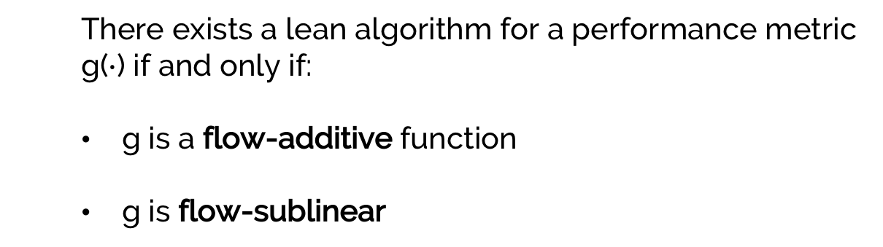
So: Are lean algorithms achievable?
  There exists a lean algorithm for a performance metric g($∙$) if and only if:
  g is a flow-additive function
  g is flow-sublinear
Check out our paper for more details!

Slide 14
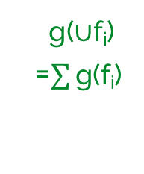
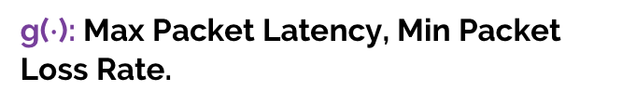

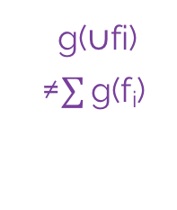
Requirement 1: Flow-additive functions
Flow-additive
Non Flow-additive
g(f_{i})
g(f_{i})
f₁
f₁
f₂
f₂
f₃
f₃
g($∪$fi)
≠$\sum{\text{g}\text{(}\text{fi}\text{) }}$
g($∪$f_{i})
=$\sum{\text{g}\text{(}\text{fi}\text{) }}$
f₄
f₄
f_{N}
f_{N}
Flows
Flows
g($∙$): Total Packet Latency, Total Packet Loss, Total Retransmitted Packets.
g($∙$): Max Packet Latency, Min Packet Loss Rate.

Slide 15
Requirement 2: Flow sublinear
  For a network flow f_{i} ,
  if g( f_{i} ) can be estimated using space sublinear in M( f_{i} ),
  where M( f_{i} ) is the size of flow f_{i} ,
  Then g is flow-sublinear
Take-away: if g is not flow-sublinear, there is little hope g can be estimated across all flows.

Slide 16
Lean algorithm example I: Round-trip latency
  RTT = total round trip latency for every packet in the traffic
  Objective: Detect flows whose total round trip time exceeds $ε∙$ RTT
Flow key f
H₁(f)
5
+t₁
7
9
11
3
Packet Sent
H₂(f)
.
.
.
3
4
6
+t₁
10
7
d arrays of
counters
Detected
flows
+t₁
9
6
11
8
4
7
9
5
10
3
H_{d} (f)
+t₁
r counters per array

Slide 17
Lean algorithm example I: Round-trip latency
  RTT = total round trip latency for every packet in the traffic
  Objective: Detect flows whose total round trip time exceeds $ε∙$ RTT
Flow key f
H₁(f)
5
-t₂
7
9
11
3
ACK Received
H₂(f)
.
.
.
3
4
6
-t₂
10
7
d arrays of
counters
Detected
flows
-t₂
9
6
11
8
4
7
9
5
10
3
H_{d} (f)
-t₂
r counters per array

Slide 18
Lean algorithm example II: Packet loss
  Objective: Detect flows with high packet loss
  Assumption: Random packet loss
Flow key f
5
+1
7
9
11
H₁(f)
3
Packet
H₂(f)
.
.
.
3
4
6
+1
10
7
Detected
flows
1
+1
9
6
11
8
4
7
9
5
10
3
H_{d} (f)
+1

Slide 19
Lean algorithm example II: Packet loss
  If there is no packet loss
Flow key f
5
-1
7
9
11
H₁(f)
3
Packet
H₂(f)
.
.
.
3
4
6
-1
10
7
Detected
flows
2
-1
9
6
11
8
4
7
9
5
10
3
H_{d} (f)
-1
1
2
3
4
5
6
7
8
9
1
Counters:
0
-1
1 2 3 4 5 6 7 8 9

Slide 20
Flow-additive example II: Packet loss
  If there is random packet loss
Flow key f
5
+1
7
9
11
H₁(f)
3
Packet
H₂(f)
.
.
.
3
4
6
+1
10
7
Detected
flows
1
+1
9
6
11
8
4
7
9
5
10
3
H_{d} (f)
+1
1
1
2
4
6
8
9
Counters:
0
1 2 4 6 8 9
-1
-2
-3
Random walk

Slide 21
Implementation on programmable switches
TCP Packet Format:
ETH | IP | TCP | Payload
Parser
Header/Metadata in Shared Memory
Deparser
Match-Action
Table
Match-Action
Table
Match-Action
Table

Slide 22

Implementation on programmable switches
TCP Packet Format:
ETH | IP | TCP | Payload
Parser
Header/Metadata in Shared Memory
Deparser
Match:
Is_ACK== 1
Action:
Decrement counters
Match:
Is_ACK== 0
Action:
Increment counters
Match:
Is_Heavy_hitter==1
Action:
Report to
CPU

Slide 23
Lean algorithms on detecting high latency flows
3,700,000 flows in a public Internet trace.
Start with 5 rows of 2000 32-bit counters (40KB).
Approximately detect top 100 high latency flows
23

Slide 24
Lean algorithms on detecting lossy flows
3,700,000 flows in a public Internet trace.
Start with 5 rows of 2000 32-bit counters (40KB).
Approximately detect top 100 lossy flows
24

Slide 25
Conclusions
Network performance statistics are important for network diagnosis.
Existing solutions require per-flow information to detect problematic flows.
Lean algorithms can be designed for a set of performance statistics
Future directions:
  Other performance statistics: high and low TCP sending/receiving windows.
  Explore real-world characteristics: Are packet loss random?
  Are retransmitted packets and packet losses correlated?
  Build diagnosis tools using lean algorithms.
Thank you!
25

