Slide 1
Enabling CISE Research and Education in the Cloud
Magdalena Balazinska (UW), David Culler (UCB), Jen Rexford (Princeton), Jeannette Wing (Columbia)
http://www.cs.princeton.edu/~jrex/nsfcloud/
(login: cise and password: cise)

Slide 2
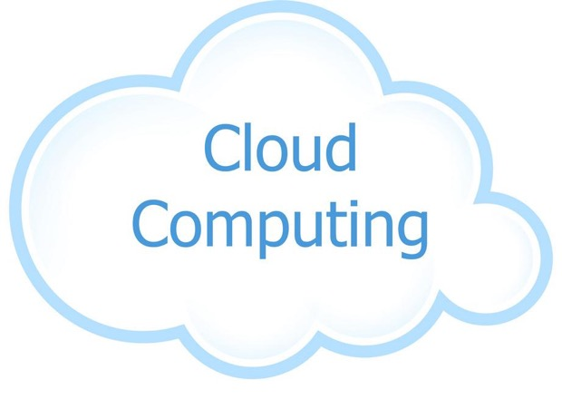
NSF Workshop on CISE and the Cloud
Cloud Companies
(Google, Microsoft, Amazon, NVIDIA, IBM, Oracle)
Professors
(research and education cloud users, cloud systems researchers)
Academic IT
(campus CIOs, Internet2, EDUCAUSE)
Funding Agencies
(NSF CISE, NIH)

Slide 3
Workshop Recommendations
Make the case
For academics to use the public cloud
For cloud providers to target academic users
Lower the barriers
Remove artificial costs
Create support structures
Form a central cloud “nexus”
Cloud providers ←→ academic institutions

Slide 4
Why Academics Should Use the Cloud
Efficiency
Lower cost
Better energy efficiency
Zero physical space
Solid platform
Security
Privacy
Availability

Slide 5
Why Academics Should Use the Cloud
Shared access
Public data sets
Standard software/libraries
Easier data sharing
Reproducible research
Repeating analysis with same code and data
Training students
Preparing for future jobs

Slide 6
When Academics Shouldn’t Use Cloud
Sufficient local resources
Personal laptop/desktop
Existing cluster
Long-running jobs
Local data
Downloaded often
Data visualization
Created locally
Real-time control

Slide 7
When Academics Shouldn’t Use Cloud
Specialized equipment
Very latest GPUs
Programmable NICs
Hands-on access to bare metal
Hardware/OS teaching
Cloud systems research
Academic software licenses

Slide 8
Why Cloud Providers Should Care
Academic mindshare
Cloud creators
Cloud users
Could decision-makers
Early visibility into future requirements
Power users
New features
Real-time apps

Slide 9
Why Cloud Providers Should Care
Innovations in cloud platforms
Machine-learning libraries
Operating systems
Network architecture
Moderately large market
4500 U.S. higher-ed institutions
… with 20M students at a time

Slide 10
Artificially High Costs for Cloud Use
Low cost for buying local resources
Computer labs included in tuition
No overhead charges on equipment
Equipment stays after a grant ends
Low cost for using local resources
Power/cooling/space seem “free”
Grad students as cheap sys-admins

Slide 11
Artificially High Costs for Cloud Use
Using the cloud may not save (much) money
Managing cloud costs (e.g., experiment runs amok)
Limited savings for small users and institutions
Costs for uploading data not already in cloud

Slide 12
Challenges in Transitioning to Cloud
Challenges for early adopters
Transition time and risk, especially for junior faculty
Lack of critical mass, example use cases, etc.
Lack of local expertise and support
Diverse cloud offerings
Need for training, support, and local/regional staff

Slide 13
Challenges in Transitioning to Cloud
Uncertainty about privacy restrictions
Education: student information
Research: funding-agency restrictions, medical data, etc.

Slide 14
Nexus for CISE Cloud Adoption
Unified voice for CISE researchers and educators
Completing the recommended studies
Identifying base cloud requirements
Bulk purchase/allocation of cloud credits
Fostering broad cloud adoption
Template agreements and data-management plans
Create cadre of support professionals
Serve the full range of academic institutions
Stand up virtual centers with disciplinary focus

Slide 15
Conclusion
Cloud is an opportunity for CISE
Cost, energy, space, privacy, security, availability
New modes of research and collaboration
Cloud adoption is a challenge for CISE
Reducing or eliminating the artificial costs
Creating support structures
The challenges are surmountable
Especially with a unified voice of the community

Slide 16
Thank You!!
Workshop co-organizers
Magdalena Balazinska, David Culler, and Jeannette Wing
NSF CISE partners
Jim Kurose
Chaitan Baru, Meghan Houghton, Vandana Janeja, Erwin Gianchandani, and more
Workshop attendees
Faculty, academic IT, cloud firms, NSF/NIH

