Slide 1
Online Algorithms, Linear Programming, and the k-Server Problem
 | Seffi Naor Computer Science Dept. Technion
Approximation Algorithms: The Last Decade and The Next
Princeton, June 2011
Joint work with: Nikhil Bansal, Niv Buchbinder, and Aleksander Madry

Slide 2




The Paging/Caching Problem (1)
CPU
cache
Browser
cache
web

Slide 3
The Paging/Caching Problem (2)
Universe of n pages, cache of size k<n.
Request sequence of pages 1, 6, 4, 1, 4, 7, 6, 1, …
If requested page is already in cache, no penalty.
Otherwise, cache miss!
Cache miss: fetch page into the cache, (possibly) evicting some other page
Main Question: which page to evict?
Goal: minimize number of cache misses

Slide 4

The Paging/Caching Problem (3)
What can be obtained deterministically?
Best Algorithm:
Evict the least recently used page (LRU)
Theorem: LRU is k-competitive.
(number of cache misses at most k times the optimal)
Theorem: Any algorithm is at least k-competitive.

Slide 5

The Paging/Caching Problem (4)
Can randomization help? A lot!
Theorem:
There is an O(log k)-competitive randomized paging algorithm (marking algorithm, 1988)
Theorem:
Any randomized algorithm is Ω(log k)-competitive

Slide 6
The k-server Problem
k servers (fire trucks) lie in an n-point metric space.
Requests arrive at points of the metric space.
To serve request: move a server to request point.
Goal: Minimize total distance traveled by servers.
Example:

Slide 7
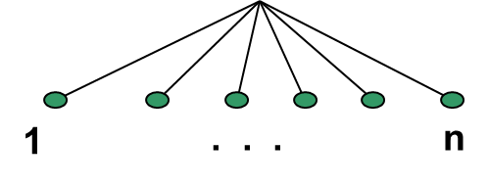
The k-Server Conjecture
Paging = k-server on a uniform metric.
page ≡ point; server at location p = page p in cache
Lower bounds:
Deterministic: k
Randomized: Ω(log k)
Deterministic k-server conjecture:
There is a k-competitive algorithm for any metric
Randomized k-server conjecture:
There is an O(log k)-competitive algorithm for any metric

Slide 8
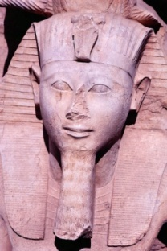
25 years of deterministic history
[Sleator, Tarjan 1985]:
  LRU k-competitive for paging; any algorithm is at least k-competitive,
[Manasse McGeoch Sleator 1988]:
  Definition of k-server and the k-server conjecture.
[Fiat, Rabani, Ravid 1990]:
  (k!)³ for general metrics (independent of metric size)
[Chrobak, Karloff, Payne, Vishwanathan 1990]: k-competitive for line.
[Chrobak Larmore 1991]: k-competitive algorithm for trees
[Koutsoupias, Papadimitriou 1994]: (2k-1)-competitive algorithm for any metric.

Slide 9
25 years of randomized history
[Fiat, Karp, Luby, McGoch, Sleator, Young 1988]:
  Paging: O(log k)-competitive algorithm; lower bound of Ω(log k) on any algorithm
[Bartal, Blum, Burch, Tomkin 1997], [Fiat, Mendel 2000]:
    O(poly log k)-competitive algorithm for metric with k+c points
[Seiden 2001]:
    O(polylog k)-competitive algorithm for some well separated spaces
[Casba Lodha 2006]:
  O(n^{2/3})-competitive algorithm for an equally spaced line
[Bansal, Buchbinder, Naor 2007]:
    O(log k)-competitive algorithm for weighted paging
[Cote, Meyerson, Poplawski 2008]:
    O(log Δ)-competitive algorithm on binary HST with stretch Ω(log Δ)
[Bansal, Buchbinder, Naor 2010]:
  exp(O(log n)^{1/2})-competitive algorithm for an equally spaced line

Slide 10
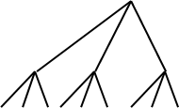
Randomization: Not Well Understood
Two simple metrics:
depth 2-tree: no o(k) guarantee
line metric: no o(k) guarantee
known: n^{2/3} [Csaba-Lodha 2006]
exp(O(log n)^{1/2}) [Bansal-Buchbinder-Naor 2010]

Slide 11
An Abstract Online Problem
P: Primal Covering
D: Dual Packing
Primal: constraints arrive one by one
Primal Goal: find feasible solution x* of min cost
Requirements:
Upon arrival constraint must be satisfied
Cannot decrease variables (online nature)

Slide 12
An Abstract Online Problem
P: Primal Covering
D: Dual Packing
Dual: columns arrive one by one (new variables).
Dual Goal: find feasible solution y* with max profit
Requirements:
new variable is set only upon arrival (online nature)

Slide 13

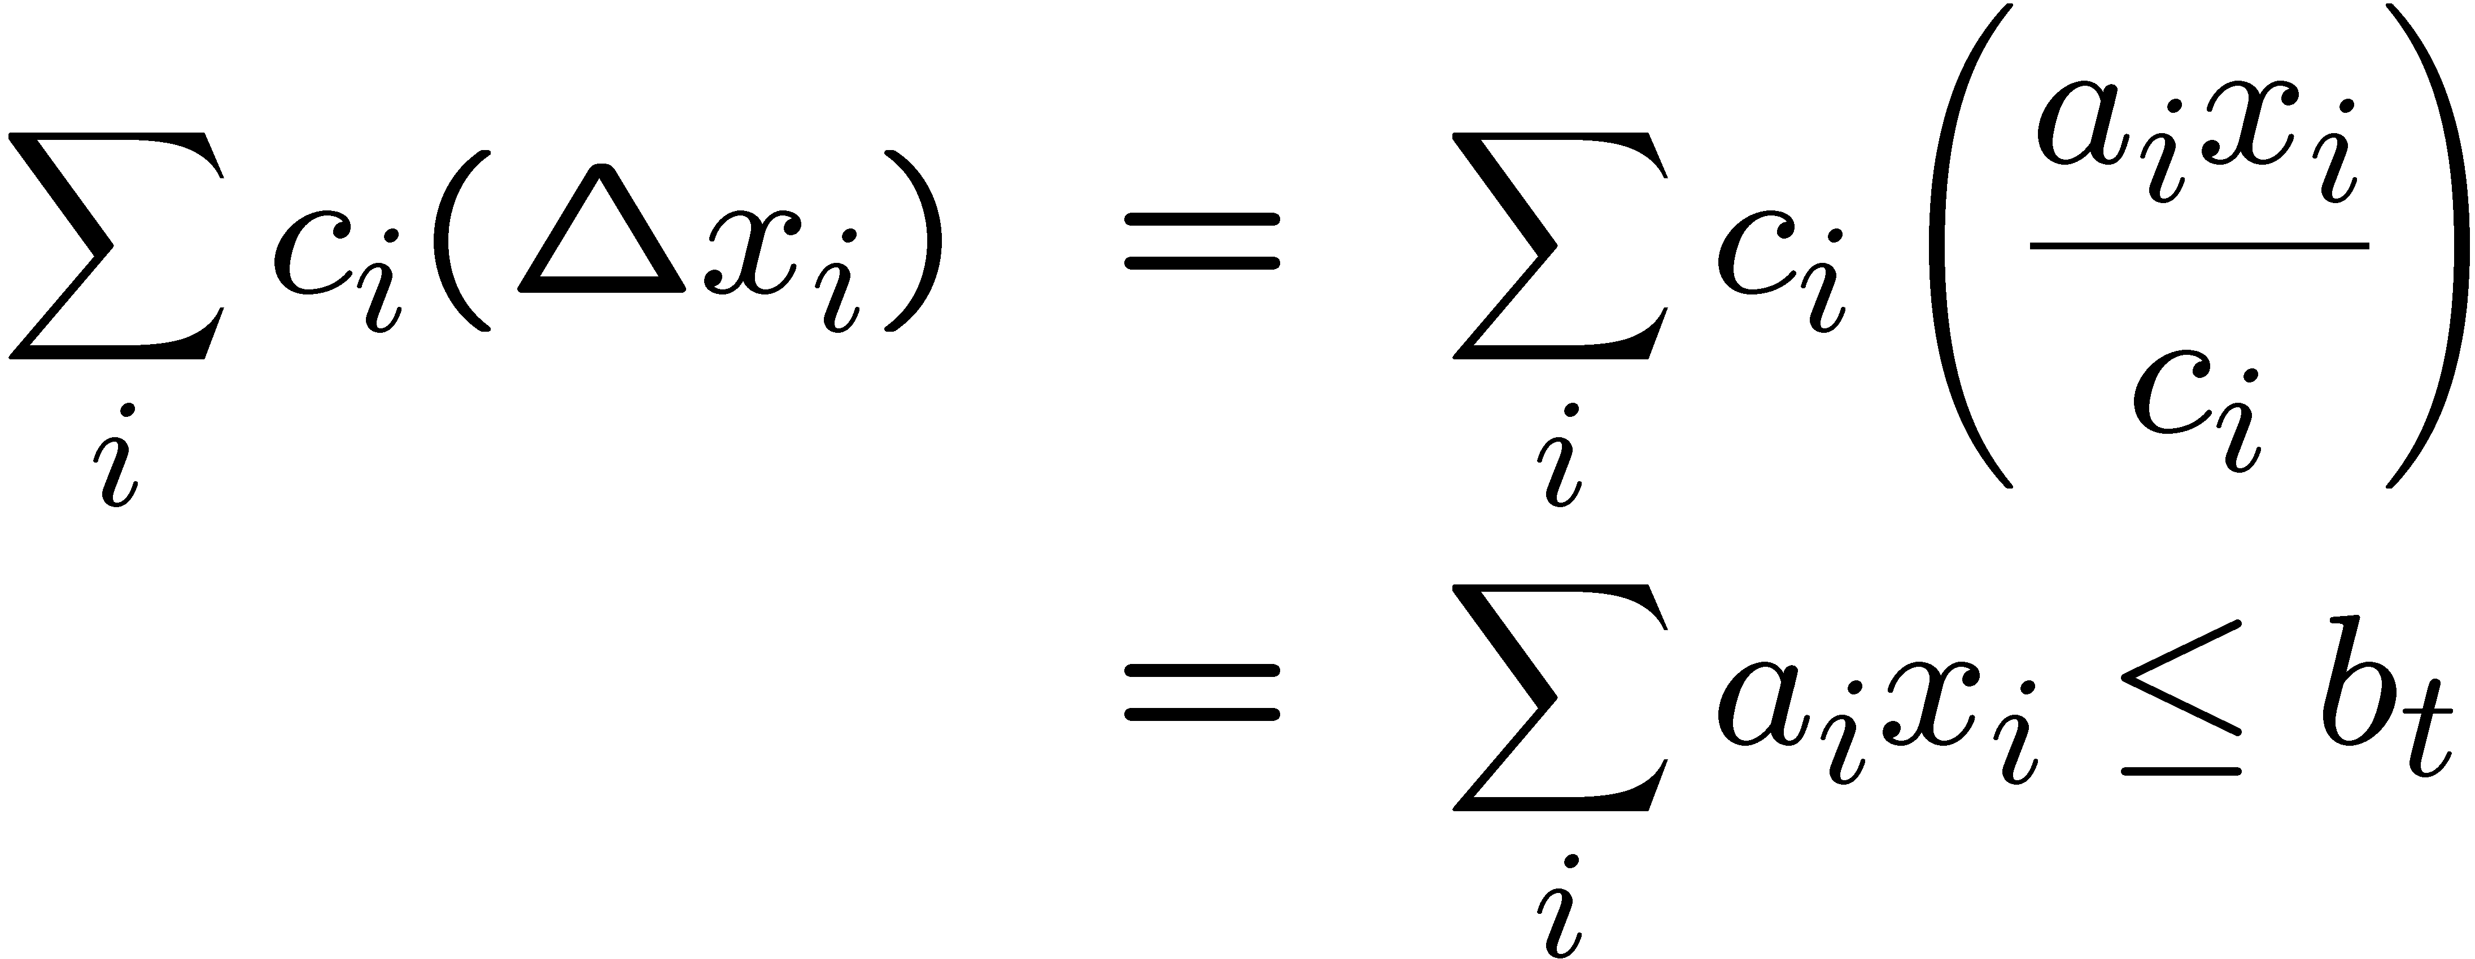
Key Idea for Online Primal-Dual
Primal: Min ∑_{i} c_{i} x_{i} Dual
Step t, new constraint: New variable y_{t}
a₁x₁ + a₂x₂ + … + a_{j}x_{j} ≥ b_{t} + b_{t} y_{t} in dual objective
How much: Δ x_{i} ? y_{t} ← y_{t} + 1 (additive update)
Δ primal cost =
= Δ Dual Cost
dx/dy proportional to x … so, x varies as exp(y)

Slide 14
Online Primal-Dual Algorithms
Unified framework: generic ideas and algorithms applicable to many online problems:
ski rental, dynamic TCP-acknowledgement, parking permit problem, online routing/load balancing problems, online matching, ad-auctions problem, online set cover, online graph covering problems, weighted paging, …
Linear program helps detecting the difficulties of the online problem
General recipe for both design and analysis of online algorithms via duality

Slide 15
The k-Server Problem on HSTs
α²
α
1
Hierarchically Separated Trees (HSTs): requests and servers reside in the leaves
c-competitive algorithm on an α-HST
O(cα log n)-competitive algorithm for general metrics

Slide 16
Approach of [CMP 08] to k-Server
Approach of Cote-Meyerson-Poplawski [STOC 08]:
Solve the k-server problem on an HST.
Main tool: the allocation problem on a uniform metric: distributes servers among children of a tree node

Slide 17
Allocation Problem
Uniform Metric:
At each time t, request arrives at some location i
request = (h_{t}(0),…,h_{t}(k)) [monotone: h(0) ¸ h(1) … ¸ h(k)]
Upon getting a request, can reallocate (move) servers
hit cost = h_{t}(k_{i}) [k_{i} : number of servers at i]
Total cost = hit cost + move cost
Paging: hit cost vectors (1,0,0,…,0)
*number of servers k(t) can also change over time (let’s ignore this)

Slide 18

Allocation Problem: Example
N (=5) possible locations for projects (uniform metric)
k (=8) workers
Projects arrive online
(total) Hit Cost | Move cost
1 3
k-ary Vector: How much does it cost to run/service the project with any number of workers.
Vectors are always monotonically decreasing.
3≥1≥1 ≥1v≥0…
3 4
10≥4≥2 ≥1 ≥0…
6 4
…
2≥2≥1≥0≥0…

Slide 19
Allocation Problem & k-Server [CMP08]
Theorem [Cote-Poplawski-Meyerson, STOC 2008]:
An algorithm for the allocation problem such that for
any ε > 0:
i) hit cost · (1+ε) OPT
ii) move cost · β(ε) OPT
gives ¼ O(Δ β(1/ Δ)) competitive k-server algorithm on HSTS of depth Δ.
Thus, β = poly(1/ε) polylog(k,n) suffices.
(Δ = log (aspect ratio))
*HSTs need some well-separatedness
*Later, we do tricks to replace dependence on Δ by n

Slide 20
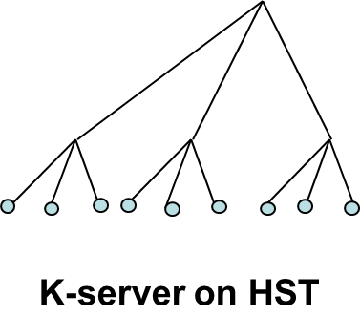
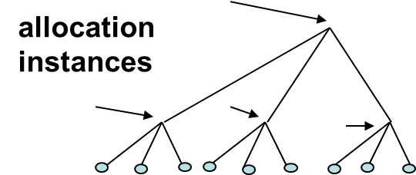
Allocation to k-Server: High Level Idea
Idea: apply the allocation problem recursively to an HST
hit cost at time t, tree node p, j servers: incremental cost of an optimal solution to the k-server problem (requests restricted to subtree of p) having j servers
Remark: Important to have good bounds for the hit cost since it multiplies over the levels in the recursion.
We do not know how to obtain such an algorithm!
[CMP08]: competitive algorithm for 2 nodes.

Slide 21
Our Result
Theorem: There is an O(log² k log³ n) competitive* algorithm for the k-server problem on any metric with n points.
Key Idea: A fractional version of the framework of [CMP08].
* Hiding some log log n terms

Slide 22
Back to Fractional Paging
Fractional Model:
Fractions of pages are kept in cache: probability distribution over pages p₁,…,p_{n}
Total sum of fractions of pages in cache ≤ k
At each step: mass on current page request = 1
Algorithm:
Updates the distribution on the pages at each step
if p₁,…,p_{n} changes to q₁,…,q_{n} : cost = (1/2) ∑_{i} |p_{i} – q_{i}|
(earthmover distance)
k units of cache

Slide 23
Fractional View of Randomized Algorithms
A randomized algorithm specifies:
i) probability distribution on states at each time t
ii) The way it changes at time t+1
iii) cost = distance between distributions
Paging:
Fractional Paging Randomized Paging (2x loss)
What about the fractional allocation problem?

Slide 24
Fractional Allocation Problem
x_{i,j} - prob. of having j servers at location i (at time t)
∑_{j} x_{i,j} = 1 (prob. distribution at i)
∑_{i} ∑_{j} j x_{i,j} · k (global server bound)
Cost: hit cost = ∑_{j} x_{i,j} h(j) with h(0),…,h(k)
move cost = ε|j’-j| if moving ε mass from (i,j) to (i,j’)
Surprisingly, a fractional allocation is not a good approximation to the allocation problem.

Slide 25
A Gap Example
allocation problem on two points
k servers
Left
Right
requests alternate between locations.
Left hit-cost: (1,1,…,1,0) Right hit-cost: (1,0,…,0,0)
any integral solution must pay Ω(T) in T steps
fractional solution pays only T/(k-1) in T steps
Left: x_{L,0} = 1/(k-1), x_{L,k} = 1-1/(k-1) hit-cost = 1/(k-1)
Right: x_{R,1} = 1 hit-cost = 0
move cost = 0 (distribution does not change)

Slide 26
Fractional Algorithm Suffices
Thm (Analog of Cote et al): Suffices to have fractional allocation algorithm with (1+ε,β(ε)) guarantee.
Gives a fractional k-server algorithm on HST
Thm (Rounding): Fractional k-server alg. on HSTs -> Randomized Alg. with O(1) loss.
Thm (Frac. Allocation): Design a fractional allocation algorithm with β(ε) = O(log (k/ε)).

Slide 27
Fractional Paging Algorithm
current cache state: p₁,…,p_{n} satisfying ∑_{i} p_{i} =k
new request: page 1
Algorithm: brings 1-p₁ mass for page 1
evicts mass from other pages
rule: for each page iǂ1 decrease p_{i} / 1–p_{i} + δ (δ = 1/k)
Intuition: if p_{i} close to 1, be more conservative in evicting
“multiplicative update”: update by an exponential function
0
1
0
1
0
1
0
1
1-p₁
p₁
1-p₂
p₂
1-p_{n}
p_{n}
Pg 1
Pg 2
…
Pg n

Slide 28
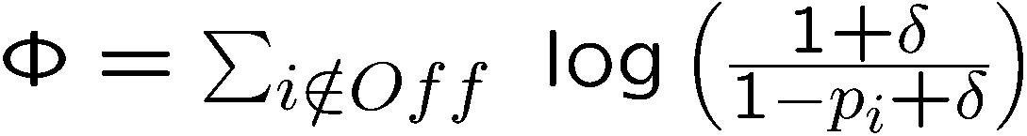
Analysis: via Potential Function (1)
Contribution of page i to Φ:
0 if p_{i} =0
log(k+1) if p_{i}=1
a decreasing function in 1-p_{i}
Properties of Φ:
if online and offline coincide, contribution to Φ is zero
if online has a page i in cache that offline does not have, Φ comes to the rescue - if p_{i}=1, contribution to Φ is large.
δ = 1/k

Slide 29

Analysis: via Potential Function (2)
Show that for each time t:
On(t) + Φ(t) - Φ(t-1) · O(log k) Off(t)
first, analyze move of offline
then, analyze move of online
Suppose page 1 is requested.
Offline move:
if page 1 is in offline cache: ΔΦ = 0
else, it evicts a page, and ΔΦ · log(k+1)

Slide 30
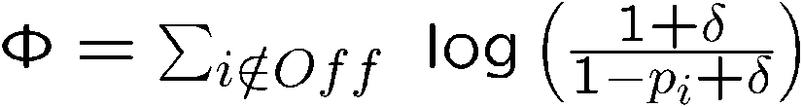
Analysis: via Potential Function (2)
Recall: On(t) + Φ(t) - Φ(t-1) · O(log k) Off(t)
Infinitesimal step:
p₁ increases by ε
p_{i} decreases by dp_{i} = ε (1-pi+δ) / N
Offline
Online
On = {i : p_{i} > 0}
Observation: for each page i in On\Off, Φ decreases by
dp_{i} ¢ dΦ / dp_{i} = dp_{i} ¢ (1/(1-p_{i}+δ)) = ε/N
But, |On\Off| ≥ |On|-k, thus total potential drop ¸ ε¢(|On|-k)/N
N = ∑_{i 2 On} (1-p_{i}+δ) = |On|-k + δ|On| = |On|-k + |On|/k ¼ |On|-k
Hence, total potential drop ¸ ε

Slide 31
Back to the Allocation Problem
What makes the allocation problem harder?
Paging: if page 1 is requested, we know that OPT must have this page in the cache
Allocation Problem: not so clear …
suppose location 1 gets a hit and, say, there are already 10.5 servers there:
  should we add even more servers?
  maybe OPT has just one server in location 1?
distance between two fractional solutions is determined by an earthmover metric (EMD) over a linear metric

Slide 32
Extension to Allocation
Suppose hit cost vector δ_{j} = (δ,δ,…,δ,0,…,0) at location 1
(cost is δ if · j servers, otherwise it is 0)
hit cost is Y= δ(x_{1,0}+ …+ x_{1,j})
Increase servers ¼ Y (move from j to j+1)
Fix number of servers: for each location i (including 1), rebalance prob. mass by multiplicative update.
(location 1)
0
1
2
k
j
j+1
Recall ∑_{j} x_{ij} = 1, 8i
……
each x_{i,p} (except last p)
increases / x_{i,p}

Slide 33
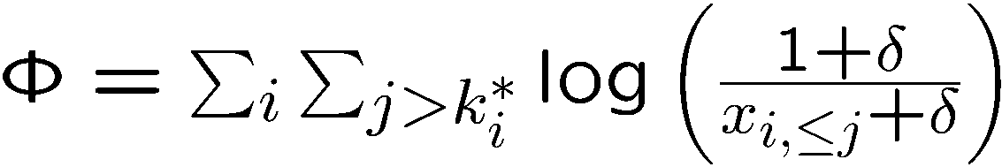
Proof Idea
b
E.g: Location i contributes 3 log (1+k) to Φ.
Key observation: For every cut · j, x_{i,· j} increases / x_{i,· j}.
EMD on linear metrics is determined by cuts (e.g., x_{i,· j}).
Location i
OPT
ON

Slide 34
Concluding Remarks
Removing dependence on aspect ratio:
HST -> Weighted HST with O(log n) depth.
tool: extending allocation to weighted star
Main Open Questions:
Can we remove the dependence on n?
1. Metric -> HST
2. But even on an HST - get a bound independent of n
What about special metrics? E.g., a line metric

Slide 35
Thank you

