Slide 1
Prize-collecting Frameworks
Mohammad T. HajiAghayi
University of Maryland, College Park &
AT&T Labs-- Research
TexPoint fonts used in EMF.
Read the TexPoint manual before you delete this box.: AAAAAAAA

Slide 2
Prize-collecting Problems
Prize-collecting problems are classic optimization problems in which there are various demands that desire to be ``served'' by some lowest-cost structure.
However, if some demands are too expensive to serve, then we can refuse and instead pay a penalty.
Several applications both in theory and practice.

Slide 3
Examples
Theory applications: Lagrangian relaxation of budgeted
problems such as k-MST or applications in orienteering
Real-world AT&T application saving millions of dollar: Design fiber build connecting new customers to existing network.
Graph: street network for metro area
Root: existing fiber (supernode)
Edge cost: digging trench, laying fiber, line cards at customer endpoints
Prize: monthly cost for each new customer location to serve (maybe by other careers)
We can define prize-collecting versions of lots of
optimization problems, but let’s see a few classic ones

Slide 4
Prize-collecting TSP (PCTSP)
Given: graph G=(V,E), (metric) edge costs c_{e} ≥ 0 and penalties p_{v} ≥ 0 on vertices
Goal: choose a cycle C ⊆ E so as to
Cost of edges in the cycle + penalty of unvisited nodes, i.e. ∑_{e∈C} c_{e} + ∑_{v is not visited node} p_{v}, is minimized
Introduced by Balas’89
Bienstock et al.’93: 3-approx. LP-rounding algorithm
Goemans-Williamson ‘92: 2-approx primal-dual. Algorithm
Archer, Bateni, H., Karloff’09: 1.98-approx via PC-clustering technique
Goemans: 1.91-approx

Slide 5
Prize-collecting Steiner tree (PCST)
Given: graph G=(V,E), edge costs c_{e} ≥ 0, root r∈V,
penalties p_{v} ≥ 0 on vertices
Goal: choose a set of edges F ⊆ E so as to Cost of edges picked + penalty of nodes disconnected from r, i.e., ∑_{e∈F} c_{e} + ∑_{v not connected to r} p_{v} , is minimized
r
Bienstock et al.’93: 3-approx. LP-rounding algorithm
Goemans-Williamson’92 : 2-approx primal-dual. Algorithm
Archer, Bateni, H., Karloff’09: 1.967-approx via PC-clustering technique

Slide 6
Prize-collecting Steiner forest (PCSF)
Given: graph G=(V,E), edge costs c_{e} ≥ 0,
source-sink pairs s_{i}-t_{i}
penalties p_{i} ≥ 0 on each s_{i}-t_{i} pair
Goal: choose a set of edges F ⊆ E so as to
minimize ∑_{e∈F} c_{e} + ∑_{i: si not connected to ti in F} p_{i}

Slide 7
Prize-collecting Steiner forest (PCSF)
Given: graph G=(V,E), edge costs c_{e} ≥ 0,
source-sink pairs s_{i}-t_{i}
penalties p_{i} ≥ 0 on each s_{i}-t_{i} pair
Goal: choose a set of edges F ⊆ E so as to
minimize ∑_{e∈F} c_{e} + ∑_{i: si not connected to ti in F} p_{i}
Generalizes connectivity function of PCST
Introduced by H., Jain’06: gave a 3-approx. primal-dual algorithm and 2.54-approx randomized LP rounding

Slide 8
Prize-collecting Steiner Net. (PCSN)
Given: graph G=(V,E), edge costs c_{e} ≥ 0,
source-sink pairs s_{i}-t_{i}
decreasing penalty function p_{i} ≥ 0 on each s_{i}-t_{i} pair
Goal: choose a set of edges H ⊆ E so as to
minimize ∑_{e∈H} c_{e} + ∑_{i} p_{i}(λ(s_{i}-t_{i})) where λ(s_{i}-t_{i}) is the edge-connectivity of s_{i}-t_{i} pair in H
Special and still equivalent case: All-or-Nothing
pays penalty p_{i} if λ(s_{i}-t_{i}) < r_{i} ;zero otherwise
H., Khandekar, Kortsarz, Nutov’10: 2.54-approx

Slide 9
Prize-Collecting vs. Non-Prize-Collecting
By non-prize-collecting we mean the regular problem where we need to serve all demands
There is one non-trivial separation:
Bateni, H., Marx’10: Seiner forest has PTAS on planar graphs & Euclidian plane though PCSF is APX-hard on these graphs
But for other problems still we do not know that much about approximation factors
What we know:
Usually there is a constant factor and indeed an additive factor 1 difference for approximation factors of PC versions vs. non-PC versions
It is not always easy though, e.g., All-or-Nothing PCSN

Slide 10
Reduction to All-or-Nothing

Slide 11
LP for All-or-Nothing PCSN
First attempt (usually successful):
It can be arbitrarily bad for large r_{i} and thus it was the main open problem of Nagarajan, Sharma, Williamson’08

Slide 12
New LP for All-or-Nothing PCSN

Slide 13
New LP for All-or-Nothing PCSN
We can improve it to 2.54 by randomized LP rounding.

Slide 14
PCSN with submodular penalty f’n.
Special cases considered by HST05, SSW07, NSW08, HN10.
Given: graph G=(V,E), edge costs c_{e} ≥ 0, k source-sink pairs s_{i}-t_{i} with connectivity requirement r_{i}, penalty is given by a set-function p : 2^{[1..k]} → ℜ_{≥ 0} , where
p is submodular: p(A)+p(B) ≥ p(A ∪ B)+p(A ∩ B)
Goal: : choose a set of edges H ⊆ E so as to
minimize ∑_{e∈H} c_{e} + p({i|λ(s_{i}-t_{i})< r_{i}}) where λ(s_{i}-t_{i}) is the edge-connectivity of s_{i}-t_{i} pair in H
Generalizs All-or-Nothing variant and has 2.54 approximation which is quite non-trivial (via Lovasz’s continuous extension of submodular functions)

Slide 15
Prize-Collecting Clustering
New clustering paradigm based on prize-collecting framework

Slide 16
PC-Clustering: More precisely

Slide 17
PC-Clustering Applications
PC Steiner tree: 1.967-approx (Archer, Bateni,H., Karloff ‘09)
PC TSP (and Tour): 1.980- approx (Archer, Bateni,H., Karloff ‘09)
Planar Steiner Forest: PTAS (Bateni, H., Marx’10)
Planar Submodular prize-collecting Steiner forest: Reduction to bounded-treewidth graphs (Bateni, Chekuri, Ene, H., Korula, Marx’11)
Planar multiway cut: PTAS (Bateni, H., Klein, Mathieu)

Slide 20
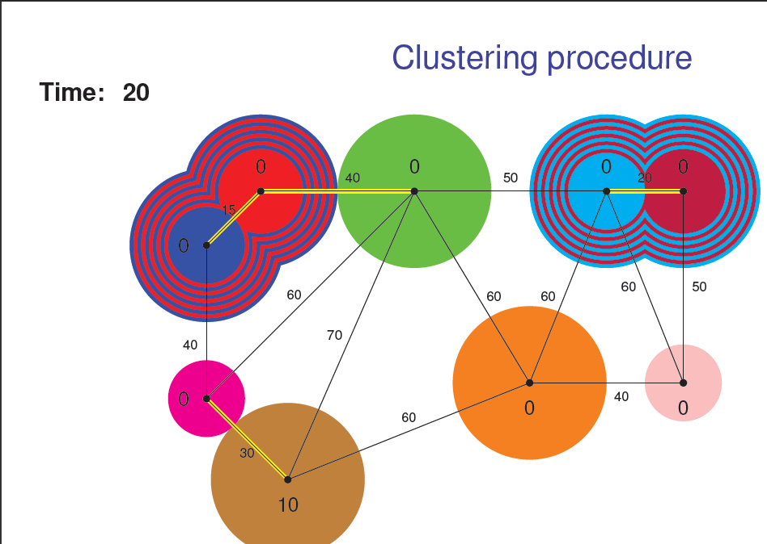

Slide 21
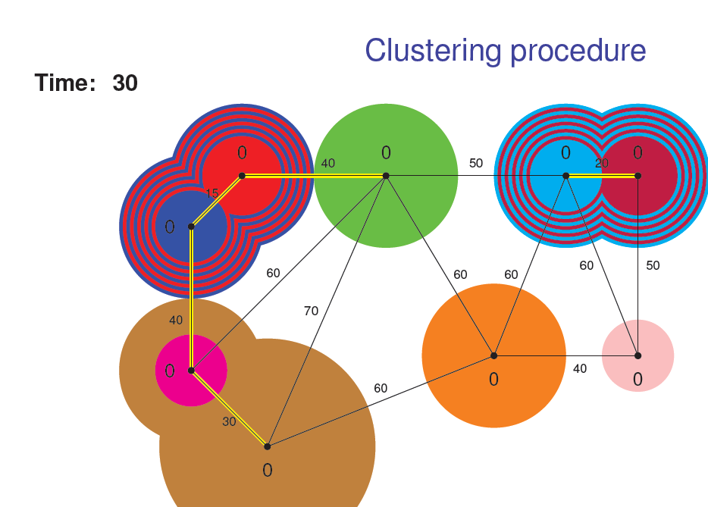

Slide 23
Lower bound part needs several new ideas

Slide 24
PC-Clustering Applications
PC Steiner tree: 1.967-approx (Archer, Bateni,H., Karloff ‘09)
PC TSP (and Tour): 1.980- approx (Archer, Bateni,H., Karloff ‘09)
Planar Steiner Forest: PTAS (Bateni, H., Marx’10)
Planar Submodular prize-collecting Steiner forest: Reduction to bounded-treewidth graphs (Bateni, Chekuri, Ene, H., Korula, Marx’11)
Planar multiway cut: PTAS (Bateni, H, Klein, Mathieu)

Slide 25
Application to PCST

Slide 26
Open Problems
There is a gap of around 0.5 between approx. factors for PC versions and non-PC versions
PCTSP 1.91 vs 1.5
PCST 1.96 vs 1.39
PCSF 2.54 vs 2
PCSN 2.54 vs 2
Submodular PCSN 2.54 vs 2
We do not know any hardness or even integrality gap that separates PC versions and non-PC versions except one for planar/Euclidean graphs.
Can we close the gaps above or prove hardness/integrality gaps?

