Slide 1
Buy at Bulk Network Design (with Protection)
Chandra Chekuri
Univ. of Illinois, Urbana-Champaign

Slide 2
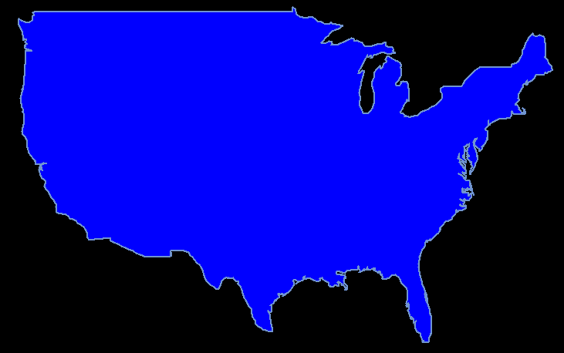
Optical Network Design
Goal: install equipment on network (light up some fibers in dark network) to satisfy (route) traffic
Objectives: minimize cost, maximize fault tolerance, ...

Slide 3
Optical Network Design
Details: see tutorial talk by C-Zhang, DIMACS workshop on Next Gen Networks, August 2007

Slide 4
Buy-at-Bulk Network Design
[Salman-Cheriyan-Ravi-Subramanian’97]
Network: graph G=(V,E)
Cost functions: for each e 2 E, f_{e}: R₊ ! R₊
Demand pairs: s₁t₁, s₂t₂, ..., s_{h}t_{h} (multicommodity)
Demands: s_{i}t_{i} has a positive demand d_{i}

Slide 5
Buy-at-Bulk Network Design
Feasible solution:
a multi-commodity flow for the given pairs
d_{i} flow from s_{i} to t_{i} (can also insist on unsplittable flow along a single path)
Cost of flow: ∑_{e} f_{e}(x_{e}) where x_{e} is total flow on e
Goal: minimize cost of flow

Slide 6
Single-sink BatB
Sink s, terminals t₁, t₂, ..., t_{h} , demand d_{i} from t_{i} to s

Slide 7
Economies of scale (sub-additive costs)
f_{e}(x) + f_{e}(y) ¸ f_{e}(x+y)
cost
bandwidth

Slide 8
Economies of scale (sub-additive costs)
f_{e}(x) + f_{e}(y) ¸ f_{e}(x+y)
cost
bandwidth
no economies of scale
dis-economies of scale
cost
cost
bandwidth
bandwidth

Slide 9
Economies of scale
fixed cost
rent-or-buy
cost
cost
bandwidth
bandwidth
discrete cable capacities
cost-distance (universal)
cost
cost
bandwidth
bandwidth

Slide 10
Uniform versus Non-uniform
Uniform: f_{e} = c_{e} f where c : E ! R⁺
(wlog c_{e} = 1 for all e, then f_{e} = f )
Non-uniform: f_{e} different for each edge
(can assume wlog is a simple cost-distance function)
Throughout talk graphs are undirected

Slide 11
Approximability
 | Single-cable | Uniform | Non-Uniform
Single Source (hardness) | O(1) [SCRS’97] Ω(1) folklore | O(1), 20.42 [GMM’01, GR’10] Ω(1) folklore | O(log h) [MMP’00] Ω(log log n) [CGNS’05]
Multicommodity (hardness) | O(log n) [AA’97] Ω(log^{1/4 -ε} n) [A’04] | O(log n) [AA’97] Ω(log^{1/4 -ε} n) [A’04] | O(log⁴ h)* [CHKS’06] Ω(log^{1/2 -ε} n) [A’04]
*O(log³ n) for poly-bounded demands [KN’07]

Slide 12
Easy to state open problems
Close gaps in the table
Improved bounds for planar graphs or geometric instances?

Slide 13
Three algorithms for Multi-commodity BatB
Using tree embeddings of graphs for uniform case. [Awerbuch-Azar’97]
Greedy routing with randomization and inflation [Charikar-Karagiazova’05]
Junction based approach [C-Hajiaghayi-Kortsarz-Salavatipour’06]

Slide 14
Alg1: Using tree embeddings
Suppose G is a tree T
Routing is unique/trivial in T
For each e 2 T, routing induces flow of x_{e} units
Cost = ∑_{e} c_{e} f(x_{e})
Essentially an optimum solution modulo computing f

Slide 15
Alg1: Using tree embeddings
[Bartal’96,’98, FRT’03]
Theorem: O(log n) distortion for embedding a n point finite metric into random dominating tree metrics
[Awerbuch-Azar’97]
Theorem: O(log n) approximation for multicommodity buy-at-bulk with uniform cost functions

Slide 16
Open problems for uniform
Close gap between O(log n) upper bound and Ω(log^{1/4-²} n) hardness [Andrews’04]
Obtain an O(log h) upper bound where h is the number of pairs follows from refinement of tree embeddings due to [Gupta-Viswanath-Ravi’10]

Slide 17
Alg2: Greedy using random permutation
[Charikar-Karagiozova’05] (inspired by [GKRP’03] for rent-or-buy)
Assume d_{i} = 1 for all i // (unit-demand assumption)
Pick a random permutation of demands
// (wlog assume 1,2,...,h is random permutation)
for i = 1 to h do
set d’_{i} = h/i // (pretend demand is larger)
route d’_{i} for s_{i}t_{i} greedily along shortest path on current solution
end for

Slide 18
Details
“route d’_{i} for s_{i}t_{i} along shortest path on current solution”
x_{j}(e): flow on e after j demands have been routed
compute edge costs c(e) = f_{e}(x_{i-1}(e)+d’_{i}) - f_{e}(x_{i-1}(e)) // (additional cost of routing s_{i}t_{i} on e)
compute shortest s_{i}-t_{i} path according to c

Slide 19
Alg2: Theorems
[CK’05]
Theorem: Algorithm is 2^{O(√log h log log h)} approx. for non-uiform cost functions.
Theorem: Algorithm is O(log² h) approx. for uniform cost functions in the single-sink case
Justifies simple greedy algorithm
Key: randomization and inflation
Some empirical evidence of goodness

Slide 20
Alg2: Open Problems
Question/Conjecture: For uniform multi-commodity case, algorithm is polylog(h) approx.
Question: What is the performance of the algorithm in the non-uniform case? polylog(h) ?

Slide 21
Alg3: Junction routing
[HKS’05, CHKS’06]
Junction tree routing:
junction

Slide 22
Alg3: Junction routing
density of junction tree: cost of tree/# of pairs
Algorithm:
While demand pairs left to connect do
Find a low density junction tree T
Remove pairs connected by T

Slide 23
Analysis overview
OPT: cost of optimum solution
Theorem: In any given instance, there is a junction tree of density O(log h) OPT/h
Theorem: There is an O(log² h) approximation for a minimum density junction tree
Theorem: Algorithm yields O(log⁴ h) approximation for buy-at-bulk network design

Slide 24
Existence of good junction trees
Three proofs:
Sparse covers: O(log D) OPT/h where D = ∑_{i} d_{i}
Spanning tree embeddings: Õ(log h) OPT/h
Probabilistic and recursive partitioning of metric spaces: O(log h) OPT/h

Slide 25
Min-density junction tree
junction
Similar to single-source? Assume we know junction r.
Two issues:
which pairs to connect?
how do we ensure that both s_{i} and t_{i} are connected to r?

Slide 26
Min-density junction tree
[CHKS’06]
Theorem: ® approximation for single-source via natural LP implies an O(® log h) approximation for min-density junction tree.
Via [C-Khanna-Naor’01] on single-source LP gap, O(log² h) approximation.
Approach is generic and applies to other problems

Slide 27
Alg3: Open Problems
Close gap for non-uniform: Ω(log^{1/2-ε} n) vs O(log⁴ h)
[Kortsarz-Nutov’07] improved to O(log³ n) for polynomial demands
Junction tree analysis is with respect to integral solution. What is the integrality gap of the natural LP?

Slide 28
Buy-at-Bulk with Protection
(1+1)-protection in practical optical networks
For each pair s_{i}t_{i} send data simultaneously on node disjoint paths P_{i} (primary) and Q_{i} (backup)
Protection against equipment/link failures
P_{i}
t_{i}
s_{i}
Q_{i}

Slide 29
Buy-at-Bulk with Protection
More generally:
For each pair s_{i}t_{i} route on k_{i} disjoint paths (edge or node disjoint depending on applications)
Generalize SNDP (survivable network design problem)

Slide 30
Buy-at-Bulk with Protection
[Antonakopoulos-C-Shepherd-Zhang’07]
2-junction scheme for node-disjoint case:
u
v

Slide 31
Buy-at-Bulk with Protection
[ACSZ’07]
2-junction-Theorem: α-approx for single-source problem via natural LP implies O(α log³ h) for multi-commodity problem
junction density proof (only one of the proofs in three can be generalized with some work)
single-source problem not easy! O(1) for single-cable via clustering arguments

Slide 32
Buy-at-Bulk with Protection
[C-Korula’08]
Single-sink with vertex-connectivity requirements
(log n)^{O(b)} for b cables for k=2 via clustering args.
2^{O(√log h)} for any fixed k for non-uniform case. Algorithm is greedy inflation. Is it actually better?
[Gupta-Krishnaswamy-Ravi’10]
O(log² n) for k=2 (edge-connectivity, uniform multicommodity)

Slide 33
Open problems
Approximability of single-sink case for k=2. ® approx. for single-sink implies O(® polylog(n)) for multi-comm.
Single-sink for fixed k>2. Best is 2^{O(√log h)}
Multi-commodity for fixed k>2.

Slide 34
Conclusion
Buy-at-bulk network design useful in practice and led to several new theoretical ideas
Algorithmic ideas:
application of Bartal’s tree embedding [AA’97]
derandomization and alternative proof of tree embeddings [CCGG’98,CCGGP’98]
hierarchical clustering for single-source problems [GMM’00, MMP’00,GMM’01]
cost sharing, boosted sampling [GKRP’03]
junction routing scheme [CHKS’06]
Hardness of approximation:
canonical paths/girth ideas for routing problems [A’04]
Several open problems

Slide 35
Uniform costs: cable model
In practice costs arise due to discrete capacity cables:
Cables of different type: (c₁, u₁), (c₂, u₂), ..., (c_{r}, u_{r})
c_{i}: cost of cable of type i
u_{i}: capacity of cable of type i
u₁ < u₂ < ... < u_{r} and c₁/u₁ > c₂/u₂ > ... > c_{r}/u_{r}
Can use multiple copies of each cable type
f(x) = min cost set of cables of total capacity at least x

