Slide 1
Measurement Query Languages for Software-Defined Networks
Jennifer Rexford
Princeton University
http://www.cs.princeton.edu/~jrex
Joint work with Srinivas Narayana, Mina Tahmasbi, and David Walker
To appear in NSDI’16: http://www.cs.princeton.edu/~narayana/pathqueries/

Slide 2
Management = Measure + Control
Network Management
Measure
Control
Software-Defined Networking (SDN)

Slide 3
Measuring is a Hard (Big-Data) Problem
A few standard tools:
Ping, traceroute, SNMP, NetFlow, tcpdump
Global state of the network is complex & dynamic:
Switches: rules, counters, buffers
Packets: in flight, rewritten, dropped
An operator must “join” multiple data streams:
Forwarding: protocol, controller, topology updates
Traffic: packet samples, counters, etc.
Result: inaccurate or high overhead ☹

Slide 4
Declarative Query Language
1. Path Query Language
Expressive measurement
Efficient measurement
2. Query Run-Time System
3. Optimizations
Accurate measurements
on commodity hardware

Slide 5
I. Path Query Language

Slide 6
Goal: Declarative Measurement Spec
Packet loss localization
Uneven load balancing
Traffic matrix
Slice isolation
DDoS source identification
Port-level traffic matrix
Congested link diagnosis
Loop detection
Middlebox traversal order
Incorrect NAT rewrite
Firewall evasion
...
Q: Common Primitives?
Without referring to:
Forwarding policy
Other measurements
Hardware specifics

Slide 7
Key Primitive: Packet Path
Common goal in the examples:
Relate packets across switches and interfaces, as they flow through the network
Packet paths:
Tests on packets at a single location in network
Same packet must satisfy multiple tests
Specify measurements precisely:
Where to capture the packets?
How to capture the packets?

Slide 8
Expressing Packet Paths
Regular expressions:
natural to state paths on graphs
S2
S3
S1
S4
S6
S5

Slide 9
Expressing Packet Paths
Regular expressions:
natural to state paths on graphs
S2
S3
S1
S4
S1 ^ S6 ^ S3 ^ S4
S6
S5

Slide 10
Expressing Packet Paths
Regular expressions:
natural to state paths on graphs
S2
S3
S1
S4
S1 ^ .* ^ S4
S6
S5

Slide 11
Expressing Packet Paths
Regular expressions:
natural to state paths on graphs
S2
S3
S1
S4
S1 ^ .* ^ S4
Boolean packet predicate
S6
S5
pred ::= true | false
| header=value
| location=value
| pred & pred
| pred | pred
| ~pred
| ingress()
| egress()

Slide 12
Expressing Packet Paths
Regular expressions:
natural to state paths on graphs
atom ::= in_atom(pred)
| out_atom(pred)
| in_out_atom(pred,
pred)
S1
Input packet
Forwarding
Output packet

Slide 13
Expressing Packet Paths
Regular expressions:
natural to state paths on graphs
S2
S3
in_atom(true)*
in_atom(sw=S4)
S1
S4
S1 ^ .* ^ S4
in_atom(sw=S1)
S6
S5
in_atom(sw=S1) ^ in_atom(true)* ^ in_atom(sw=S4)

Slide 14
Query Language
path ::= atom
| path ^ path
| path | path
| path*
| path & path
| ~path
p1
“hop”
p2

Slide 15
Packets Evading a Firewall
ingress()
^
(~switch=FW)*
^
egress()
ingress
egress
ingress
egress
ingress
egress

Slide 16
Evaluation: Let’s write queries!
Switch-level traffic matrix:
 | E1 | E2 | ...
I1 | 250 | 100 | ...
I2 | 120 | 95 | ...
... | ... | ... | ...

Slide 17
Evaluation: Let’s write queries! (3/3)
Switch-level traffic matrix:
in_atom(ingress())
^
in_atom(true)*
^
out_atom(egress())
Flow | #pkts
* | 1000
Count all packets, going from any ingress to any egress.

Slide 18
Evaluation: Let’s write queries!
Switch-level traffic matrix:
in_group(ingress(),
[switch])
^
in_atom(true)*
^
out_group(egress(),
[switch])
Flow | #pkts
sw=I1, sw=E1 | 250
sw=I1, sw=E2 | 100
... | ...
Group counts by
packet’s ingress and egress switch!
➔ Traffic matrix!

Slide 19
Query Language
path ::= atom
| path ^ path
| path | path
| path*
| path & path
| ~path
atom ::=
| in_atom(pred)
| out_atom(pred)
| in_out_atom(pred,
pred)
| in_group( pred,
[fields])
| out_group(pred,
[fields])
| in_out_group(pred,
[fields], pred,
[fields])

Slide 20
Where to capture matching packets?
Packet flow
Upstream
Downstream
{path}.up()
Queried Path
{path}.down()
For a given query: packets may be different!

Slide 21
How to process matching packets?
{path}.set_bucket(bucket)
count_bucket()
(Get switch counters)
packet_bucket()
(Send to controller)
sampling_bucket()
(Get sFlow packet samples)

Slide 22
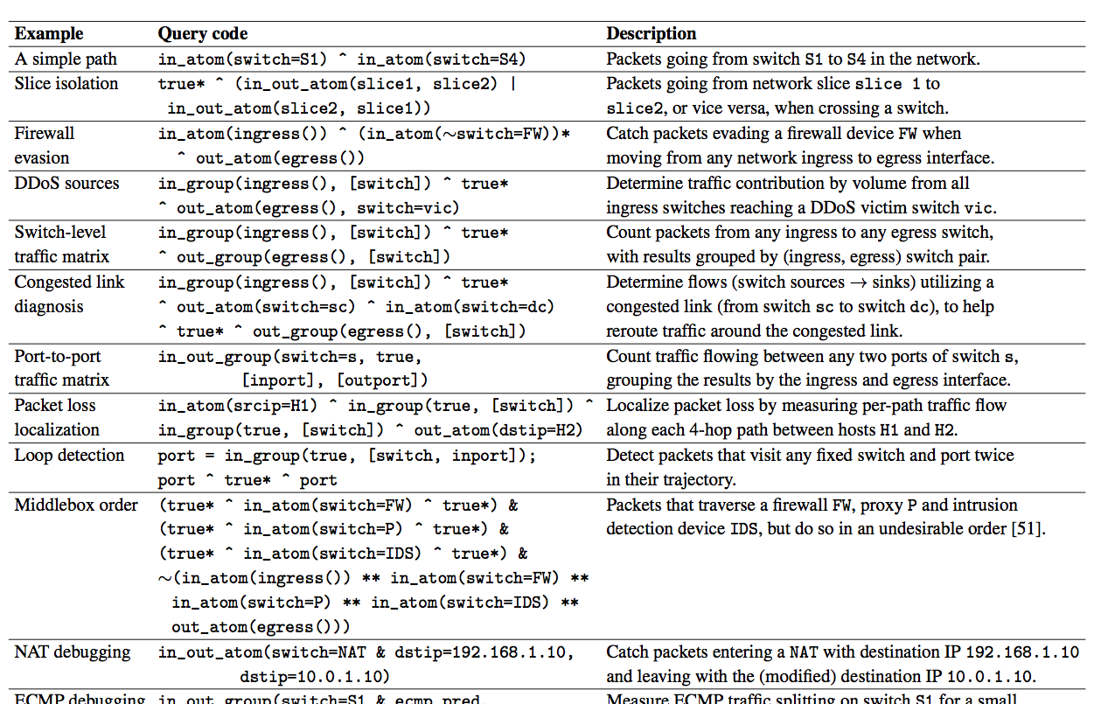
More Query Examples

Slide 23
II. The Run-Time System

Slide 24
Solution Approach
1. Path Query Language
Query expressions
Statistics
2. Query Run-Time System
3. Optimizations
SDN controller
Payloads
Statistics

Slide 25
Goal: Query → Network Measurement
Accurate answer
Pay exactly for what you query
Commodity hardware

Slide 26
Commodity HW: Match-Action Tables
Wildcard bit pattern
(ternary matching)
Forward/Drop/Modify
match1 ➔ action1
match2 ➔ action2
...
26

Slide 27
Commodity HW: Multi-Stage Mat-Act
match1 ➔ action1
match2 ➔ action2
...
match1 ➔ action1
match2 ➔ action2
...
...

Slide 28
Goal: Query → Network Measurement
Accurate answer
Pay exactly for what you query
Commodity hardware

Slide 29
Goal: Query → Network Measurement
Accurate answer
Pay for what you query
Commodity hardware
How to observe a packet’s
path accurately in the data plane
with low overhead?
Avoid inaccuracy of joining traffic and forwarding data, and the overhead of recording every hop of every packet.

Slide 30
Recording Limited Path Info on Packets
Observation 1: Queries already tell us what’s needed!
Only record path info needed by queries
Observation 2: Queries are regular expressions
Regular expressions ➔ Finite automaton (DFA)
Distinguish only paths corresponding to query DFA states

Slide 31
Reducing Path Information on Packets
Observation 1: Queries already tell us what’s needed!
Only record path state needed by queries
Observation 2: Queries are regular expressions
Regular expressions ➔ Finite automaton (DFA)
Distinguish only paths corresponding to DFA states
Record only DFA state on packets (1-2 bytes)
Use existing “tag” fields (e.g., VLAN)

Slide 32
Downstream Query Compilation (1/3)
p =
(switch=S1 & srcip=10.0.0.1)
^ (switch=S2 & dstip=10.0.0.3)
p.set_bucket(count_bucket())
S1
S2
switch=S1 & srcip=10.0.0.1
switch=S2 & dstip=10.0.0.3
Q0
Q1
Q2
Notes:
Not only do we know, but also modify packet processing on switches to make measurements easier. ➔ need to make this point somewhere.
Note that there are details to make the execution of the automaton deterministic on the data plane – which we are skipping in the interest of time.
Also, the queries are assumed to be matching a packet only once on each switch: typically there are 2 matching points, but let’s assume only ingress queries exist for the time being.

Slide 33
Downstream Query Compilation (2/3)
switch=S1 & srcip=10.0.0.1
switch=S2 & dstip=10.0.0.3
Q0
Q1
Q2
Generate “match-action-able” rules
state=Q0 & switch=S1 & srcip=10.0.0.1 ➔ state←Q1
DFA
Transition
state=Q1 & switch=S2 & dstip=10.0.0.3 ➔ state←Q2
state=Q1 & switch=S2 & dstip=10.0.0.3 ➔ count
DFA Accept
Notes:
Not only do we know, but also modify packet processing on switches to make measurements easier. ➔ need to make this point somewhere.

Slide 34
Downstream Query Compilation (3/3)
DFA-Transitioning
)
(
>>
Forwarding
+
DFA-Accepting
All acting on the same data plane packets!
Use policy composition operators and compiler
Composing software-defined networks. Monsanto et al., 2013
Notes:
Why does this composed policy make sense? Explain.

Slide 35
Downstream Query Compilation (3/3)
DFA-Transitioning
)
(
>>
Forwarding
+
DFA-Accepting
dstip=10.0.0.1 ➔ fwd(1)
dstip=10.0.0.2 ➔ fwd(2)
dstip=10.0.0.3 ➔ fwd(3)
...
state=Q0 & switch=S1 & srcip=10.0.0.1 ➔ state←Q1
state=Q1 & switch=S2 & dstip=10.0.0.3 ➔ state←Q2
>>
state=Q0 & switch=S1 & srcip=10.0.0.1 & dstip=10.0.0.2
➔ state←Q1, fwd(2)
Composing software-defined networks. Monsanto et al., 2013
Notes:
Why does this composed policy make sense? Explain.

Slide 36
III. Optimizations

Slide 37
Solution Approach
1. Path Query Language
Query expressions
Statistics
2. Query Run-Time System
3. Optimizations
SDN controller
Payloads
Statistics

Slide 38
Goal: Make Run-Time Efficient
Metrics:
Rule space
Query compile time
Packet state space
Stanford network on a mix of queries:
Unoptimized: didn’t compile in 2 hours
Fully optimized:
Query compile time: ~ 5 seconds
Rule space: ~ 650 rules (TCAM capacity 2-4K)
Packet state space: state fits in VLAN header
Fit in switch rule memory?
Debugging “interactive”?
Fit on typical “tag” headers?

Slide 39
Optimizations: Summary
Optimization | # Rules? | Time? | # States?
Separate query & forwarding actions into separate stages
Optimize conditional policy compilation
Integrate tagging and capture policies
Pre-partition predicates by flow space
Cache predicate overlap decisions
Decompose query predicates into multiple stages
Detect predicate overlaps with Forwarding Decision Diagrams
Notes:
// table of optimizations + intended metrics that should be reduced

Slide 40
Optimizations: Summary
Optimization | # Rules? | Time? | # States?
Separate query & forwarding actions into separate stages
Optimize conditional policy compilation
Integrate tagging and capture policies
Pre-partition predicates by flow space
Cache predicate overlap decisions
Decompose query predicates into multiple stages
Detect predicate overlaps with FDDs
Cross-Product Explosion
Notes:
// table of optimizations + intended metrics that should be reduced

Slide 41
Cross-Product Explosion
DFA-Transitioning
)
(
>>
Forwarding
+
DFA-Accepting
state=Q0 & srcip=10.0.0.2 ➔ state←Q1
state=Q1 & srcip=10.0.0.3 ➔ state←Q2
state=Q2 & port=4 ➔ state←Q4
state=Q3 & srcmac=01:* ➔ state←Q5
state=Q4 & srcip=10.0.0.1 ➔ state←Q3
state=Q5 & tpdstport=80 ➔ state←Q5
state=Q6 & srcip=10.0.0.3 ➔ state←Q6
state=Q7 & dstip=10.0.0.4 ➔ state←Q2
...
dstip=10.0.0.1 ➔ fwd(1)
dstip=10.0.0.2 ➔ fwd(2)
dstip=10.0.0.3 ➔ fwd(3)
dstip=10.0.0.4 ➔ fwd(4)
dstip=10.0.0.5 ➔ fwd(5)
dstip=10.0.0.6 ➔ fwd(6)
dstip=10.0.0.7 ➔ fwd(7)
dstip=10.0.0.8 ➔ fwd(8)
...
>>
state=Q0 & srcip=10.0.0.2 & dstip=10.0.0.1
➔ state←Q1, fwd(1)

Slide 42
Taming Cross-Product Explosion
Key Problem: Coerce multiple actions on overlapping sets of packets
match1 ➔ action1
match2 ➔ action2
...

Slide 43
Taming Cross-Product Explosion
Key Idea: Leverage multiple passes for each packet
Multi-stage match-action tables on switch hardware
match1 ➔ action1
match2 ➔ action2
...
match1 ➔ action1
match2 ➔ action2
...
...
Rule space O(M+N), not O(M*N)

Slide 44
Taming Huge Policies
(DFA-Ingress-Transitioning >> Forwarding >> DFA-Egress-Transitioning) +
(DFA-Ingress-Accepting)
+
(DFA-Ingress-Transitioning >> Forwarding >> DFA-Egress-Accepting)
☹
(DFA-Ingress-Transitioning + DFA-Ingress-Accepting)
>>
Forwarding
>>
(DFA-Egress-Transitioning + DFA-Egress-Accepting)

Slide 45
Taming Huge Policies
(DFA-Ingress-Transitioning + DFA-Ingress-Accepting) >> Forwarding
>> (DFA-Egress-Transitioning + DFA-Egress-Accepting)
in_transition
+
in_accept
out_transition
+
out_accept
forwarding
O(M*N) ➔ O(M+N)

Slide 46
Taming Overlapping Query Predicates
p1: srcip=10.0.0.1
p2: srcip=10.0.0.2
...
p100: srcip=10.0.0.100
p101: dstip=192.168.0.101
p102: dstip=192.168.0.102
...
p200: dstip=192.168.0.200
in_transition
+
in_accept
srcip=10.0.0.1 ➔ state1←q1
srcip=10.0.0.2 ➔ state1←q2
...
dstip=192.168.0.101 ➔ state2←q1
dstip=192.168.0.102 ➔ state2←q2
...
O(M*N) ➔ O(M+N)
Running many parallel Query DFAs!
...

Slide 47
Implementation
Prototype
Pyretic SDN controller
NetKAT (Ocaml) compiler
Install rules on OpenVSwitch
Currently single-threaded
Intel Xeon E3, 3.70Ghz 32GB
Implementation publicly available online
http://frenetic-lang.org/pyretic/
Composing software-defined networks. Monsanto et al., 2013
A fast compiler for NetKAT. Smolka et al., 2015
OpenVSwitch.org

Slide 48
Benefit of Optimizations
Stanford campus network topology
Several queries:
Traffic matrix, DDoS detection, per-hop packet loss, firewall evasion, slice isolation, congested link
Metrics and Stanford results (all queries together):
Compile time: > 2 hours ➔ 5 seconds
# Rules: ~ 650
# State bytes: 2 bytes
Notes:
Rule space estimation for DNF cases.
Stanford forwarding policy has 3840 rules overall – that’s 240 per device on aveage. Almost all rules match on destination ip address, which almost none of the queries actually match on. This means the best-case reduction applies: ~240 times or two orders of magnitude reduction of rule count going from single-stage to multi-stage tables.
Then there’s at least a factor of 6.6 from the instances that _do_ terminate. Together, that’s 7 * 240 = 1680, or three orders of magnitude reduction in rule space from the unoptimized case.

Slide 49
Benefit of Optimizations (Stanford)
Cumulative Optimization | Time (s) | # Rules | # State Bits
None | > 7900 | DNF | DNF
Separate query & forwarding actions into separate stages | > 4920 | DNF | DNF
Optimize conditional policy compilation | > 4080 | DNF | DNF
Integrate tagging and capture policies | 2991 | 2596 | 10
Pre-partition predicates by flow space | 56.19 | 1846 | 10
Cache predicate overlap decisions | 35.13 | 1846 | 10
Decompose query predicates into multiple stages | 5.467 | 260 | 16
Notes:
Rule space estimation for DNF cases.
Stanford forwarding policy has 3840 rules overall – that’s 240 per device on aveage. Almost all rules match on destination ip address, which almost none of the queries actually match on. This means the best-case reduction applies: ~240 times or two orders of magnitude reduction of rule count going from single-stage to multi-stage tables.
Then there’s at least a factor of 6.6 from the instances that _do_ terminate. Together, that’s 7 * 240 = 1680, or three orders of magnitude reduction in rule space from the unoptimized case.

Slide 50
Scalability Trends
Five synthetic ISP (Waxman) topologies at various network sizes
At each network size, run mix of queries from before
Averaged metrics across queries & topologies

Slide 51
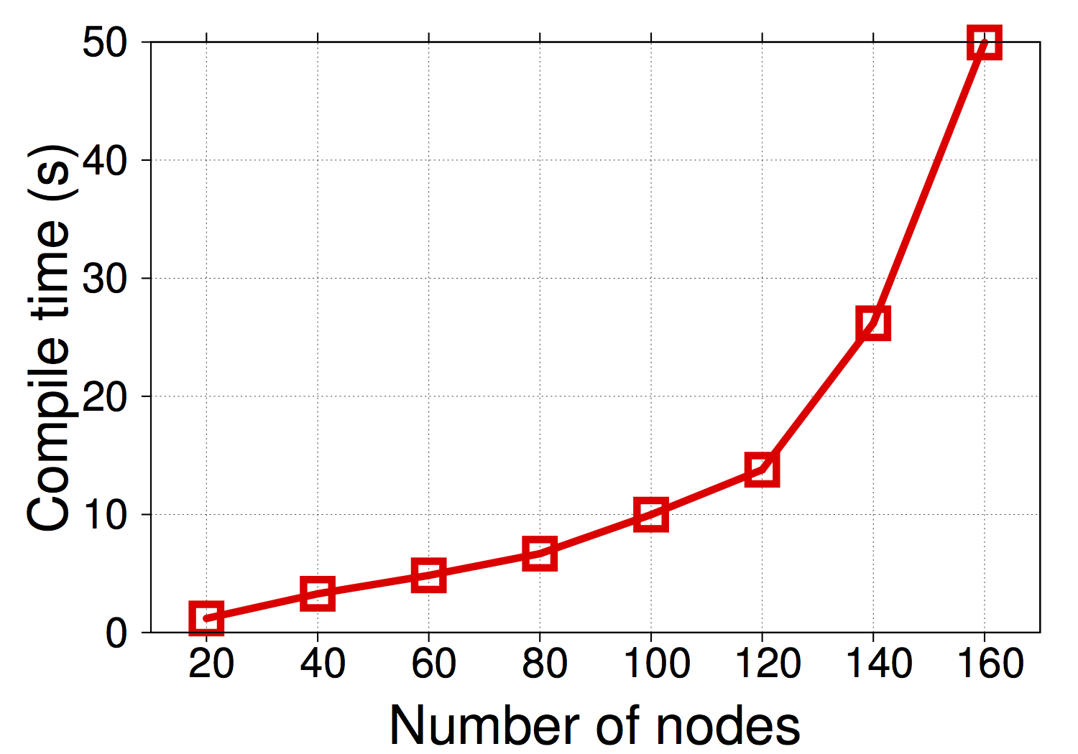
I. Query Compile Time
Interactive problem solving (15s)
Response time in man-computer conversational transactions. Miller, 1968

Slide 52
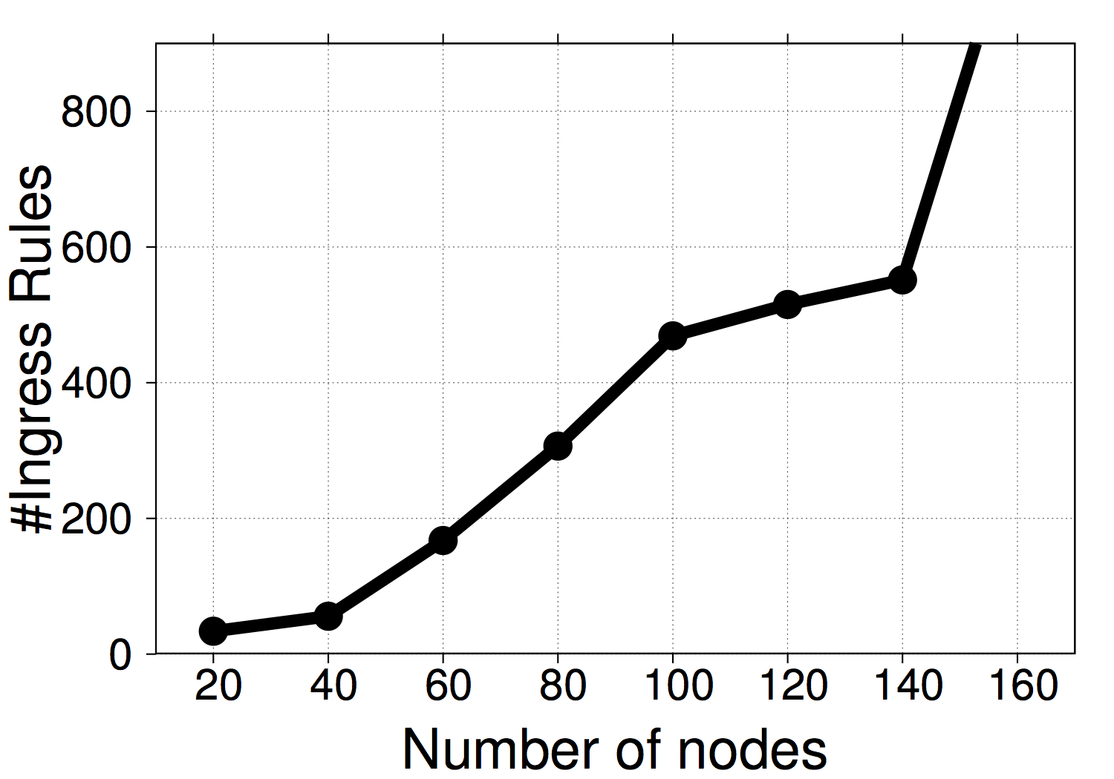
II. Rule Count
Switch TCAM capacity: 2K-4K rules

Slide 53
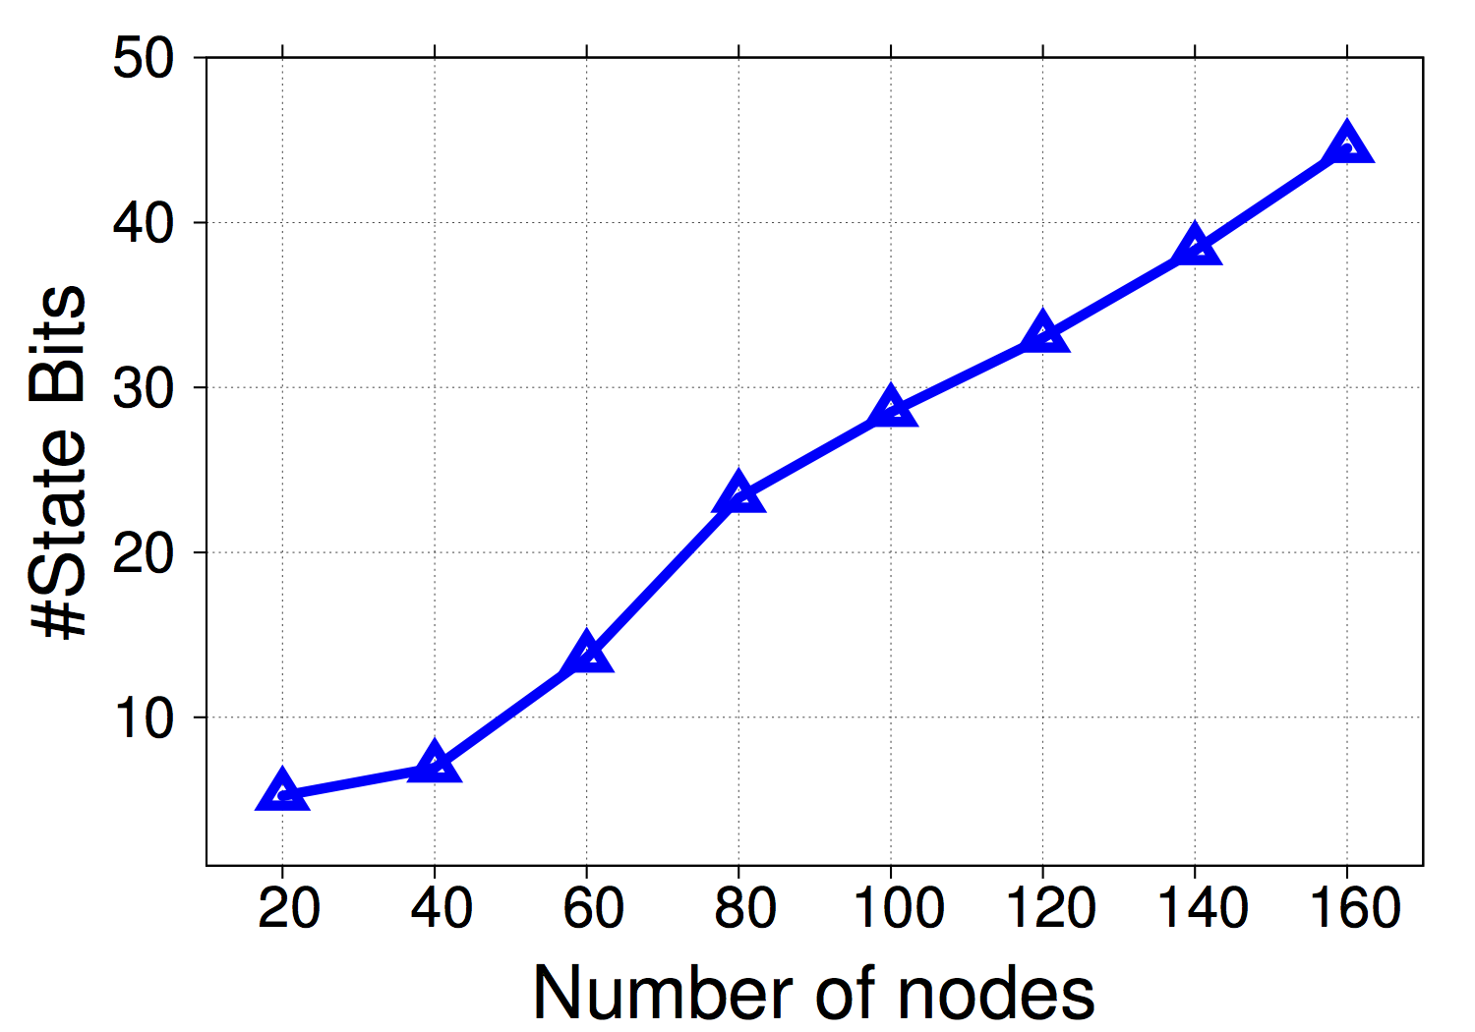
III. Packet State Bits
MPLS
VLAN

Slide 54
Summary
Declarative path query language
Regular expressions, grouping
Capture locations, capture actions
Compositional run-time system
Query-DFA packet state
Key optimizations for a practical system
Addressing cross-product explosion
Paper and more info at http://www.cs.princeton.edu/~narayana/pathqueries

