Slide 1
Programmable NextG Networks
Jennifer Rexford
Princeton University

Slide 2
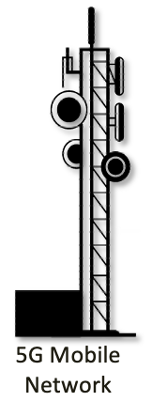
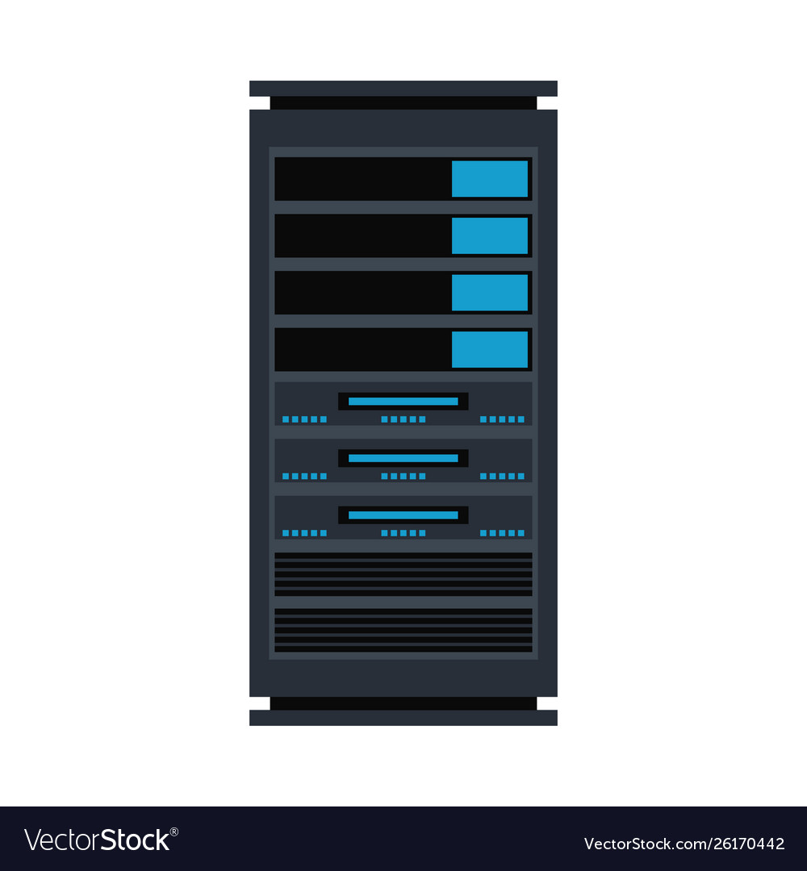
NextG Convergence of Access, Network, Edge-Compute
Internet
Notes:
The future of networked devices (robotics, self-driving cars, IoT, AR/VR)
Combining high-speed access (e.g., cellular), networking, and edge compute
For the cloud: low-latency connectivity to end users and devices.
For the access network: replacing special-purpose appliances with commodity hardware.

Slide 3
NextG Convergence of Access, Network, Edge-Compute
For the cloud
Low-latency connectivity to end-users and their devices
Enabling applications like AR/VR, IoT, autonomous vehicles, robotics
Native support for mobility of these devices
For the access network
Replacing purpose-built appliances with commodity hardware
Faster pace of innovation through software and cloud services
For the network
An opportunity for tighter integration with end-hosts and applications
Great opportunities for innovation!

Slide 4
NextG Industry Disruption
Many industry players
Carriers (e.g., AT&T, Verizon, T-Mobile)
Cloud providers (e.g., Google, Amazon, Microsoft)
Equipment vendors (e.g., Qualcomm, Huawei, Ericsson, Nokia)
Upstarts (e.g., Dish, Rakuten, startups)
Many industry use cases
Industrial control
Healthcare
Manufacturing
Agriculture
Smart facilities
Campus networks
Private NextG networks
Customized network for different deployment scenarios
Notes:
Many opportunities to think about how the ecosystem should evolve
Many potential “deep dives” into use cases!

Slide 5
NextG Architecture Spanning Traditional Research Silos
Virtualization
Spectrum sharing, network slicing, virtual machines, mobile virtual network operators
Programmability
Software-defined radios, programmable switches, network interface cards
Telemetry
Radio measurements, packet statistics, path performance, AI-driven management
Security and privacy
Hardware trojans, radio jamming, location privacy, DDoS attacks
Disaggregation
Open Radio Access Network (O-RAN), control-plane microservices, open-source
Opportunities to bridge across traditional research divides!

Slide 6
NextG Open Standards and Software
A wealth of open interfaces and platforms
Roll your own NextG network
Prototype, evaluate, and deploy research ideas
A path to impact for research results

Slide 7
Pronto Project
Creating an open-source, end-to-end, 5G-connected, edge cloud as a programmable, verifiable network with closed-loop control enabling research and demonstration of new concepts
Guru Parulkar, Oguz Sunay, Larry Peterson
Nick McKeown, Sachin Katti
Jen Rexford
Nate Foster

Slide 8
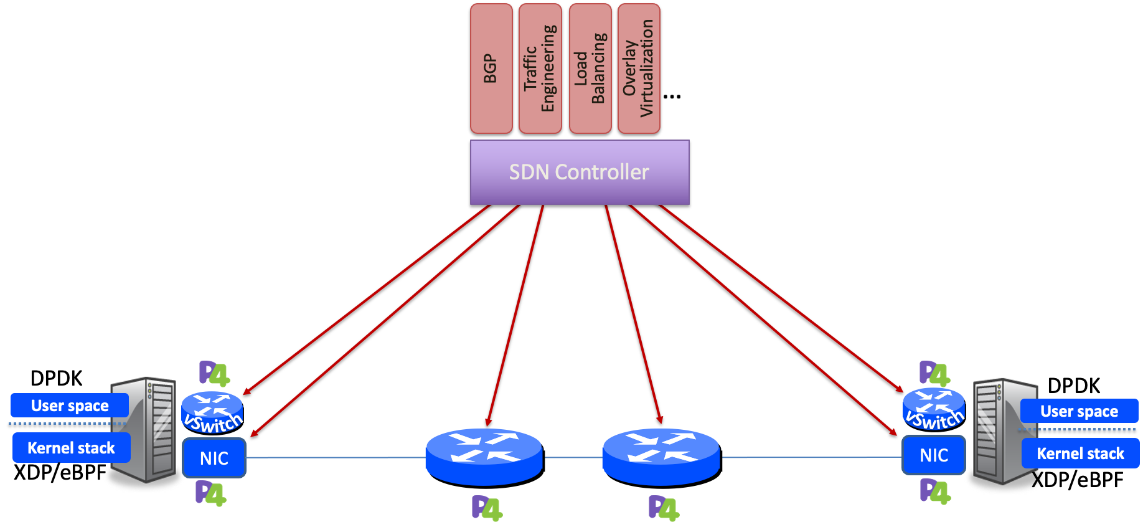
Programmability: Top-to-Bottom and End-to-End

Slide 9
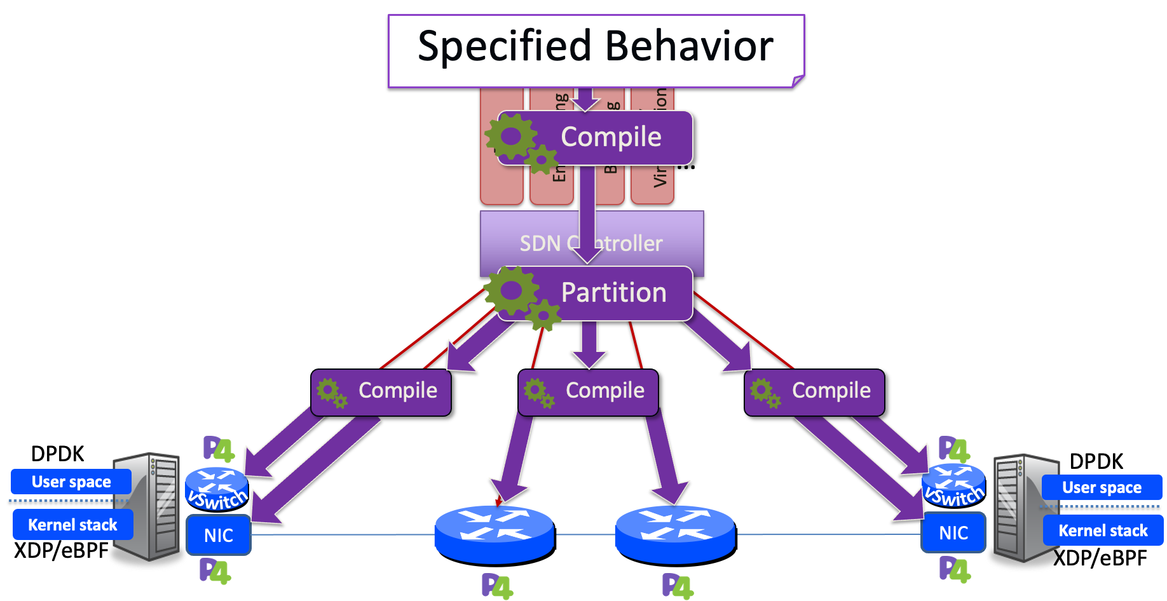

Slide 10
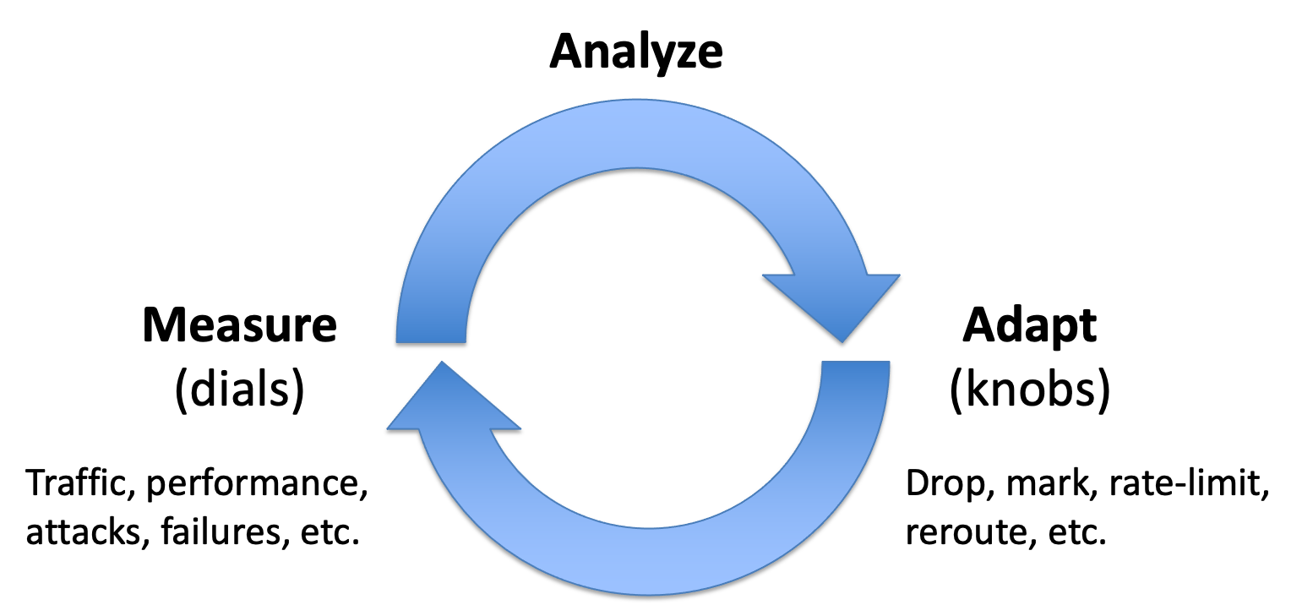
Programmability Enables Closed-Loop Control

Slide 11
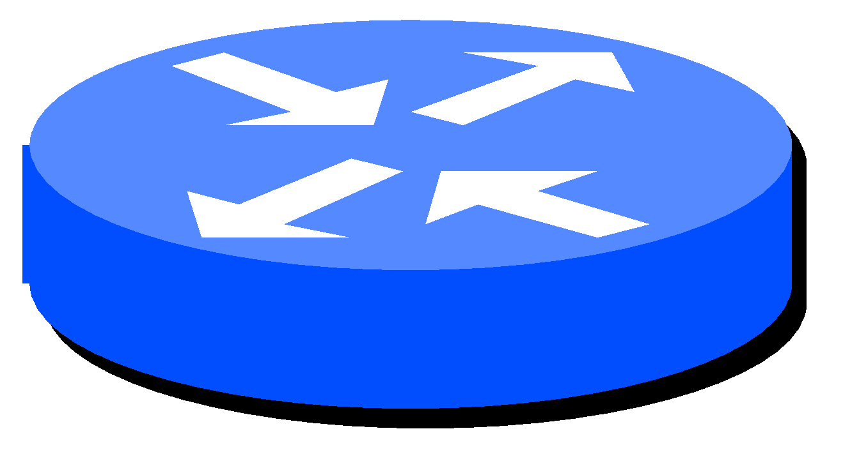
Pronto’s Premise
Networks, for the first time, will be
Programmable end-to-end
Specified top-to-bottom
Defined entirely by software
This creates new possibilities
To verify network is “correct by construction”
To measure and validate, in real time, against the network specification
To correct bugs through closed-loop control
BGP
Overlay Virtualization
Load
Balancing
Traffic Engineering
…
SDN Controller
Because of open-source, we (the research community) get to take part.
DPDK
DPDK
User space
User space
Kernel stack
NIC
NIC
Kernel stack
XDP/eBPF
XDP/eBPF
5G Mobile
Network

Slide 12
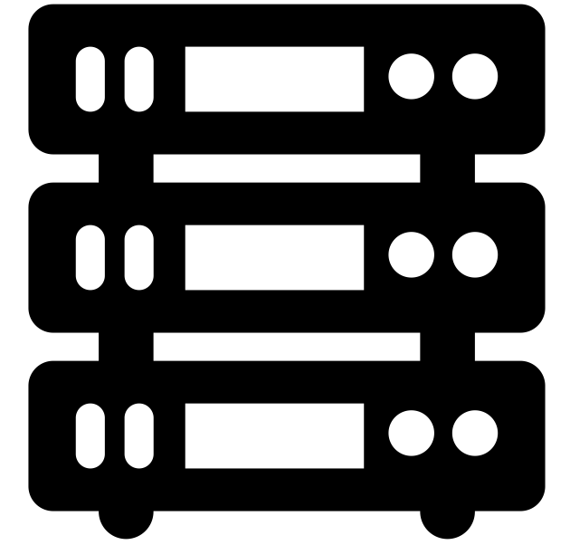
ONF Aether Software Architecture
aetherproject.org
RAN Control
Fabric Control
4G/5G Core User Plane
µONOS SD-RAN Controller
ONOS
Aether Management Platform (AMP)
fabric.p4
fabric.p4
Operational Control
Lifecycle Mgmt
Monitoring / Logging
Stratum
Stratum
Kubernetes
INT
INT
Tofino Switch
Tofino Switch
Aether Connectivity Control (ACC)
4G/5G Core Control Plane
fabric.p4
fabric.p4
Central Cloud
Stratum
Stratum
INT
INT
Tofino switch
Tofino switch
RAN
Aether Connected Edge
(ACE)

Slide 13
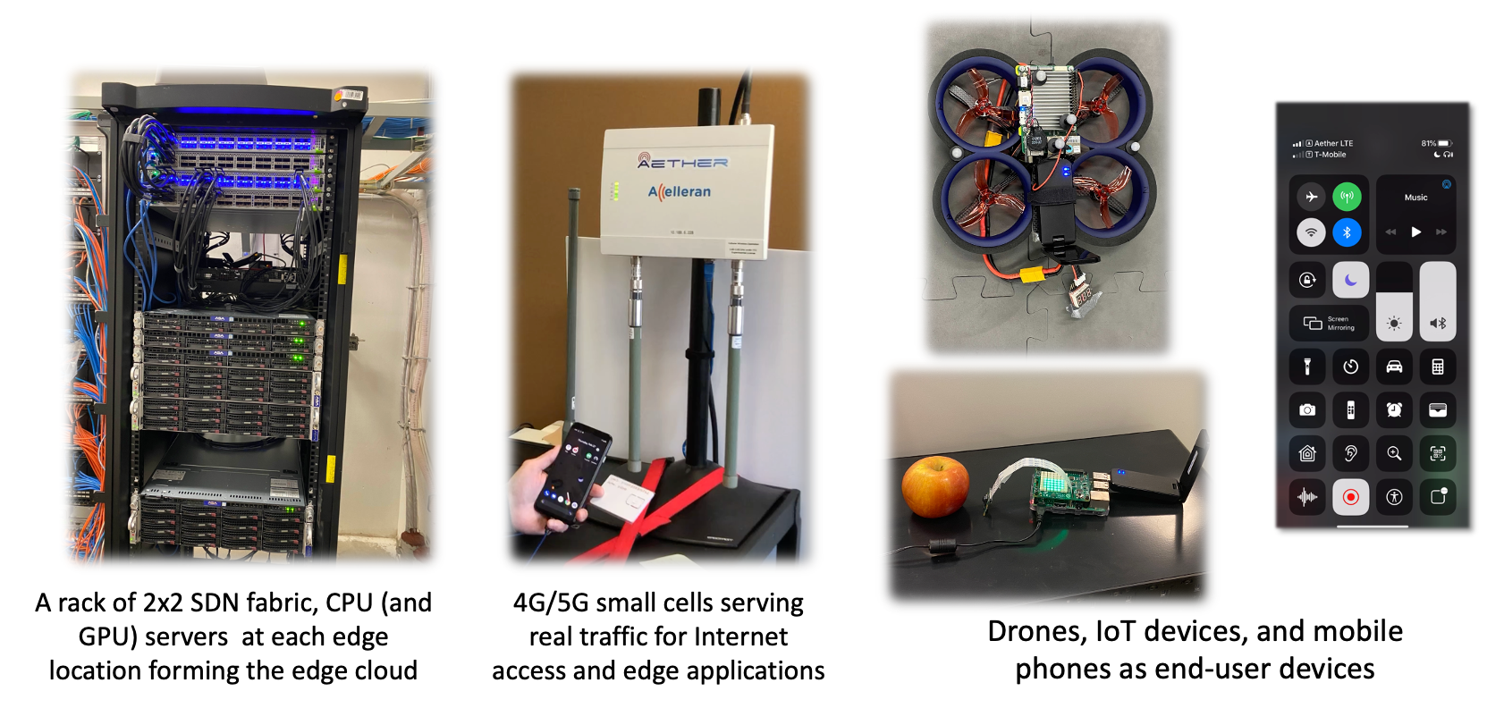
Pronto Deployments of ONF Aether Pods

Slide 14
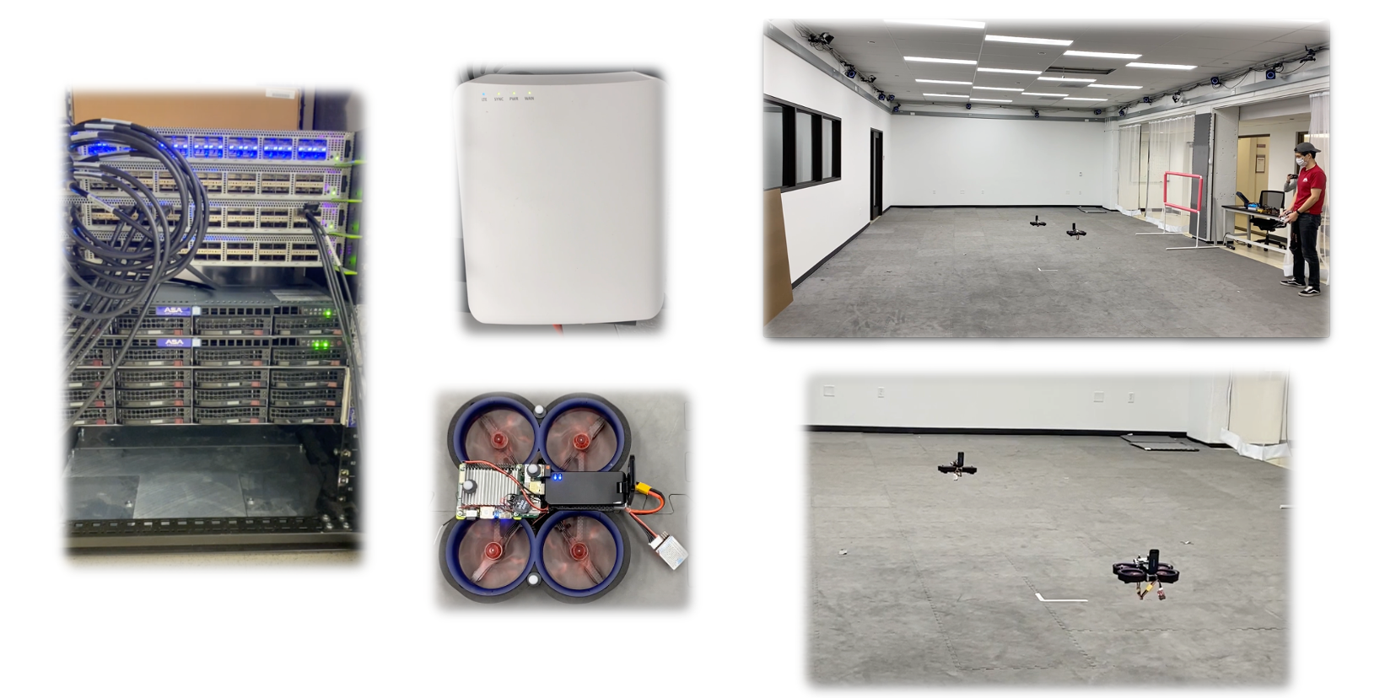
Pronto Demonstrations With Drones at Stanford

Slide 15
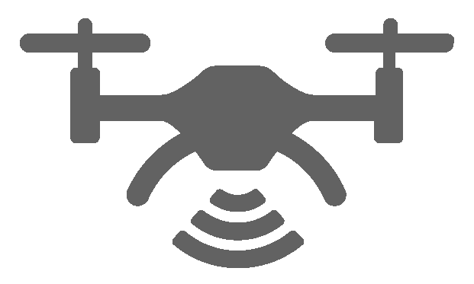
Pronto at Stanford Flight Lab
Aether Management Platform
5G SD-Core Control
Drone location information
delivered to the Motion Capture app
SD-Fabric Control
INT
Control
5G SD-Core UPF Control
ONOS (Highly Available)
ONOS (Highly Available)
ONOS (Highly Available)
Telemetry Collection
Closed-Loop Control
Verification
Edge Cloud Platform
5G SD-Core UPF
Leveraging input from Motion Capture App,
The Command Control app makes decisions
for next waypoint location of each drone
and sends them to the drones via CBRS
small cell
Motion Capture
Command Control

Slide 16
Real-Time Mitigation of Microbursts
Aether Management Platform
5G SD-Core Control
SD-Fabric Control
INT
Control
5G SD-Core UPF Control
ONOS (Highly Available)
ONOS (Highly Available)
ONOS (Highly Available)
Fine-grained visibility based
closed-loop control
Telemetry Collection
Closed-Loop Control
Verification
Edge Cloud Platform
ConQuest
An edge application causes unexpected congestion,
effectively creating a DoS attack.
Without Pronto’s fine-grained visibility based closed-loop control,
this causes disruption to the drone flight.
5G SD-Core UPF
Motion Capture
Command Control
ConQuest automatically drops/rate-limits congesting traffic,
enabling uninterrupted connectivity service to drone operation.
Edge Application
https://opennetworking.org/p4/conquest-flow-level-queue-analysis-in-p4/

Slide 17
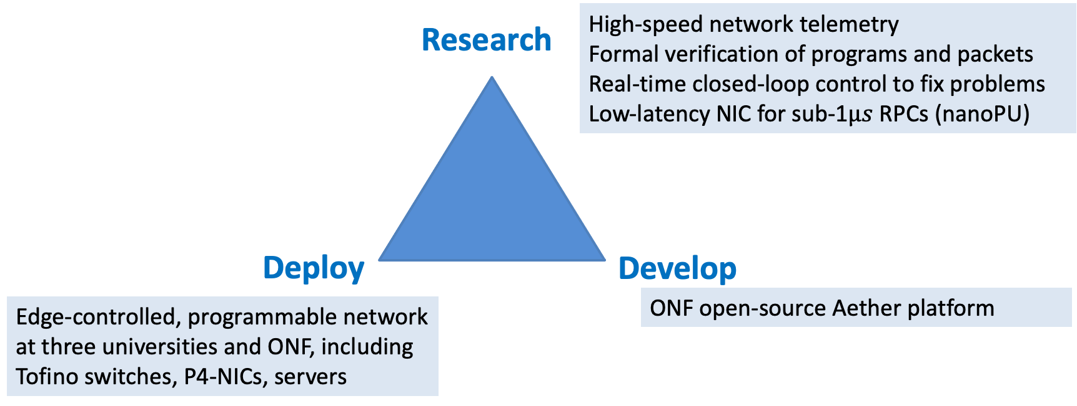
Pronto
Enable network owners to run their networks better!

Slide 18
NextG Networks are an Exciting Opportunity
Edge communication services
Access + Network + Edge-cloud
Numerous promising use cases
Tremendous practical interest
Increasingly programmable equipment
Great research opportunities
Break down interdisciplinary silos
Use and extend open-source software
Do real deployments in your local environment
Collaborate with a range of industries

Slide 20
References
Larry Peterson, Tom Anderson, Sachin Katti, Nick McKeown, Guru Parulkar, Jennifer Rexford, Mahadev Satyanarayanan, Oguz Sunay, Amin Vahdat, “Democratizing the network edge,” in ACM SIGCOMM Computer Communications Review, April 2019.
Larry Peterson and Oguz Sunay, 5G Mobile Networks: A Systems Approach, Morgan and Claypool Publishers, July 2020.
Nate Foster, Nick McKeown, Jennifer Rexford, Guru Parulkar, Larry Peterson, and Oguz Sunay, "Using deep programmability to put network owners in control," in ACM SIGCOMM Computer Communication Review, October 2020.
Pronto demos
Introduction: https://youtu.be/KjdXEOUMnOI
Demo 1: Resolving hardware and software failures: https://youtu.be/CUdOSv0mUmM
Demo 2: Runtime software upgrades: https://youtu.be/K44KgMNFcZc
Demo 3: Detecting and blocking microburst congestion: https://youtu.be/XW_pgPMvuqw
Demo 4: Resiliency against DoS and exfiltration attacks: https://youtu.be/lLhffmr4YbY
Demo 5a: Automated deployment of the new Stanford edge: https://youtu.be/04sq4kQ6ySw
Demo 5b: Centralized management of all Pronto and Aether networks: https://youtu.be/FAVyonQMSuc

