Slide 1
Closing the Network Control Loop
Jennifer Rexford
Princeton University

Slide 2




Programmability From Top-to-Bottom and End-to-End
…
DoS Mitigation
Overlay Virtualization
Load
Balancing
Traffic Engineering
SDN Controller
vSwitch
DPDK
User space
NIC
NIC
Kernel stack
XDP/eBPF
5G Mobile
Network

Slide 3


What Will Network Owner’s Do?
What will network owners do with this new flexibility?
We believe they will want to run their networks better!

Slide 4
Adding New Dials
Traffic
Performance
Cyberattacks
Failures
Signal strength
<Your measurement here>

Slide 5

Adding New Knobs
Drop
Mark
Rate-limit
Reroute
Hand-off
<your knob here>

Slide 6
Closed-Loop Control
Analyze
Measure
(dials)
Adapt
(knobs)

Slide 7
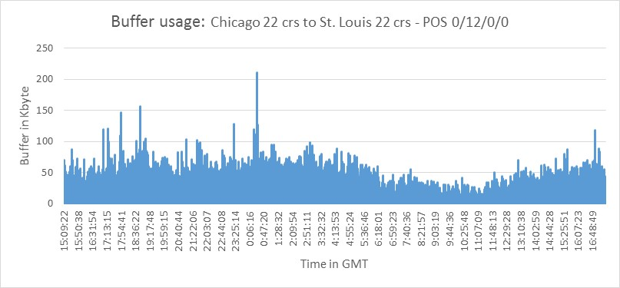
Example #1: Microbursts
5x
Microbursts
3x
Queue Length
1x
16:00:00
0:00:00
8:00:00
16:00:00
Time in day (24h)
Small timescale traffic bursts
  Long queues caused by incast, attacks, etc.
  Lead to high packet delay and loss
  … despite low average link utilization

Slide 8
Example #1: Microburst Measurement
Data-plane measurement and analysis
  Backlog in the queue
  A flow’s own contribution to the queue
55%
10%
ConQuest: "Fine-grained queue measurement in the data plane" in CoNEXT’19.

Slide 9
Example #1: Microburst Mitigation
Data-plane adaptation
  Drop or mark an arriving packet probabilistically
  Based on its flow’s contribution to the queue
55%
10%

Slide 10


Example #2: Distributed Denial-of-Service Attacks
DNS
DNS
DDoS attacks
  DNS reflection attack
  SYN or HTTP flooding
  Slowloris attack
Overwhelm the victim
  Exhausting network and server resources
. . .
Attacker
Victim

Slide 11
Example #2: DDoS Detection
Data-plane measurement and analysis
  Identify suspected victim destinations (key DstIP)
  … receiving traffic from distinct senders (attribute SrcIP)
  … in excess of a threshold (threshold T)
Key
select DstIP where distinct(SrcIP) > T
Attribute
Threshold
BeauCoup: “Answering many network traffic queries, one memory update at a time” in SIGCOMM’20

Slide 12

Example #2: DDoS Mitigation
Data-plane adaptation
  Drop or rate-limit packets to suspected victims
  Run stateful firewall
  for suspected victims
  Pushback upstream toward the senders
DNS
DNS
. . .
Attacker
Victim

Slide 13
Example #3: Path Performance
Network path diversity
Load balancing to achieve good performance
  Track the performance (load, loss, delay) of paths
  Split traffic effectively over the multiple paths

Slide 14
Example #3: Path Performance Monitoring
Data-plane tracking of path performance
  E.g., lowest maximum link utilization
  E.g., minimum end-to-end latency or loss
Probes along reverse path
30%
10%
30%
25%
30%
20%
50%
10%
10%
20%
50%

Slide 15
Example #3: Performance-Aware Load Balancing
Data-plane adaptation to direct traffic over the best path
  Sending packets in the forward direction
  … along the path with the best performance
25%
30%
20%
10%
20%
50%
Contra: "A programmable system for performance-aware routing” (NSDI’20)

Slide 16

Enabler: Programmable Data Planes
p4.org
Registers
Parser
Deparser
Memory
Match-
Action
Table
ALU
Stages

Slide 17
Challenges: Resource Limitations
p4.org
Limited
depth
Limited
# bits
Limited
# rules
Limited # registers
and # of accesses
Limited ALU
operations
Registers
Parser
Deparser
Memory
Match-
Action
Table
ALU
Stages

Slide 18


Solution: Compact Data Structures
Approximate analysis is fine
  Microbursts: size estimate for just the large flows
  DDoS: rough count for large #s of distinct sources
  Path performance: rough estimates for best paths
Data structures can fit in data-plane registers
  Sketch (e.g., Bloom filter, count-min sketch, etc.)
  Small hash table (e.g., cache of the popular keys)

Slide 19
Grand Challenge
High-level goals
Distributed software
Compiler
Controller
vSwitch
Switch OS
Switch OS
vSwitch
control
loop
NIC
NIC
NIC
switch
switch
NIC

Slide 20
THANKS

