Slide 1
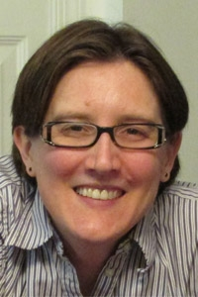
Compiling Network Path Queries
Srinivas Narayana
Princeton University
Notes:
1

Slide 2
Network Management is Complex
Computer networks getting bigger
Commodity components: high failure rates
Outages are costly!
~ $300K/hour, 200 minutes/outage
Management tools are useful
Programmatic tools can really help!
“The cost of downtime.” Andrew Lerner, 2014
“Downtime, outages and failures: Understanding their true costs.” Evolven, 2012

Slide 3
Management = Measure + Control
Network Operators
Measure
Control
Software-Defined Networking (SDN)

Slide 4
Software-Defined Networking
Forwarding
SDN controller
Control logic
Rules

Slide 5
Measuring is a Hard Problem
A few standard tools:
Ping, traceroute, SNMP, NetFlow, tcpdump
An operator must “join” multiple data streams:
Forwarding: controller policy, topology updates
Traffic: packet samples, counters

Slide 6
Example: Where’s the Packet Loss?
Suspect: Faulty network device(s) along the way.
A
B
100 pkts
25 pkts ☹

Slide 7
Example: Where’s the Packet Loss?
Idea: “Follow” the path of packets through the network.
A
B
100 pkts
25 pkts ☹
Fine-grained (A→B) counters
+ Forwarding
Program Complex
Rules
Understand Complex Policies

Slide 8
Lots of Measurement Use-Cases
Traffic matrix
Uneven load balancing
DDoS source identification
Port-level traffic matrix
Congested link diagnosis
Slice isolation
Loop detection
Middlebox traversal order
Incorrect NAT rewrite
Firewall evasion
...
Resource management
Policy enforcement
Problem diagnosis
Complex join procedure
Inaccurate results
High overheads
Notes:
Yet, challenging:
Accuracy: Hard to infer trajectories in data plane
Efficiency: bandwidth, packet bits, rules
Composition: measurements with forwarding

Slide 9
Solution Approach
Declarative Query Specification
Forwarding independence
Co-Measurement independence
Hardware independence
Query-Driven Measurement
Accurate answers
Pay exactly for what you query
Commodity hardware
Path Query Language
Query
Run-Time
System

Slide 10
Solution Approach
1. Path Query Language
Query Expressions
Forwarding
Statistics
2. Query Run-Time System
3. Optimizations
SDN controller
Payloads
Statistics

Slide 11
Solution Approach
1. Path Query Language
Expressive measurement
Efficient measurement
2. Query Run-Time System
3. Optimizations
Accurate measurements
on commodity hardware

Slide 12
Example: Where’s the Packet Loss?
Instead: get A → B packet counts each step along paths where A → B traffic flows
25
25
A
50
B
25
100
25
0
50
50
100 pkts
25 pkts ☹
(srcip=a & dstip=b) ^
repeat(groupby(true, [switch]), MAX_HOPS)

Slide 13
I. Path Query Language

Slide 14
Goal: Declarative Measurement Spec
Packet loss localization
Uneven load balancing
Traffic matrix
Slice isolation
DDoS source identification
Port-level traffic matrix
Congested link diagnosis
Loop detection
Middlebox traversal order
Incorrect NAT rewrite
Firewall evasion
...
Q: Common Primitives?

Slide 15
Common Goals?
Relate a packet across interfaces it flows through
Specify multiple related trajectories
Extract different outputs: packets, counters, ...
Specify where to collect measurement
How to design general primitives
that are efficiently implemented
in the network?

Slide 16
Common Goals?
Relate a packet across interfaces it flows through
... in the data plane
Static analysis of policy
isn’t enough

Slide 17
Key Primitive: Packet Path
Packet paths:
Tests on packets at a single location in network
Same packet must satisfy multiple tests
➔ Regular expressions!
Narrow
Efficient
General
Inefficient
Single location packet test
Packet paths over regular expressions
Tests on sets of packets

Slide 18
Key Primitive: Packet Path
Packet paths:
Tests on packets at a single location in network
Same packet must satisfy multiple tests
➔ Regular expressions!
Multiple related trajectories:
SQL-like constructs for aggregation
Specify measurements precisely:
Upstream and downstream capture
Capture packets, counters, packet samples

Slide 19
Expressing Packet Paths
Regular expressions:
natural to state paths on graphs
S2
S3
S1
S4
S1 ^ .* ^ S4
S6
S5

Slide 20
Expressing Packet Paths
Regular expressions:
natural to state paths on graphs
S2
S3
S1
S4
S1 ^ .* ^ S4
Boolean packet predicate
S6
S5
pred ::= true | false
| header=value
| location=value
| pred & pred
| pred | pred
| ~pred
| ingress()
| egress()

Slide 21
Expressing Packet Paths
Regular expressions:
natural to state paths on graphs
atom ::= in_atom(pred)
| out_atom(pred)
| in_out_atom(pred,
pred)
S1
Input packet
Forwarding
Output packet

Slide 22
Expressing Packet Paths
Regular expressions:
natural to state paths on graphs
S2
S3
S1
S4
S6
S5
S1 ^ .* ^ S4
in_atom(sw=S1) ^ in_atom(true)* ^ in_atom(sw=S4)

Slide 23
Query Language
path ::= atom
| path ^ path
| path | path
| path*
| path & path
| ~path
p1
“hop”
p2

Slide 24
An Example
Capture packets evading a firewall in the network
ingress()
^
(~switch=FW)*
^
egress()
ingress
egress
ingress
egress
ingress
egress
0 or more
repetitions

Slide 25
An Example
Capture packets evading a firewall in the network
ingress()
^
(~switch=FW)*
^
egress()
ingress
egress
ingress
egress
ingress
egress

Slide 26
Query Language: Aggregation
Switch-level traffic matrix:
 | E1 | E2 | ...
I1 | 250 | 100 | ...
I2 | 120 | 95 | ...
... | ... | ... | ...

Slide 27
Query Language: Aggregation
Switch-level traffic matrix:
in_atom(ingress())
^
in_atom(true)*
^
out_atom(egress())
Flow | #pkts
* | 1000
Count all packets, going from any ingress to any egress.

Slide 28
Query Language: Aggregation
Switch-level traffic matrix:
in_group(ingress(),
[switch])
^
in_atom(true)*
^
out_group(egress(),
[switch])
Flow | #pkts
sw=I1, sw=E1 | 250
sw=I1, sw=E2 | 100
... | ...
Group counts by
packet’s ingress and egress switch!
➔ Traffic matrix!

Slide 29
Query Language
path ::= atom
| path ^ path
| path | path
| path*
| path & path
| ~path
atom ::=
| in_atom(pred)
| out_atom(pred)
| in_out_atom(pred,
pred)
| in_group( pred,
[fields])
| out_group(pred,
[fields])
| in_out_group(pred,
[fields], pred,
[fields])

Slide 30
Where to capture matching packets?
Packet flow
Upstream
Downstream
{path}.up()
Queried Path
{path}.down()
For a given query: packets may be different!

Slide 31
How to process matching packets?
{path}.set_bucket(bucket)
count_bucket()
(Get switch counters)
packet_bucket()
(Send to controller)
sampling_bucket()
(Get sFlow packet samples)

Slide 32
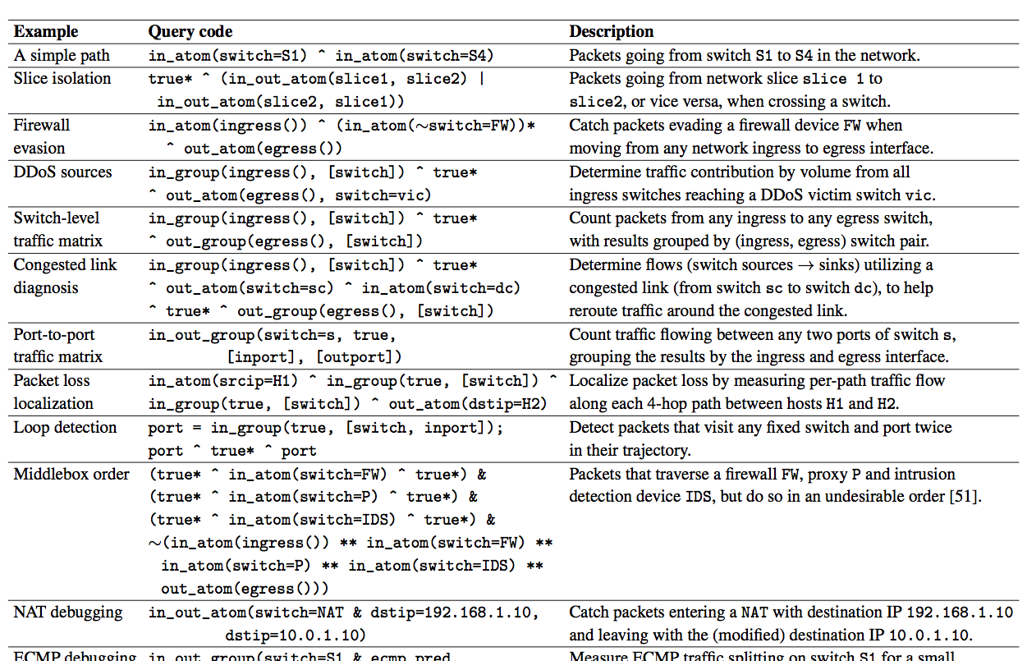
More Query Examples
Compiling path queries, to appear in NSDI 2016

Slide 33
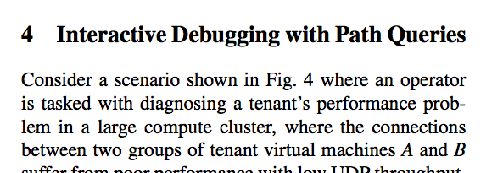
More Query Examples
Compiling path queries, to appear in NSDI 2016

Slide 34
Path Query Language: Summary
Predicates: single point tests
Paths: regular expressions on predicates
Aggregation: groupby construct
Location: downstream and upstream measurement
Result format: packets, counts, samples

Slide 35
II. The Run-Time System

Slide 36
Solution Approach
1. Path Query Language
Query expressions
Statistics
2. Query Run-Time System
3. Optimizations
SDN controller
Payloads
Statistics

Slide 37
Goal: Query → Network Measurement
Accurate answer
Pay exactly for what you query
Commodity hardware

Slide 38
Commodity HW: Match-Action Tables
Wildcard bit pattern
(ternary matching)
Forward/Drop/Modify
match1 ➔ action1
match2 ➔ action2
...
38

Slide 39
Commodity HW: Multi-Stage Match-Act
match1 ➔ action1
match2 ➔ action2
...
match1 ➔ action1
match2 ➔ action2
...
...

Slide 40
Goal: Query → Network Measurement
Accurate answer
Pay exactly for what you query
Commodity hardware
Consider downstream measurement...

Slide 41
Goal: Query → Network Measurement
Accurate answer
Pay for what you query
Commodity hardware
How to observe a packet’s
path accurately in the data plane
with low overhead?

Slide 42
Approach 1: Join Traffic & Forwarding
Packets may be dropped downstream
Dynamic
Timestamps not aligned!
Traffic dataset
e.g., NetFlow, SNMP
Forwarding updates
e.g., OF/routing protocol updates
X
Deriving traffic demands for operational IP networks. Feldmann et al., 2001
Sampled NetFlow

Slide 43
Approach 1: Join Traffic & Forwarding
Ambiguity between identical packets downstream
??
Dynamic
Timestamps not aligned!
Traffic dataset
e.g., NetFlow, SNMP
Forwarding updates
e.g., OF/routing protocol updates
X
Packet traceback for software-defined networks. Zhang et al., 2015

Slide 44
Approach 1: Join Traffic & Forwarding
Packet rewriting compounds the ambiguity!
Ambiguity between identical packets downstream
??
Dynamic
Timestamps not aligned!
Traffic dataset
e.g., NetFlow, SNMP
Forwarding updates
e.g., OF/routing protocol updates
X
Trajectory sampling for direct traffic observation. Duffield et al., 2001

Slide 45
Approach 2: Collect at Every Hop
Using packet histories to troubleshoot networks. Handigol et al., 2014
Hash-based IP traceback. Snoeren et al., 2001
Packet-level telemetry in large data-center networks. Zhu et al., 2015

Slide 46
Approach 2: Collect at Every Hop
Too expensive to collect up front!
Using packet histories to troubleshoot networks. Handigol et al., 2014
Hash-based IP traceback. Snoeren et al., 2001
Packet-level telemetry in large data-center networks. Zhu et al., 2015

Slide 47
Approach 2: Collect at Every Hop
Too expensive to collect up front!
Sampling to reduce overhead may miss the packets you care about…
Trajectory sampling for direct traffic observation. Duffield et al., 2001

Slide 48
Approach 3: Write Path into Packet
Switches have very accurate info on prior packet path ☺
Match-action HW can’t match regexes :-(
Too much info on packet! :-(
sw: S1,
srcip: ___,
dstip: ___,
...
sw: S3, ...;
sw: S2, ...;
sw: S1, ...;
sw: S2,
srcip: ___,
dstip: ___;
sw: S1, ...;
IP record route, RFC 791. Postel, 1981
Tracing packet trajectory in data-center networks. Tammana et al., 2015

Slide 49
Approach 3: Write Path into Packet
Switches have very accurate info on prior packet path ☺
As such, too much info on packet! ☹
How to reduce the amount of path information on packets?
sw: S1,
srcip: ___,
dstip: ___,
...
sw: S3, ...;
sw: S2, ...;
sw: S1, ...;
sw: S2,
srcip: ___,
dstip: ___;
sw: S1, ...;
[8] IP record route
[9] Tracing packet trajectory in data-center networks. Tammana et al., 2015

Slide 50
Reducing Path Info on Packets
Observation 1: Queries already tell us what’s needed!
Only record path info needed by queries
Observation 2: Queries are regular expressions
Processing: Finite automaton (DFA)
Distinguish only DFA states on the network!

Slide 51
Reducing Path Info on Packets
Observation 1: Queries already tell us what’s needed!
Only record path state needed by queries
Observation 2: Queries are regular expressions
Regular expressions ➔ Finite automaton (DFA)
Distinguish only paths corresponding to DFA states
Record only DFA state on packets (1-2 bytes)
Use existing “tag” fields (e.g., VLAN)

Slide 52
Downstream Query Compilation
Queries
Forwarding
Regex Matching on Packet Trajectories!
Downstream Query Compiler
Data Plane Rules

Slide 53
Downstream Query Compilation
Queries
Forwarding
(1) Get Query DFA
(2) Get Transitioning & Accepting Policies
(3) Compose into Unified Policy
Data Plane Rules

Slide 54
Downstream Query Compilation (1/3)
p = (switch=S1 & srcip=10.0.0.1)
^ (switch=S2 & dstip=10.0.0.3)
p.set_bucket(count_bucket())
S1
S2
switch=S1 & srcip=10.0.0.1
switch=S2 & dstip=10.0.0.3
Q0
Q1
Q2
Notes:
Not only do we know, but also modify packet processing on switches to make measurements easier. ➔ need to make this point somewhere.
Note that there are details to make the execution of the automaton deterministic on the data plane – which we are skipping in the interest of time.
Also, the queries are assumed to be matching a packet only once on each switch: typically there are 2 matching points, but let’s assume only ingress queries exist for the time being.

Slide 55
Downstream Query Compilation (2/3)
switch=S1 & srcip=10.0.0.1
switch=S2 & dstip=10.0.0.3
Q0
Q1
Q2
Generate “match-action-able” rules
state=Q0 & switch=S1 & srcip=10.0.0.1 ➔ state←Q1
DFA
Transition
state=Q1 & switch=S2 & dstip=10.0.0.3 ➔ state←Q2
state=Q1 & switch=S2 & dstip=10.0.0.3 ➔ count
DFA Accept
Notes:
Not only do we know, but also modify packet processing on switches to make measurements easier. ➔ need to make this point somewhere.

Slide 56
Downstream Query Compilation (3/3)
DFA-Transitioning
)
(
>>
Forwarding
+
DFA-Accepting
All acting on the same data plane packets!
Use policy composition operators and compiler
Composing software-defined networks. Monsanto et al., 2013
Notes:
Why does this composed policy make sense? Explain.

Slide 57
Downstream Query Compilation (3/3)
DFA-Transitioning
)
(
>>
Forwarding
+
DFA-Accepting
dstip=10.0.0.1 ➔ fwd(1)
dstip=10.0.0.2 ➔ fwd(2)
dstip=10.0.0.3 ➔ fwd(3)
...
state=Q0 & switch=S1 & srcip=10.0.0.1 ➔ state←Q1
state=Q1 & switch=S2 & dstip=10.0.0.3 ➔ state←Q2
>>
state=Q0 & switch=S1 & srcip=10.0.0.1 & dstip=10.0.0.2
➔ state←Q1, fwd(2)
Composing software-defined networks. Monsanto et al., 2013
Notes:
Why does this composed policy make sense? Explain.

Slide 58
Downstream Query Compilation (3/3)
(DFA-Ingress-Transitioning >> Forwarding >> DFA-Egress-Transitioning) +
(DFA-Ingress-Accepting)
+
(DFA-Ingress-Transitioning >> Forwarding >> DFA-Egress-Accepting)

Slide 59
Compiling the Full Language
DFA construction with overlapping predicates
Upstream queries
Groupby atoms
Generate an ‘orthogonal basis’ for predicates
Formulate reachability test with Filter output
Traverse AST proactively, rewriting to “basic” atoms

Slide 60
Query Run-Time System: Summary
Translation of Queries to Network Measurements
Accurate measurement
Packets carry trajectories
Efficient encoding through DFA states
Pay exactly for what you query
Only collect packets matching queries
Use commodity hardware
Path regex matching on match-action tables!

Slide 61
III. Optimizations

Slide 62
Solution Approach
1. Path Query Language
Query expressions
Statistics
2. Query Run-Time System
3. Optimizations
SDN controller
Payloads
Statistics

Slide 63
Goal: Make Run-Time Efficient
Metrics:
Rule space
Query compile time
Packet state space
Stanford network on a mix of queries (~550 statistics)
Unoptimized: didn’t compile in 2 hours
Fully optimized:
Query compile time: ~ 5 seconds
Rule space: ~ 650 rules (TCAM capacity 2-4K)
Packet state space: state fits in VLAN header
Fit in switch rule memory?
Debugging “interactive”?
Fit on typical “tag” headers?

Slide 64
Optimizations: Summary
Optimization | # Rules? | Time? | # States?
Separate query & forwarding actions into separate stages
Optimize conditional policy compilation
Integrate tagging and capture policies
Pre-partition predicates by flow space
Cache predicate overlap decisions
Decompose query predicates into multiple stages
Detect predicate overlaps with Forwarding Decision Diagrams
Notes:
// table of optimizations + intended metrics that should be reduced

Slide 65
Optimizations: Summary
Optimization | # Rules? | Time? | # States?
Separate query & forwarding actions into separate stages
Optimize conditional policy compilation
Integrate tagging and capture policies
Pre-partition predicates by flow space
Cache predicate overlap decisions
Decompose query predicates into multiple stages
Detect predicate overlaps with FDDs
Cross-Product Explosion
Notes:
// table of optimizations + intended metrics that should be reduced

Slide 66
Cross-Product Explosion (1/2)
DFA-Transitioning
)
(
>>
Forwarding
+
DFA-Accepting
state=Q0 & srcip=10.0.0.2 ➔ state←Q1
state=Q1 & srcip=10.0.0.3 ➔ state←Q2
state=Q2 & port=4 ➔ state←Q4
state=Q3 & srcmac=01:* ➔ state←Q5
state=Q4 & srcip=10.0.0.1 ➔ state←Q3
state=Q5 & tpdstport=80 ➔ state←Q5
state=Q6 & srcip=10.0.0.3 ➔ state←Q6
state=Q7 & dstip=10.0.0.4 ➔ state←Q2
...
dstip=10.0.0.1 ➔ fwd(1)
dstip=10.0.0.2 ➔ fwd(2)
dstip=10.0.0.3 ➔ fwd(3)
dstip=10.0.0.4 ➔ fwd(4)
dstip=10.0.0.5 ➔ fwd(5)
dstip=10.0.0.6 ➔ fwd(6)
dstip=10.0.0.7 ➔ fwd(7)
dstip=10.0.0.8 ➔ fwd(8)
...
>>
state=Q0 & srcip=10.0.0.2 & dstip=10.0.0.1
➔ state←Q1, fwd(1)

Slide 67
Cross-Product Explosion (2/2)
Packets can satisfy both p1 and p101
Also p1 and p102; p1 and p103; ...
Query DFA edges (and rules) for each combination!
p1: srcip=10.0.0.1
p2: srcip=10.0.0.2
...
p100: srcip=10.0.0.100
p101: dstip=192.168.0.101
p102: dstip=192.168.0.102
...
p200: dstip=192.168.0.200

Slide 68
Taming Cross-Product Explosion
Key Problem: Coerce multiple actions on overlapping sets of packets

Slide 69
Taming Cross-Product Explosion
Key Problem: Coerce multiple actions on overlapping sets of packets
Idea: Can we leverage multiple passes on each packet in hardware?
match1 ➔ action1
match2 ➔ action2
...
Multi-stage match-action tables can already do this!

Slide 70
Taming Cross-Product Explosion
Key Idea: Leverage multiple passes for each packet
Overlapping actions on different tables!
match1 ➔ action1
match2 ➔ action2
...
match1 ➔ action1
match2 ➔ action2
...
...
Rule space O(M+N), not O(M*N)

Slide 71
Taming Huge Policies
(DFA-Ingress-Transitioning >> Forwarding >> DFA-Egress-Transitioning) +
(DFA-Ingress-Accepting)
+
(DFA-Ingress-Transitioning >> Forwarding >> DFA-Egress-Accepting)
☹
(DFA-Ingress-Transitioning + DFA-Ingress-Accepting)
>>
Forwarding
>>
(DFA-Egress-Transitioning + DFA-Egress-Accepting)

Slide 72
Taming Huge Policies
(DFA-Ingress-Transitioning + DFA-Ingress-Accepting) >> Forwarding
>> (DFA-Egress-Transitioning + DFA-Egress-Accepting)
in_transition
+
in_accept
out_transition
+
out_accept
forwarding
O(M*N) ➔ O(M+N)

Slide 73
Taming Overlapping Query Predicates
p1: srcip=10.0.0.1
p2: srcip=10.0.0.2
...
p100: srcip=10.0.0.100
p101: dstip=192.168.0.101
p102: dstip=192.168.0.102
...
p200: dstip=192.168.0.200
in_transition
+
in_accept
srcip=10.0.0.1 ➔ state1←q1
srcip=10.0.0.2 ➔ state1←q2
...
dstip=192.168.0.101 ➔ state2←q1
dstip=192.168.0.102 ➔ state2←q2
...
O(M*N) ➔ O(M+N)
Running many parallel Query DFAs!
...

Slide 74
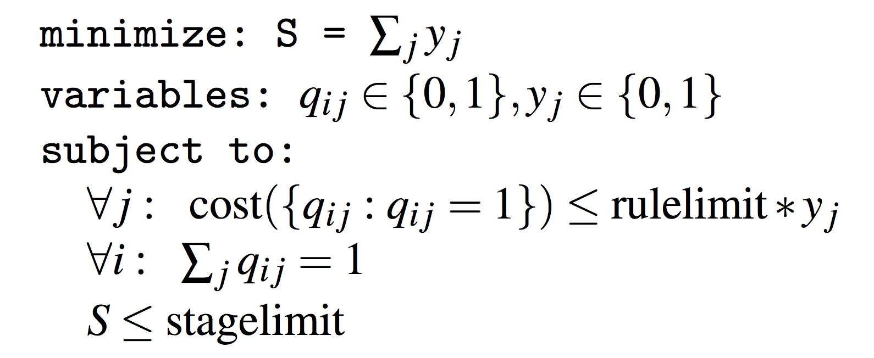
Taming Overlapping Query Predicates
Approach: “pack” queries into tables to minimize cost while respecting per-stage rule capacities and #stages
Total # stages
# Rules in stage j

Slide 75
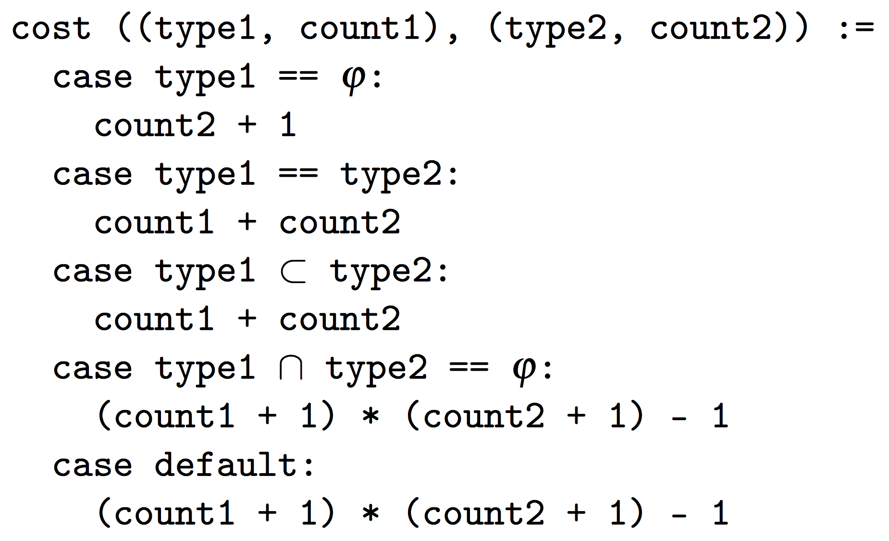
Taming Overlapping Query Predicates
Cost function: upper bound on actual # rules
Move “dissimilar” predicates into different table stages
Concurrent NetCore: From policies to pipelines. Schlesinger et al., 2014
Compiling packet programs to reconfigurable swithces. Jose et al., 2015

Slide 76
Implementation
Prototype
Pyretic SDN controller
NetKAT (Ocaml) compiler
Install rules on OpenVSwitch
Currently single-threaded
Intel Xeon E3, 3.70Ghz 32GB
Implementation publicly available online
http://frenetic-lang.org/pyretic/
Composing software-defined networks. Monsanto et al., 2013
A fast compiler for NetKAT. Smolka et al., 2015
OpenVSwitch.org

Slide 77
Benefit of Optimizations
Stanford campus network topology
Several queries:
Traffic matrix, DDoS detection, per-hop packet loss, firewall evasion, slice isolation, congested link
Metrics and Stanford results (all queries together):
Compile time: > 2 hours ➔ 5 seconds
# Rules: ~ 650
# State bytes: 2 bytes
Notes:
Rule space estimation for DNF cases.
Stanford forwarding policy has 3840 rules overall – that’s 240 per device on average. Almost all rules match on destination ip address, which almost none of the queries actually match on. This means the best-case reduction applies: ~240 times or two orders of magnitude reduction of rule count going from single-stage to multi-stage tables.
Then there’s at least a factor of 6.6 from the instances that _do_ terminate. Together, that’s 7 * 240 = 1680, or three orders of magnitude reduction in rule space from the unoptimized case.

Slide 78
Benefit of Optimizations (Stanford)
Cumulative Optimization | Time (s) | # Rules | # State Bits
None | > 7900 | DNF | DNF
Separate query & forwarding actions into separate stages | > 4920 | DNF | DNF
Optimize conditional policy compilation | > 4080 | DNF | DNF
Integrate tagging and capture policies | 2991 | 2596 | 10
Pre-partition predicates by flow space | 56.19 | 1846 | 10
Cache predicate overlap decisions | 35.13 | 1846 | 10
Decompose query predicates into multiple stages | 5.467 | 260 | 16
Notes:
Rule space estimation for DNF cases.
Stanford forwarding policy has 3840 rules overall – that’s 240 per device on aveage. Almost all rules match on destination ip address, which almost none of the queries actually match on. This means the best-case reduction applies: ~240 times or two orders of magnitude reduction of rule count going from single-stage to multi-stage tables.
Then there’s at least a factor of 6.6 from the instances that _do_ terminate. Together, that’s 7 * 240 = 1680, or three orders of magnitude reduction in rule space from the unoptimized case.

Slide 79
Scalability Trends
Five synthetic ISP (Waxman) topologies at various network sizes
At each network size, run mix of queries from before
Averaged metrics across queries & topologies

Slide 80
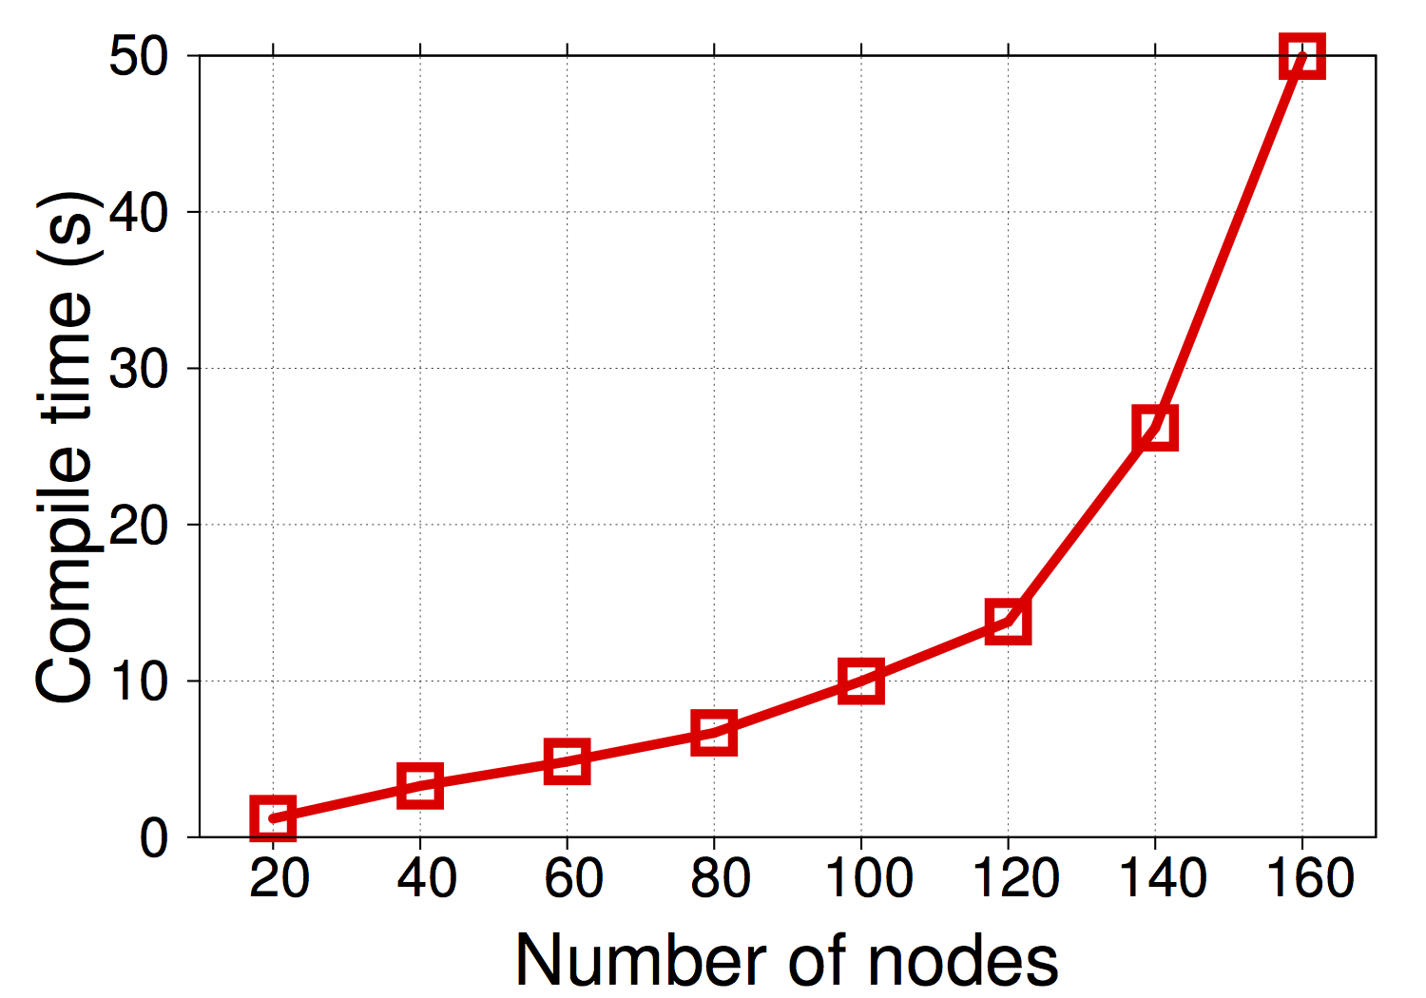
I. Query Compile Time
Interactive problem solving (15s)
Response time in man-computer conversational transactions. Miller, 1968

Slide 81
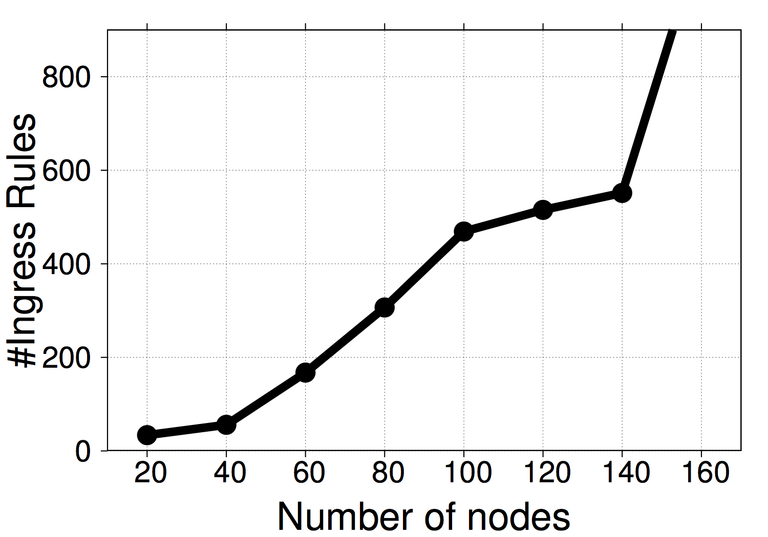
II. Rule Count
Switch TCAM capacity: 2K-4K rules

Slide 82
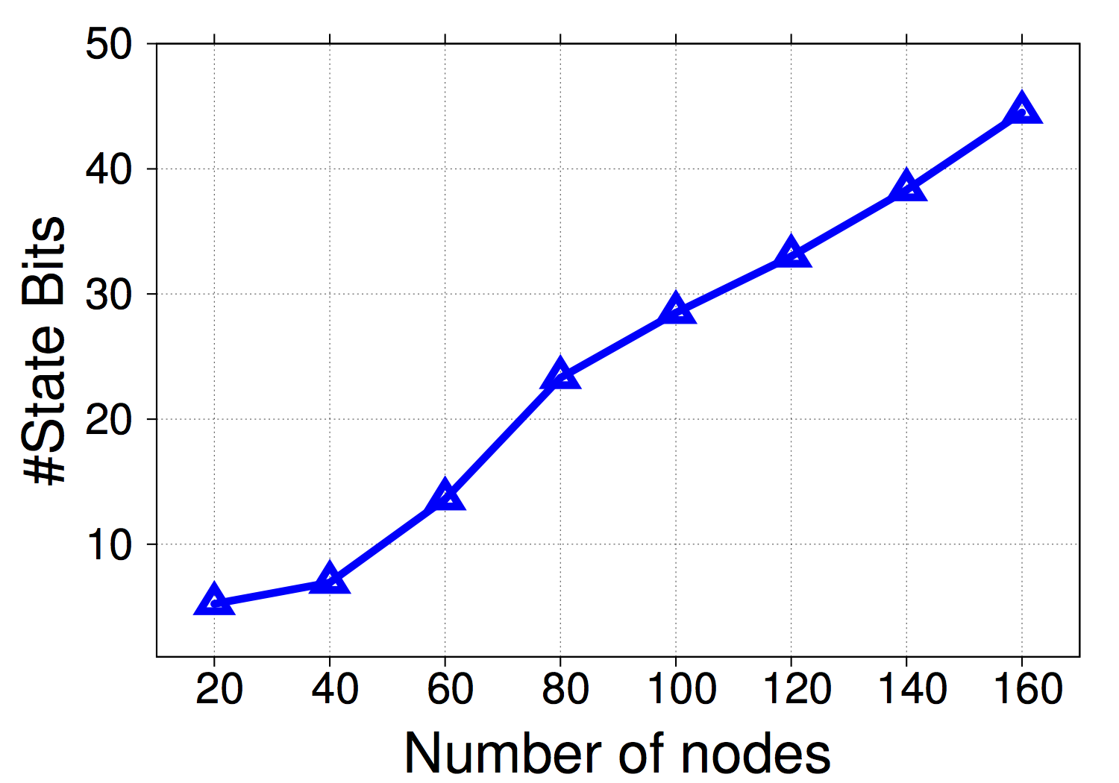
III. Packet State Bits
MPLS
VLAN

Slide 83
Summary
Declarative path query language
Regular expressions, grouping
Capture locations, capture actions
Compositional run-time system
Query-DFA packet state
Key optimizations for a practical system
Addressing cross-product explosion
Paper and more info at http://www.cs.princeton.edu/~narayana/pathqueries

Slide 84
Queries? ☺

Slide 85
