Slide 1
P4 Amore! (Or, How I Learned to Stop Worrying and Love P4)
Jennifer Rexford
Princeton University
Notes:
A story of unnatural acts, and moving beyond the tail wagging the dog, …

Slide 2
My Personal Path to P4
Centralized network management (‘97-’03)
Network-wide control, through unnatural acts
Indirect, by “inverting” the control plane
… but, constrained by command-line interfaces
Optimize Link Weights
Collaboration with algorithms and optimization, and network operators!
Measure traffic matrix
Tweak OSPF link weights
Notes:
1996-2004, central control through the CLI
Unnatural acts
Collaboration with optimization and algorithms
My life has been about the “tail wagging the dog”

Slide 3
My Personal Path to P4
Direct network control (’03-’07)
Direct, but only by abusing legacy protocols
Enabled innovation and real deployment!
… but, constrained by legacy control protocols
Routing Control Platform
Collaboration with distributed systems, and network operators!
Conventional measurement
BGP messages
Notes:
2003-2007, direct control, through legacy protocols

Slide 4
My Personal Path to P4
Open network control (’07-)
Logically central control with open interfaces
Bigger scope for innovation and impact!
… but, constrained by legacy data planes
SDN Controller
Collaboration with programming languages to build control-loop abstractions on OpenFlow!
OpenFlow measurement
OpenFlow control
Notes:
2003-2007, direct control, through legacy protocols
Got super excited when Nick and others at Stanford proposed OpenFlow

Slide 5
My Personal Path to P4
Protocol-independent data planes (’13-)
Programs tell the switches how to behave
Header formats, parser, table graphs, actions
Finally, create the networks we want!
P4 Program
Collaboration with switch designers, programming languages, and more!
Novel measurement primitives
Configurable parser, tables, etc.
Notes:
2003-2007, direct control, through legacy protocols
Collaboration with

Slide 6
Excited About P4
Get it right
Incorporating all the hard-won lessons
Programming abstractions driving the interface
Leverage new technology
Reconfigurable ASICs, FPGAs/NPs, flexible NICs, software switches, …
Enable innovation
Traffic engineering solely in the data plane
Consensus protocol (Paxos) in the data plane
Detection and diagnosis of performance problems
Notes:
Example apps I’m super excited about.

Slide 7
P4 Language Consortium
Build a community
A common language
Open-source software
Support for many target platforms
Enable a wealth of innovation
Diverse “apps” (including proprietary ones!)
… while leveraging commodity switches
With a low barrier to entry
Free membership
Simple software licensing

Slide 8
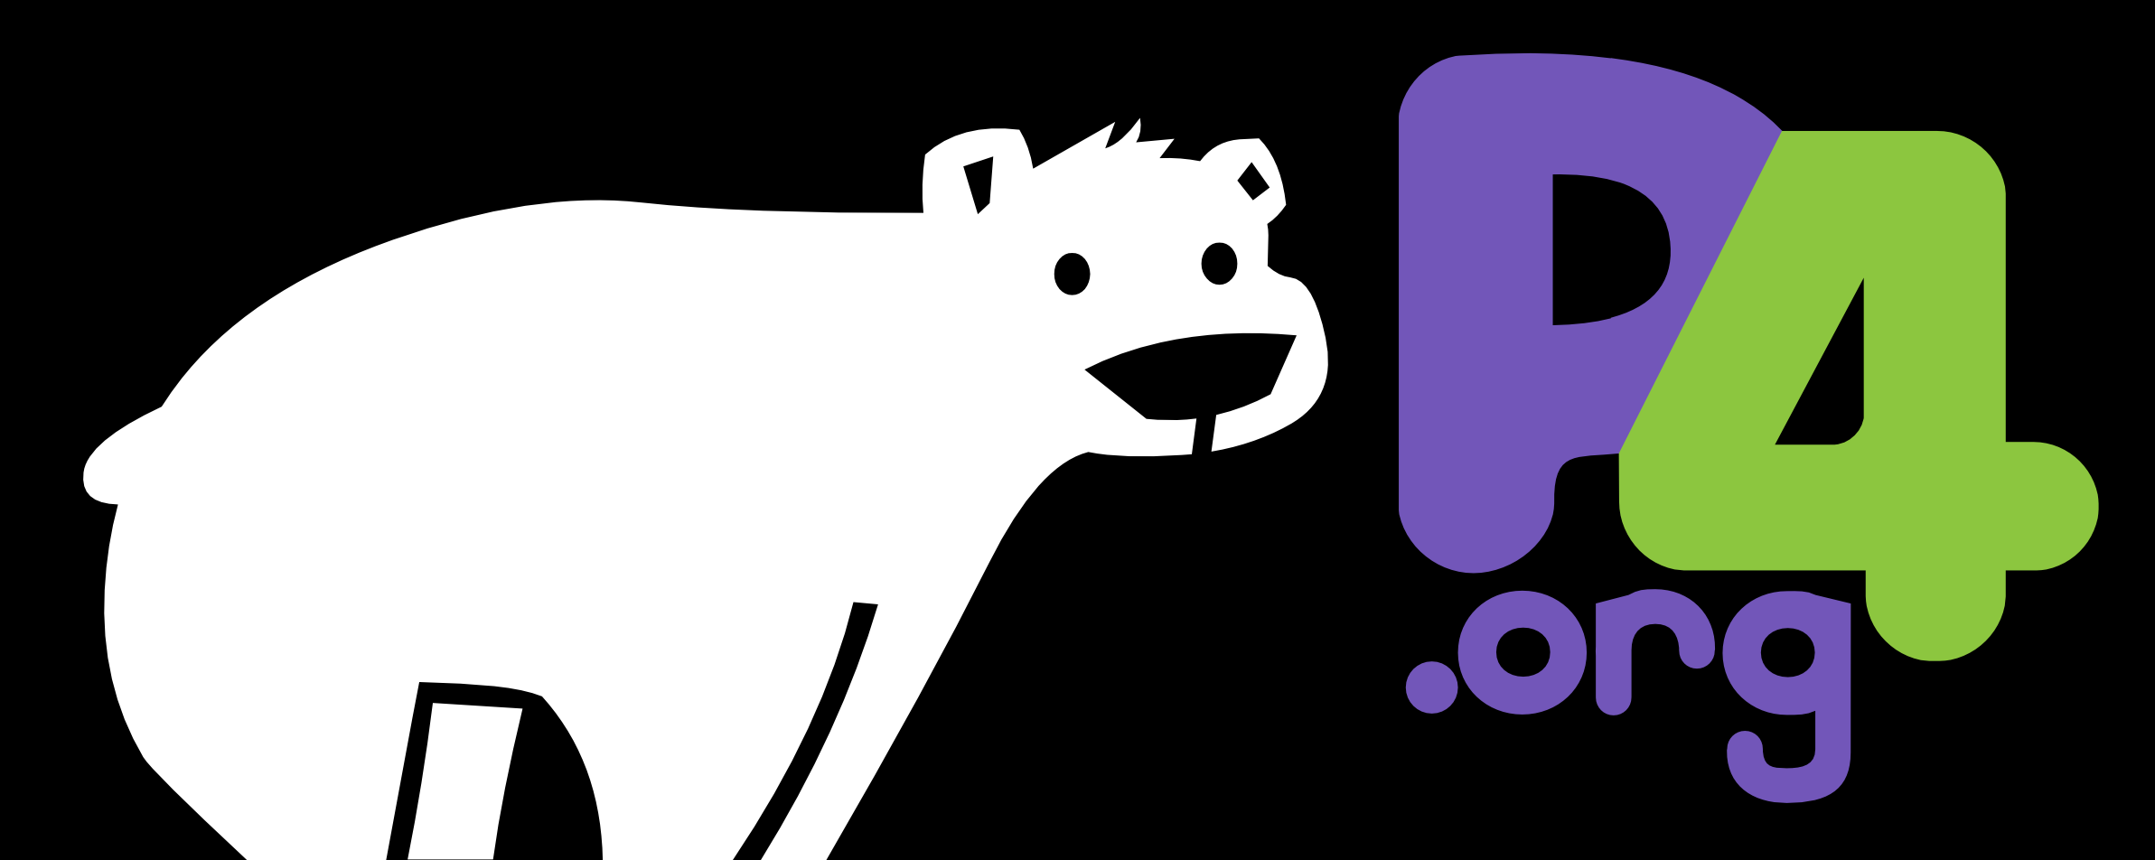
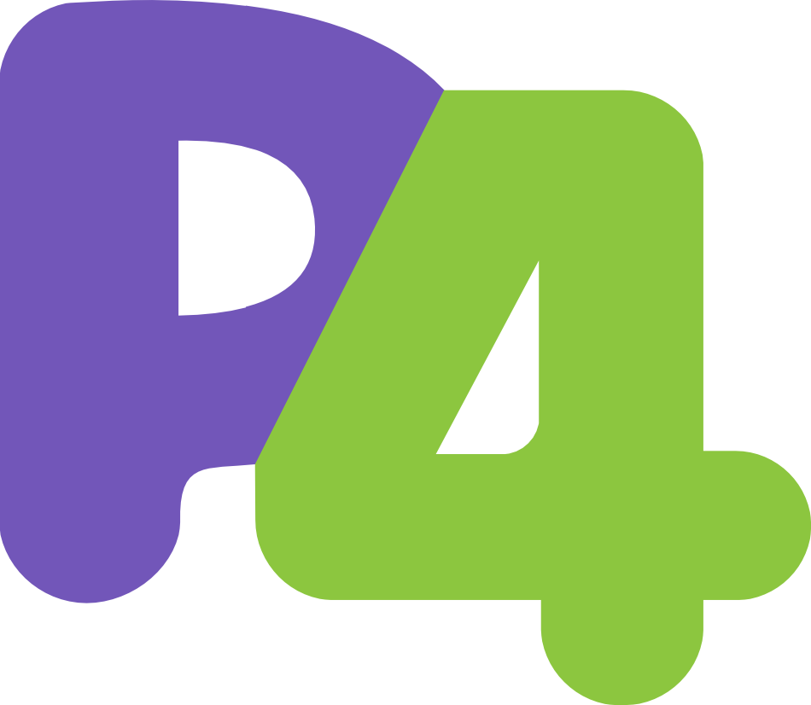
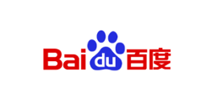
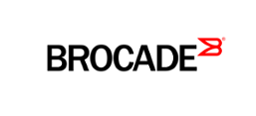
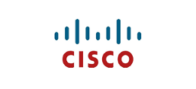
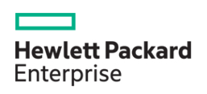
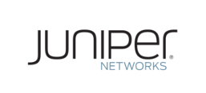
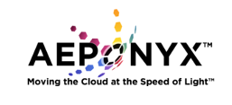
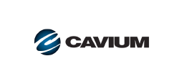
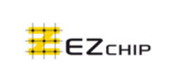
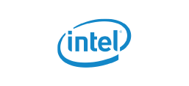
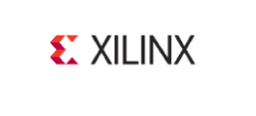
Membership Growth
Operators
Systems
Targets
Academia
Notes:
1/3 since our June workshop

Slide 9
P4 Consortium Going Forward
Adding board members
Currently, just Nick McKeown and me
Want to add at least one person, maybe three
(An odd number, more diversity, etc.)
Building community
P4 tutorials (e.g., SIGCOMM’15)
P4 workshops (June’15, Nov’15, and beyond)
P4 boot-camp (later this week)
Enabling bigger long-term impact
Become part of a larger open-source effort?
<Insert your ideas here!>

Slide 10
So, Welcome!
A busy day
Talks, demos, discussions
An opportunity to bridge divides
Diverse collection of attendees
Hardware and software, users and vendors, academics and industry, …
A chance to strategize
Creating a better P4 language
Planning for long-term impact

Slide 11
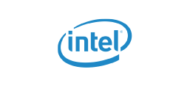
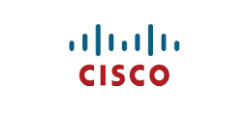
Thanks to Our Sponsors!

