Slide 1
Computer Science Independent Work
Spring 2017
Margaret Martonosi
Robert Fish
Colleen Kenny-McGinley

Slide 2
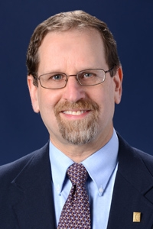
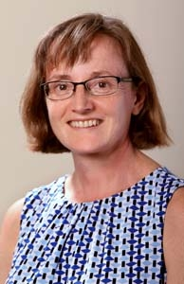
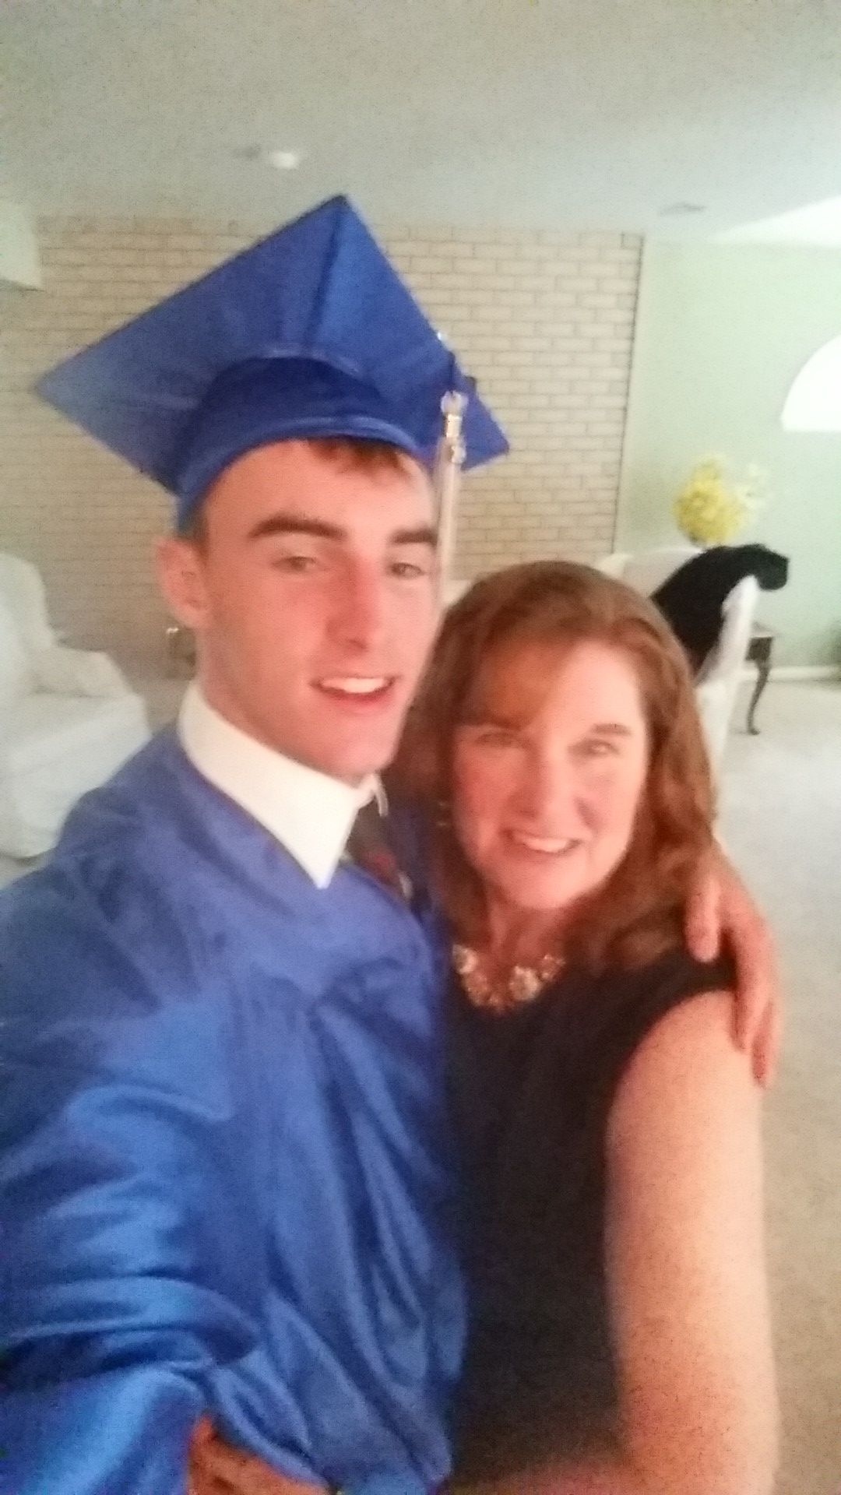
Welcome!
Robert Fish
IW Coordinator
rfish@cs.princeton.edu
206 Computer Science
Margaret Martonosi
IW Coordinator
mrm@cs.princeton.edu
410 Computer Science
Colleen Kenny-McGinley
Undergrad Coordinator
ckenny@cs.princeton.edu
210 Computer Science

Slide 3
Outline for This Session
Best Poster Awards Fall 2016 Presentation
Overview of independent work in COS
Details of important steps and deadlines
Pointers to where to get more info and help

Slide 4
Best Poster Awards Fall 2016
Rohan Doshi – “Deep Learning for Sarcasm Classification”
Sheon Han – “Analyzing Chronological Changes in Philosophical and Religious Inclination from Text”
Karen Feng – “Scaling Genetic Association Testing in Structured Populations to Millions of Humans”
Sara Malamut – “Accessibility in the New York City MTA Subway System”
Allison Chang – “An Analysis of the Gut Microbiota of Pancreatic Cancer Patients”
Manbir Gulati – “Online Sleep Onset Detection”
Eric Mitchell – “Assessing a Bitcoin Price Prediction Model and Trading Strategy”
Alex Yue – “IoT Inspector: A Packet Inspection Framework to Analyze and Visualize Internet of Things Device Traffic”

Slide 5
Let’s get started …

Slide 6
What Is Independent Work?
Individual project to study a novel idea in depth
Novel algorithm
Novel system design
Novel problem formulation
Novel benchmark suite
Novel proof of a theorem
Novel application
Novel investigation of a dataset
Novel …

Slide 7
Why Do Independent Work?
Study a topic in depth
Dive into much more detail than could in a course
Learn important skills
Technical writing, speaking, project management
Work closely with faculty
Meet weekly, get advice, get to know them, etc.
Do something interesting to talk about in …
Grad applications, job interviews, etc.
Have Fun!!!

Slide 8
Types of Independent Work
One semester project
All AB juniors and some BSE juniors/seniors
Project designed for one semester, but can be followed by related project in later semester
IW seminar or individual advising
Two-semester thesis
All AB seniors and some BSEs
Project designed for full year
Individual advising

Slide 9
IW Seminars
Same as one semester projects, but students work on related topics and meet with adviser together
Enables collaborative projects
Enables sharing of infrastructure
Enables feedback to/from other students
Targeted at first-time IW students
Provides more help on how to choose good projects, how to manage time, how to design talks, how to write papers, etc.

Slide 10
Important Steps and Deadlines
One semester projects:
Feb 24: Written project proposal due
March 13: Checkpoint form due
TBD: “How to Give an IW Talk” session*
TBD: “How to Write an IW Paper” session**
April 24-28: Oral final presentation
May 5: Written final report
May 11: Poster session
* At 7:30PM in CS 105
**At 12:30PM in CS 105

Slide 11
Questions so far?

Slide 12
On to the specifics ....

Slide 13
Important Steps and Deadlines
One semester projects:
Feb 24: Written project proposal due
March 13: Checkpoint form due
TBD “How to Give an IW Talk” session*
TBD “How to Write an IW Paper” session**
April 24-28: Oral final presentation
May 5: Written final report
May 11: Poster session
* At 7:30PM in CS 105
**At 12:30PM in CS 105

Slide 14
Written Project Proposal
Submit written description of your project plan
Logistics:
Due Feb 24th
1-2 page paper
Submit PDF document via CS dropbox

Slide 15
Written Project Proposal
Motivation and goal
“The goal of my project is …”
Related Work
Survey of prior work with similar goals
Approach
Key novel idea
Implementation plan
Things you plan to implement. How you plan to do it.
Evaluation plan
Experiment design. Data. Metrics. Comparisons.

Slide 16
Checkpoint Form
Write short summaries of what’s done in first half and what’s planned for second half
Logistics:
Due March 13th
Write two paragraphs
Get feedback from adviser
Submit via online web form

Slide 17
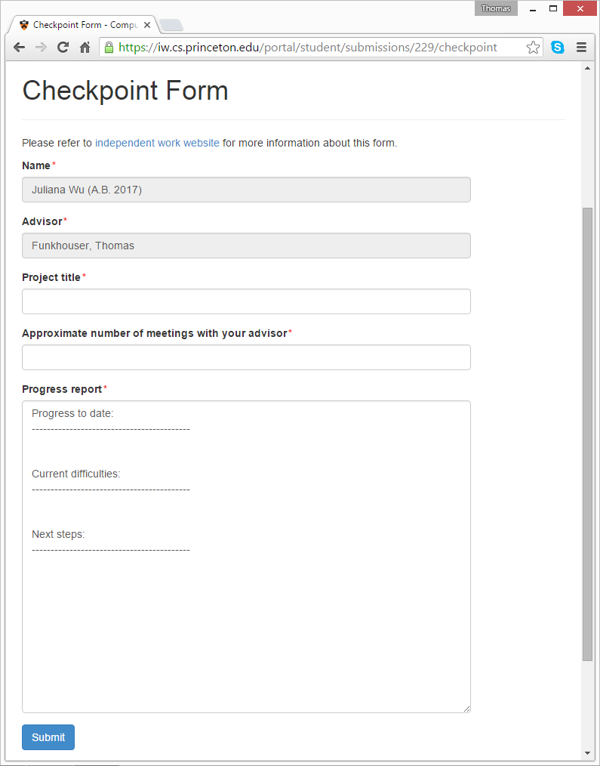
Checkpoint Form
Progress to date:
Current difficulties:
Next steps:

Slide 18
Oral Presentation
Give an 9 minute talk about what you’ve done over the whole semester
Logistics:
April 24-28(last week of classes)
Attend “How to Give an IW Talk”
Sign up for one hour time slot via WASS
4 talks per hour
Submit slides via CS dropbox the night before
Give your talk, watch others, provide feedback

Slide 19
Oral Presentation
Motivation and goal
“The goal of my project is …”
Related Work
Survey of prior work with similar goals
Approach
Key novel idea
Implementation
Things you implemented. How you did it? What remains to be done.
Evaluation
Experiment design. Data. Metrics. Comparisons. Qualitative results. Quantitative results. Further results needed.
Discussion
Conclusions. Limitations. Future work.

Slide 20
Written Final Report
Submit a written description of your project, including results and conclusions
Logistics:
Due May 5th
Attend “How to Write an IW Paper”
Submit PDF report via CS dropbox
For one semester projects:
20-25 pages double-spaced + appendix
For theses:
40-50 pages double-spaced + appendix

Slide 21
Written Final Report
Motivation and goal
“The goal of my project is …”
Related Work
Survey of prior work with similar goals
Approach
Key novel idea
Implementation
Things you built. How did you do it? What remains to be done.
Evaluation
Experiment design. Data. Metrics. Comparisons. Qualitative results. Quantitative results. Further results needed.
Discussion
Conclusions. Limitations. Future work.

Slide 22
Poster Session
Present a poster describing your project to other students, faculty, and visitors
Logistics:
In Convocation Room on May 11th
Submit PDF posters via CS dropbox
Present posters on 4x4 bulletin boards
Live demos, videos, props, etc.
Best poster awards!

Slide 23
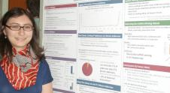
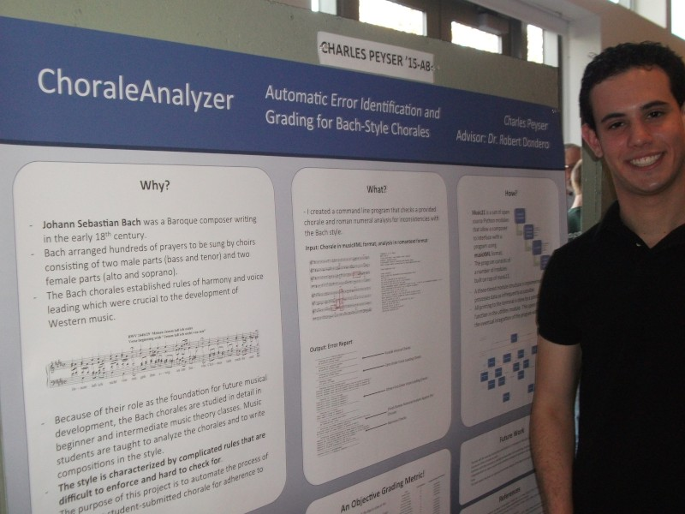
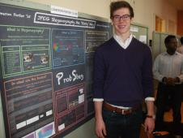
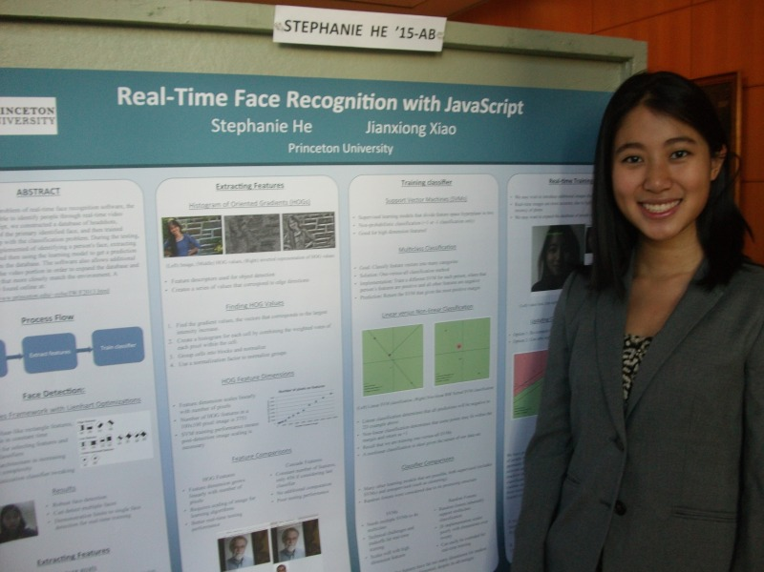
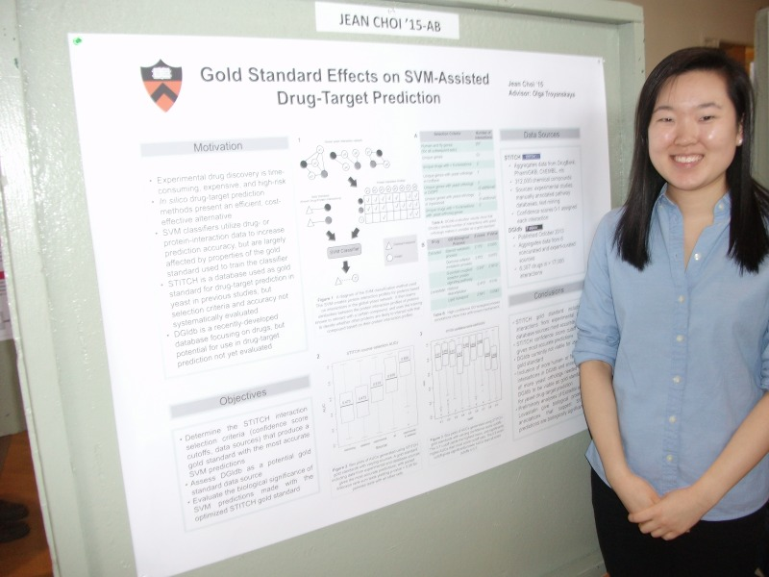
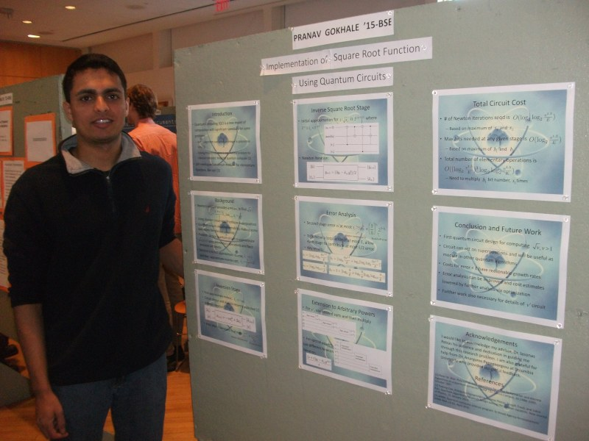
Poster Session
See examples on bulletin boards of department

Slide 24
Some more logistics ....

Slide 25
IW Portal
https://iw.cs.princeton.edu/portal/

Slide 26
Funding
Project-related expenses:
Unusual hardware, software, data sets, etc.
Available funds:
School of Engineering and Applied Science
Expect email soliciting proposals soon Support up to $500 or so
Student Activities Funding Engine (SAFE)
http://www.princeton.edu/studentfunding/

Slide 27
Collaboration
“Independent work”
Every student must do his/her own project
Collaboration
Multiple IW projects can be synergistically part of a larger effort, either with other IW students or grad students
Each student must carve out a distinct part with a clear goal, novel idea, evaluation methodology, etc.
Each student must submit his/her own work
Each student will be graded separately

Slide 28
Grading
Grades will depend upon:
Student initiative and contribution: the creativity and originality of student ideas
Student progress: content, amount of work accomplished to date, clarity and polish of presentations
Student presentation and paper: the content, eloquence, organization and clarity
Majority of grade will depend upon quality of work
But, poor presentation and/or poster, and missing checkpoints will also have an impact

Slide 29
Grading
A-level
New contribution – interesting, creative
Solid execution and results – refined and tested
Excellent papers, talks, and posters – thoughtful, thorough
B-level
Not-so-innovative contribution – variant of previous work
Working execution and results – not fully refined and tested
Complete papers, talks, and posters – limited insights
C-level
Not innovative
Unfinished or not working implementation
Report looks like workbook or lab report
D-level
Nothing interesting attempted, nothing gained
Report is stream of consciousness

Slide 30
Common Mistakes
Delay project planning until last minute
Get started right away
Select a project topic that is too broad/general.
Be willing to focus. And, listen to your adviser’s guidance.
Postpone meetings with your adviser
Try to meet once/week, even if it’s a brief meeting
Allow yourself to get stuck
Talk to your adviser; don’t avoid them when you are stuck
TA’s are assigned to every seminar, use them!
Put off work until the end of the semester
Work consistently during the semester (10 hrs/week min.)
Prepare papers and presentations at the last minute
Iteratively refine. Get feedback from your adviser.

Slide 31
If You’re Having Trouble…
Let us know…
Examples:
Expect to miss a deadline
Problems with your adviser
Problems with your project
Other factors in your life
If you tell us early, we might be able to help you
We can direct you to right person
Fixing problems post facto may be much harder
Often involves Deans, etc.

Slide 32
Who/What You Can Ask
Adviser
Anything research related
Not: can I skip the project proposal or poster or write-up
IW Coordinator (Dr. Fish and Prof. Martonosi)
Anything about mandatory requirements
Not: is this research interesting
Undergrad coordinator (Colleen Kenny-McGinley)
Anything about dates, forms, funding, etc
Not: can you give me an extension

Slide 33
How to Ask Questions
Piazza – Primary Resource
http://piazza.com/princeton/spring2017/cosiw
Ask IW staff and other students questions about logistics, advice, toolkits, data sets, etc.

Slide 34
Where to Find More Information
Web site:
http://www.cs.princeton.edu/ugrad/independent-work
Important steps and deadlines
Guidelines and useful information
These slides are linked from there

Slide 35
That pretty-much covers it. Let’s summarize the key points ....

Slide 36
My Thoughts on IW at Princeton
This is your chance to do an in-depth project on a novel topic of your own choosing
It doesn’t get better than this
It’s probably why you came to Princeton
It’s certainly what you’ll most remember from your academics at Princeton
So, take the initiative and be awesome!

Slide 37
What to Do Today?
Read everything on the web site
Read through the guidelines and useful information
Take note of important deadlines
Schedule weekly meetings with your adviser

Slide 38
What to Do In February?
Work diligently to develop your project plan
Work hard to define a specific goal
Understand all related work
Articulate what makes your project novel
Know what software and data you will use
Have a good idea of what you need to implement
Have a specific plan to evaluate your results
Write your project proposal early, get feedback, and refine multiple times

Slide 39
But the Semester Just Started!
The first few weeks are really important …
A good project plan is the key to success
It takes time to understand related work, relevant software, and available data sets
It takes iteration and refinement (multiple meetings with your adviser) to define a good project goal and novel approach
Working hard in the first few weeks greatly reduces the chances of ending up with a weak project

Slide 40
OK, that’s it. Thanks!!!

