Slide 1
Microarray Basics, and Planning a Microarray Experiment
Amy Caudy
Lewis-Sigler Fellow

Slide 2
Outline
Microarray platforms
Uses of microarrays
Labeling approaches
Experimental considerations
Emerging technologies

Slide 3
Hybridization – the fundamental principle of array analysis
...AAAAAGCTAGTCGATGCTAG...
...TTTTTCGATCAGCTACGATC...

Slide 4
In order to design an array…
You need to have the sequence of interest in hand
What if there is sequence diversity in your population?

Slide 5
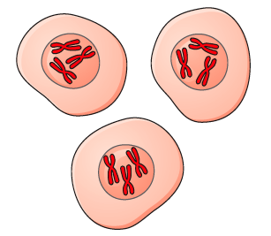
The first gene arrays
Analysis of expression of 588 transcripts using the Atlas cDNA Expression Array
Purify RNA from cells
Reverse transcribe with radioactive dNTPs (makes a DNA copy)
Detect radioactivity
Hybridize to a membrane spotted with DNA from genes
oooooooooooo
oooooooooooo
Biochemical Journal (2001) Volume 356, 77-85

Slide 6
Microarray platforms
Spotted oligos – open source technology!
DNA synthesized on chip
Affymetrix – oligo synthesis by photolithography. (Each nucleotide of synthesis requires a mask.)
Nimblegen – photolithography, but with moving mirrors (customizable)
Agilent – inkjet printing of DNA, one nucleotide at a time (customizable)

Slide 7
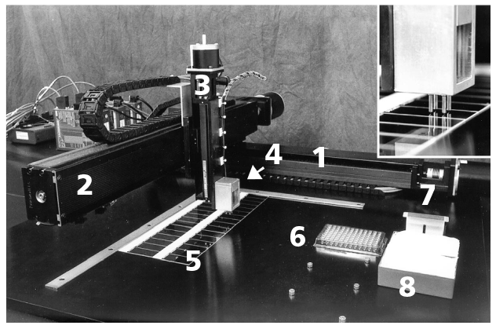
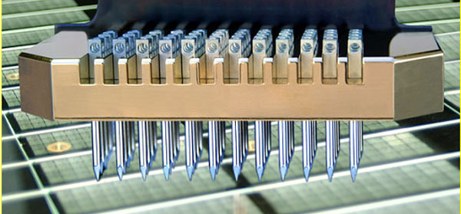
Spotting DNA
Nature Genetics 21, 15 - 19 (1999)

Slide 8
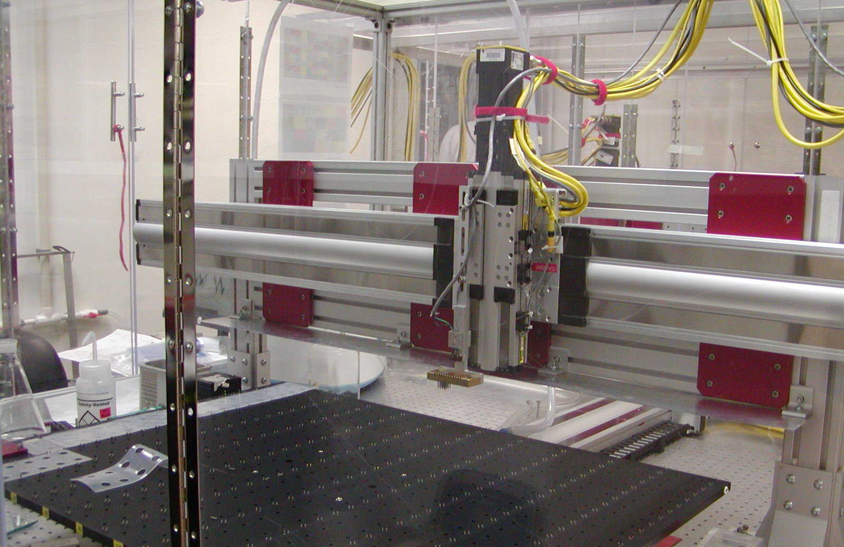

Slide 9
What to spot?
PCR products
Oligonucleotides
Proteins
siRNAs
Drugs
Cells

Slide 10
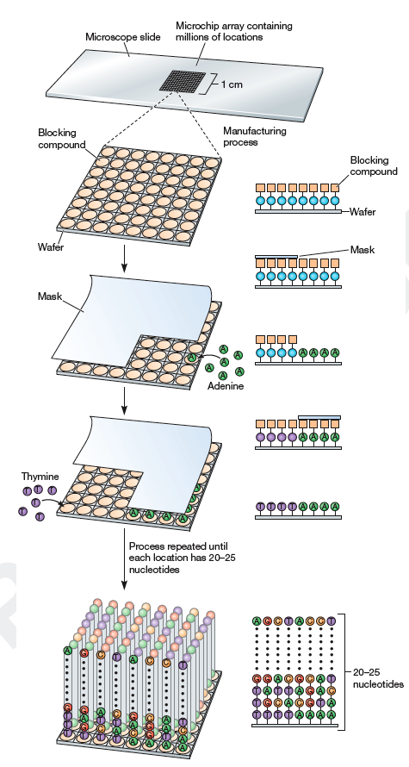
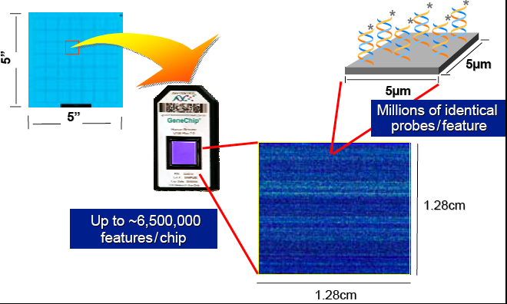
Photolithography for oligo synthesis
Affymetrix method of array synthesis
Advantage is that extremely high density arrays with over 6 million features is possible
Masks are reusable, but expensive to synthesize. (Nimblegen uses similar chemistry, but mirrors permit more flexibility in array design.)
Affymetrix
Recombinant DNA

Slide 11
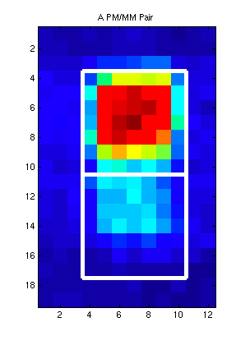
Using mismatch probes to measure specificity
PM: GCTAGTCGATGCTAGCTTACTAGTC
MM: GCTAGTCGATGCAAGCTTACTAGTC
Affymetrix tries to control for cross-hybridization by using multiple probes along with Perfect Match (PM) and Mismatch (MM) probes.
The PM probe is always placed directly above the MM probe on the GeneChip.
Keith Baggerly and Kevin Coombes, MD Anderson

Slide 12
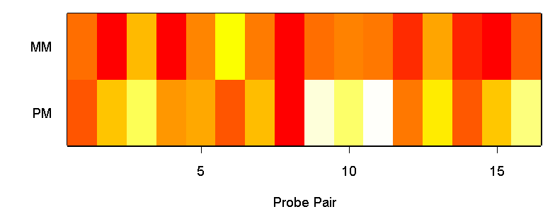
Affymetrix arrays use multiple PM/MM probes per gene
For each target gene on an Affymetrix array, use between 11 and 20 probe-pairs. (The oldest GeneChips used 20 probe-pairs per target gene; the second generation used 16; the newest arrays use 11.)
The first basic challenge in quantifying Affymetrixarrays is summarizing the 22 to 40 numbers from a probe set with a single estimate of the expression of the target gene.
These are shown here together, but in modern designs are placed in multiple locations throughout the array to guard against local defects.
Keith Baggerly and Kevin Coombes, MD Anderson

Slide 13
The disruption in hybridization can be used in another way – to “resequence” DNA
(more later on)

Slide 14
Agilent prints DNA with an inkjet printer
Agilent Technologies

Slide 15
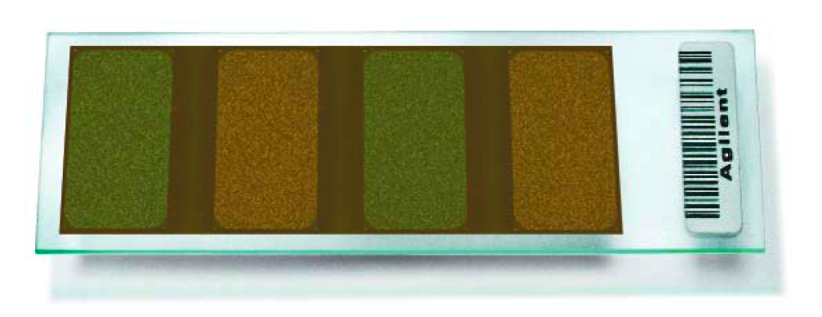
Custom Agilent arrays
Agilent Technologies

Slide 16
Probe design considerations
Uniqueness of probe in genome
Hybridization kinetics of probe (usually measured in Tm, the melting temperature)
Genome annotation – the sequence of interest must be on the genome to measure it.
Gene predictions are a moving target!
Samples from different individuals may have sequence polymorphisms that affect hybridization!
Position of probe on sequence, especially for expression arrays
Reverse transcription begins at 3’ end of gene and becomes less efficient towards 5’ end

Slide 17
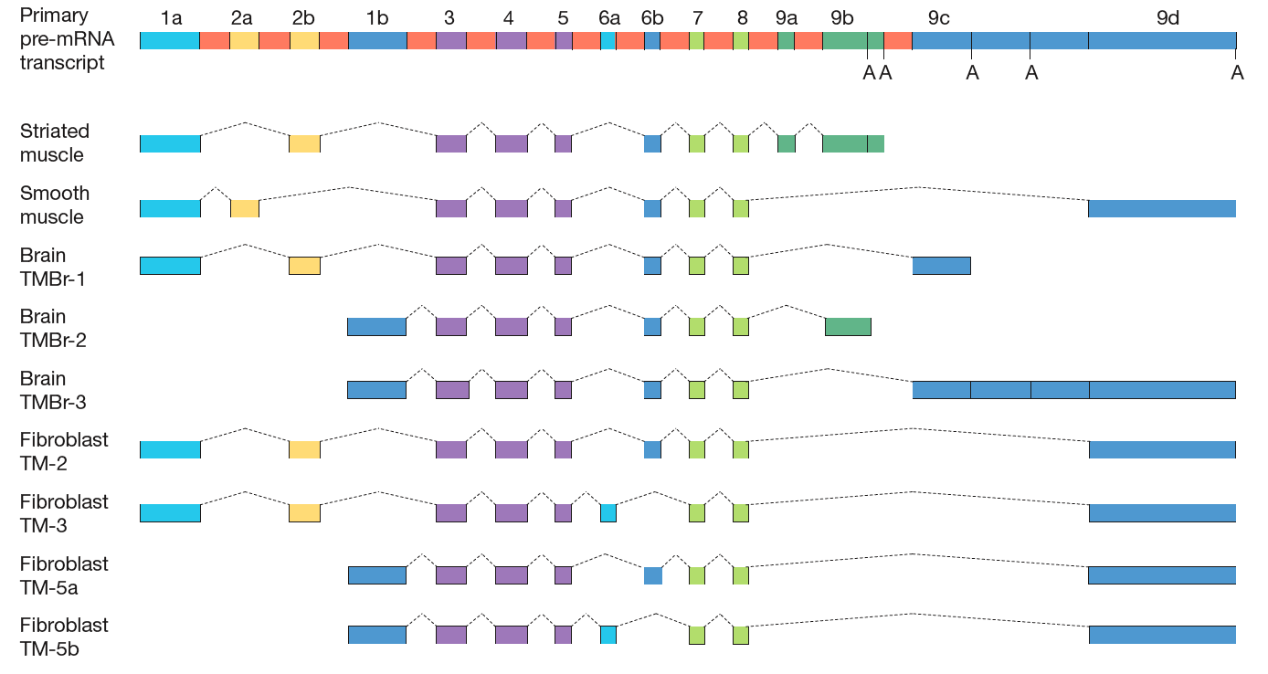
Tropomyosin – what do you measure to measure its expression?
Recombinant DNA

Slide 18
Probe length
Long PCR products or long oligos are more tolerant of mismatched
In a situation with sequence divergence, you can still get hybridization
Even if you don’t know the sequence of your organism, you could make random cDNAs and spot them, and figure out the interesting features later
Long oligos hybridize better
Short oligos are more sensitive to mismatches
You can more easily design probes to discriminate between similar genes
Assessing levels of probes affected by mismatches is error-prone

Slide 19
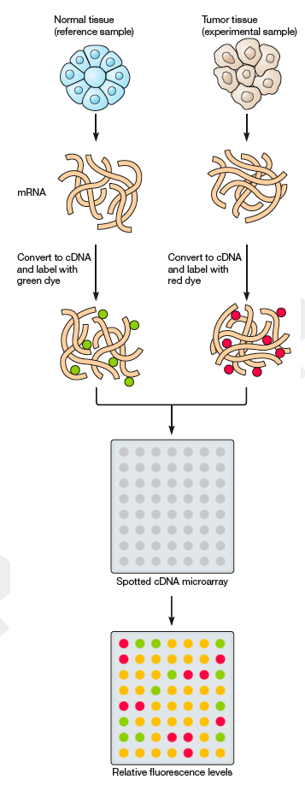
Comparing samples to determine relative expression
1/0 = ∞
Your reference must have detectable expression of genes of interest
Even with one-color systems like Affymetrix, the end goal of analysis is to compare an experimental sample with a control sample
Recombinant DNA

Slide 20
Gene expression
With a few exceptions, the cells in your body have an identical genetic code, yet they are profoundly different. Ultimately, these differences arise through the expression.
With a microarray, you can quantify the expression of all genes at once.
But you are measuring RNA levels, not the activity of the gene.
RNAs can be sequestered so that they are present but not translated
Some proteins are only active following specific modification (phosphorylation, methylation, ubiquitination)

Slide 21
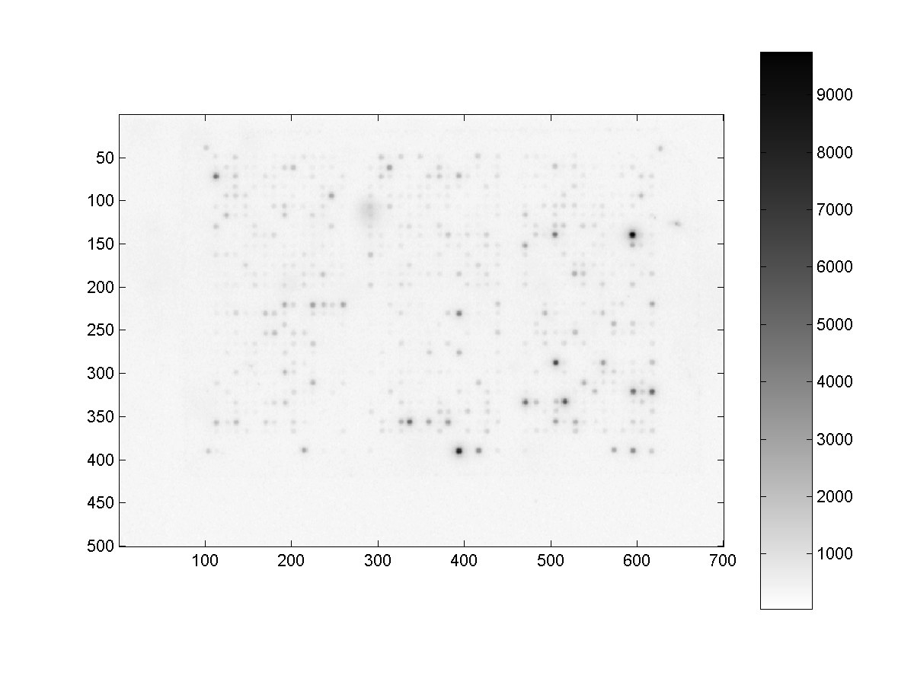
The image is the data

Slide 22
The image is still the data
Same image, inverted

Slide 23
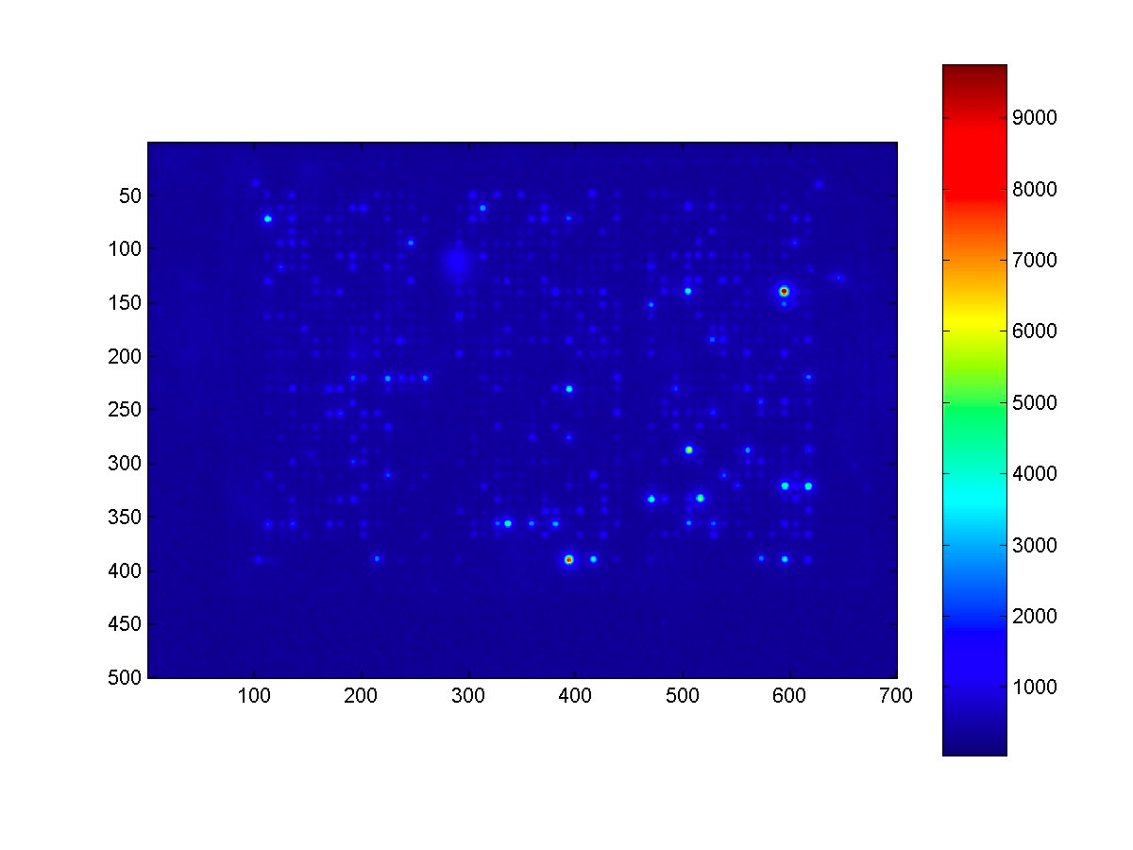
You can change the image (but not the data) to see it better

Slide 24
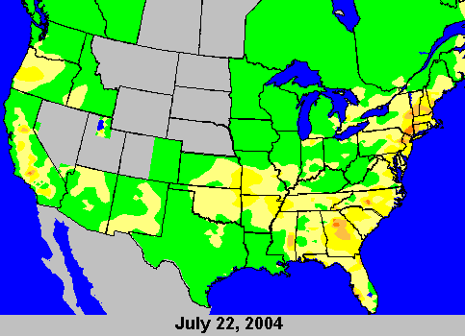
Ozone and your arrays

Slide 25
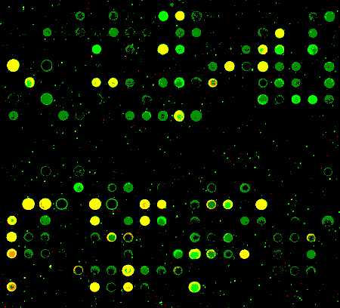
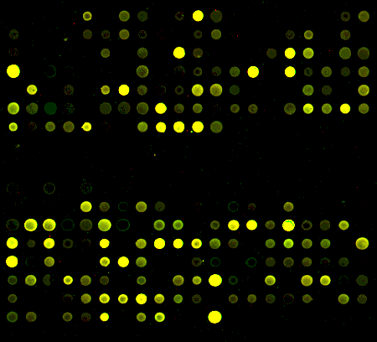
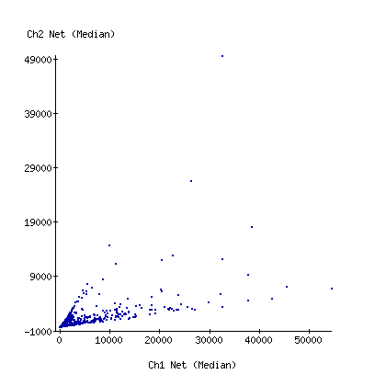
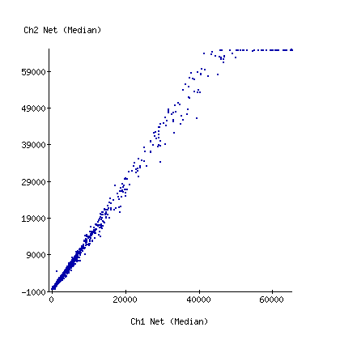
Ozone and your arrays
At the bench, Princeton, NJ
Ozone reduced, Princeton, NJ
Maitreya Dunham

Slide 26
Maitreya Dunham, available on tshirt or mousepad

Slide 27
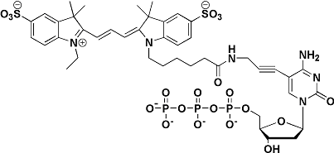
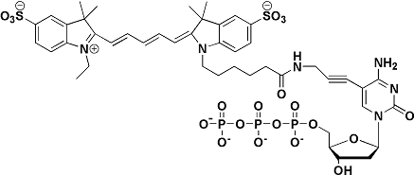
Cy dye structure
Cy3-dCTP
Cy5-dCTP
Note that Cy5 is larger than Cy3; typically Cy5 is incorporated less well than Cy3
To check for and assess this bias, a typical control experiment is a “dye swap” in which the experimental sample is labeled with Cy3 and the reference with Cy5.
Otherwise, the convention is to use Cy5 for your experimental sample and Cy3 for the reference

Slide 28
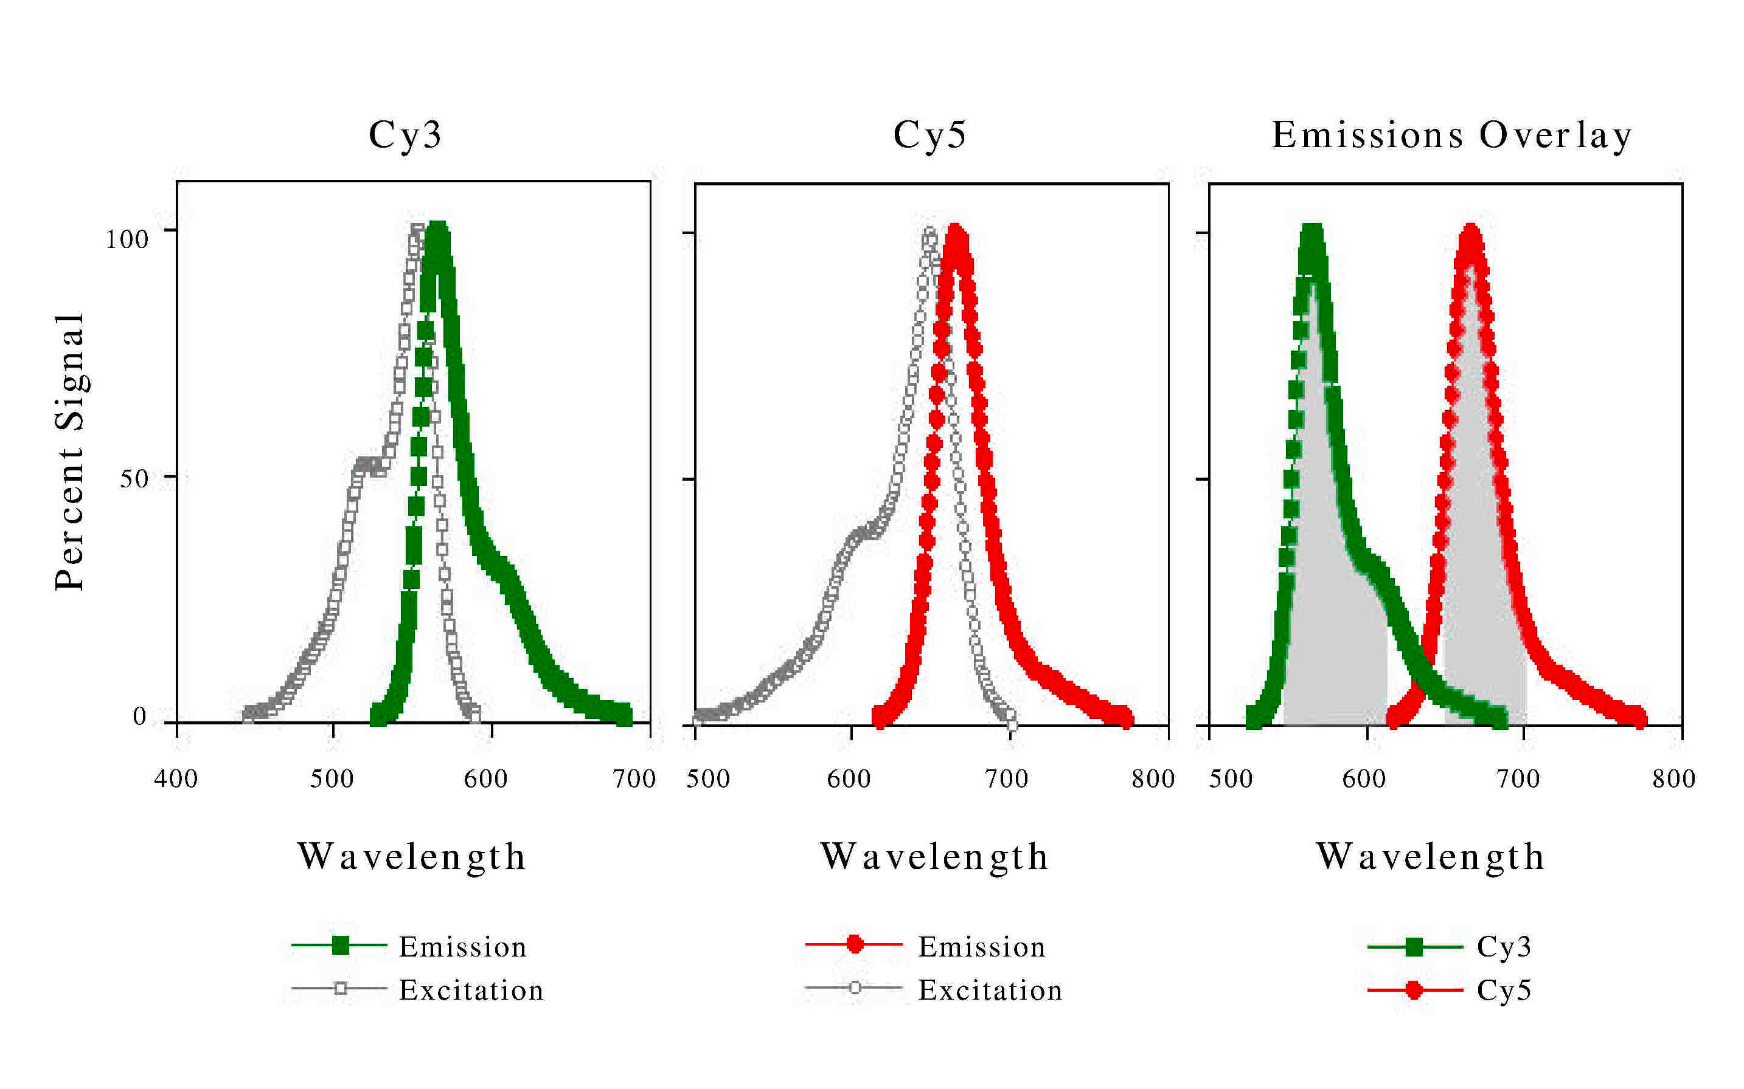
Cy dye spectra
Keith Baggerly and Kevin Coombes, MD Anderson

Slide 29
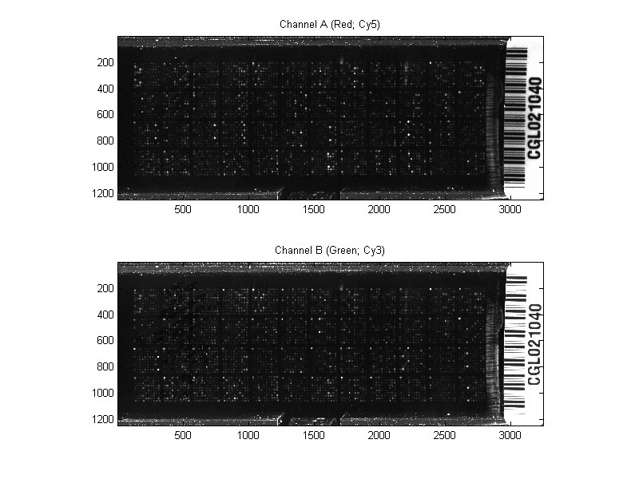
Scan of ratiometric array
Keith Baggerly and Kevin Coombes, MD Anderson

Slide 30
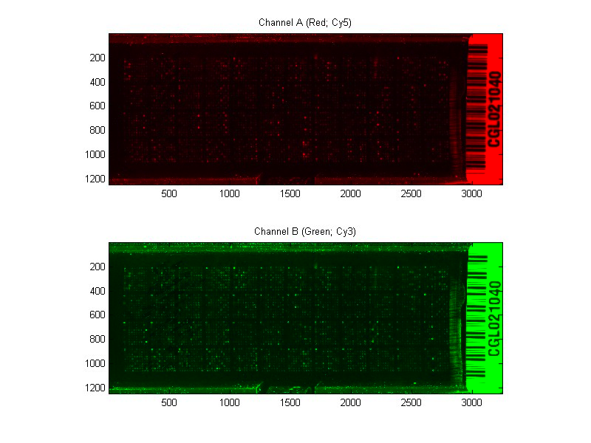
False color image
Keith Baggerly and Kevin Coombes, MD Anderson

Slide 31
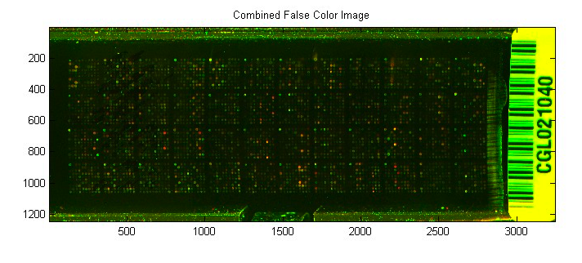
Combined false color image
Keith Baggerly and Kevin Coombes, MD Anderson

Slide 32
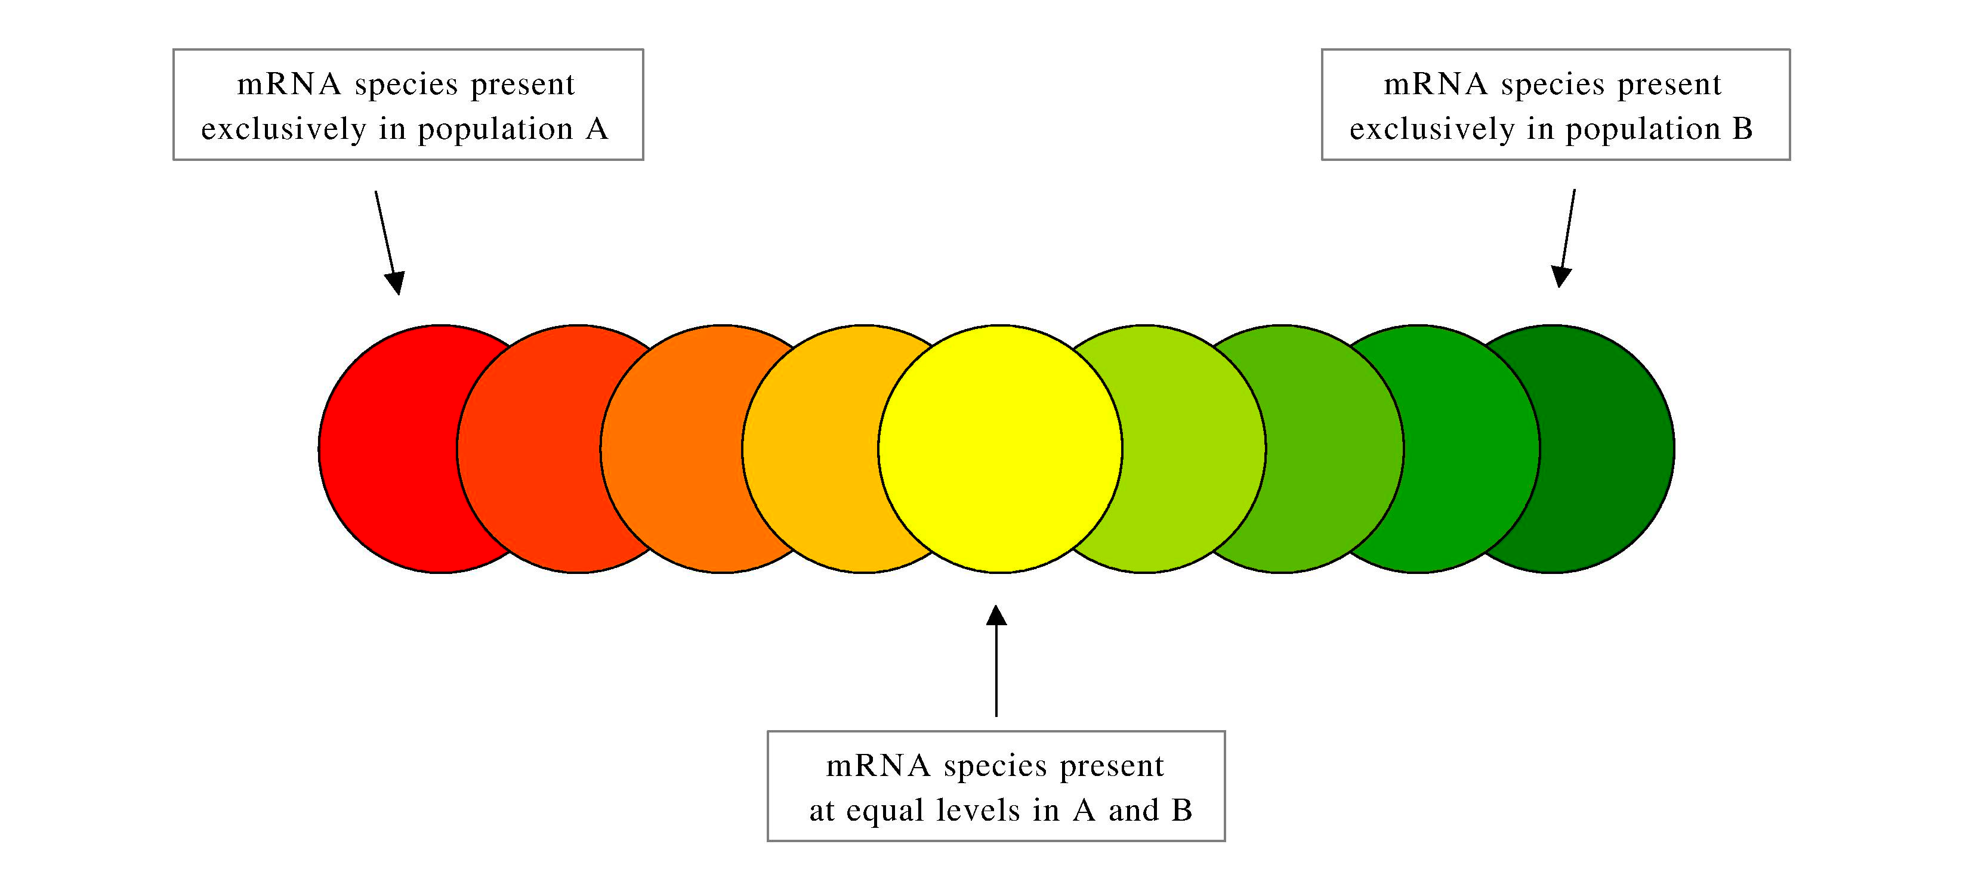
Keith Baggerly and Kevin Coombes, MD Anderson

Slide 33
Probe specificity – a test case of an array designed to discriminate 2 yeast species with ~80% nucleotide similarity
Each species DNA labeled with a different color and hybridized to the array. Intensity ratios are indicated.
Maitreya Dunham

Slide 34
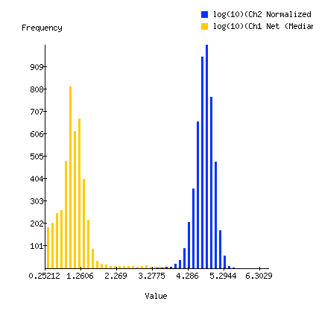
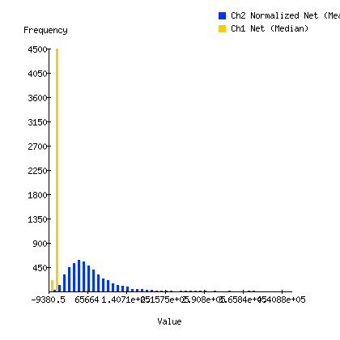
Continuing the data, the intensities on the array (used to calculate the ratios)
Log10 intensities
Intensities on a linear scale

Slide 35
Labeling RNA – Direct Labeling
Polyadenylated mRNA
AAAAAAAAA
TTTTTTTTTTT
Hybridize oligo-dT primer
Reverse transcriptase, dNTPs, labeled dNTPs
AAAAAAAAA
TTTTTTTTTTT
No amplification
Needs more RNA sample than in amplification methods
Polymerase incorporation of large chemical groups is not favorable

Slide 36
Linear RNA amplification
Can use ~100 ng starting RNA, or even less with multiple rounds of amplification
A promoter is added to the cDNA so that it can be transcribed
Developed by Jim Eberwine (often called the Eberwine method)
Used in standard Agilent labeling protocol
Agilent

Slide 37
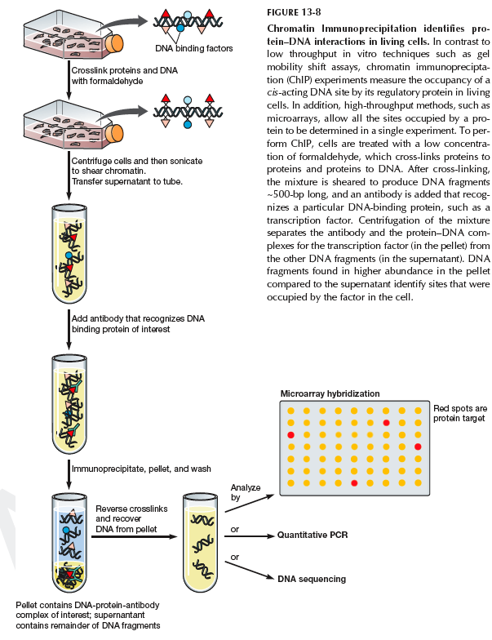
Chromatin Immunoprecipitation
Need an antibody sepectiic for protein of interest
Need an array that represents regions of genome that are bound
Recombinant DNA

Slide 38
An approach for detecting DNA methylation
In many organisms including humans (although not flies, yeast, or worms…), DNA methylation is a key regulator of gene activity.
DNA methylation is inherited (in part) from one cell to the next.
DNA methylation influences gene expression, even though a methylation event is not a mutation. Such a heritable influence without mutation is classified as an epigenetic phenomenon. (Epi = above, on top of)
Some restriction enzymes are sensitive to DNA methylation

Slide 39
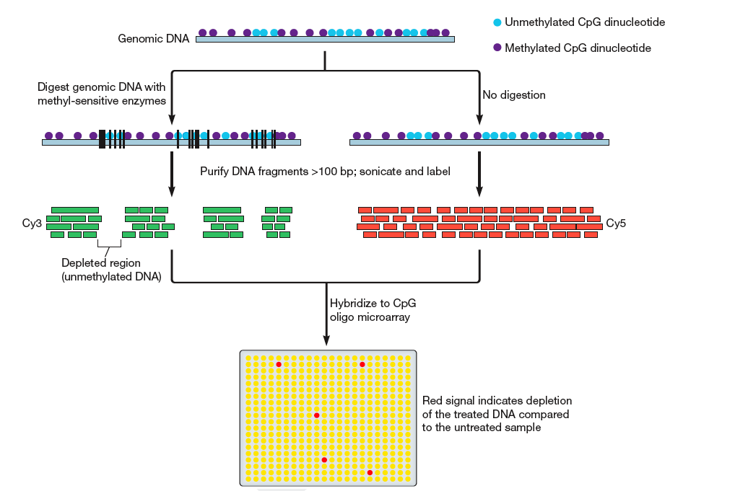
An approach for detecting DNA methylation
Recombinant DNA

Slide 40
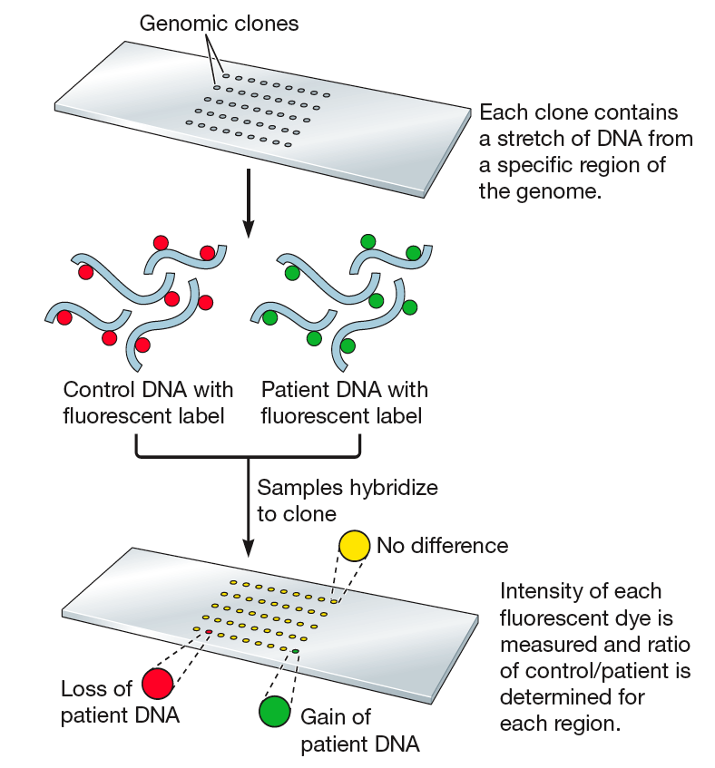
CGH – comparative genome hybridization
Recombinant DNA

Slide 41
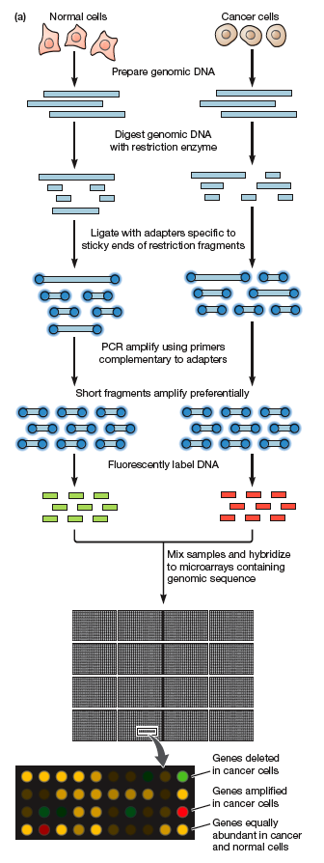
Detecting copy number variation
The total complexity of human genomic DNA is so high that it is difficult for it to hybridize to an array.
Multiple approaches are available to reduce complexity so that hybridization can proceed in a reasonable amount of time. Many of these approaches rely on preferential amplification of small fragments of DNA.
Recombinant DNA

Slide 42
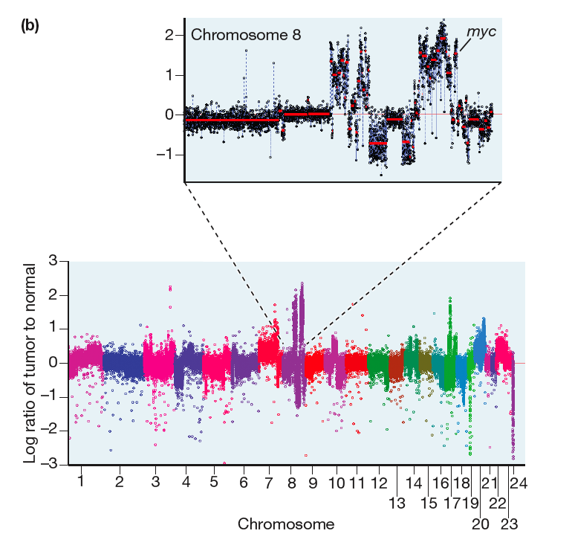
Detecting copy number variation
Recombinant DNA

Slide 43
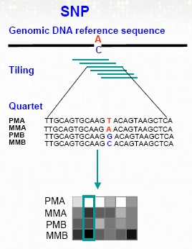
Genotyping
Affymetrix

Slide 44
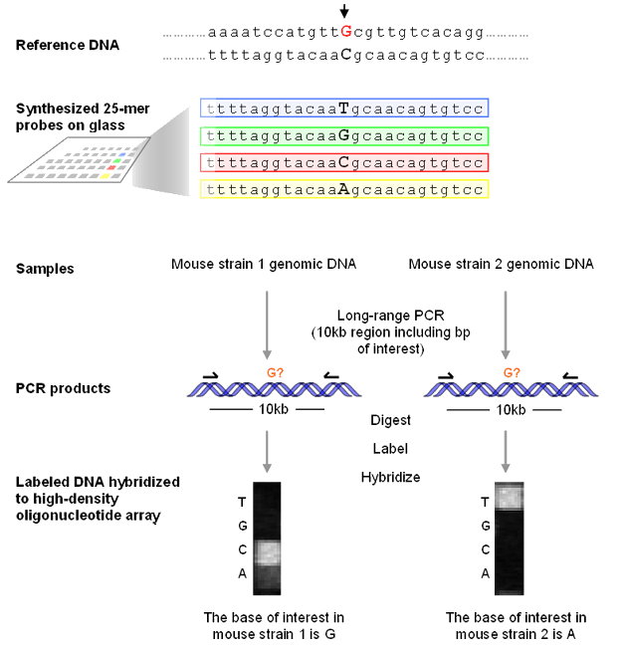
Resequencing on arrays
Perlegen

Slide 45
Resequencing on arrays
4 features required for each base of interest
The possible changes in the sequence must be known – new mutations would produce unexpected behavior
Perhaps you could take advantage of this unexpected behavior….

Slide 46
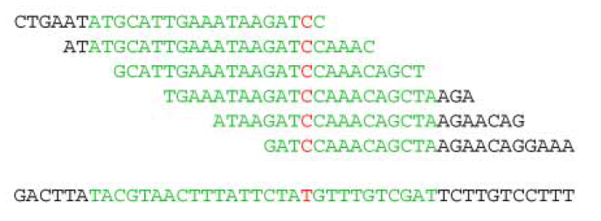
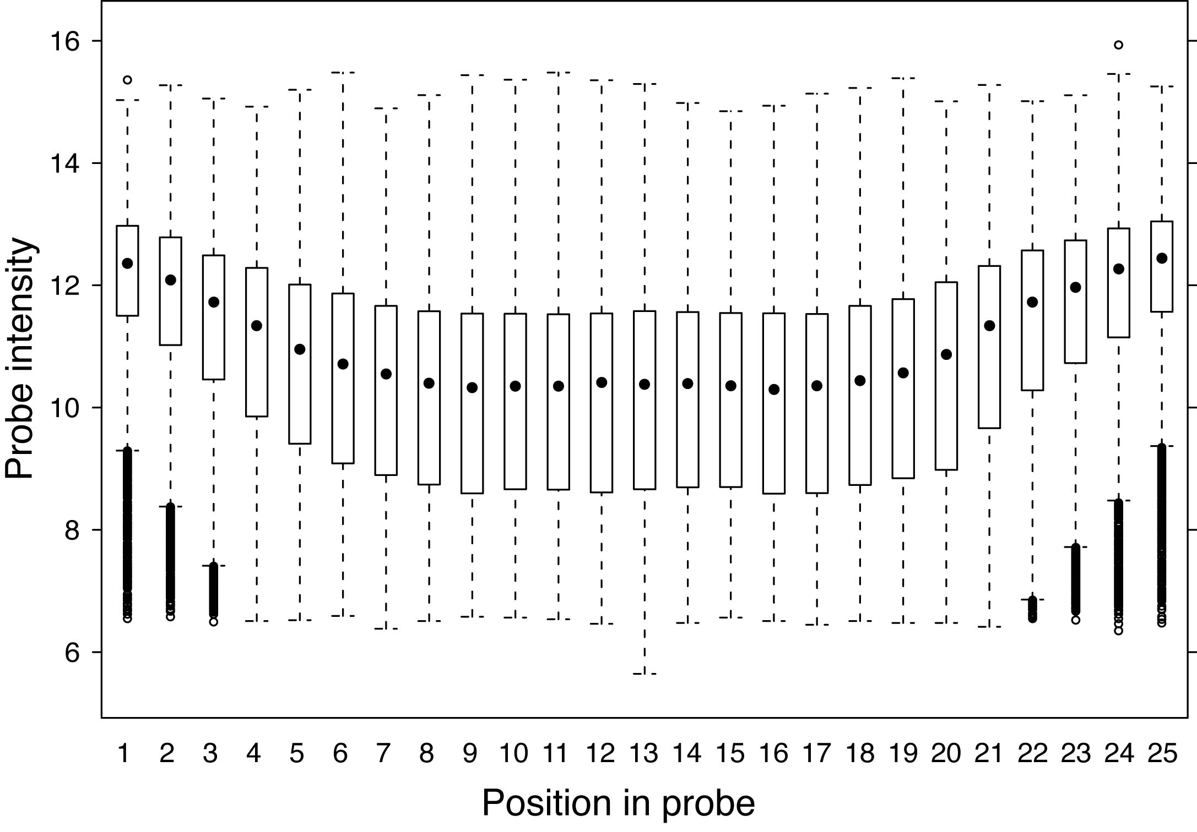
SNP scanner – using a tiling array for mutation detection
Mismatches in the center of a probe decrease hybridization more than mismatches toward the ends
Boxes show the interquartile range (there is a lot of variation!)
Gresham et al., Science 2006

Slide 47
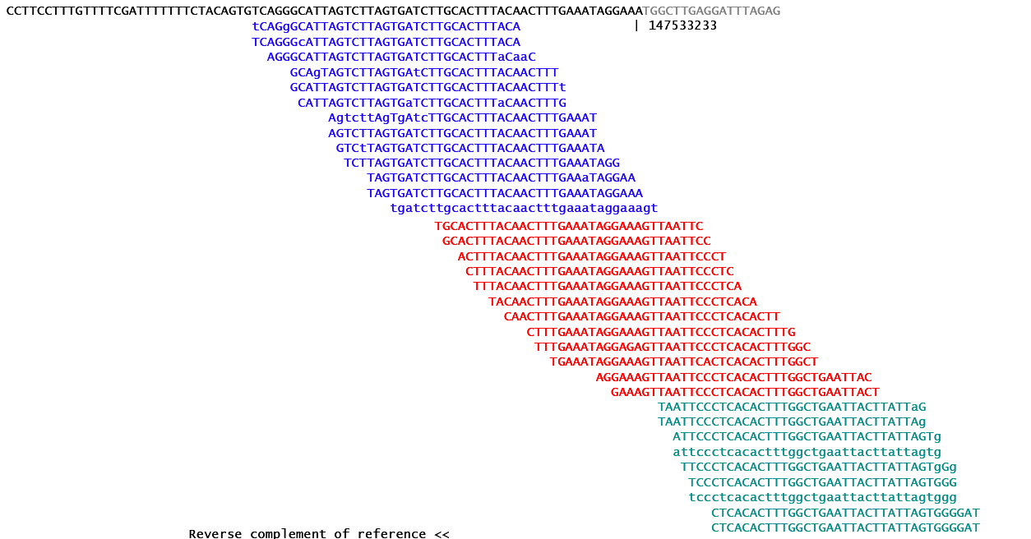
Emerging technology – ultrahighthroughput sequencing

Slide 48
What is the future of arrays?
Currently, the cost and throughput of microarrays is far superior for gene expression
Sequencing approaches don’t require you to know the sequence of the organism, or the sequence of the individual under study
However, sequence analysis is much easier with a reference sequence.
There is no cross-hybridization in sequencing
But there may be sequences duplicated throughout the genome

Slide 49
Good sources for more microarray information
http://bioinformatics.mdanderson.org/MicroarrayCourse/Lectures/
http://www.stat.berkeley.edu/users/terry/Classes/s246.2002/index.html

Slide 50
Thank you
John Matese, PUMA
Matt Hibbs
Curtis Huttenhower
Maitreya Dunham
David Botstein
Caudy Lab
Integrated Science Students

