Slide 1
Visible Light Communication
COS 463: Wireless Networks
Lecture 23
Kyle Jamieson

Slide 2
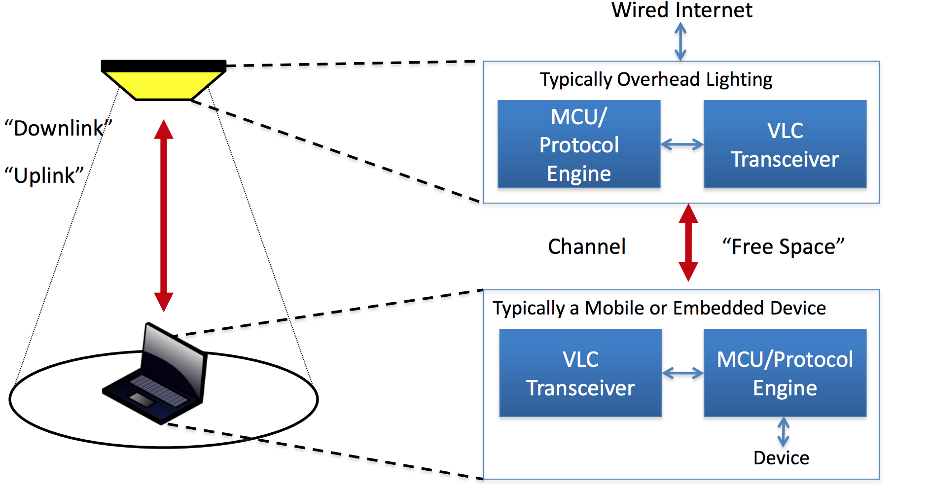
What is VLC
Visible light communication (VLC)
visible light source as a signal transmitter
air as a transmission medium
appropriate photodiode as a signal receiving component

Slide 3
What is VLC
Key idea behind VLC
Eye cannot detect fast light switching but semiconductor‐ based photodetector can do

Slide 4
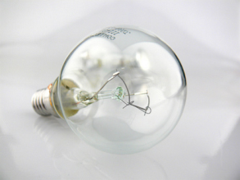
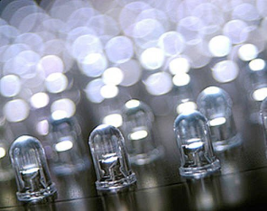
What is VLC – Light source
Power
usage
Incandescent bulb
First industrial light source
5% light, 95% heat
Few thousand hours of life
Efficiency
Lumens/W: 10-18
5%
> 40%
Fluorescent lamp
White light
25% light
Lifetime ~10,000s hours
Lumens/W: 35-100
25%
20%
Light emitting diode (LED) – since 1990s
Compact and 50% light
Uses 2-17 watts of electricity
More than 100,000 hours lifespan
Lumens/W: 35-150
80%
60%
10%

Slide 5
What is VLC － Light detector
PIN photodiode
low cost, large area
limited sensitivity
Image sensors
Charge-Coupled Device (CCD): low cost, slow due to serial read-out

Slide 6
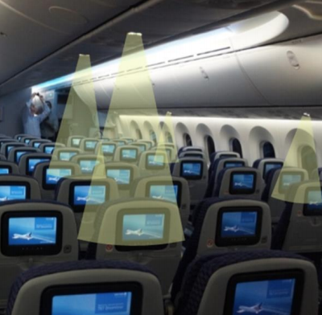
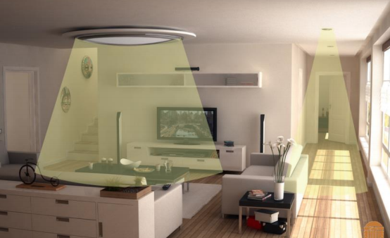
Motivation of VLC
Privacy-preserving
Resilient to Interference
Radio spectrum crunch
Ever-growing user demands meet limited radio spectrum

Slide 7
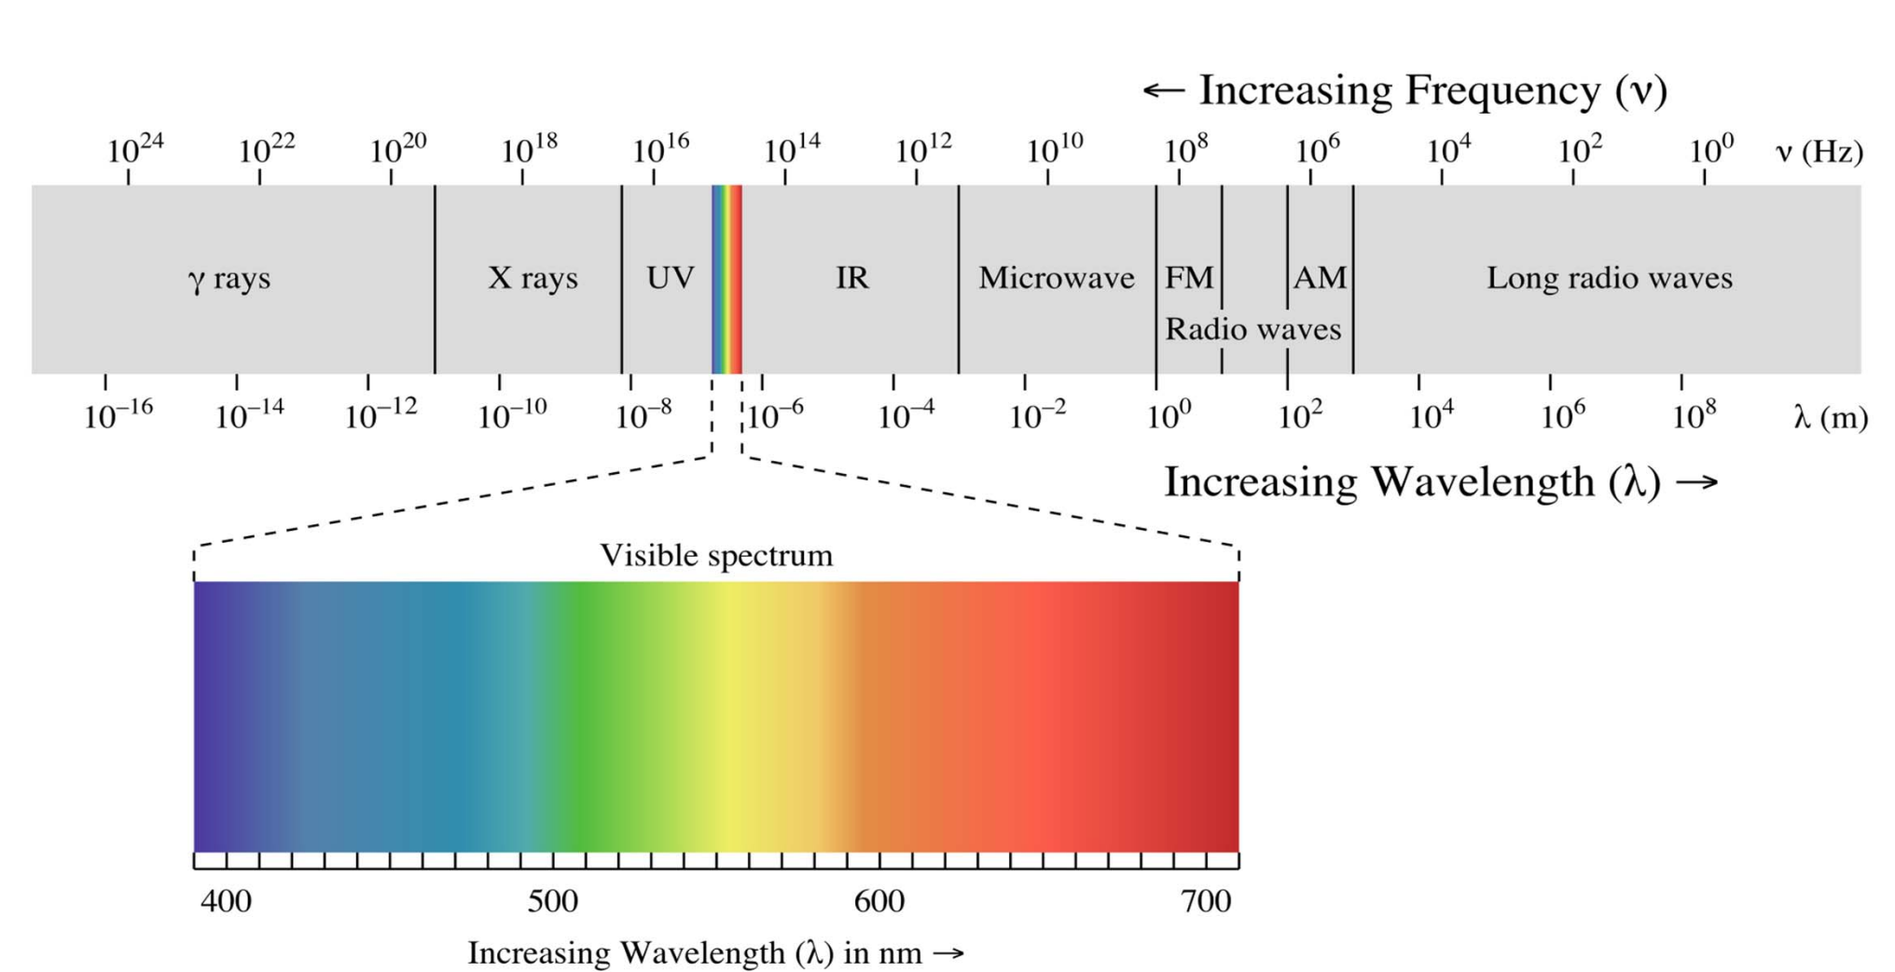
Looking into VLC spectrum
VLC has a large frequency band
390 nm – 700 nm in wavelengths
430 – 770 THz in frequency

Slide 8
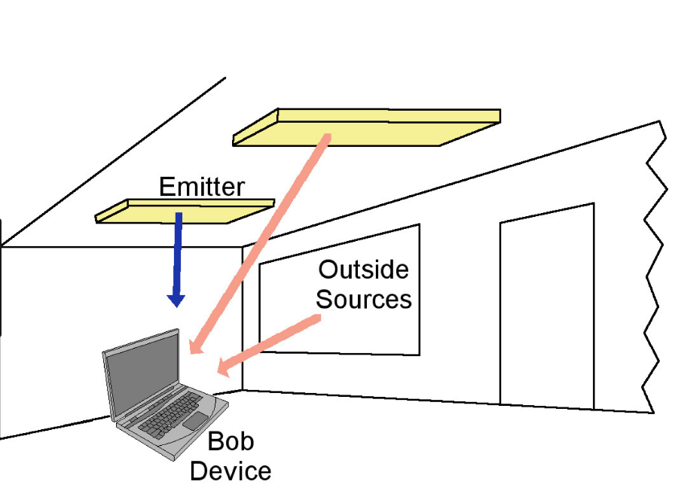
Key difference from RF
RF communication works in a Non-line-of-sight environment
VLC requires Line-of-sight between the transmitter and the receiver
RF signals
VLC

Slide 9
VLC Modulation Schemes
Many conventional schemes can be applied:
On-off keying (OOK)
Frequency-shift keying (FSK)
Pulse amplitude modulation (PAM)
Pulse width modulation (PWM)

Slide 10
Current VLC Systems
 | Range (m) | Data rate | Modulation | Year
Langer et.al. | 1.5 | 230Mb/s | OOK | 2010
Khalid et.al. | 0.5 | 1Gb/s | OFDM | 2012
Kottke et.al. | 0.3 | 1.25Gb/s | OFDM | 2012
Sewaiwar et.al. | 0.85 | 3Gb/s | OFDM+RGB | 2015

