Slide 1
COS 461 Recitation 7
Remote Procedure Calls

Slide 2
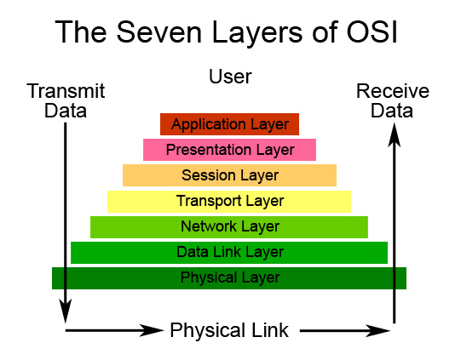
Let’s Look at Layers Again
Notes:
In this picture, a lot of interesting stuff is happening at the “application layer.” In particular this is where typical programmers spend their days.

Slide 3
Common Networked Application Pattern
Buy X
OKAY
APP1 sends message to APP2, expecting Reply
Message has a static part and a dynamic part
Similar to a function call!
Static = function name
Dynamic = function args
Notes:
A really common pattern is for code on one end of the network to communicate with code on the other end, expecting some reply.

Slide 4
Remote Procedure Calls (RPCs)
Not a particular “protocol”, rather a class of application protocols
Common Elements:
Procedure names known a priori
Arguments are fixed length, usually typed
Often: Arguments supplied as plain code objects
Protocols need to define:
Message Format
How to translate from code to message format

Slide 5
Remote Procedure Calls (RPCs)
Are RPCs just like normal procedure calls?
No!
Calls traverse network: many possible problems / exceptions
Can’t libraries abstract away the networking?
NO!!

Slide 6
Trying to Abstract the Network
Trying to mask failures is a Bad Thing TM
Example: network timeout
Do you retransmit automatically?
Potential Solutions?

Slide 7
Using Nonces
Nonce : unique-ish number
Receiver can tell if a message is repeated
What about responses to the client?
Can we guarantee the following?
If a RPC is processed by the server, the client will receive a successful response.

Slide 8
Let’s Look at Real RPC Protocols
Message Formats:
XML and JSON
Protocols / Libraries
Java RMI
Google Protobufs

Slide 9
Common Message Formats
XML and JSON most common “general formats”
These are “string” formats
(typically UTF-8 or even ASCII)
XML is horrible
<Message type=“terribleRPCformat” version=“1”>
<procedure name=“foo”>
<argument number=“1” value=“bar”>
</procedure>
</Message>
Compare to just saying “foo(bar)”
Message is longer, harder to parse, etc.

Slide 10
JSON is a bit better
JSON has lists, values and “dictionaries”
Looks like:
Still kind of a silly format
That’s what you get for string-based “object” formats, though.
{“type”: “sillyRPCFormat”,
“procedure”: “Foo”,
“arguments”: [“bar”]
}

Slide 11

Java RMI
Biggest Issue for Java Library:
Allowing objects to be used in procedure calls
Java Serializable
POJOs in, Bytes out
MAGIC?!

Slide 12
Java Serialization is not, as it turns out, Magic.
Marking class “Serializable” indicates that it is “okay to serialize”
Library inspects the object:
For every field, attempt to serialize()
Primitives, such as int and char, have hardcoded serialization functions
Write an “identifier” for the Object’s type.
Includes Object’s fully-qualified name, and a version

Slide 13
Default Java Serialization is Expensive
The algorithm is not theoretically expensive
However, crawling object reference graphs is expensive in practice.
This requires lots of indirect memory fetches, which are not necessarily known by the library
E.g., Object A may have an Object[] array. This array can store arbitrary types!
How much space would you need to allocate?
What kind of Objects do you expect to need to serialize?

Slide 14
Google Protobufs
Programmers define the contents of the message
Specify exactly what the output of the serialization will be
Allows for arrays – but these arrays must be of single types
Programmers must also define exactly how objects are translated
There are automatic tools to help with this
With the definition, the library optimizes the output, packs it into a condensed binary format

