Slide 1
Secrets & Lies, Knowledge & Trust. (Modern Cryptography)
COS 116, Spring 2012 Adam Finkelstein

Slide 2
Cryptography
|kripˈtägrəfē| noun the art of writing or solving codes.
Ancient ideas (pre-1976)
Complexity-based cryptography (post-1976)
Basic component of Digital World. More than just encryption / secret writing!

Slide 3
Main themes of today's lecture
Creating problems can be easier than solving them
Seeing information vs. making sense of it
Role of randomness in the above
Two complete strangers exchange secret information

Slide 4
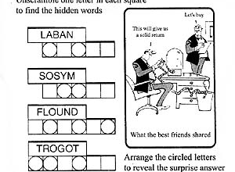
Theme 1: Creating problems can be easier than solving them
Example:
(Aside: This particular problem is trivial for computers!)
Reminiscent of something similar that is hard for current computers?

Slide 5
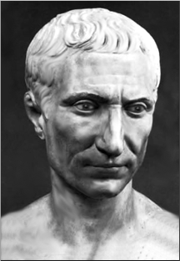
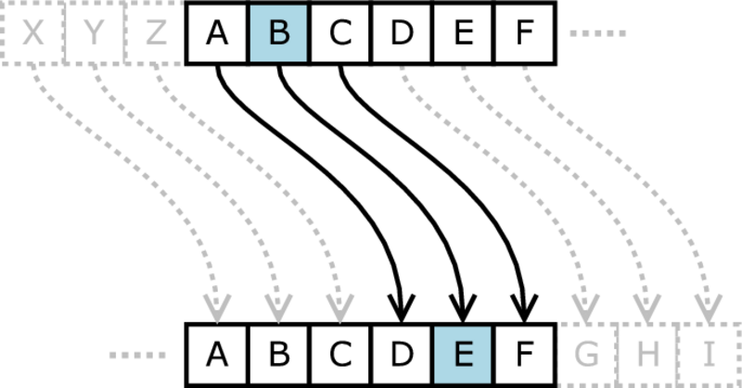
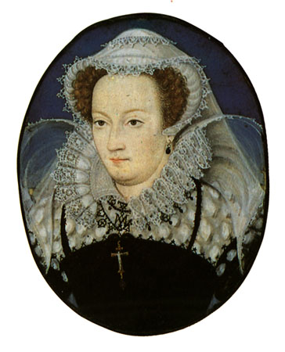
Letter scrambling: ancient cryptographic idea
Example 1: “Caesar cipher” (c. 100BC)
Example 2: Cipher used in conspiracy plot involving Queen Mary of Scots, 1587

Slide 6
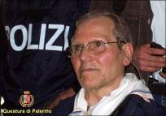
Mafia Boss's Messages Deciphered
“Boss of bosses” Bernardo Provenzano, captured after 40 years
Sent “pizzini” (little messages on scraps of paper) using variant of Caesar cipher
"...I met 512151522 191212154 and we agreed that we will see each other after the holidays...,”
5 = B, 12 = I, 15 = N, etc.
“It will keep your kid sister out, but it won't keep the police out.” - Bruce Schneier (Cryptographer)

Slide 7
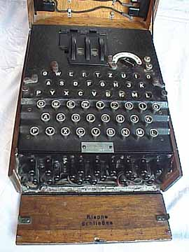
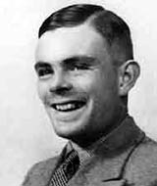
Letter scrambling (cont.)
Example 3: Enigma
Used by Nazi Germany (1940's)
Broken by British (Turing), Polish
“Won us the war.” – Churchill
Moral: Use of computer necessitates new ideas for encryption.

Slide 8
Integer factoring
Easy-to-generate problem
Generation
Pick two 32-digit prime numbers p, q, and multiply them to get r = pq
Factoring problem
Given r: find p and q
Hard to solve
We discussed an algorithm… Running time?

Slide 9
Status of factoring
Despite many centuries of work, no efficient algorithms. Believed to be computationally hard, but remains unproved (“almost–exponential time”) You rely on it every time you use e-commerce (coming up)
Note: If quantum computers ever get built, this may become easy to solve.

Slide 10
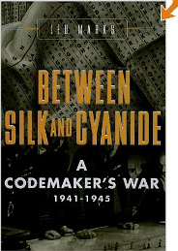
Theme 2: Seeing information vs. making sense of it
Theme 3: Role of randomness.
Simple example that illustrates both: one-time pad (“daily codebook.”)

Slide 11
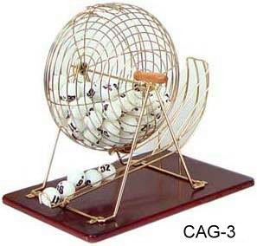
Random source hypothesis
Integral to modern cryptography
We have a source of random bits
They look completely unpredictable
Possible sources: Quantum phenomena, timing between keystrokes, etc.
0110101010011010011011101010010010001…

Slide 12
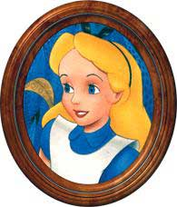
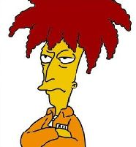
One-time pad (modern version)
Goal: transmit n-bit message
One-time pad: random sequence of n bits (shared between sender and receiver)
Alice
Bob
Eve

Slide 13
Using one-time pad
Encryption: One-time pad scrambles the message, as follows:
0 means “don't flip” the bit in the message
1 means “flip” the bit in the message
Example:
Encryption
Decryption (same rule!)
Message | 0110010
Pad | 1011001
Encrypted | 1101011
Encrypted | 1101011
Pad | 1011001
Message | 0110010

Slide 14
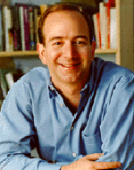
Musings about one-time pad
Incredibly strong security: encrypted message “looks random” … equally likely to be encryption of any n-bit string
How would you use one-time pad?
How can you and Amazon agree on a one-time pad?
Insecure link (Internet)
(Jeff Bezos '86)

Slide 15
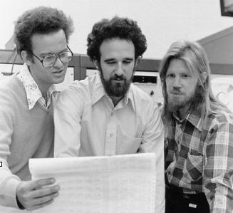
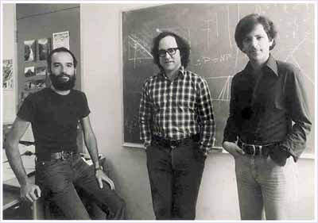
Theme: How perfect strangers can send each other encrypted messages.
Powerful idea: public-key encryption
Diffie-Hellman-Merkle [1976]
Rivest, Shamir, Adleman [1977]

Slide 16
Public-key cryptography
c = Encrypt(m, K_{pub})
Private key K_{priv}
(512-bit number, known only to Amazon.)
Message m
Public key K_{pub}
(512 bit number, publicly available, e.g. from Verisign Inc)
m = Decrypt(c, K_{priv})
Important: encryption and decryption algorithms are not secret, only private key!

Slide 17
Public-key encryption at a conceptual level
“Box that clicks shut, and only Amazon has the key to open it.”
Example: Key exchange [Diffie-Hellman]
User generates random string (“one-time pad”)
Put it in box, ship it to Amazon
Amazon opens box, recovers random string
01011
01011

Slide 18
Public-Key Encryption at a mathematical level (RSA version)
Key generation: Pick random primes p, q. Let N = p x q Find k that is not divisible by p, q. (“Public Key”) Encryption: m is encrypted as m^{k} (mod N)
Random Source Hypothesis!
Primes and “modular” math
Decryption: Symmmetric to Encryption; use “inverse” of k (this is private key)
(don’t sweat the details on this!)

Slide 19
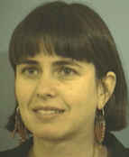
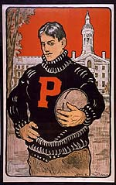
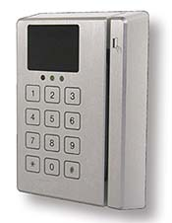
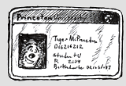
Zero Knowledge Proofs [Goldwasser, Micali, Rackoff '85]
Desire: Prox card reader should not store “signatures” – potential security leak
Just ability to recognize signatures!
Learn nothing about signature except that it is a signature
Student
prox card
prox card reader
“ZK Proof”: Everything that the verifier sees in the interaction it could easily have generated itself.

Slide 20
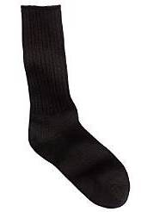
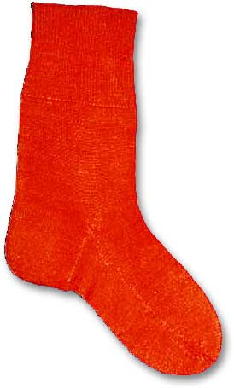
Illustration: Zero-Knowledge Proof that “Sock A is different from sock B”
Usual proof: “Look, sock A has a tiny hole and sock B doesn't!”
ZKP: “OK, why don't you put both socks behind your back. Show me a random one, and I will say whether it is sock A or sock B. Repeat as many times as you like, I will always be right.”
Why does verifier learn “nothing”? (Except that socks are indeed different.)
Sock A
Sock B

Slide 21
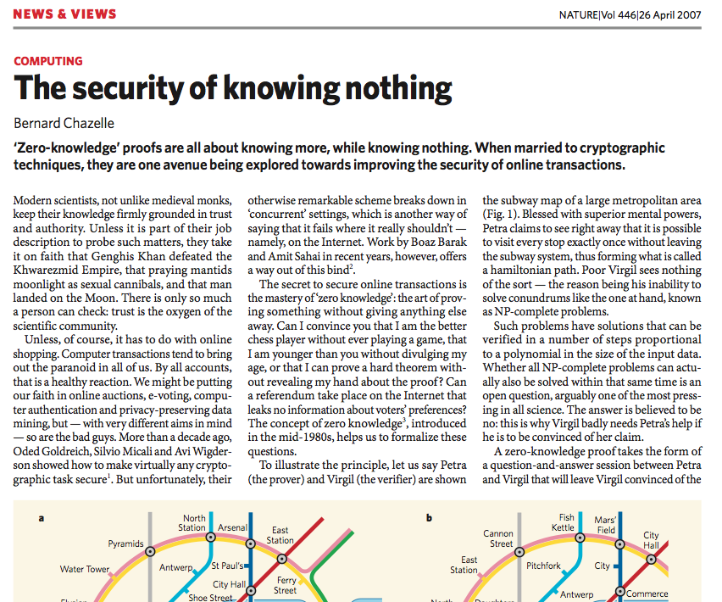
(what did you make of this…?)

Slide 22
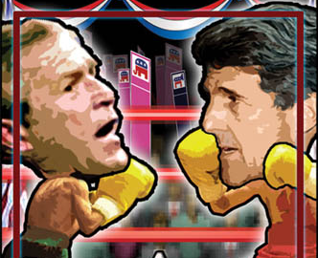
(From Lecture 1): Public closed-ballot elections
Hold an election in this room
Everyone can speak publicly (i.e. no computers, email, etc.)
At the end everyone must agree on who won and by what margin
No one should know which way anyone else voted
Is this possible?
Yes! (A. Yao, Princeton)
“Privacy-preserving Computations” (Important research area)

