Slide 1
What is the computational cost of automating brilliance or serendipity? (Computational complexity & P vs NP)
COS 116, Spring 2012 Adam Finkelstein

Slide 2
Combination lock
Why is it secure?
(Assume it cannot be picked)
Ans: Combination has 3 numbers 0-39… thief must try 40³ = 64,000 combinations

Slide 3
Boolean satisfiability
Does it have a satisfying assignment?
What if instead we had 100 variables?
1000 variables?
How long will it take to determine the assignment?
(A + B + C) · (D + F + G) · (A + G + K) · (B + P + Z) · (C + U + X)

Slide 4
Exponential running time
2^{n} time to solve problems of “size” n
Increase n by 1 → running time doubles!
Main fact to remember: For case of n = 300, 2^{n} > number of atoms in the visible universe.

Slide 5
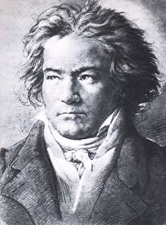
Discussion
Is there an inherent difference between being creative / brilliant
and being able to appreciate creativity / brilliance?
What is a computational analogue of this phenomenon?

Slide 6
A Proposal
Brilliance = Ability to find “needle in a haystack”
Beethoven found “satisfying assignments” to our neural circuits for music appreciation
Comments??

Slide 7
There are many computational problems where finding a solution is equivalent to “finding a needle in a haystack”….

Slide 8
CLIQUE Problem
CLIQUE: Group of students, every pair of whom are friends
In this social network, is there a CLIQUE with 5 or more students?
What is a good algorithm for detecting cliques?
How does efficiency depend on network size and desired clique size?

Slide 9
Rumor mill problem
Social network at PU
Each node represents a student
Two nodes connected by edge if those students are friends
Samantha starts a rumor
Will it reach Thomas?
Suggest an algorithm
How does running time depend on network size?
Internet servers solve this problem all the time (last lecture).

Slide 10
Exhaustive Search / Combinatorial Explosion
Naïve algorithms for many “needle in a haystack” tasks involve checking all possible answers → exponential running time.
Ubiquitous in the computational universe
Can we design smarter algorithms (as for “Rumor Mill”)? Say, n² running time.

Slide 11
Harmonious Dorm Floor
Given: Social network involving n students.
Edges correspond to pairs of students who don't get along.
Decide if there is a set of k students who would make a harmonious group (everybody gets along).
Just the Clique problem in disguise!

Slide 12
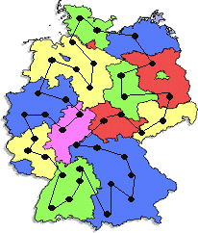
Traveling Salesman Problem (aka UPS Truck problem)
Input: n points and all pairwise inter-point distances, and a distance k
Decide: is there a path that visits all the points (“salesman tour”) whose total length is at most k?

Slide 13
Finals scheduling
Input: n students, k classes, enrollment lists, m time slots in which to schedule finals
Define “conflict”: a student is in two classes that have finals in the same time slot
Decide: If schedule with at most 100 conflicts exists?

Slide 14
The P vs NP Question
P: problems for which solutions can be found in polynomial time (n^{c} where c is a fixed integer and n is “input size”). Example: Rumor Mill
NP: problems where a good solution can be checked in n^{c} time. Examples: Boolean Satisfiability, Traveling Salesman, Clique, Finals Scheduling
Question: Is P = NP?
“Can we automate brilliance?” (Note: Choice of computational model --- Turing-Post, pseudocode, C++ etc. --- irrelevant.)

Slide 15
NP-complete Problems
Problems in NP that are “the hardest”
If they are in P then so is every NP problem.
Examples: Boolean Satisfiability, Traveling Salesman, Clique, Finals Scheduling, 1000s of others
How could we possibly prove these problems are “the hardest”?

Slide 16
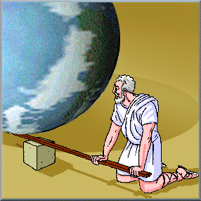
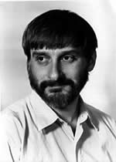
“Reduction”
“If you give me a place to stand, I will move the earth.” – Archimedes (~ 250BC)
“If you give me a polynomial-time algorithm for Boolean Satisfiability, I will give you a polynomial-time algorithm for every NP problem.” --- Cook, Levin (1971)
“Every NP problem is a satisfiability problem in disguise.”
Notes:
Remember harmonious dorm floor problem was really CLIQUE in disguise.

Slide 17
Dealing with NP-complete problems
Heuristics (algorithms that produce reasonable solutions in practice)
Approximation algorithms (compute provably near-optimal solutions)

Slide 18
Computational Complexity Theory: Study of Computationally Difficult problems.
A new lens on the world?
Study matter → look at mass, charge, etc.
Study processes → look at computational difficulty

Slide 19
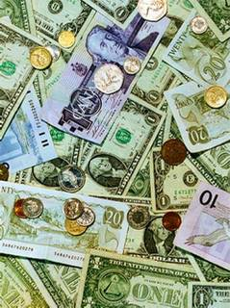
Example 1: Economics
General equilibrium theory:
Input: n agents, each has some initial endowment (goods, money, etc.) and preference function
General equilibrium: system of prices such that for every good, demand = supply.
Equilibrium exists [Arrow-Debreu, 1954]. Economists assume markets find it (“invisible hand”)
But, no known efficient algorithm to compute it. How does the market compute it?

Slide 20
Example 2: Factoring problem
Given a number n, find two numbers p, q (neither of which is 1) such that n = p x q.
Any suggestions how to solve it?
Fact: This problem is believed to be hard. It is the basis of much of cryptography. (More next time.)

Slide 21
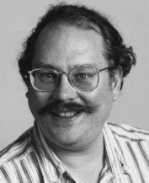
Example 3: Quantum Computation
A
B
Peter Shor
Central tenet of quantum mechanics: when a particle goes from A to B, it takes all possible paths all at the same time
[Shor'97] Can use quantum behavior to efficiently factor integers (and break cryptosystems!)
Can quantum computers be built, or is quantum mechanics not a correct description of the world?

Slide 22
Example 4: Artificial Intelligence
What is computational complexity of language recognition?
Chess playing?
Etc. etc.
Potential way to show the brain is not a computer: Show it routinely solves some problem that provably takes exponential time on computers.

Slide 23
Why is P vs NP a Million-dollar open problem?
If P = NP then Brilliance becomes routine (best schedule, best route, best design, best math proof, etc…)
If P ≠ NP then we know something new and fundamental not just about computers but about the world (akin to “Nothing travels faster than light”).

Slide 24
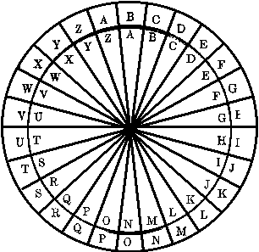
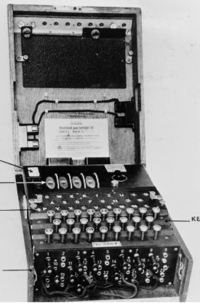
Next time: Cryptography (practical use of computational complexity)

