Slide 1
The science that drives modern computers.
COS 116, Spring 2012
Adam Finkelstein

Slide 2
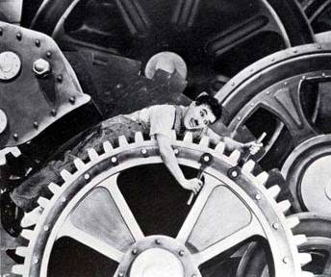
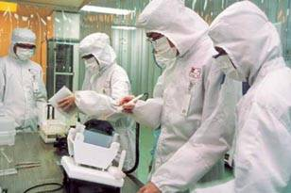
Changing face of manufacturing
1936
Late 20th century
“Modern Times”
Silicon wafer fabrication

Slide 3
20th century science and IT: a match made in heaven?
“These are the days of miracles and wonders.” – Paul Simon, Graceland
Main theme in this lecture: Scientific Advances→ Ability to control matter precisely
→ Amazing products/computers

Slide 4
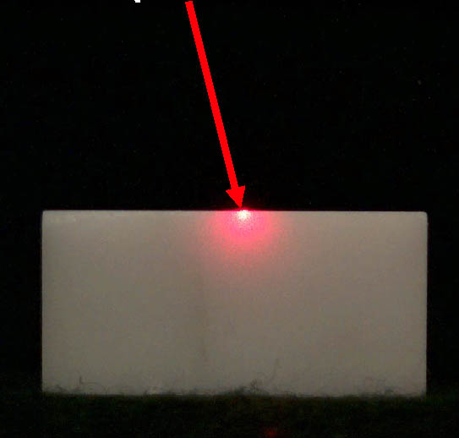
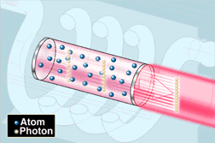
Example of precise control of matter: Lasers
Quantum mechanics (wave-particle duality, quantization of energy, etc.)
Ability to create light of a single frequency (“laser”)

Slide 5
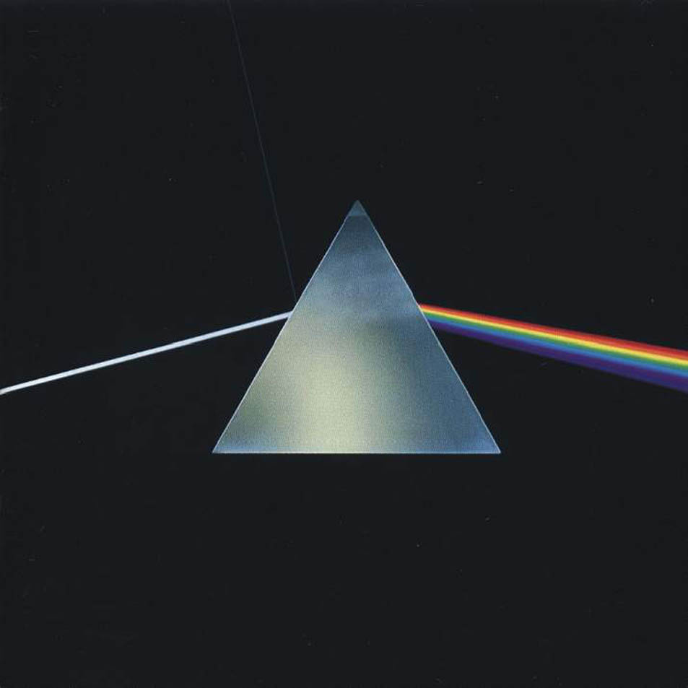
Why lasers are so useful: Accurate focusing
White light
Different colors focus at different points – “smudge”
Laser
Focus at single point

Slide 6
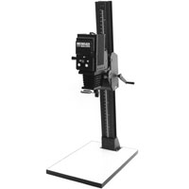
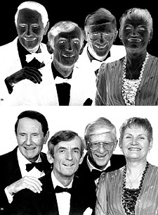
Silicon Chip manufacturing
“A picture is worth a billion gates.”
Fact: Modern chips are manufactured using a process similar to photography

Slide 7
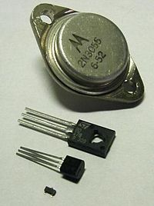
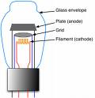
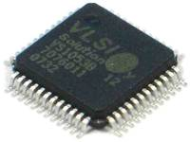
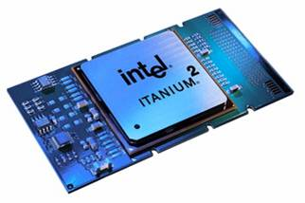
Timeline
Vacuum Tube Triode (1908)
Transistor 1947 (silicon, germanium)
Very Large Scale Integrated (VLSI)
Circuits; 1970s-- (> 1,000 transistors per chip)
Intel Itanium (Tukwila)
2008: 2 billion transistors

Slide 8
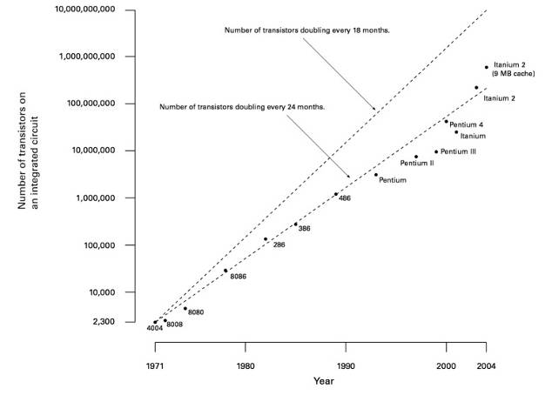
Moore’s Law
Technology advances so that number of gates per square inch doubles every 18 months.
[Gordon Moore 1965]
Number of gates doubling every 18 months
Number of gates doubling every 24 months

Slide 9
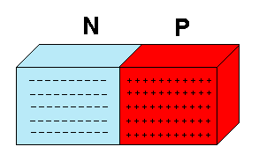
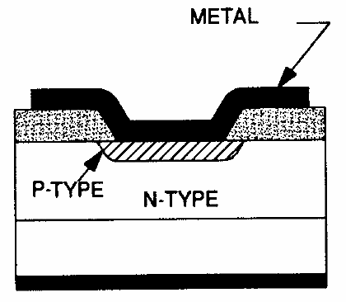
Implementation of a gate in a modern chip
Semiconductor: not as good a conductor as metals, not as bad as wood
Example: silicon
Doped semiconductor: semiconductor with some (controlled) impurities: p-type, n-type
Switch: p-n junction

Slide 10
Example: an AND gate
Power
N
A
P
N
N
B
P
N
Output
Ground

Slide 11
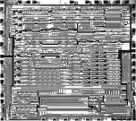
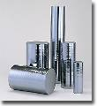
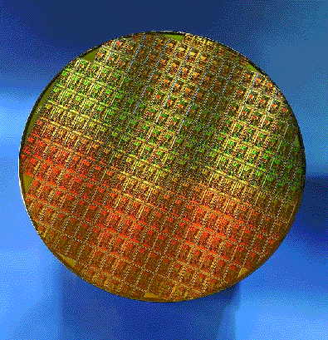
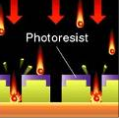
Chip Fabrication
Grow silicon ingots
Cut wafers and polish
Create mask
Repeat to add metal channels (wires) and insulation; many layers!
Coat wafer with light sensitive chemicals and project mask onto it
Coat with chemicals that remove parts unexposed to light

Slide 12
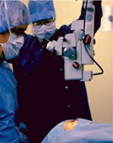
Aside: Lasik eye correction
Uses laser invented for chip fabrication

Slide 13
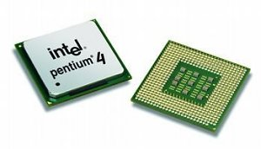
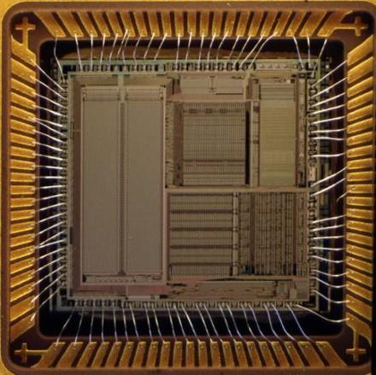
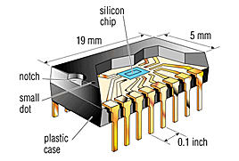
Chip Packaging
Inside
Outside

Slide 14
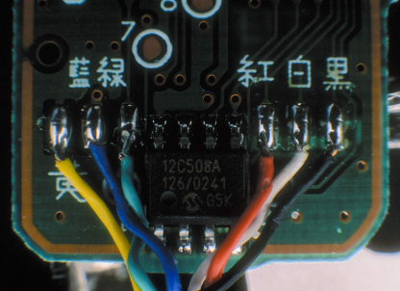
Life cycle of a microprocessor
Fact: Less than 1% of microprocessors sold are used in computers
Inside an iPod Remote

Slide 15
Why so few new CPU’s?
Cost of new design: $8 billion
Profit: $100 / chip
Need to sell 80 million to break even

Slide 16
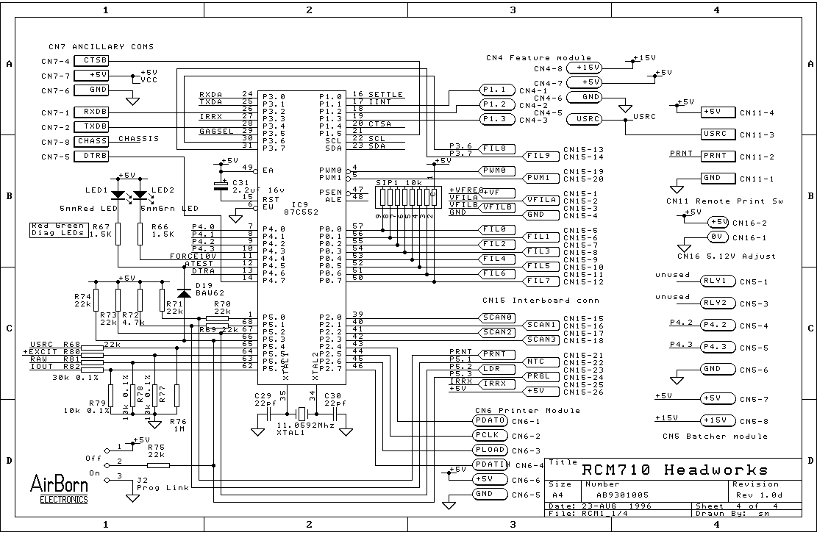
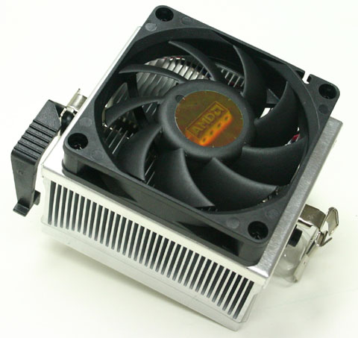
Engineering tradeoffs
Can run at twice the clock speed! (Why?)
But: higher clock speeds → much more heat!
36 months later...
Half the size!

Slide 17
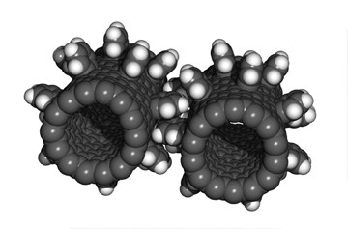
Even more precise control of matter
Nanotechnology: manufacture of objects (machines, robots, etc.)
at the atomic or molecular level (1-100 nanometers)
“nanogear”
Biocomputing: Implementing computers via interactions of biological molecules.

Slide 18
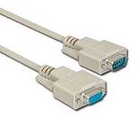
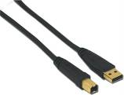
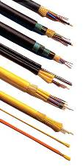
Another example of control of matter: the changing data cable
Serial cable: 115 kb/s
USB cable: 480 Mb/s (USB 2.0)
Fiber optic cable: 40 Gb/s

Slide 19
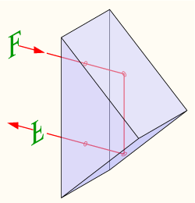
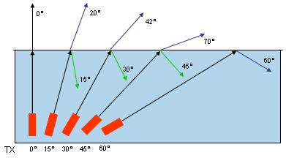
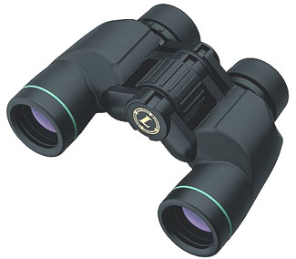
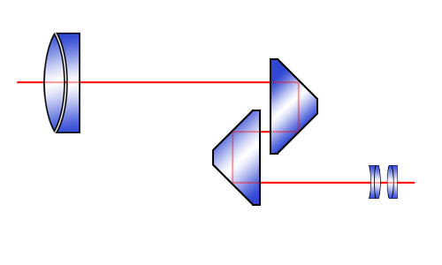
Total Internal Reflection
Porro Prism

Slide 20
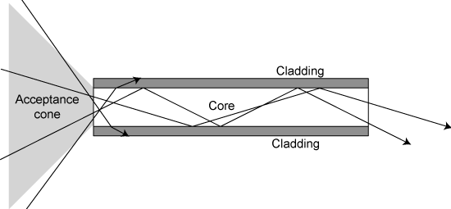
How optical fibers work
Glass fiber: 10-40 billion bits/s
“Total internal reflection”
Pulsing Laser beam

Slide 21
Wave Division Multiplexing (WDM)
Transmission rates of trillion (“Tera”) bits/s
Multiple (100 or so) data streams enter
Multiple data streams exit
Fiber optic cable
Multiplexor
De-multiplexor
One beam with various frequencies mixed in

Slide 22
Thoughts about the 20th century
What factors (historical, political, social) gave rise to this knowledge explosion?
Will it continue in the future?

Slide 23
Are faster chips the answer to all problems in computing?
An Answer: No! Halting problem is undecidable!

