Slide 1
Finite State Machines (FSMs) and RAMs and inner workings of CPUs
COS 116, Spring 2012
Adam Finkelstein
Notes:
Did an extensive demo that clarified what determines clock speed.

Slide 2
Recap
Combinational logic circuits: no cycles, hence no “memory”
Sequential circuits: cycles allowed; can have memory
as well as “undefined”/ambiguous behavior
Clocked sequential circuits: Contain D flip flops
whose “write” input is controlled by a clock signal

Slide 3
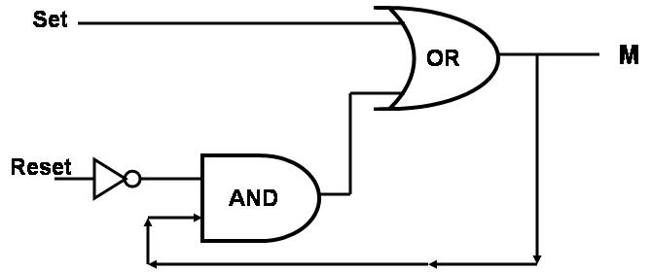
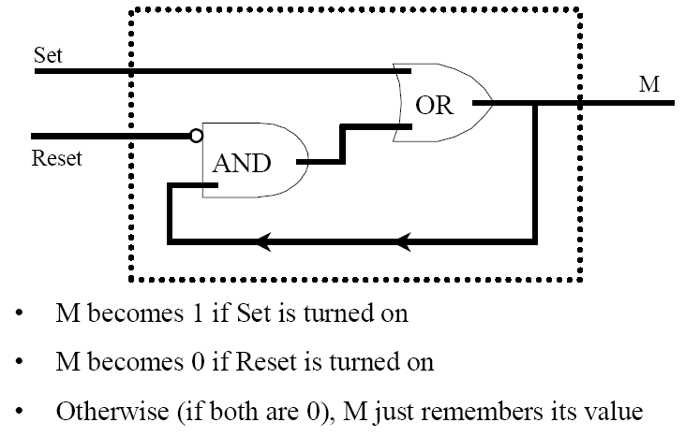
R-S Flip-Flop
(corrected slide)
S
M
R
(But do not
make both
Set and Reset
TRUE at
same time!)

Slide 4
Recap: D Flip Flop
Basic Memory Block – stores 1 bit.
D
If we “toggle” the write input (setting it 1 then setting it 0) then M acquires the value of D.
M
W

Slide 5
“Timing Diagram”
D
M
W
5V
D
0V
Time
5V
W
0V
Time
5V
M
0V
Time

Slide 6
Finite State Machines (FSMs)
Detected Person
“Automatic Door”
No Person Detected
Closed
Open
Detected Person
No Person Detected
Finite number of states
Machine can produce outputs, these depend upon current state only
Machine can accept one or more bits of input; reading these causes transitions among states.

Slide 7

Discussion
Time
What are some examples of FSMs?
How can we implement a FSM using logic gates etc?
If number of states = 2^{k} then represent “state”
by k boolean variables.
Identify number of input variables
Write truth table expressing how “next state”
is determined from “current state”
and current values of the input.
Express as clocked synchronous circuit.

Slide 8
Example: 4-state machine; 1 bit of input; No output
State variables: P, Q
Input variable: D
Next value of P = (P + Q) • D
Next value of Q = P
What is its state diagram?

Slide 9
Implementation: General Schematic
Flip flops
(memory
elements)
Circuit to
compute
next state
Circuit to
compute
outputs
CLK
Inputs
K Flip flops allow FSM to have 2^{K} states

Slide 10
Implementing door FSM as synchronous circuit
INPUT
0 = No Person Detected
1 = Person Detected
Input | Present State | Next State
0 | 0 | 0
1 | 0 | 1
0 | 1 | 0
1 | 1 | 1
STATE
0 = Door Closed
1 = Open

Slide 11
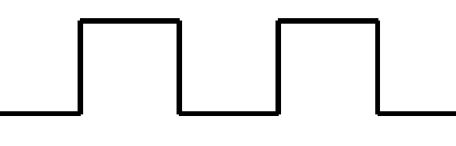
Implementation of door FSM (contd)
0 = No Person Detected
1 = Person Detected
INPUT
D
M
STATE
W
0 = Door Closed
1 = Open
CLOCK

Slide 12
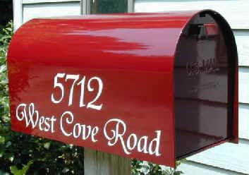
Next….
Random Access Memory (RAM)
Memory where each location has an address

Slide 13
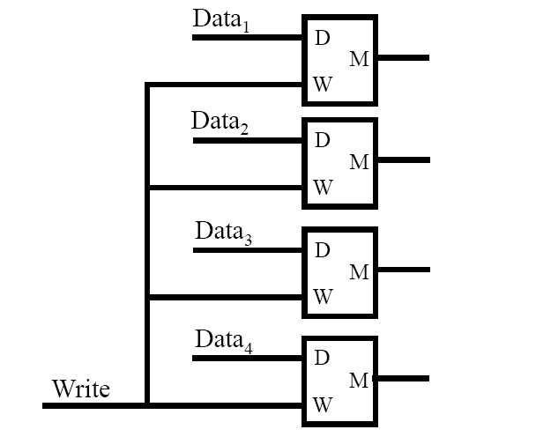
Recall from last lecture:
“Register” with 4 bits of memory
How can you
set up an
addressing
system for
large banks of
memory?

Slide 14
Random Access Memory (RAM)
RAM
RAM
Data
Data
K Address Bits
K Address Bits
Read
2^{K} bits;
bank of
flipflops
Write

Slide 15
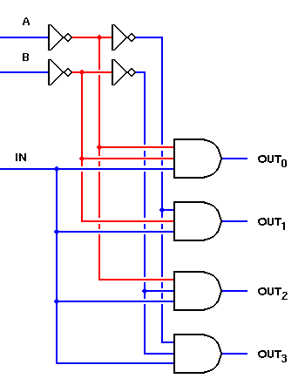
If 4 locations, “address” has 2 bits
Address
Clock
To RAM’s
“Clock” input

Slide 16
RAM: Implementing “Write”
RAM
Decoder
Data
The decoder selects which cell in the RAM gets its “Write” input toggled
Clock
(simple combinational
circuit; see logic handout)
K-bit address
(in binary)

Slide 17
Ram: implementing “Read”
RAM
Multiplexer
Data
The multiplexer is connected to all cells in the RAM; selects the appropriate cell based upon the k-bit address
(simple combinational
circuit; see logic handout)
K-bit address
(in binary)

Slide 18
Next, the secret revealed...
How computers execute programs.
CPU = Central Processing Unit

Slide 19
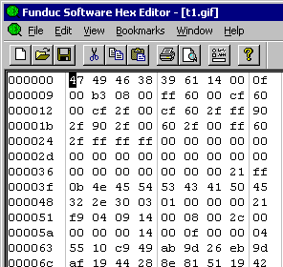
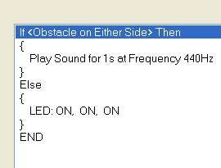
Scribbler Control Panel Program
Machine Executable Code
F5
“Download to Robot”
(Compilation)
Similar to:
Point 1: Programs are “translated”
into “machine language”; this is
what’s get executed.
T-P programs represented
in binary
.exe files in the Wintel
world

Slide 20
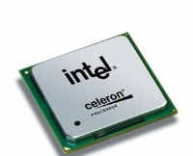

Greatly simplified view of modern CPUs.
Program (in binary)
stored in memory
Memory Registers
Arithmetic and
Logic Unit
(ALU)
Control FSM
Lots of Custom Hardware
Instruction Pointer
RAM

Slide 21
Examples of Machine Language Instructions
ADD 3 7 12 | Add contents of Register 3 and Register 7 and store in Register 12
LOAD 3 67432 | Read Location 67432 from memory and load into Register 3
JUMP 4 35876 | If register 4 has a number > 0 set IP to 35876
Stored in binary (recall Davis’s binary encoding of T-P programs)

Slide 22
Different CPUs have different machine languages
Intel Pentium, Core, Xeon, etc. (PC, recent Mac)
Power PC (old Mac)
ARM (cellphones, mobile devices, etc.)
“Backwards Compatibility” – Core 2’s machine language extends Pentium’s machine language
Machine languages now allow complicated calculations (eg for multimedia, graphics) in a single instruction

Slide 23
Main Insight
Computer = FSM controlling a larger (or infinite) memory.

Slide 24
Meet the little green man…
The Fetch – Decode – Execute FSM
Decode
Fetch
Execute

Slide 25
Fetch – Decode – Execute FSM
ADD Instruction
“Fetch”
IP IP + 1
JUMP Instruction
Go to next
instruction
Decode
Execute

Slide 26
CPU as a conductor of a symphony
Network Card
CPU
Sound Card
“BUS”
e.g., PCI
CD-ROM
Video Card
Bus: “Everybody hears everybody else”

Slide 27
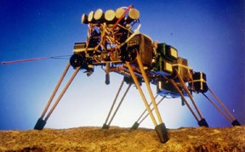
How an FSM does “reasoning”
“If left infrared sensor detects
a person, turn left”
L = 1
T =1
L = 0
T= 0

Slide 28
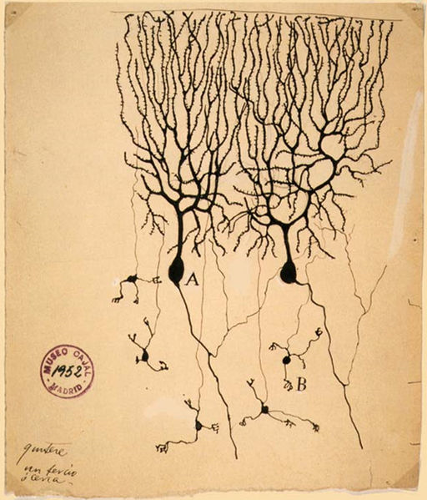
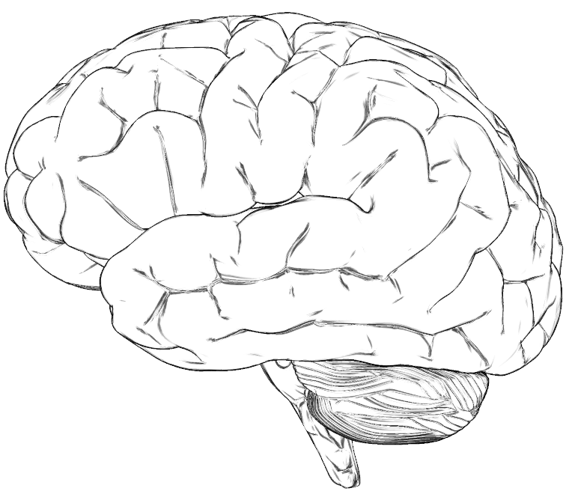
Speculation: Brain as FSM?
Network (“graph”) of 100 billion neurons; each
connected to a few thousand others
Neuron = tiny Computational Element;
“switching time” 0.01 s
Neuron generates a voltage spike depending
upon how many neighbors are spiking.

