Slide 1
Memory; Sequential & Clocked Circuits;
Finite State Machines
COS 116, Spring 2012
Adam Finkelstein
Notes:
Did an extensive demo that clarified what determines clock speed.

Slide 2


Recap: Boolean Logic
Boolean Expression E = S AND D
S
Boolean Circuit
E
D
D
S
E
Truth table:
Value of E for every
possible D, S.
TRUE=1; FALSE= 0.
Truth table has
rows if
the number of
variables is k
0
0
0
0
1
1
1
0
0
1
1
0

Slide 3
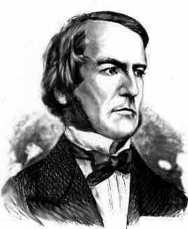
Boole’s reworking of Clarke’s “proof” of existence of God
(see handout – after midterm)
General idea: Try to prove that Boolean expressions
E₁, E₂, …, E_{k} cannot simultaneously be true
Method: Show E₁· E₂ · … · E_{k} = 0
Discussion for after Break: What exactly does Clarke’s “proof” prove? How convincing is such a proof to you?
Also: Do Google search for “Proof of God’s Existence.”

Slide 4
Circuit for binary addition?
    25
    + 29
    54
    11001
    11101
    110110
Want to design a circuit to add
any two N-bit integers.
Q: Is the truth table method useful for N=64?

Slide 5
Modular design for N-bit adder
Suffices to use N 1-bit adders!
c_{N-1} c_{N-2} … c₁ c₀
a_{N-1} a_{N-2} … a₁ a₀
+ b_{N-1} b_{N-2} … b₁ b₀
s_{N} s_{N-1} s_{N-2} … s₁ s₀
Carry bits

Slide 6

Modular design
Have small number
of basic components.
Put them together to achieve
desired functionality
Basic principle of modern industrial design;
recurring theme in next few lectures.

Slide 7
1-bit adder
a_{k}
b_{k}
c_{k+1}
c_{k}
(Carry from previous adder)
1-ADD
Carry bit for
next adder.
s_{k}
Do yourself: Write truth table, circuit.

Slide 8
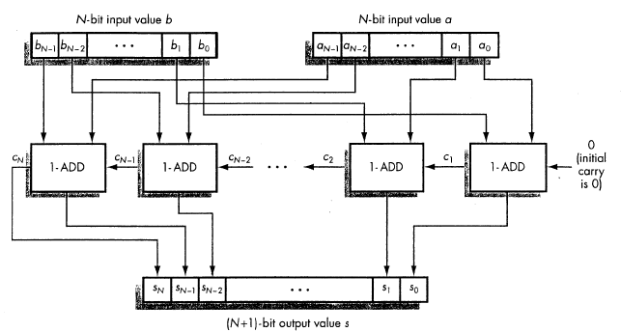
A Full Adder (see logic reading)

Slide 9
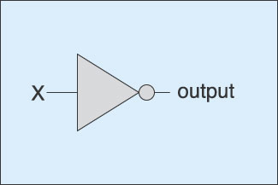
Timing Diagram
NOT gate
5V
X
0V
Time
delay
5V
output
0V
Time

Slide 10

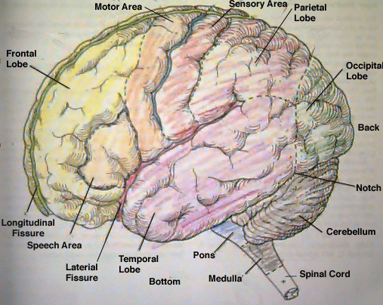
Memory
Rest of this lecture:
How boolean circuits have “memory”.

Slide 11
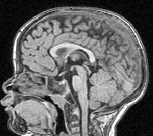
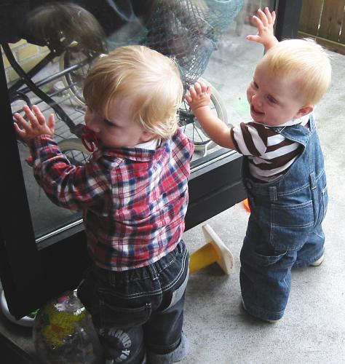
What do you understand by ‘memory’…?
How can you tell that a
1-year old child has it?
Behaviorist’s answer: Child’s actions depend upon past events.

Slide 12
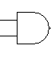

Combinational circuit
Boolean gates connected by wires
Important: no cycles allowed
Wires: transmit voltage
(and hence value)
Today: Circuits with loops; aka “Sequential Circuits”

Slide 13


Matt likes Sue but he doesn’t like changing his mind
Represent with a circuit: Matt will go to the party if Sue goes or if he already wanted to go
S
M
Is this well-behaved?!?

Slide 14
Sequential Circuits
Circuits with AND, OR and NOT gates.
Cycles are allowed (ie outputs can feed
back into inputs)
Can exhibit “memory”.
Sometimes may have “undefined” values

Slide 15

Enter Rita
Matt will go to the party if Sue goes OR if the following holds:
if Rita does not go and
he already wanted to go.
?
M
R, S: “control” inputs
What combination of R, S changes M?
S
M
R

Slide 16
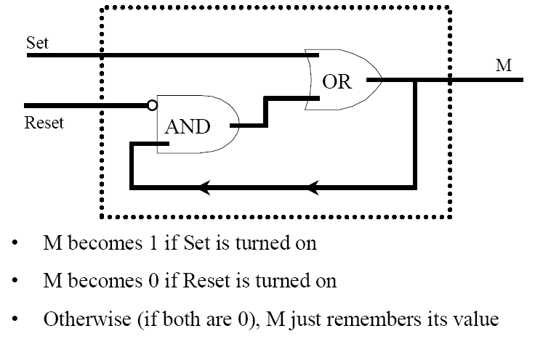
R-S Flip-Flop
S
M
R

Slide 17
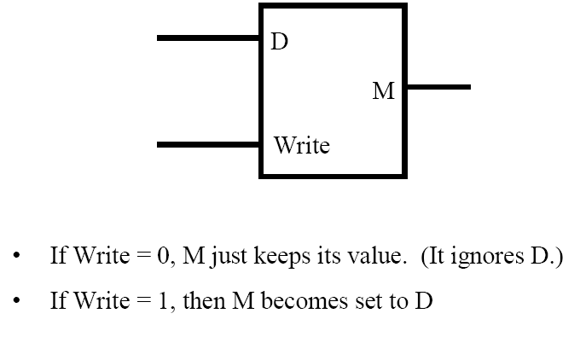
A more convenient form of memory
No “undefined”
outputs ever!
Fact: “Data Flip-Flop” (or “D flip flop”)
can be created using R-S flip flops!

Slide 18
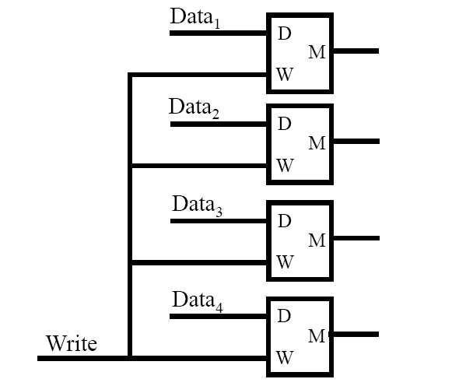
Register with 4 bits of memory

Slide 19
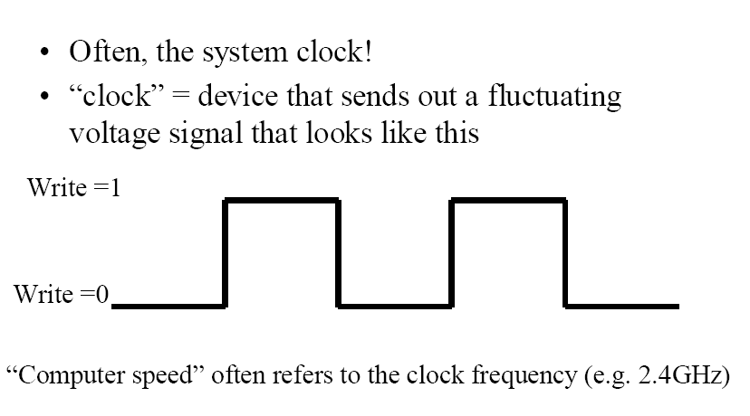
What controls the “Write” signal?

Slide 20
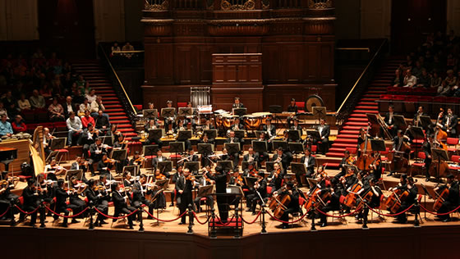
The “symphony” inside a computer
Clock
Clocked
Sequential
Circuit
(aka
Synchronous
Circuits)
Combinational
circuit
Memory

Slide 21
Clocked Sequential Circuits

Slide 22
Synchronous Sequential Circuit
(aka Clocked Sequential Circuit)
INPUTS
Combinational Circuit
Memory
(flip-flops)
CLOCK

Slide 23
Shorthand
Combinational Circuit
Memory
(flip-flops)
CLK
This stands for “lots of wires”

Slide 24
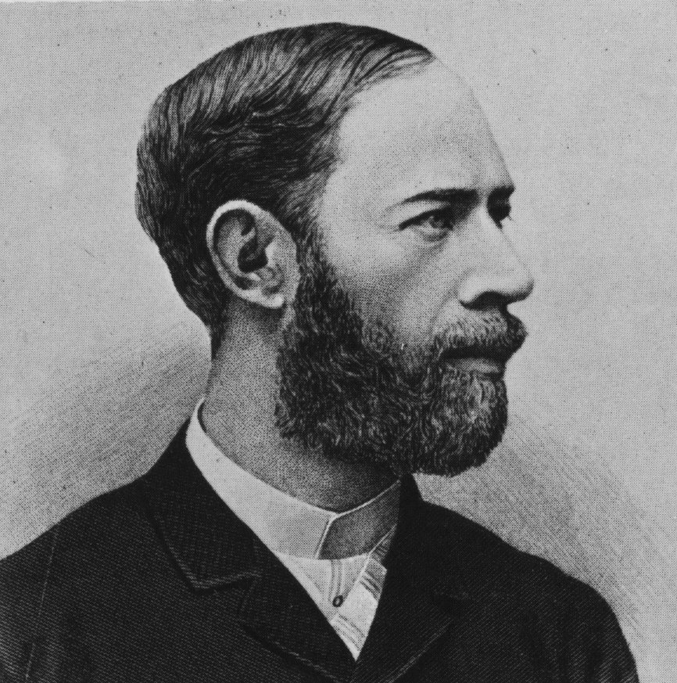
Clock Speeds
1974 | Intel 8080 | 2 MHz (Mega = Million)
1981 | Original IBM PC | 4.77 MHz
1993 | Intel Pentium | 66 MHz
2005 | Pentium 4 | 3.4 GHz (Giga = Billion)
Heinrich Hertz
1857-94

Slide 25
What limits clock speed?
Combinational Circuit
Memory
(flip-flops)
CLK
Delays in combinational logic (remember the adder)
During 1 clock cycle of Pentium 4, light travels: 4 inches

Slide 26
Finite State Machines
Next lecture….

Slide 27
Example: State diagram for automatic door at grocery store
No Person Detected
Detected Person
Closed
Open
Detected Person
No Person Detected

