Slide 1
Self-reproducing programs. And Introduction to logic.
COS 116, Spring 2012
Adam Finkelstein

Slide 2
Midterm
One week from today – in class Mar 15
Covers
  lectures, labs, homework, readings to date
Old midterms will be posted on course web
Mar 12 and 14 lab times will be review
  feel free to attend either or both
  come with questions

Slide 3
Part 1: Self-Reproduction
Fallacious argument for impossibility:
Blueprint
Blueprint
Blueprint
Notes:
Recall the question: how does the seed encode the whole?

Slide 4
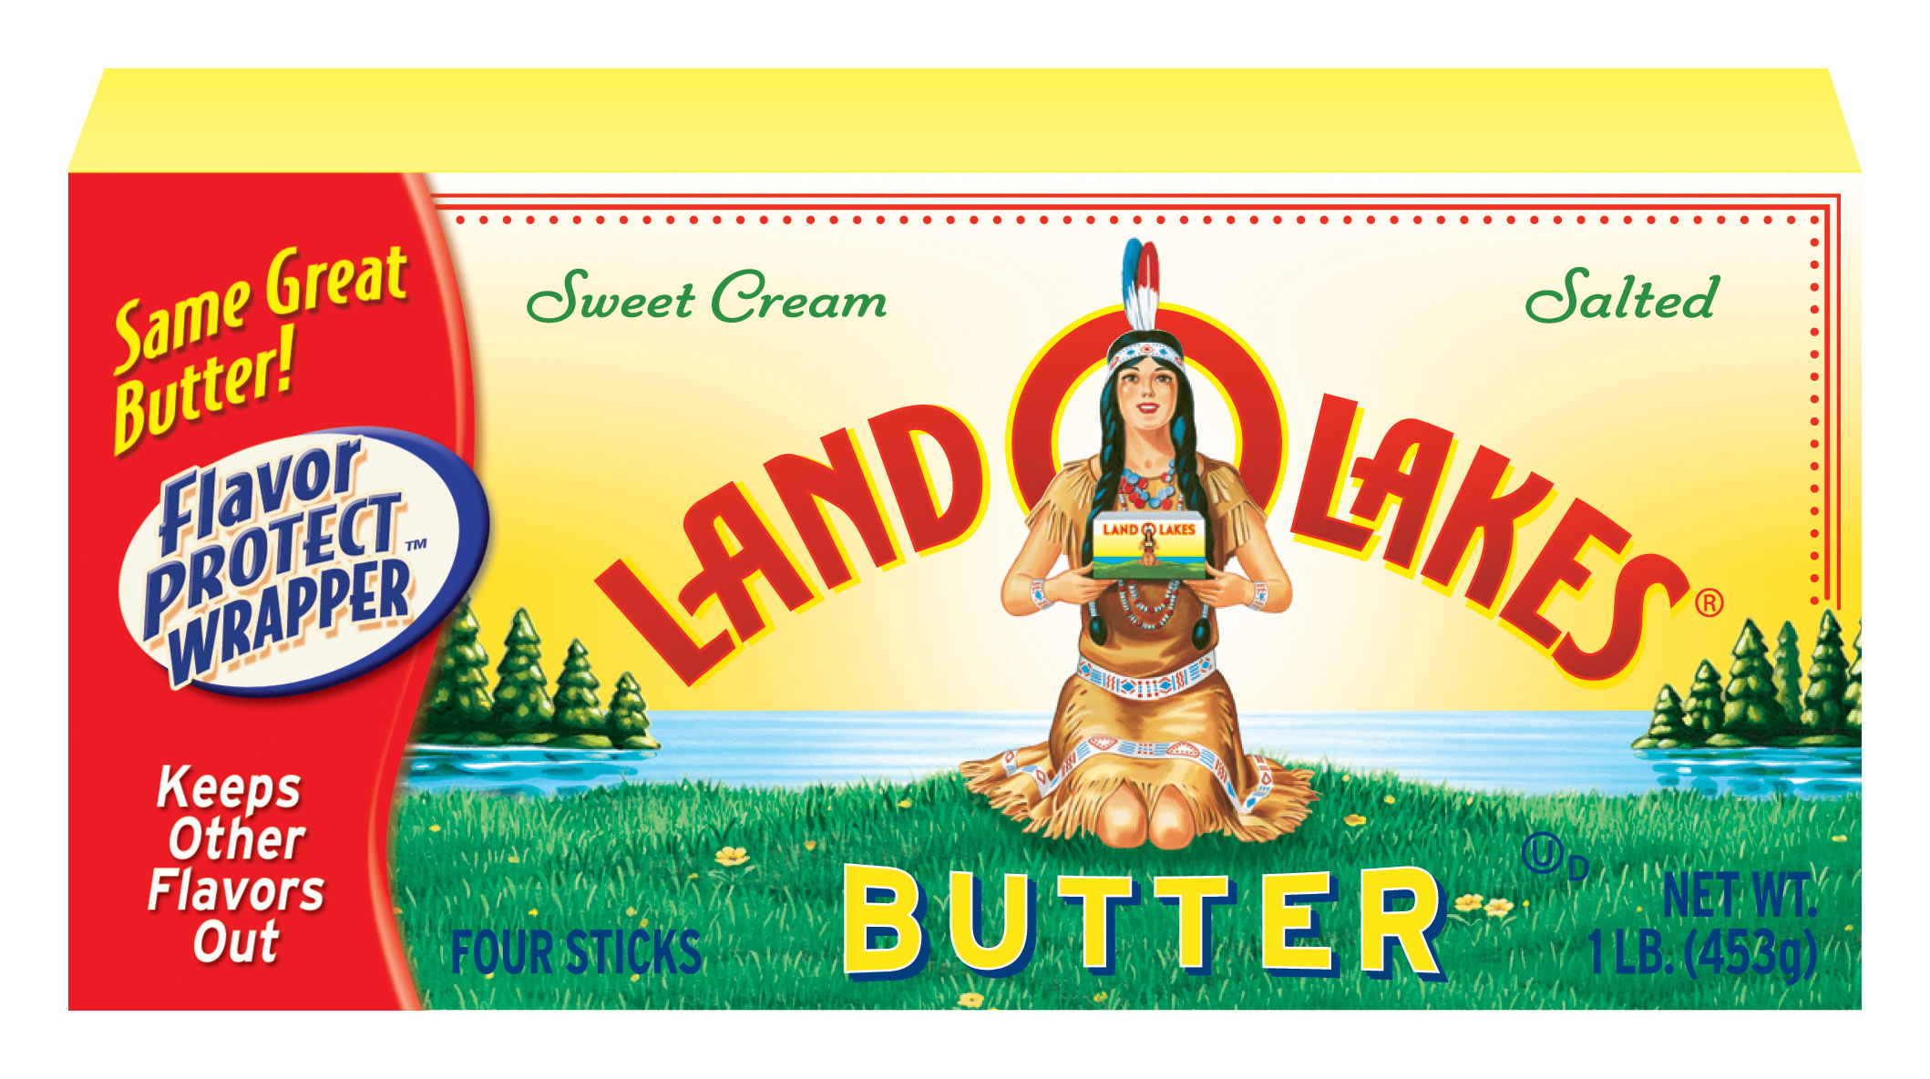
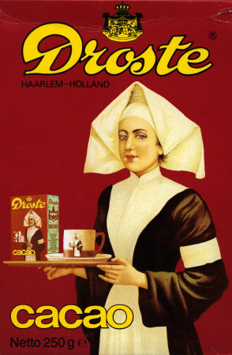
“Droste Effect”

Slide 5
Fallacy Resolved:
“Blueprint” can involve computation; need not be an exact copy!
Print the following sentence twice,
the second time in quotes. “Print the following sentence twice, the second time in quotes.”

Slide 6
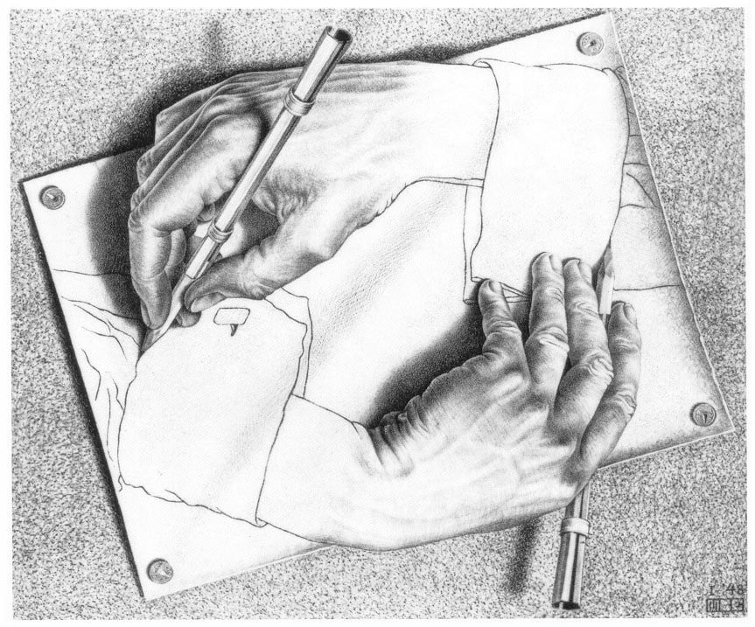
Notes:
Question, how would you print this sequence of bits (say 1 0 1 1 0 0 1 1 1 ) on the tape of a TM?

Slide 7
High-level view of self-reproducing program
}
Print 0
Print 1
.
.
.
Print 0
A
Prints binary code of B
}
. . . . . .
. . . . . .
. . . . . .
. . . . . .
Takes binary string on tape, and in its place prints (in English) the sequence of statements that produce it, followed by the translation of the binary string into English.
B

Slide 8
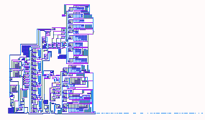
Self-reproducing machines
[John von Neumann, 1940s]
2-D and 3-D cellular automata
(with a “moving arm” controlled
by the automaton itself) that
makes a precise copy of itself.
“Accidental changes” during
copying --> mutations, evolution
This and related ideas of Pauli motivated discovery
of the molecular basis of life on earth (DNA, RNA etc.)

Slide 9
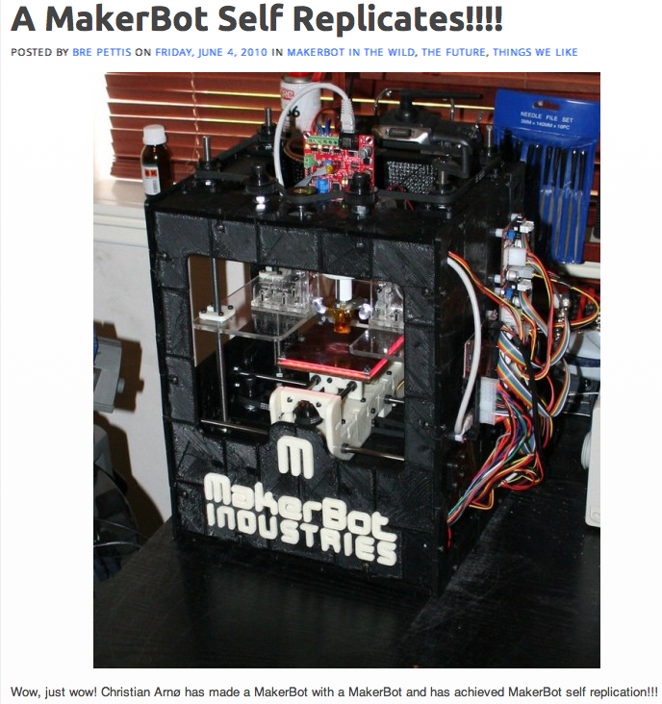

Slide 10
Moving on to part 2…
Upcoming lectures: Computational Hardware
Boolean logic and Boolean circuits
Sequential circuits (circuits with memory)
Clocked circuits and Finite State Machines
CPUs
Operating System
Networks, Internet
Notes:
In order of increasing complexity… building up from simplest.

Slide 11

Discussion
Time
Ben only rides to class if he overslept,
but even then if it is raining he’ll walk and show up late (he hates to bike in the rain). But if there’s an exam that day,
he’ll bike if he overslept, even in the rain.
Q: It is raining today, Ben overslept, and there’s an exam. Will Ben bike today?
“Logical reasoning”, “Propositional logic.”

Slide 12
Propositional Logic: History
Aristotle – Law of excluded middle,
Law of contradiction.
Stoic Philosophers (3rd century BC) –
Basic inference rules (modus ponens etc.)
Some work by medieval philosophers
De Morgan and Boole (19th century):
Symbolic logic – “automated”, “mechanical”
C. Shannon (1930s) –
Proposal to use digital hardware

Slide 13
Example
Ed goes to the party if
Dan does not and Stella does.
Choose “Boolean variables” for 3 events:
{
}
E: Ed goes to party
D: Dan goes to party
S: Stella goes to party
Each is either
TRUE or FALSE
E = S AND (NOT D)
Alternately: E = S AND D

Slide 14
Ed goes to the party if Dan goes or Stella goes
Logical “OR”
E = D OR S
E is TRUE if one or both of D and S are TRUE
Note:
In everyday language OR has another meaning too!
Example: You can eat an orange or an apple

Slide 15
Boolean expressions
Composed of boolean variables, AND, OR, and NOT
Examples:
D AND ( P OR (NOT Q))
C OR D OR E
Notes:
Each variable is either true or false
Each expression is either true or false
Why no parens in second example?

Slide 16
Truth table
Lists the truth value of the Boolean expression for all
combinations of values for the variables.
Boolean Expression E = S AND D
Truth table
0 = FALSE
1 = TRUE
Write E for all possible
values of D, S.
D
S
E
0
0
0
0
1
1
1
0
0
1
1
0

Slide 17
Let’s work an example…
Boolean Expression E = D OR S
What are x and y ?!?
D
S
E
0
0
1
Possibilities:
x=0, y=0
x=0, y=1
x=1, y=0
X=1, y=1
0
1
x
1
0
y
1
1
1

Slide 18
Ben Revisited
Ben only rides to class if he overslept.
But even then if it is raining he’ll walk and show up late (he hates to bike in the rain).
But if there’s an exam that day he’ll bike if he overslept, even in the rain.
B: Ben Bikes
R: It is raining
E: There is an exam today
O: Ben overslept
Break up in groups of three and come up with Boolean expression for B in terms of R, E and O.

Slide 19
Boolean “algebra”
A AND B written as A • B A OR B written as A + B
0 • 0 = 0
0 • 1 = 0
1 • 1 = 1
0 + 0 = 0
1 + 0 = 1
1 + 1 = 1
Funny arithmetic
Notes:
This is just notation.

Slide 20
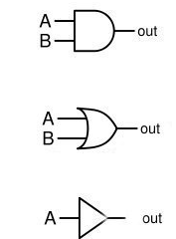
Boolean circuit
Pictorial representation of Boolean expression using
Special symbols for AND, OR and NOT
A AND B
A OR B
A

Slide 21


Three Equivalent Representations
Boolean Expression E = S AND D
S
Boolean Circuit
E
D
D
S
E
Truth table:
Value of E for every
possible D, S.
TRUE=1; FALSE= 0.
0
0
0
0
1
1
1
0
0
1
1
0

Slide 22
Ed goes to the party if
Dan doesn’t AND Stella doesn’t
E = D AND S
Is this equivalent to:
Ed goes to the party if
NOT (Dan goes OR Stella goes)
….?
(De Morgan’s Laws)

Slide 23
Next time: Boolean circuits, the
basic components of the digital world
Midterm will have a question on boolean logic.

