Slide 1
What computers just cannot do.
(Part II)
COS 116, Spring 2012
Adam Finkelstein

Slide 2
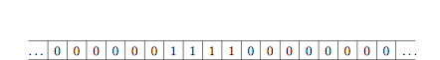
Recap from last time
Turing-Post computational model:
  Greatly simplified model
  Infinite tape, each cell contains symbol (0 or 1)
  Program = finite sequence of instructions
  (only 6 types!)
  Unlike pseudocode, no conditionals or loops, only “GOTO”
  code(P) = binary representation of program P

Slide 3
Example: doubling program
1. PRINT 0
2. GO LEFT
3. GO TO STEP 2 IF 1 SCANNED
4. PRINT 1
5. GO RIGHT
6. GO TO STEP 5 IF 1 SCANNED
7. PRINT 1
8. GO RIGHT
9. GO TO STEP 1 IF 1 SCANNED
10. STOP
Program halts on this input data if STOP is executed in a finite number of steps

Slide 4
Some facts
Fact 1: Every pseudocode program can be written as a T-P program, and vice versa
Fact 2: There exists a universal T-P program
…
1
1
0
0
1
0
1
1
0
1
1
1
0
0
…
code(P)
V
U
U simulates P’s computation on V

Slide 5

Discussion
Time
Is there a universal pseudocode program ?
How would you write it?
What are some examples of universal programs
in real life?

Slide 6
Halting Problem
Decide whether P halts on V or not
Cannot be solved! Turing proved that
no Turing-Post program can solve Halting Problem
for all inputs (code(P), V).
…
1
1
0
0
1
0
1
1
0
1
1
1
0
0
…
code(P)
V

Slide 7
Makes precise something quite intuitive:
“Impossible to demonstrate a negative”
Suppose program P halts on input V.
How can we detect this in finite time?
Proposal: “Just simulate.”
Intuitive difficulty: If P does not actually halt, no obvious way
to detect this after just a finite amount of time.
Turing’s proof makes this intuition concrete.

Slide 8
Ingredients of the proof…..

Slide 9
Ingredient 1: “Proof by contradiction”
Fundamental assumption:
A mathematical statement is either
true or false
“When something’s not right, it’s wrong.”
Bob Dylan

Slide 10
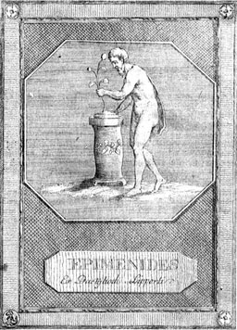
Aside: Epimenides Paradox
Κρῆτες ἀεί ψεύσται
“Cretans, always liars!”
But Epimenides was a Cretan!’
More troubling: “This sentence is false.”

Slide 11
Ingredient 2:
Suppose you have programs A and B.
What is the program whose net effect is
“Run A first and then B?”
Suppose you are given some T-P program P
How would you turn P into a T-P program
that does NOT halt on all inputs that P halts on?

Slide 12
Finally, the proof…
Consider program D
On input V, check if it is
code of a T-P program.
If no, HALT immediately.
If yes, use doubling
program to create the
bit string V, V and simulate
H on it.
If H says “Doesn’t Halt”,
HALT immediately.
If H says “Halts”, go into
infinite loop
Suppose program H
solves Halting Problem
on ALL inputs of the form
code(P), V.
H
Gotcha! Does D halt on the input code(D)?
Either it halts or not – and both ways lead to contradictions!

Slide 13
Lessons to take away
Computation is a very simple process
( can arise in unexpected places)
Universal Program
No real boundary between hardware, software, and data
No program that decides whether or not mathematical statements are theorems.
Many tasks are uncomputable; e.g. “If we start Game of
life in this configuration, will cell (100, 100) ever have
a critter?”

Slide 14
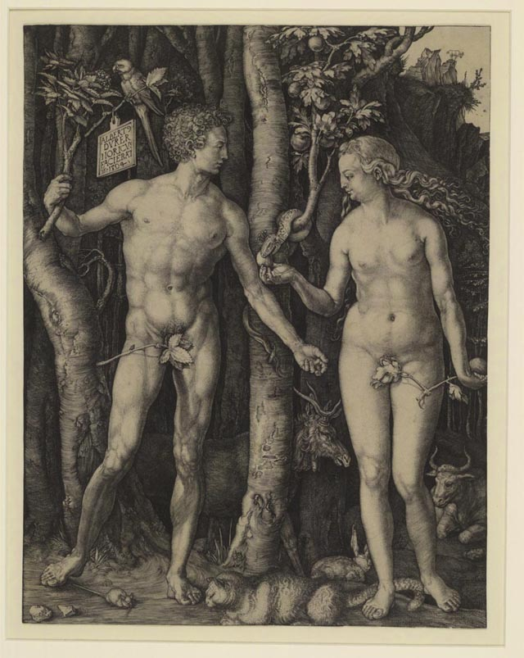
Age-old mystery: Self-reproduction.
How does the seed
encode the whole?

Slide 15
Self-Reproduction
False argument for impossibility:
Blueprint
Blueprint
Blueprint

Slide 16
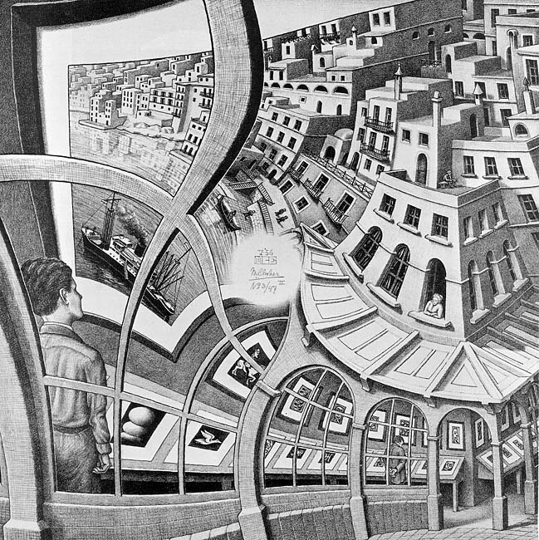
M.C. Escher
Print Gallery

Slide 17
Fallacy Resolved: “Blueprint” can involve some computation; need not be an exact copy!
Print this sentence twice, the second time in quotes. “Print this sentence twice, the second time in quotes.”

Slide 18
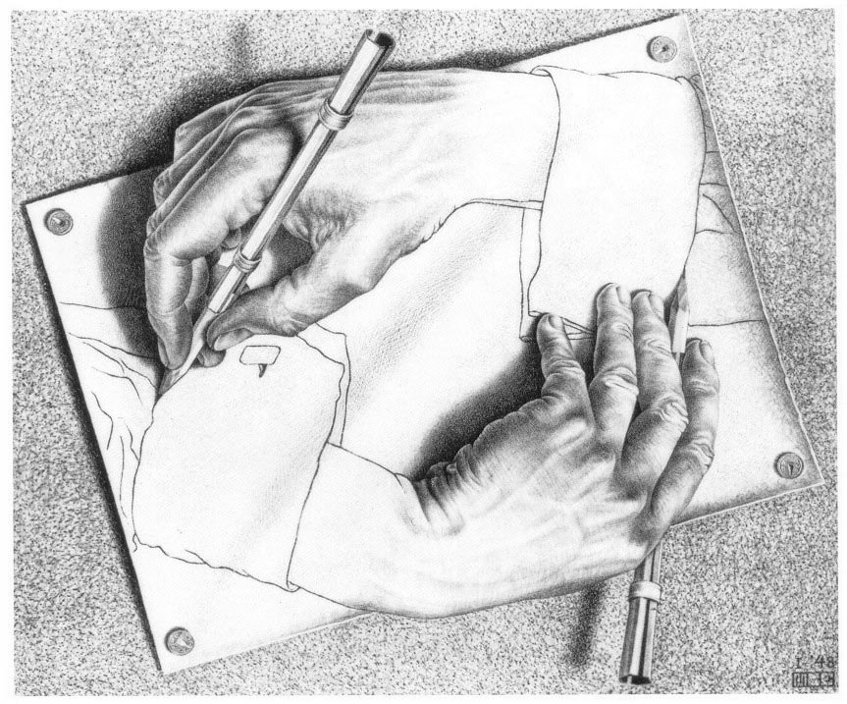

Slide 19
High-level description of program that self-reproduces
}
Print 0
Print 1
.
.
.
Print 0
A
Prints binary code of B
}
. . . . . .
. . . . . .
. . . . . .
. . . . . .
Takes binary string on tape, and in its place prints (in English) the sequence of statements that produce it, followed by the translation of the binary string into English
(ie into a T-P program).
B

Slide 20

Self-reproducing programs
Fact: for every program P, there exists a program P’ that has the exact same functionality except at the end it also prints code(P’) on the tape
MyDoom
Reproduce program send to someone else!
Crash user’s computer!

