Slide 1
“It ain’t no good if it ain’t snappy enough.” (Efficient Computations)
COS 116, Spring 2012
Adam Finkelstein

Slide 2
Today’s focus: efficiency in computation
“If it is worth doing, it is worth doing well, and fast.”
Recall: our model of “computation”: pseudocode

Slide 3
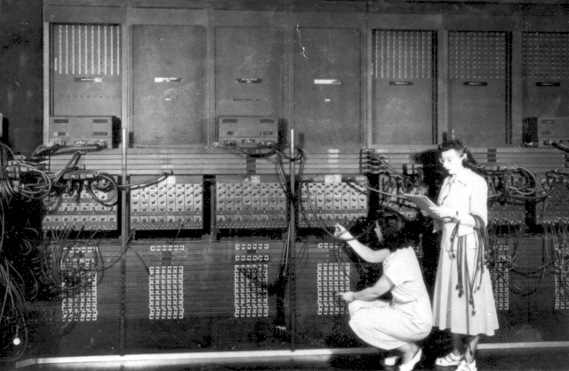
Question: How do we measure the “speed” of an algorithm?
Ideally, should be independent of:
machine
technology

Slide 4
“Running time” of an algorithm
Definition: the number of “elementary operations” performed by the algorithm
Elementary operations: +, -, *, /, assignment, evaluation of conditionals (discussed also in pseudocode handout)
“Speed” of computer: number of elementary operations it can perform per second (Simplified definition)
Do not consider this in “running time” of algorithm; technology-dependent.

Slide 5
Example: Find Min
n items, stored in array A
Variables are i, best
best ← 1
Do for i = 2 to n
{
if (A[ i ] < A[best]) then
{ best ← i }
}

Slide 6
Example: Find Min
n items, stored in array A
Variables are i, best
best ← 1
Do for i = 2 to n
{
if (A[ i ] < A[best]) then
{ best ← i }
}
How many operations executed before the loop?
A: 0 B: 1 C: 2 D: 3

Slide 7
Example: Find Min
n items, stored in array A
Variables are i, best
best ← 1
Do for i = 2 to n
{
if (A[ i ] < A[best]) then
{ best ← i }
}
How many operations per iteration of the loop?
A: 0 B: 1 C: 2 D: 3

Slide 8
Example: Find Min
n items, stored in array A
Variables are i, best
best ← 1
Do for i = 2 to n
{
if (A[ i ] < A[best]) then
{ best ← i }
}
How many times does the loop run?
A: n B: n+1 C: n-1 D: 2n
“iterations”

Slide 9
Example: Find Min
n items, stored in array A
Variables are i, best
best ← 1
Do for i = 2 to n
{
if (A[ i ] < A[best]) then
{ best ← i }
}
Uses at most 2(n – 1) + 1 operations
1 assignment & 1 comparison
= 2 operations per loop iteration
(roughly = 2n)
}
Number of iterations
Initialization

Slide 10
Efficiency of Selection Sort
Do for i = 1 to n – 1
{
Find cheapest bottle among those numbered i to n
Swap that bottle and the i’th bottle.
}
For the i’th round, takes at most 2(n – i ) + 3
To figure out running time, need to figure out how to sum (n – i) for i = 1 to n – 1 …and then double the result.
About 2(n – i) steps
3 steps

Slide 11
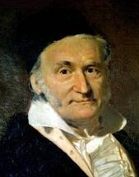
Gauss’s trick : Sum of (n – i) for i = 1 to n – 1
S = 1 + 2 + … + (n – 2) + (n – 1)
+ S = (n – 1) + (n – 2) + … + 2 + 1
2S = n + n + … + n + n
2S = n(n – 1)
So total time for selection sort is ≤ n(n – 1) + 3n
n – 1 times

Slide 12
“20 Questions”: I have a number between 1 and a million in mind. Guess it by asking me yes/no questions, and keep the number of questions small.
Discussion
Time
Question 1: “Is the number bigger than half a million?”
No
Question 2: “Is the number bigger than a quarter million?”
No
Strategy: Each question halves the range of possible answers.

Slide 13
Pseudocode: Guessing number from1 to n
Lower ← 1
Upper ← n
Found ← 0
Do while (Found=0) {
Guess ←Round( (Lower + Upper)/2 )
If (Guess = True Number) { Found ← 1
Print(Guess)
}
If (Guess < True Number) {
Lower ← Guess
} else
{
Upper← Guess
} }
Binary Search
How many times does the loop run??

Slide 14
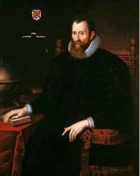
Brief detour: Logarithms (CS view)
log₂ n = K means 2^{K-1} < n ≤ 2^{K}
In words: K is the number of times you need to divide n by 2 in order to get a number ≤ 1
 | 16 | 1024 | 1048576 | 8388608
log₂ n | 4 | 10 | 20 | 23
John Napier
n

Slide 15
Running times encountered in this lecture
 | n= 8 | n= 1024 | n= 1048576 | n=8388608
log₂ n | 3 | 10 | 20 | 23
n | 8 | 1024 | 1048576 | 8388608
n² | 64 | 1048576 | 1099511627776 | 70368744177664
Efficiency really makes a difference!

Slide 16
Next….
“There are only 10 types of people in the world – those who know binary and those who don’t.”

Slide 17
Binary search and binary representation of numbers
Say we know 0 ≤ number < 2^{K}
0
2^{K}
Is 2^{K} / 2 ≤ number < 2^{K}?
No
Yes
Is 2^{K} / 4 ≤ number < 2^{K} / 2?
No
Yes
Is 2^{K} × 3/8 ≤ number < 2^{K} / 2?
No
Yes
…
…

Slide 18
Binary representations (cont’d)
In general, each number can be uniquely identified by a sequence of yes/no answers to these questions.
Correspond to paths down this “tree”:
Is 2^{K} / 2 ≤ number < 2^{K}?
No
Yes
Is 2^{K} / 4 ≤ number < 2^{K} / 2?
…
No
Yes
Is 2^{K} / 8 ≤ number < 2^{K} / 4?
Is 2^{K} × 3/8 ≤ number < 2^{K} / 2?
No
Yes
No
Yes
…
…
…
…

Slide 19
Binary representation of n (the more standard definition)
n = 2^{k} b_{k} + 2^{k-1} b_{k-1} + … + 2 b₂ + b₁
where the b’s are either 0 or 1)
The binary representation of n is:
⎣n⎦₂ = b_{k} b_{k – 1} … b₂ b₁

Slide 20
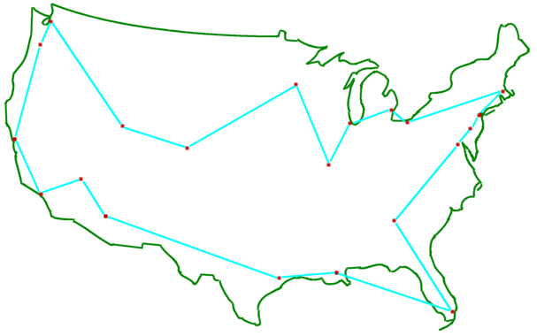
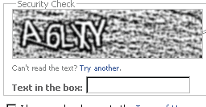
Efficiency of Effort: A lens on the world
QWERTY keyboard
“UPS Truck Driver’s Problem” (a.k.a. Traveling Salesman Problem or TSP)
CAPTCHA’s
Quantum computing
[Jim Loy]

Slide 21
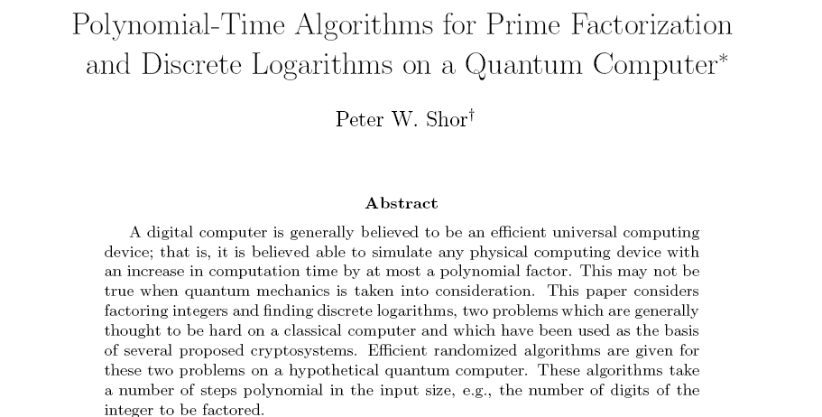
SIAM J.
Computing
26(5) 1997
Can n particles do 2^{n} “operations” in a single step? Or is Quantum Mechanics not quite correct?
Computational efficiency has a bearing on physical theories.

