Slide 1
Telling a computer how to behave
(via pseudocode -- a workaround for Computing’s Tower of Babel.)
COS 116, Spring 2012
Adam Finkelstein

Slide 2

Today’s theme

Slide 3
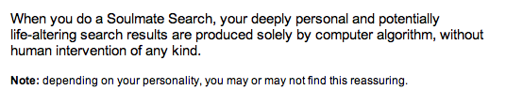

Slide 4
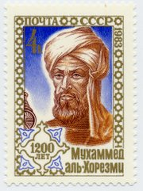
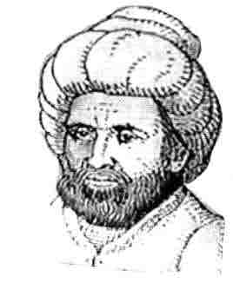
Algorithm
A precise unambiguous procedure for accomplishing a task
Named for Abu Abdullah Muhammad bin Musa al-Khwarizmi
  His book "Al-Jabr wa-al-Muqabilah" evolved into today's high school algebra text.
Examples:
recipe, long division, selection sort.

Slide 5

Example: Adding two numbers
Discussion
Time
Imagine you are describing this task
to somebody who has never done it.
How would you describe it?

Slide 6
How can we describe an algorithm precisely
enough so there is no ambiguity?

Slide 7
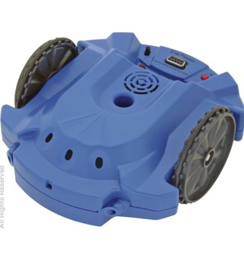
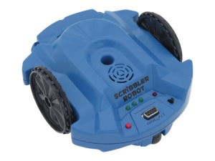
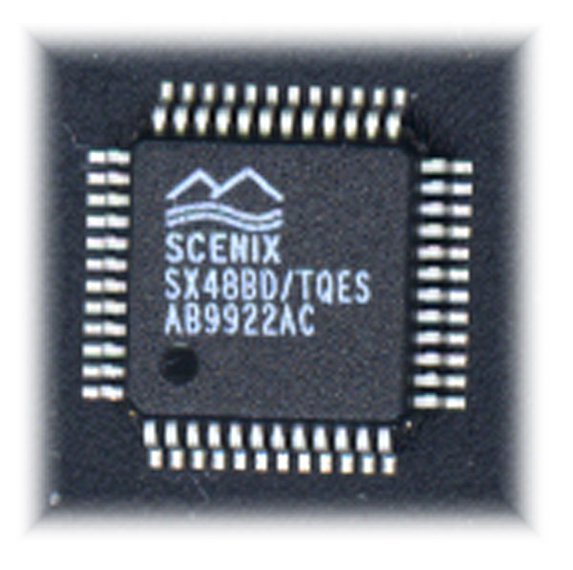
Scribbler
Stall sensor
Speaker
Inputs
Outputs
Motor/wheels
Line sensor (underneath)
Light outputs
Light sensors
Obstacle sensor detector
Obstacle sensor emitter

Slide 8
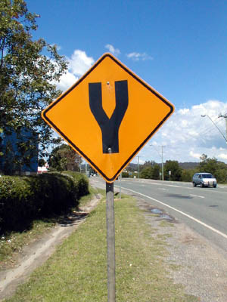
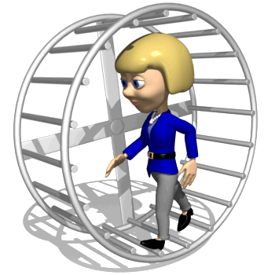
Scribbler’s “Language”
Several types of simple instructions
  E.g. “Move forward for 1 s”
Two types of compound instructions
Conditional
Loop
If condition Then
{
List of instructions
}
Else
{
List of instructions
}
Do 5 times
{
List of instructions
}

Slide 9
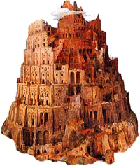
Scribbler language illustrates essential features of all computer languages
BASIC
Computing’s Tower of Babel
C++
Java
Python
Features of human languages:
nouns/verbs/subjects/objects, etc.
Features of computer languages:
variables, simple arithmetic instructions,
conditional/loop statements

Slide 10
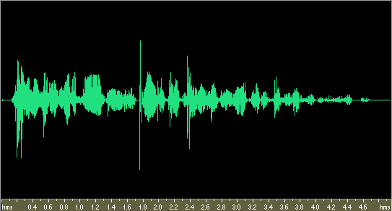

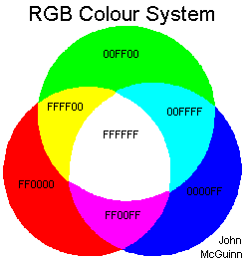
For a computer, everything’s a number
Audio waveform
Sequence of Numbers representing frequency, amplitude, etc.
Image
Sequence of Numbers representing color value
of each pixel.

Slide 11
General task faced by computer
40.99
62.99
52.99
…
22.99
Given: Sequence of numbers in memory (eg, mp3 song)
Goal: Process these numbers to achieve a desired sequence of
numbers as output (eg, electrical signals that drive the
headphones and reproduce the song)

Slide 12
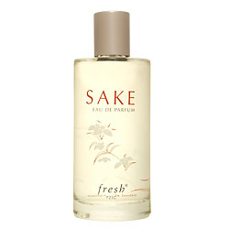
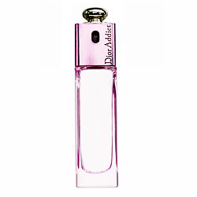
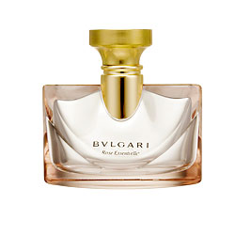

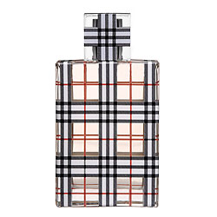
A simple problem
Our robot is getting ready for a big date…
How would it identify the cheapest bottle? (Say it can pick up a bottle & scan prices.)

Slide 13
Solution
Pick up first bottle, check price
Walk down aisle. For each bottle, do this:
  If price on bottle is less than price in hand,
  exchange it with the one in hand.

Slide 14
Similar question in different setting
Robot has n prices stored in memory
Want to find minimum price

Slide 15
Memory: a simplified view
A scratchpad that can be perfectly erased and re-written any number of times
A variable: a piece of memory with a name; stores a “value”
i =
22.99
name
value

Slide 16
Examples
i ← 5
Sets i to value 5
j ← i
Sets j to whatever value is in i.
Leaves i unchanged
i ← j + 1
Sets i to j + 1.
Leaves j unchanged
i ← i + 1
Sets i to 1 more than it was.

Slide 17
Arrays
A is an array of n values
A[ i ] is the i’th value
Example: A[3] = 52.99
A =
40.99
62.99
52.99
…
22.99

Slide 18
Solution
Pick up first bottle, check price
Walk down aisle. For each bottle, do this:
  If price on bottle is less than price in hand,
  exchange it with the one in hand.

Slide 19
Procedure findmin
n items, stored in array A
Variables are i, best
best ← 1
Do for i = 2 to n
{
if ( A[i] < A[best] ) then
best ← i
}

Slide 20
Another way to do the same
best ← 1;
i ← 1
Do while (i < n)
{
i ← i + 1;
if ( A[i] < A[best] ) then
best ← i
}

Slide 21
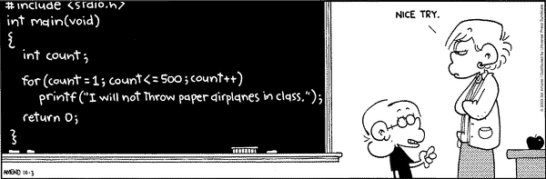

Slide 22
New problem for robot: sorting
Arrange them so prices increase from left to right.

Slide 23
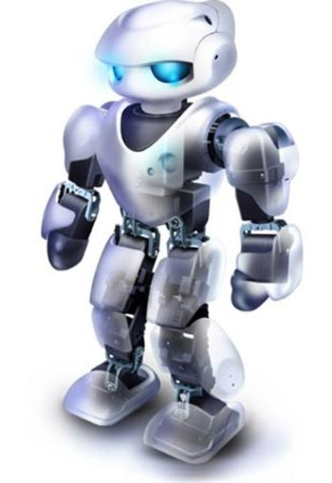
I have to sort n bottles.
Let me find the cheapest bottle and move it to leftmost position. Then I only have to the other bottles to its right.

Slide 24
Solution
Note: we know how to do this!
Do for i=1 to n-1
{
Find cheapest bottle among those numbered i to n
Swap that bottle and the i ’th bottle.
}
“selection sort”

Slide 25
Swapping
Suppose x and y are variables.
How do you swap their values?
Need extra variable!
tmp ← x
x ← y
y ← tmp

Slide 26





Love, Marriage & Broken Hearts
Standard disclaimer.

Slide 27
Stable Matching Problem
Problem:
Given N men & N women, find “suitable” matching
  Everyone lists their preferences from best to worst.
Men’s Preference List
Man
1st
2nd
3rd
4th
5th
Victor
Bertha
Amy
Diane
Erika
Clare
Wyatt
Diane
Bertha
Amy
Clare
Erika
Xavier
Bertha
Erika
Clare
Diane
Amy
Yancey
Amy
Diane
Clare
Bertha
Erika
Zeus
Bertha
Diane
Amy
Erika
Clare
best
worst

Slide 28
Stable Matching Problem
Problem:
Given N men & N women, find “suitable” matching
  Everyone lists their preferences from best to worst.
Women’s Preference List
Woman
1st
2nd
3rd
4th
5th
Amy
Zeus
Victor
Wyatt
Yancey
Xavier
Bertha
Xavier
Wyatt
Yancey
Victor
Zeus
Clare
Wyatt
Xavier
Yancey
Zeus
Victor
Diane
Victor
Zeus
Yancey
Xavier
Wyatt
Erika
Yancey
Wyatt
Zeus
Xavier
Victor
best
worst

Slide 29
Stable Matching Problem
What do we mean by “suitable”?
  PERFECT: everyone matched monogamously.
  STABILITY: no incentive for some pair to elope.
    a pair that is not matched with each other is UNSTABLE
    if they prefer each other to current partners
    unstable pair: improve by dumping spouses and eloping
STABLE MATCHING (Gale and Shapley, 1962)
= perfect matching with no unstable pairs.

Slide 30
Example
Men’s Preference List
Women’s Preference List
Man
1st
2nd
3rd
Woman
1st
2nd
3rd
Xavier
A
B
B
C
Amy
Y
X
Z
Yancey
B
A
C
Bertha
X
X
Y
Z
Zeus
A
B
C
Clare
X
Y
Z
Lavender assignment is a perfect matching.
Are there any unstable pairs?
Yes. Bertha and Xavier form an unstable pair.
They would prefer each other to current partners.

Slide 31
Example
Men’s Preference List
Women’s Preference List
Green assignment is a stable matching.
Man
1st
2nd
3rd
Woman
1st
2nd
3rd
Xavier
A
B
C
Amy
Y
X
Z
Yancey
B
A
C
Bertha
X
Y
Z
Zeus
A
B
C
Clare
X
Y
Z

Slide 32
Example
Men’s Preference List
Women’s Preference List
Gray assignment is also a stable matching.
Man
1st
2nd
3rd
Woman
1st
2nd
3rd
Xavier
A
B
C
Amy
Y
X
Z
Yancey
B
A
C
Bertha
X
Y
Z
Zeus
A
B
C
Clare
X
Y
Z

Slide 33
Propose-And-Reject Algorithm
Guarantees a stable matching.
Initialize each person to be free.
while (some man m is free and hasn't proposed to every woman)
{
w = first woman on m's list to whom he has not yet proposed
if (w is free)
assign m and w to be engaged
else if (w prefers m to her fiancé f)
assign m and w to be engaged, and f to be free
else
w rejects m
}
Gale-Shapley Algorithm (men propose)

Slide 34
Extensions
Unacceptable partners
  Every woman is not willing to marry every man,
  and vice versa.
  Some participants declare others as “unacceptable.”
Sets of unequal size
  Unequal numbers of men and women,
  e.g. 100 men & 90 women
Limited Polygamy
  e.g., Bill wants to be matched with 3 women.

Slide 35
Matching Residents to Hospitals
Hospitals ~ Men (limited polygamy allowed).
Residents ~ Women (more than hospitals)
Started just after WWII (before computer usage).
Ides of March, 13,000+ residents are matched.
Rural hospital dilemma.
  Certain hospitals (mainly in rural areas) were unpopular and declared unacceptable by many residents.
  How to find stable matching that benefits rural hospitals?

Slide 36
Homework for next Thurs
(email your answers to pu.cos116@gmail.com by 2/23 noon as part of HW2)
Write out pseudocode for selection sort.
Try Gale-Shapley algorithm for previously-shown
Amy-Erica / Victor-Zeuss preference lists,
but vary the order of choosing man m.
Does this affect the outcome?
Try the version where women propose.
Does this affect the outcome?
Bonus question: Try to justify this statement:
When the Gale-Shapley algorithm finishes,
there are no unstable pairs.

Slide 37

Lessons Learned
Powerful ideas learned in computer science.
Sometimes deep social ramifications.
      Hospitals and residents…
      Historically, men propose to women.
      Why not vice versa?
      Computer scientists get the best partners!!!
Thursday: the perfect storm…

