Slide 1
COS 116: The Computational Universe
Adam Finkelstein
Spring 2012

Slide 2
COS 116: The Computational Universe
Instructor: Adam Finkelstein
TAs: Sema Berkiten & Sourindra Chaudhuri
Labs
Mon, Wed 7:30-10:20pm, Friend 009
This week only: take-home lab

Slide 3
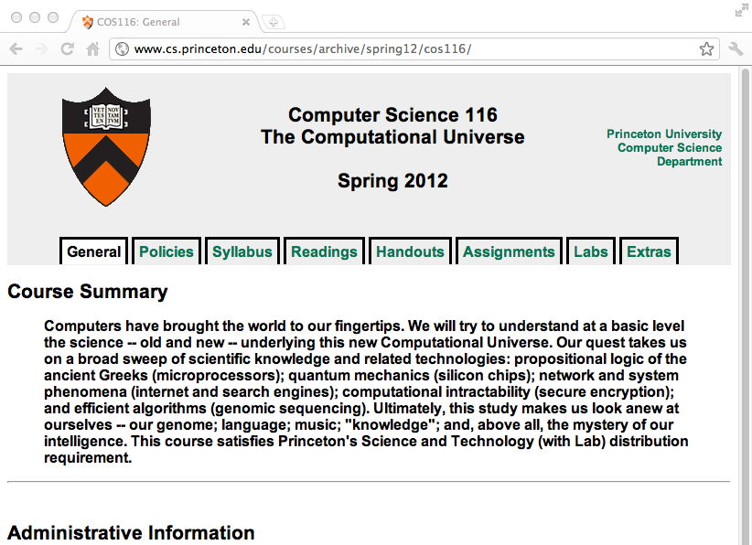

Slide 4
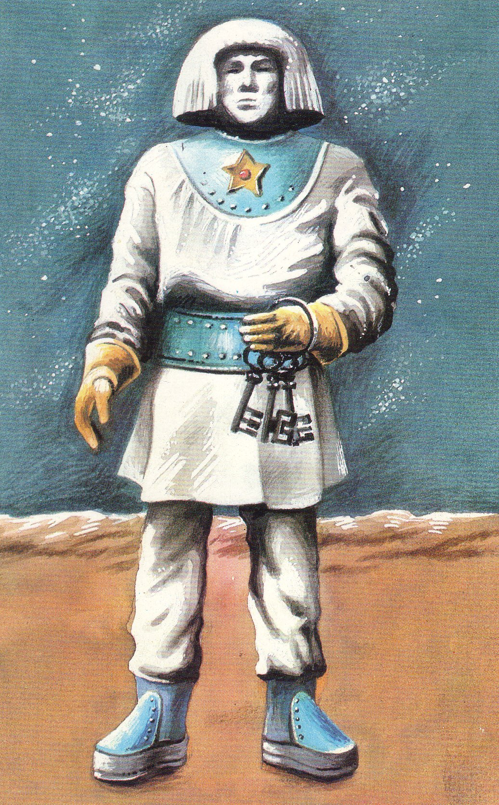
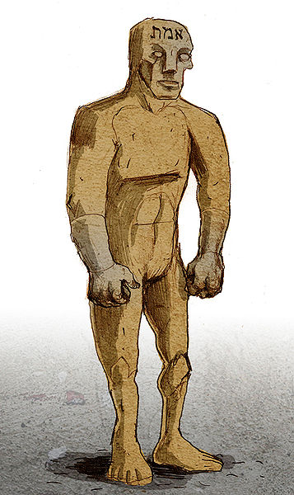
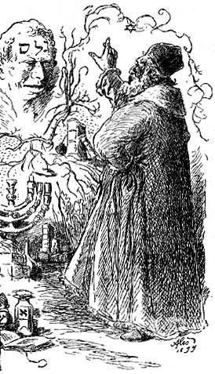
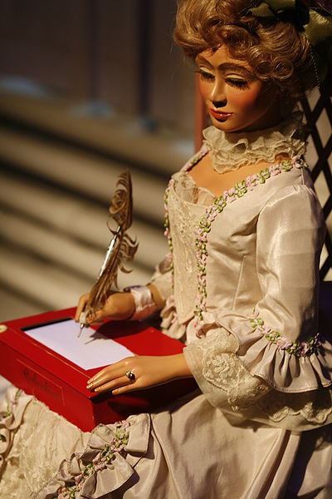
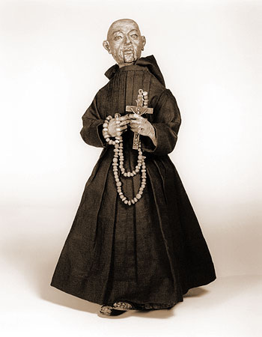
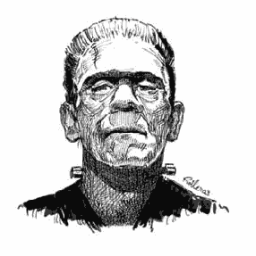
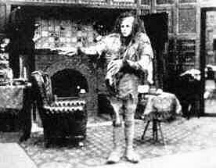
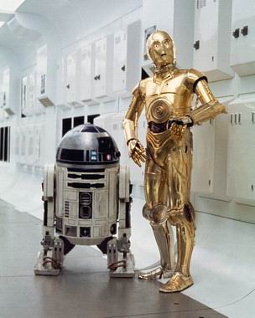
Ancient dream: “Breathe life into matter”
Philippe Semeria
CIMA museum
Golem (Jewish mythology)
Automaton (Europe)
Frankenstein (Shelley 1818)
Robot (Capek 1920)

Slide 5
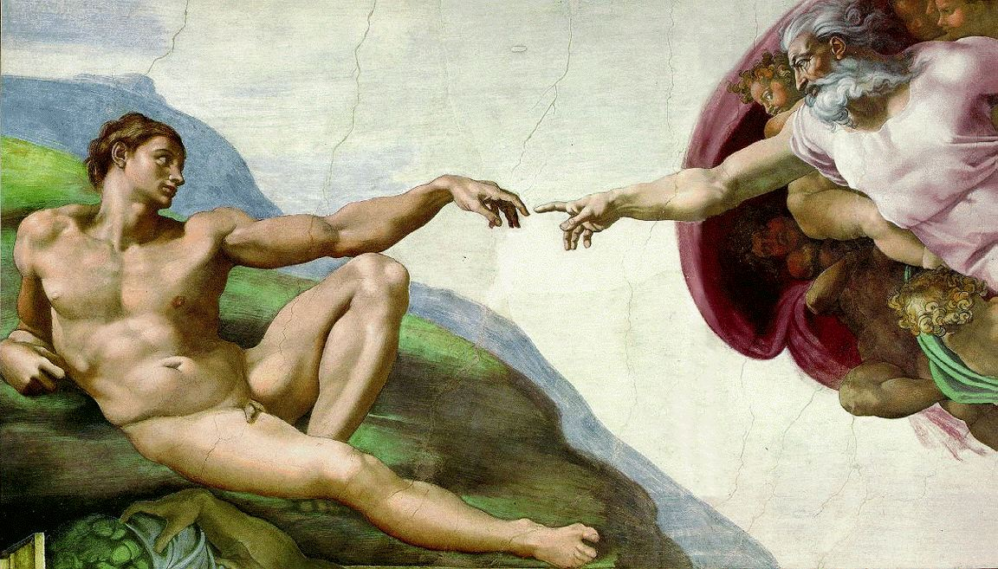
“Breathe life into matter” – Another perspective

Slide 6
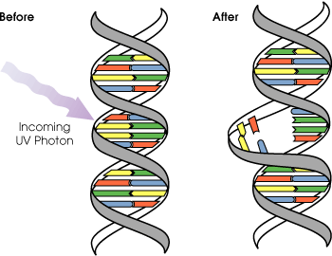
“Breathe life into matter” – A 20th century perspective
“Matter”: Atoms, molecules, quantum mechanics, relativity …
“Life”: Cells, nucleus, DNA, RNA, …
“Breathe life into matter”: Computation
One interpretation: Make matter do useful, interesting things on its own

Slide 7
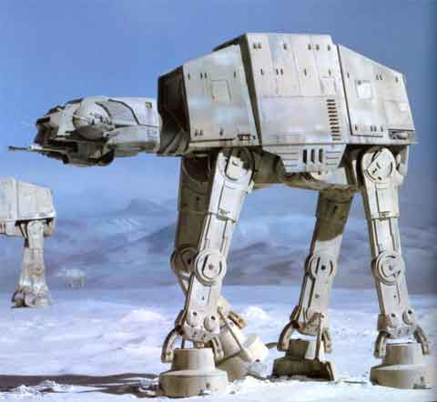
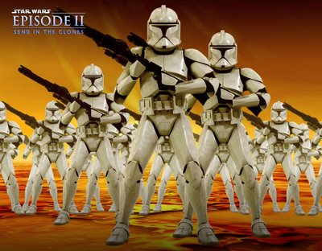
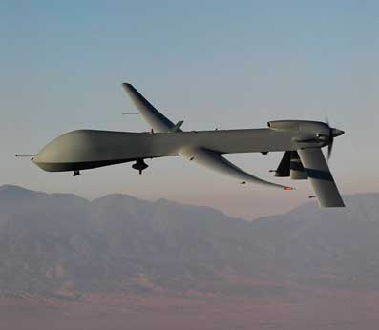
Breathing life into matter…
Military was a major sponsor of computational research in 20th century

Slide 8
Electric Sheep
Scott Draves

Slide 9
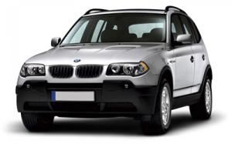
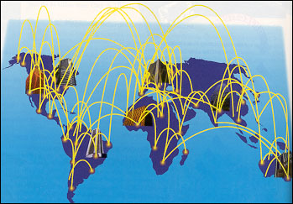
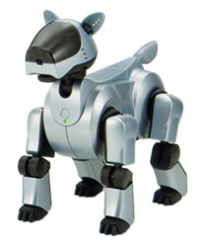
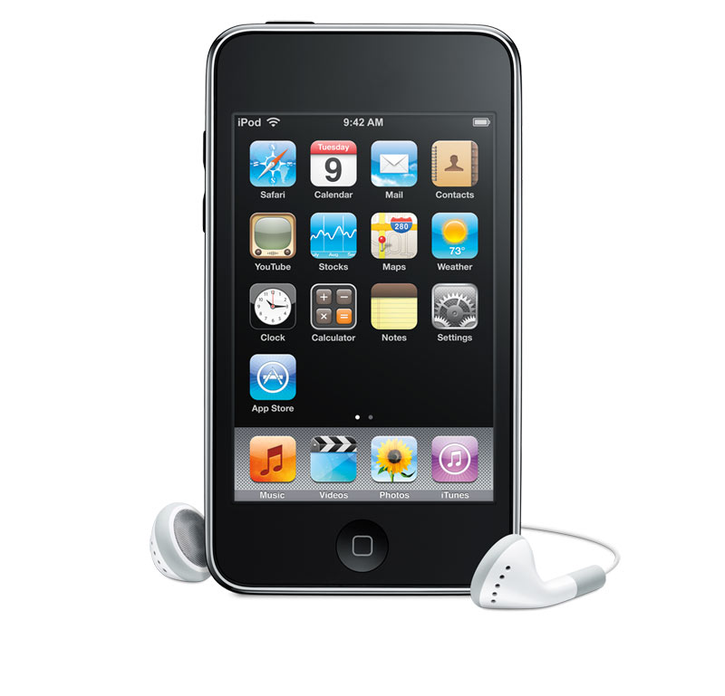
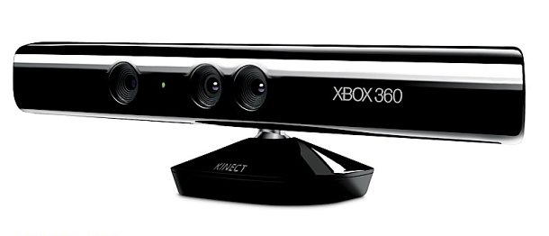
Computational Universe

Slide 10
Some important distinctions
Computer Science
vs. Computer Programming (Java, C++, etc.)
Notion of computation
vs. Specific implementation (Silicon, robots, Xbox, etc.)

Slide 11
Course not about programming!
Not necessary for understanding
More time for to cover computer science (broader than COS126!)
Little advantage to those who have prior programming experience

Slide 12
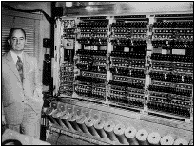
Brief history of computation
Technological:
Clocks
Clockwork “Automata”
Mechanized looms, steam engines
Vacuum tubes, electronic calculators (1910-1930’s)
ENIAC (1945)
von Neumann Computer (1949, Princeton)

Slide 13
Brief history of computation
Intellectual
Ancient Greeks, philosophers
(How to “formalize thought”)
Boolean logic (G. Boole, 1815-1864)
Crisis in math
Hilbert: Call to systematize math
Gödel: Incompleteness theorem
Lambda calculus (A. Church, 1936)
Turing machines (A. Turing, 1937)
Both at Princeton;
First clear notion of “What is computation?”
Wang tiles 1961

Slide 14
Computer Science: A new way of looking at the world

Slide 15
Example 1:

Slide 16
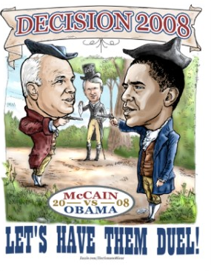
Example 2: Public closed-ballot elections
Hold an election in this room
Everyone speaks publicly (no computers, email, etc.)
End: everyone agrees on who won and margin
No one knows how anyone else voted
Is this possible?
Yes! (A. Yao, Princeton)

Slide 17
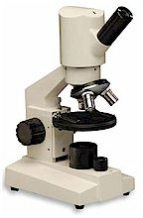
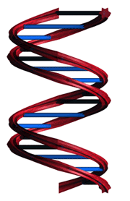
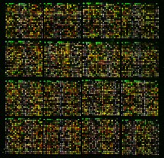
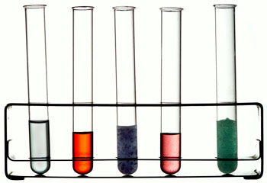
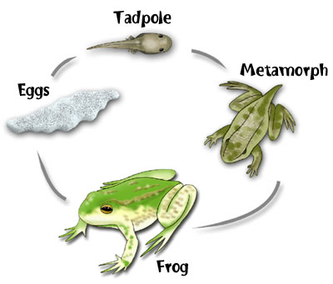
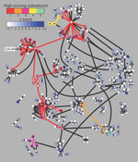
Example 3:
Computational Biology
Old Biology
New Biology
Microarrays
Pathways
Notes:
Maybe say how computers allow us to exploit microarrays to by allowing us to work over massive data sets, and they can help identify pathways of interacting genes or proteins

Slide 18
COS 116
First 10 lectures:
Cool things computers do and how
Next 8 lectures:
What’s inside, internet, silicon chips
Last 6 lectures:
Complexity, cryptography, viruses, search engines, artificial intelligence

Slide 19
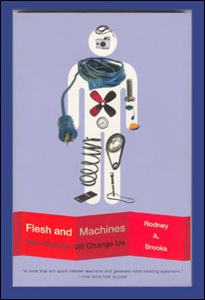
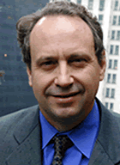
This week’s lab: Web 2.0
This week’s reading:
Brooks pp 12-21, pp 32-51
See course web page.
Take-home lab – see course web page.

Slide 20
Grading
Midterm: 15%
Final: 35%
Lab reports: 35%
Participation (class, blog): 15%
Attendance expected at lectures and labs

Slide 21
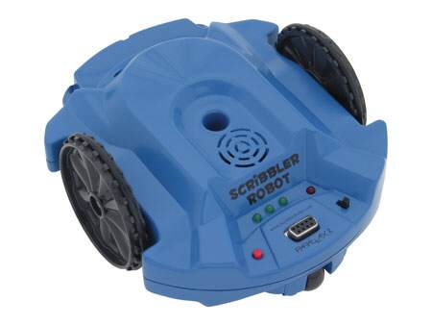
Next couple labs: Scribbler. What determines its behavior?

