Slide 1
Conflict resolution in eventual consistency
COS 418: Distributed Systems
Lecture 9
Michael Freedman
[Selected content adapted from M. Shapiro and I. Stoica]

Slide 2
Eventual consistency
Eventual consistency: If no new updates to the object, eventually all accesses will return the last updated value
Common: git, iPhone sync, Dropbox, Amazon Dynamo
Why do people like eventual consistency?
Fast read/write of local copy of data
Disconnected operation

Slide 3
Concurrent writes can conflict
Encountered in many different settings:
Peer-to-peer (Bayou)
Multi-master clusters (Dynamo)
Potential solutions
“Last writer wins”
Thomas Write Rule for DBs with timestamp-based concurrency control: Ignore outdated writes
Application-specific merge/update: Bayou, Dynamo

Slide 4
Towards generality?

Slide 5
General approach: Encode ops as incremental update
Consider banking (double-entry bookkeeping):
Initial: Alice = $50, Bob = $20
Alice pays Bob $10
Option 1: set Alice to $40, set Bob to $30
Option 2: decrement Alice -$10, incremental Bob +$10
#2 better, but can’t always ensure Alice >= $0
Works because common mathematical ops are
Commutative: A ◎ B == B ◎ A
Invertible: A ◎ A⁻¹ == 1

Slide 6
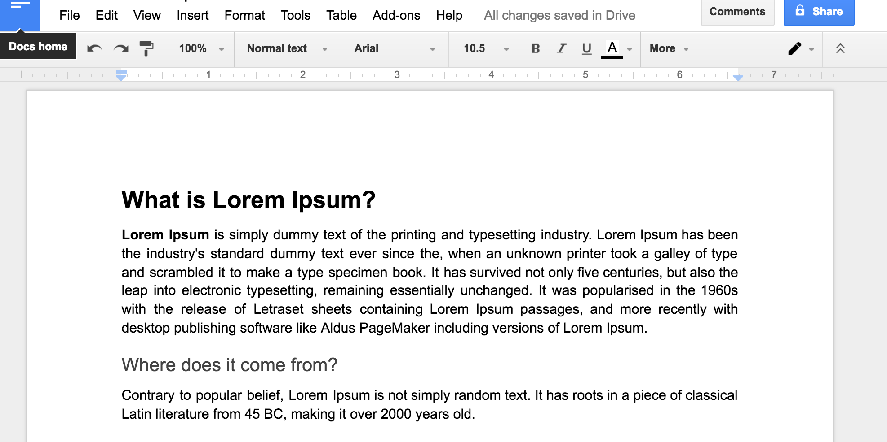
Consider shared word processing
How do I insert a new word?
Send entire doc to server? Not efficient
Send update operation!

Slide 7
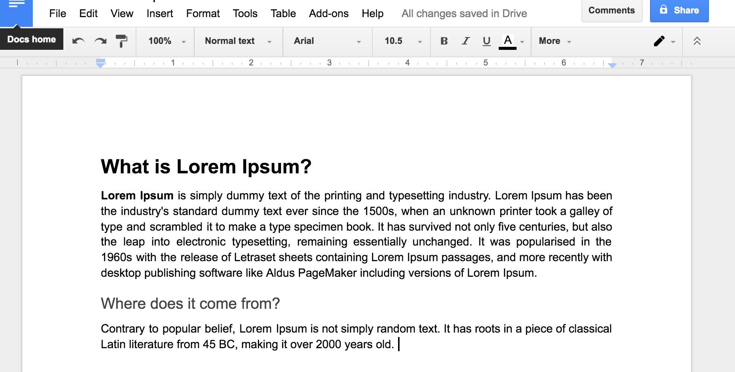
Consider shared word processing
How do I insert a new word?
Send entire doc to server? Not efficient
Send update operation! insert (string, position) = insert(“1500s”, 166)
Warning: Insert (rather than replace) shifted position of all following text

Slide 8
Operations must be commutative
$40
A
Withdraw
$10
Deposit
$15
Insert
(“1500s”, 166)
Delete
(1, 0)
$30
$55
B
C
Deposit
$15
Withdraw
$10
Delete
(1, 0)
[ delete 1 char as pos 0 ]
$45
D

Slide 9
Operations must be commutative
$40
A
Withdraw
$10
Deposit
$15
Insert
(“1500s”, 166)
Delete
(1, 0)
$30
$55
B
C
Deposit
$15
Withdraw
$10
Delete
(1, 0)
[ delete 1 char as pos 0 ]
Insert
(“1500s”, 166)
$45
D
PROBLEM!

Slide 10
Operations must be commutative
$40
A
Withdraw
$10
Deposit
$15
Insert
(“1500s”, 166)
Delete
(1, 0)
$30
$55
B
C
Deposit
$15
Withdraw
$10
Delete
(1, 0)
[ delete 1 char as pos 0 ]
Insert
(“1500s”, 165)
$45
D

Slide 11
Operations must be commutative
$40
A
Withdraw
$10
Deposit
$15
Insert
(“1500s”, 166)
Delete
(1, 0)
$30
$55
B
C
Deposit
$15
Withdraw
$10
$45
E
D
F
G
H

Slide 12
Operational Transformation
Pioneered in GROVE (GRoup Outline Viewing Edit)
C. Ellis and S. Gibbs, 1989
Now found in Apache Wave & Google Docs

Slide 13
Operational Transformation (OT)
State of system is S, ops a and b performed by concurrently on state S
Different servers can apply concurrent ops in different sequential order
Server 1:
Receives a, applies a to state S: S ◎ a
Receives b (which is dependent on S, not S ◎ a )
Transforms b across all ops applied since S (namely a): b’ = OT( b, { a })
Applies b’ to state: S ◎ a ◎ b’
Server 2
Receives b, applies b to state: S ◎ b
Receives a, performs transformation a’ = OT( a, { b }),
Applies a’ to state: S ◎ b ◎ a’
Servers 1 and 2 have identical final states: S ◎ a ◎ b’ == S ◎ b ◎ a’

Slide 14
Operational Transformation (OT)
(Used in Google Docs, EtherPad, etc.)
Server
Alice
Bob
State:
ABCDE
State:
ABCDE
Ops:
ins “ABC”
ins “DE”
Ops:
ins “ABC”
ins “DE”

Slide 15
Operational Transformation (OT)
(Used in Google Docs, EtherPad, etc.)
Server
del 2
del 4
Alice
Bob
State:
ACDE
State:
ABCE
Ops:
ins “ABC”
ins “DE”
del 2
Ops:
ins “ABC”
ins “DE”
del 4

Slide 16
Operational Transformation (OT)
(Used in Google Docs, EtherPad, etc.)
Server
Alice
Bob
State:
ACD
State:
ACE
ins “ABC”
ins “DE”
del 2
del 4
ins “ABC”
ins “DE”
del 4
del 2
Ops:
Ops:
del 2

Slide 17
Operational Transformation (OT)
(Used in Google Docs, EtherPad, etc.)
Server
Alice
Bob
State:
ACE
State:
ACE
ins “ABC”
ins “DE”
del 2
del 4
ins “ABC”
ins “DE”
del 4
del 3
del 2
Ops:
Ops:
del 2
T
T
del 4
del 2

Slide 18
More rigorous approach:
Conflict-free replicated data type
Marc Shapiro, Nuno Preguiça, Carlos Baquero, Marek Zawirski
2011

Slide 19
Definition of EC vs Strong EC
Eventual delivery: An update delivered at some correct replica is eventually delivered to all correct replicas
Termination: All method executions terminate
Convergence: Correct replicas that have delivered the same updates eventually reach equivalent state
Doesn’t preclude roll backs and reconciling
Strong Convergence: Correct replicas that have delivered the same updates have equivalent state

Slide 20
State-based approach
An object is a tuple $(S,s^{0},q,u,m)$
Local queries, local updates
Send full state: on receive, merge
Update is said ‘delivered’ at some replica when it is included in its casual history
Causal History: $C=\left[c_{1},…,c_{n}\right]$
w$here c_{i} goes through a sequence of states: c_{i}^{0},{…,c}_{i}^{k}…$
payload set
merge
initial state
update
query

Slide 21
State-based replication
Local at source $s_{1}$.u(a), $s_{2}$.u(b), …
Precondition, compute
Update local payload
Causal History:
on query: $c_{i}^{k}=c_{i}^{k−1}$
on update: $c_{i}^{k}=c_{i}^{k−1}∪\{u_{i}^{k}\left(a\right)\}$

Slide 22
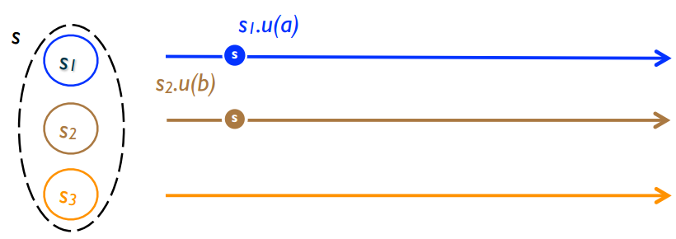
State-based replication
Local at source $s_{1}$.u(a), $s_{2}$.u(b), …
Precondition, compute
Update local payload
Causal History:
on query: $c_{i}^{k}=c_{i}^{k−1}$
on update: $c_{i}^{k}=c_{i}^{k−1}∪\{u_{i}^{k}\left(a\right)\}$

Slide 23
State-based replication
Local at source $s_{1}$.u(a), $s_{2}$.u(b), …
Precondition, compute
Update local payload
Convergence
Episodically: send $s_{i}$ payload
On delivery: merge payloads
Causal History:
on query: $c_{i}^{k}=c_{i}^{k−1}$
on update: $c_{i}^{k}=c_{i}^{k−1}∪\{u_{i}^{k}\left(a\right)\}$
on merge: $c_{i}^{k}=c_{i}^{k−1}∪c_{i′}^{k′}$

Slide 24
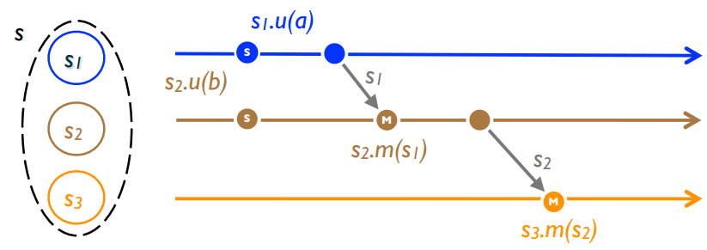
State-based replication
Local at source $s_{1}$.u(a), $s_{2}$.u(b), …
Precondition, compute
Update local payload
Convergence
Episodically: send $s_{i}$ payload
On delivery: merge payloads
Causal History:
on query: $c_{i}^{k}=c_{i}^{k−1}$
on update: $c_{i}^{k}=c_{i}^{k−1}∪\{u_{i}^{k}\left(a\right)\}$
on merge: $c_{i}^{k}=c_{i}^{k−1}∪c_{i′}^{k′}$

Slide 25
State-based replication
Local at source $s_{1}$.u(a), $s_{2}$.u(b), …
Precondition, compute
Update local payload
Convergence
Episodically: send $s_{i}$ payload
On delivery: merge payloads
Causal History:
on query: $c_{i}^{k}=c_{i}^{k−1}$
on update: $c_{i}^{k}=c_{i}^{k−1}∪\{u_{i}^{k}\left(a\right)\}$
on merge: $c_{i}^{k}=c_{i}^{k−1}∪c_{i′}^{k′}$

Slide 26
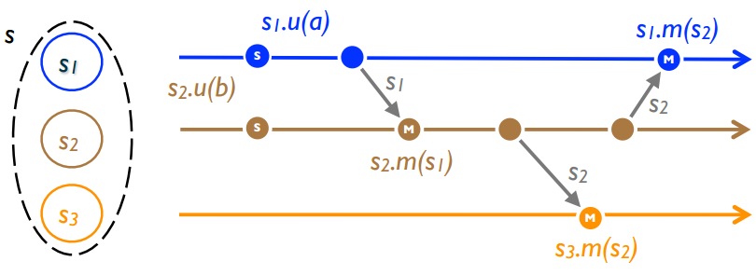
State-based replication
Desired property:
After receiving all updates (irrespective of order), each replica will have same state

Slide 27
Example: Union Set
u: add new element to local replica
q: return entire set
merge: union between remote set and local replica
{5}
{5} U {3} = {3, 5}
{3, 5} U {5, 7} = {3, 5, 7}
{5}
{5}
{5} U {3, 5} = {3, 5}
{5}
{5}
{3, 5} U {5, 7} = {3, 5, 7}
{5}
{5} U {7} = {5, 7}
{5, 7} U {3, 5} = {3, 5, 7}

Slide 28
Example
Partial order ⊆ on sets
⊔ : U (set union)
Then, we have:
commutative: A U B = B U A
idempotent: A U A = A
associative: (A U B) U C = A U (B U C)

Slide 29
Example
Partial order ≤ on set of integers
⊔ : max( )
Then, we have:
commutative: max(x, y) = max(y, x)
idempotent: max(x, x) = x
associative: max(max(x, y), z) = max(x, max(y, z))

Slide 30
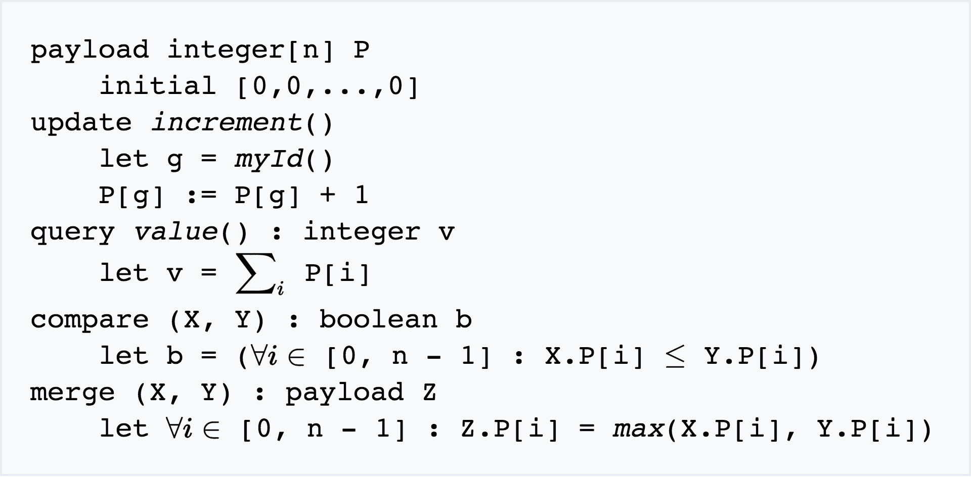
Example: Grow-Only Counter

Slide 31
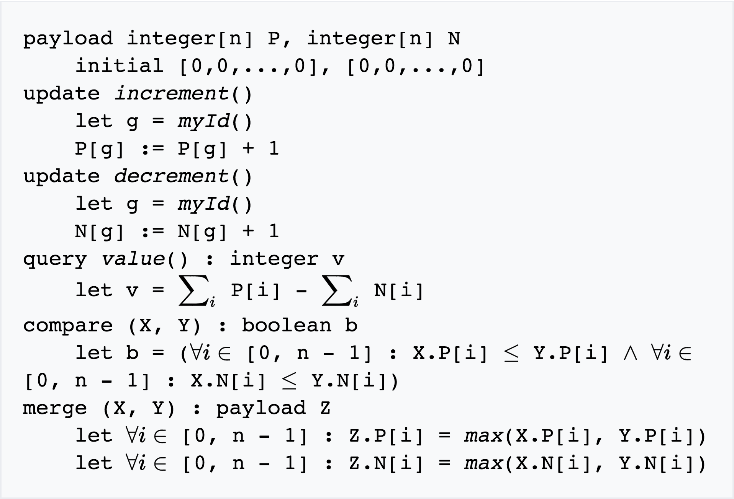
Example: Positive-Negative Counter
Notes:
A common strategy in CRDT development is to combine multiple CRDTs to make a more complex CRDT. In this case, two G-Counters are combined to create a data type supporting both increment and decrement operations. The "P" G-Counter counts increments; and the "N" G-Counter counts decrements. The value of the PN-Counter is the value of the P counter minus the value of the N counter. Merge is handled by letting the merged P counter be the merge of the two P G-Counters, and similarly for N counters. Note that the CRDT's internal state must increase monotonically, even though its external state as exposed through query can return to previous values

Slide 32
Semi-lattice
Partial order ≤ set S with a least upper bound (LUB), denoted ⊔
m = x ⊔ y is a LUB of { x, y } under ≤ iff
∀ m′, x ≤ m′ ∧ y ≤ m′
⇒ x ≤ m ∧ y ≤ m ∧ m ≤ m′
It follows that ⊔ is:
commutative: x ⊔ y = y ⊔ x
idempotent: x ⊔ x = x
associative: ( x ⊔ y) ⊔ z = x ⊔ ( y ⊔ z)

Slide 33
Monotonic Semi-lattice Object
A state-based object with partial order ≤ and the following properties, is a monotonic semi-lattice:
Set S of values forms a semi-lattice ordered by ≤
Merging state s with remote state s′ computes the LUB of the two states, i.e., s • m (s′ ) = s ⊔ s′
State is monotonically non-decreasing across updates, i.e., s ≤ s • u

Slide 34
Convergent Replicated Data Type (CvRDT)
Theorem: Assuming eventual delivery and termination, any state-based object that satisfies the monotonic semi-lattice property is SEC
Why?
Don’t care about order:
Merge is both commutative and associative
Don’t care about delivering more than once
Merge is idempotent

Slide 35
Commutative Replicated Data Type (CmRDT)
Update-based CRDTs:
Sends update operations, not state like CvRDT
Operations are commutative, but not idempotent
System must ensure all ops are delivered to other replicas, without duplication, but in any order
Often used in more complex settings for concurrent editing

Slide 36
Industry Use of CRDTs:
Databases: Redis, Riak, Facebook Apollo
Other: League of Legends Chat
Soundcloud user stream
TomTom device sync

Slide 37
New Module on Monday:
Replicated State Machines

