Slide 1
FlowN: Software-Defined Network Virtualization
Dmitry Drutskoy, Eric Keller, Jennifer Rexford.

Slide 2

What is Network Virtualization
Ability to run multiple virtual networks that:
Each has a separate control and data plane

Slide 3
What is Network Virtualization
Ability to run multiple virtual networks that:
Each has a separate control and data plane
Coexist together on top of one physical network

Slide 4
What is Network Virtualization
Ability to run multiple virtual networks that:
Each has a separate control and data plane
Coexist together on top of one physical network

Slide 5


What is Network Virtualization
Ability to run multiple virtual networks that:
Each has a separate control and data plane
Coexist together on top of one physical network
Can be managed by individual parties that potentially don’t trust each other

Slide 6
Applications of Virtualization
Traffic isolation in enterprise and campus networks

Slide 7
Applications of Virtualization
Traffic isolation in enterprise and campus networks
VLANs

Slide 8
Applications of Virtualization
Traffic isolation in enterprise and campus networks
VLANs
Secure private networks operating across wide areas

Slide 9
Applications of Virtualization
Traffic isolation in enterprise and campus networks
VLANs
Secure private networks operating across wide areas
VPNs

Slide 10
Applications of Virtualization
Traffic isolation in enterprise and campus networks
VLANs
Secure private networks operating across wide areas
VPNs
Multi-tenant datacenters

Slide 11
Applications of Virtualization
Traffic isolation in enterprise and campus networks
VLANs
Secure private networks operating across wide areas
VPNs
Multi-tenant datacenters
A collection of VM’s connected to a “virtual switch”

Slide 12
Applications of Virtualization
Traffic isolation in enterprise and campus networks
VLANs
Secure private networks operating across wide areas
VPNs
Multi-tenant datacenters
A collection of VM’s connected to a “virtual switch”
Can we do better?

Slide 13
Virtualization in Datacenters
Hosted Cloud infrastructures aim to
Provide service to many different clients at once
Be efficient: resources are shared
Provide required isolation between clients

Slide 14
Virtualization in Datacenters
Hosted Cloud infrastructures aim to
Provide service to many different clients at once
Be efficient: resources are shared
Provide required isolation between clients
We propose to virtualize the network using Software-Defined Networking to achieve this

Slide 15
Software-Defined Networking
New approach to networking that has:
Centralized control plane (smart controller)
Separate from data plane (dumb switches)
Control plane software programmable
Standardized interface for network management

Slide 16
SDN Simplified Virtualization
Each virtual network can have it’s own virtual controller
A central controller can perform virtualization to separate the virtual networks without need to support it on every switch
Since controllers are in software, do not need vendor support or proprietary protocols to do this

Slide 17
What is the right abstraction?

Slide 18
What is the right abstraction?
Clients can have different requirements
Just a set of VM’s with given IP’s

Slide 19
What is the right abstraction?
Clients can have different requirements
Just a set of VM’s with given IP’s
“Big switch” abstraction with VMs connected to it

Slide 20
What is the right abstraction?
Clients can have different requirements
Just a set of VM’s with given IP’s
“Big switch” abstraction with VMs connected to it
Proximity of certain VM’s to others

Slide 21
What is the right abstraction?
Clients can have different requirements
Just a set of VM’s with given IP’s
“Big switch” abstraction with VMs connected to it
Proximity of certain VM’s to others
Using their own addresses in the network

Slide 22
Need a General Approach
Provide the clients with a virtual network consisting of:
VM’s
A network of switches
A controller
We can match any requirements by making virtual network look like a real one
For simple networks can run a simple controller
Can be as elaborate as needed

Slide 23
Need a General Approach
Provide the clients with a virtual network consisting of:
VM’s
A network of switches
A controller
We can match any requirements by making virtual network look like a real one
For simple networks can run a simple controller
Can be as elaborate as needed
FlowN!

Slide 24
FlowN
What properties do we want to guarantee?
How does our system accommodate them?

Slide 25
1: Complete Independence
Address space isolation – each virtual network can use their full address space
Virtual networks are decoupled from the physical topology – changes in the physical network are not necessarily seen by the virtual network
Each virtual network sees its own topology, and nothing else
Each virtual network controller is independant

Slide 26
2: Control over network
Arbitrary topologies allow any (reasonable) configuration
Use of own virtual network controller allows fine-grained control of the network
“Big switch” or “collection of VM’s” abstraction can be realized as a simple topology
Embedding algorithm left up to datacenter owner

Slide 27
3: Scalability and Efficiency
This approach should be scalable
Support large amounts of virtual networks
Ability to scale out in the physical network
And efficient
Small latency increases for network traversal
Small resource consumption of virtualization layer

Slide 28
FlowN System Design
We have designed, prototyped and tested a system with some constraints
Based on OpenFlow
While parts of this have been looked at before, full virtualization using SDN is novel

Slide 29
FlowN System Design
Scalable
Mappings done using a database, leveraging existing scalability research
Database can be replicated in the future
Caching already improves performance
Design supports multiple physical controllers in the future
And efficient
We run virtual controllers in a container to lower resource consumption
Remap function calls, don’t send packets

Slide 30
FlowN System Design
Tenant 2
Application
Tenant 1
Application
Arbitrary Embedder
Address
Mapping
Container Based
Application Virtualization
DB
SDN enabled
Network

Slide 31
System Design Overview
Tenant Applications
Tenant 2
Application
Tenant 1
Application
Arbitrary Embedder
Address
Mapping
Container Based
Application Virtualization
DB
SDN enabled
Network

Slide 32
System Design Overview
Arbitrary Embedder
Tenant 2
Application
Tenant 1
Application
Arbitrary Embedder
Address
Mapping
Container Based
Application Virtualization
DB
SDN enabled
Network

Slide 33
System Design Overview
Virtualization layer
Tenant 2
Application
Tenant 1
Application
Arbitrary Embedder
Address
Mapping
Container Based
Application Virtualization
DB
SDN enabled
Network

Slide 34
System Design Overview
Database for address mappings
Tenant 2
Application
Tenant 1
Application
Arbitrary Embedder
Address
Mapping
Container Based
Application Virtualization
DB
SDN enabled
Network

Slide 35
Tenant Applications
Tenant Applications
Tenant 2
Application
Tenant 1
Application
Arbitrary Embedder
Address
Mapping
Container Based
Application Virtualization
DB
SDN enabled
Network

Slide 36
Tenant Applications
Modified controller software
Derived from existing controller with minimal changes
Function calls are remapped in our virtualization layer

Slide 37
Tenant Applications
Modified controller software
Derived from existing controller with minimal changes
Function calls are remapped in our virtualization layer
Virtual network specification

Slide 38
Virtual Network Specification
Nodes
Servers – each occupy 1 VM slot
Switches – have some capacity
Interfaces
Port number, name
Each switch has some number of interfaces
Links
Bandwidth
A link connects one interface on one node to another interface on another node

Slide 39
Embedding
Embedding
Tenant 2
Application
Tenant 1
Application
Arbitrary Embedder
Address
Mapping
Container Based
Application Virtualization
DB
SDN enabled
Network

Slide 40
Embedding
Particular choice of algorithm is left up to the datacenter manager
We provide the abstraction that
Virtual networks are specified as before
Each virtual node of a virtual network maps to a unique physical node
Physical network has remaining capacities specified

Slide 41
Physical and Virtual Topology
Switch
Server with VM slots
…
…

Slide 42
Embed Virtual obeying constraints
Switch
Server with VM slots
…
…

Slide 43
Address Mapping Database
Database for address mappings
Tenant 2
Application
Tenant 1
Application
Arbitrary Embedder
Address
Mapping
Container Based
Application Virtualization
DB
SDN enabled
Network

Slide 44
Address Mapping Database
Leverages existing database research
Simplifies storing state of network mappings

Slide 45
Address Mapping Database
Leverages existing database research
Simplifies storing state of network mappings
Centralizes state, allowing multiple controllers to have the same view in the future

Slide 46
Address Mapping Database
Leverages existing database research
Simplifies storing state of network mappings
Centralizes state, allowing multiple controllers to have the same view in the future
Support for high throughput

Slide 47
Address Mapping Database
Leverages existing database research
Simplifies storing state of network mappings
Centralizes state, allowing multiple controllers to have the same view in the future
Support for high throughput
Low latency achieved through caching

Slide 48
Address Mapping Database
Leverages existing database research
Simplifies storing state of network mappings
Centralizes state, allowing multiple controllers to have the same view in the future
Support for high throughput
Low latency achieved through caching
Guarantees on consistency even in the events of database server failure – no partial network mappings

Slide 49
Address Mapping Database
Leverages existing database research
Simplifies storing state of network mappings
Centralizes state, allowing multiple controllers to have the same view in the future
Support for high throughput
Low latency achieved through caching
Guarantees on consistency even in the events of database server failure – no partial network mappings
Updates are atomic, allowing changes to network mappings to be atomic

Slide 50
Example Query
SELECT L.Customer_ID, L.node_ID1, L.node_ID2, L.node_port1, L.node_port2
FROM Customer_Link L, Node_C2P_Mapping M
WHERE
M.customer_ID = L.customer_ID AND
(L.node_ID1 = M.customer_node_ID OR L.node_ID2 = M.customer_node_ID)
VLAN_tag = 10 AND M.physical_node_ID = 3
Looks up which virtual link a packet belongs to based on the switch it arrived at and the VLAN tag (used for encapsulation)

Slide 51
Example Query
SELECT L.Customer_ID, L.node_ID1, L.node_ID2, L.node_port1, L.node_port2
FROM Customer_Link L, Node_C2P_Mapping M
WHERE
M.customer_ID = L.customer_ID AND
(L.node_ID1 = M.customer_node_ID OR L.node_ID2 = M.customer_node_ID)
VLAN_tag = 10 AND M.physical_node_ID = 3
Get the virtual link

Slide 52
Example Query
SELECT L.Customer_ID, L.node_ID1, L.node_ID2, L.node_port1, L.node_port2
FROM Customer_Link L, Node_C2P_Mapping M
WHERE
M.customer_ID = L.customer_ID AND
(L.node_ID1 = M.customer_node_ID OR L.node_ID2 = M.customer_node_ID)
VLAN_tag = 10 AND M.physical_node_ID = 3
Looks at virtual links table and node mapping table

Slide 53
Example Query
SELECT L.Customer_ID, L.node_ID1, L.node_ID2, L.node_port1, L.node_port2
FROM Customer_Link L, Node_C2P_Mapping M
WHERE
M.customer_ID = L.customer_ID AND
(L.node_ID1 = M.customer_node_ID OR L.node_ID2 = M.customer_node_ID)
VLAN_tag = 10 AND M.physical_node_ID = 3
Table “glue”

Slide 54
Example Query
SELECT L.Customer_ID, L.node_ID1, L.node_ID2, L.node_port1, L.node_port2
FROM Customer_Link L, Node_C2P_Mapping M
WHERE
M.customer_ID = L.customer_ID AND
(L.node_ID1 = M.customer_node_ID OR L.node_ID2 = M.customer_node_ID)
VLAN_tag = 10 AND M.physical_node_ID = 3
Given packet arrived on physical switch 3 with vlan tag 10

Slide 55
Virtualization Layer
Container-based Controller
Tenant 2
Application
Tenant 1
Application
Arbitrary Embedder
Address
Mapping
Container Based
Application Virtualization
DB
SDN enabled
Network

Slide 56
Container-Based Virtualization
Virtual controllers are run as objects in the physical controller, not stand-alone applications
Can use function calls to notify them of network events
Saves computing resources
Requires minimal changes to already written controller applications

Slide 57
Virtualization
Tenant 2
Application
Tenant 1
Application
Container Based
Application Virtualization
Incoming packet
SDN enabled
Network

Slide 58
Virtualization
Tenant 2
Application
Tenant 1
Application
Container Based
Application Virtualization
packet_in event
SDN enabled
Network

Slide 59
Virtualization
Tenant 2
Application
Tenant 1
Application
Map to virtual address
Address
Mapping
Container Based
Application Virtualization
DB
SDN enabled
Network

Slide 60
Virtualization
Tenant 2
Application
Tenant 1
Application
packet_in call
Container Based
Application Virtualization
SDN enabled
Network

Slide 61
Virtualization
No need to run separate controller – can be done with a function call!
Tenant 2
Application
Tenant 1
Application
packet_in call
Container Based
Application Virtualization
SDN enabled
Network

Slide 62
Virtualization
Tenant 2
Application
Tenant 1
Application
install_datapath_flow call
Container Based
Application Virtualization
SDN enabled
Network

Slide 63
Virtualization
Same thing
Tenant 2
Application
Tenant 1
Application
install_datapath_flow call
Container Based
Application Virtualization
SDN enabled
Network

Slide 64
Virtualization
Tenant 2
Application
Tenant 1
Application
Map to physical rules
Address
Mapping
Container Based
Application Virtualization
DB
SDN enabled
Network

Slide 65
FlowN System Design
Tenant 2
Application
Tenant 1
Application
Container Based
Application Virtualization
install_datapath_flow calls
SDN enabled
Network

Slide 66
FlowN System Design
Tenant 2
Application
Tenant 1
Application
Container Based
Application Virtualization
Flow installation
SDN enabled
Network

Slide 67
Prototype and Evaluation

Slide 68
Prototype
Modified python NOX 1.0 controller
MySQL database using InnoDB engine
memcached (pylibmc wrapper for C implementation) for caching results
VLAN tags used for encapsulation
4000ish lines of code in total

Slide 69
Evaluation
VM running on Core i5-2500 @ 3.30Ghz, 4GB RAM, Ubuntu 10.04
Test VM co-located, but each has their own cores
Modified cbench for throughput/latency tests, generating packets within the network
Mininet simulation used for failure experiments

Slide 70
Latency Overhead
Run many virtual networks
Virtual controller is a simple learning switch
…
Learning Switch
Learning Switch
Learning Switch
Virtualization Layer (NOX)

Slide 71
Latency Overhead
Use cbench to simulate packet-in events one at a time
…
Learning Switch
Learning Switch
Learning Switch
Virtualization Layer (NOX)
cbench
cbench: http://www.openflow.org/wk/index.php/Oflops

Slide 72
Latency Overhead
Use cbench to simulate packet-in events one at a time
Record time for packets to be sent on the network
…
Learning Switch
Learning Switch
Learning Switch
Virtualization Layer (NOX)
cbench
cbench: http://www.openflow.org/wk/index.php/Oflops

Slide 73
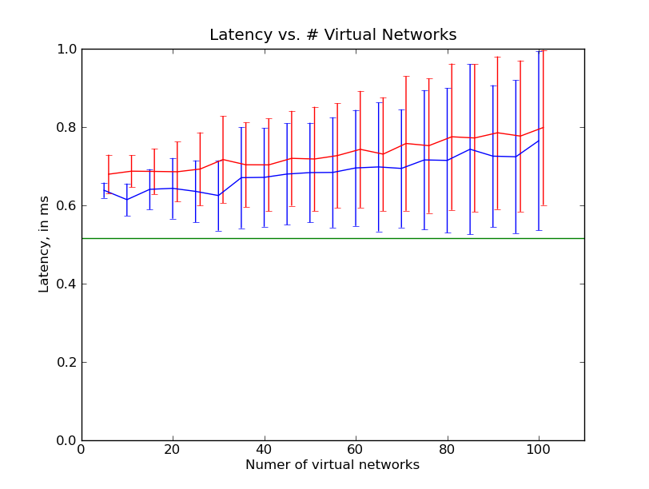
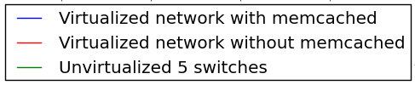
Latency Overhead

Slide 74
Failure Recovery Time
Simulate physical network using mininet
Virtualization Layer (NOX)

Slide 75
Failure Recovery Time
Simulate physical network using mininet
Run many virtual networks on top of it
…
Virtualization Layer (NOX)

Slide 76
Failure Recovery Time
Virtual controller is a host-aware controller which installs shortest path layer-2 routing rules, based on link status
…
Superswitch
Superswitch
Superswitch
Virtualization Layer (NOX)

Slide 77
Failure Recovery Time
Run high-speed ping between virtual hosts
…
Superswitch
Superswitch
Superswitch
ping!
Virtualization Layer (NOX)
pinging!

Slide 78
Failure Recovery Time
Bring link down
…
Superswitch
Superswitch
Superswitch
link broke!
Virtualization Layer (NOX)
I broke!

Slide 79
Failure Recovery Time
Record remapping time
…
Superswitch
Superswitch
Superswitch
Use this instead!
Virtualization Layer (NOX)
Ping resumes!

Slide 80
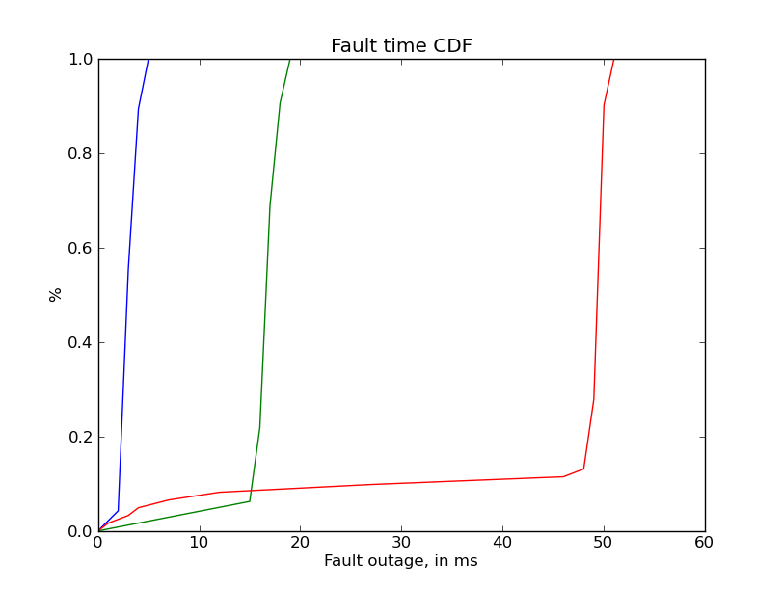

Failure Recovery Time

Slide 81
Future Work
Replicate physical controllers

Slide 82
Replication
Replicate Virtualization Servers
Tenant 3
Application
Tenant 2
Application
Tenant 1
Application
Container Based
Application Virtualization
Container Based
Application Virtualization
SDN enabled
Network

Slide 83
Future Work
Replicate physical controllers
Evaluate different embedding algorithms and their properties

Slide 84
Future Work
Replicate physical controllers
Evaluate different embedding algorithms and their properties
Perform many-to-one mappings within the same virtual network

Slide 85
Questions?

Slide 86
BELOW THIS: OLD/UNUSED SLIDES

Slide 87
Database design
Network specification lends itself to database design
Topology
Node
Link
n:1
Controller
Owner
…
1:n
Type
Capacity
Capacity
VLAN#
Interface
1:n
2:1
Port#
Name

Slide 88
Summary
Network virtualization for:
Arbitrary networks
Container-based controller virtualization
Database approach
Lends itself to network representation
Uses existing database research

Slide 89
Database design
Topology
Node
Controller
Owner
…
Link
Type
Capacity
n:1
1:n
Capacity
VLAN#
Interface
1:n
2:1
Port#
Name
Virtual Networks
Physical Node
Physical Link
Type
Rem. capacity
Physical Interface
Rem. Capacity
1:n
2:1
Port#
Name

Slide 90
Database design
Topology
Node
Controller
Owner
…
Link
Type
Capacity
n:1
1:n
Capacity
VLAN#
Interface
1:n
2:1
Port#
Name
Node Mapping
Each VM slot houses 1 VM
Each physical switch houses
many virtual
Physical Node
Physical Link
Type
Rem. capacity
Physical Interface
Rem. Capacity
1:n
2:1
Port#
Name

Slide 91
Database design
Topology
Node
Controller
Owner
…
Link
Type
Capacity
n:1
1:n
Capacity
VLAN#
Interface
1:n
2:1
Port#
Name
Each Virtual link becomes
A path of physical links
Path Mapping
Physical Node
Physical Link
Type
Rem. capacity
Physical Interface
Rem. Capacity
1:n
2:1
Port#
Name

Slide 92
Database design
Topology
Node
Controller
Owner
…
Link
Type
Capacity
n:1
1:n
Capacity
VLAN#
Interface
1:n
2:1
Port#
Name
Node Mapping
Path Mapping
Physical Node
Physical Link
Type
Rem. capacity
Physical Interface
Rem. Capacity
1:n
2:1
Port#
Name

Slide 93
Caching
Tenant 2
Application
Tenant 1
Application
Cache Results
Address
Mapping
Cache
Container Based
Application Virtualization
DB
SDN enabled
Network

Slide 94
Current Work
Multi-controller environments
Run multiple physical controller server, each housing a number of virtual controllers.
Forward messages to the right controller server if needed.
Caching for faster access
Put a cache in front of each physical controller to speed up access times.

Slide 95
FlowN System Design
Database for address mappings
Tenant 2
Application
Tenant 1
Application
Arbitrary Embedder
Address
Mapping
Container Based
Application Virtualization
DB
SDN enabled
Network

Slide 96
Current SDN Virtualization (OLD)
Address space
“Slice” the address space [FlowVisor][Pflow]
“Virtualize” by providing each virtual network with own address space [VL2][Nicira].
Topology
Edge switches with full connectivity [VL2][Nicira]
Subset existing topology [FlowVisor][PFlow]
Notes:
Mention what each is good for (you want topology to be able to control your own bandwidth allocation among your VMs, and manage failure yourself).

Slide 97
Topology
Edge switches with full connectivity [VL2][Nicira]
Notes:
Mention what each is good for (you want topology to be able to control your own bandwidth allocation among your VMs, and manage failure yourself).

Slide 98
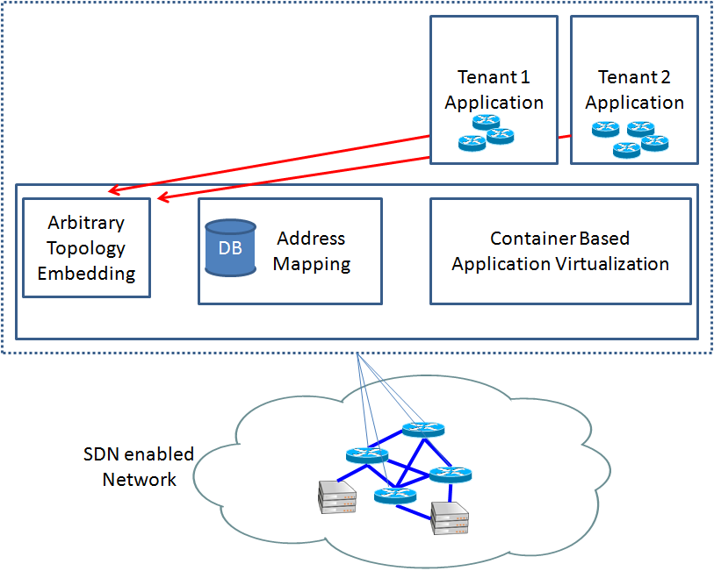
FlowN System Design (1)
Database for address mappings

Slide 99
FlowN System Design (2)
Container based controller

Slide 100
Physical and Virtual Topology
N
Switch with N capacity
10
N
Server with N VM’s
10
10
5
5
50
5
5
20
20
2
2
2
2
25
25
6
6
6
6
6
6
3
3
…
3
3
3
…
3

Slide 101
Embed Virtual obeying constraints
N
Switch with N capacity
10
N
Server with N VM’s
10
10
5
5
5
5
10
10
2
2
2
2
10
10
5
5
5
5
2
2
…
2
2
…

Slide 102
Update Constraints
N
Switch with N capacity
10
N
Server with N VM’s
10
10
5
5
50
5
5
10
10
2
2
2
2
15
15
1
6
1
6
1
1
1
1
…
3
1
1
…
3

Slide 103
Why virtualize the Network? (don’t use this slide)
Virtualization in a Datacenter environment common practice.
Virtual networks as a service.
Datacenter incurs smaller costs per resource due to size (dedicated facility, personnel, design, etc.).
Customers avoid start-up costs, pay per resources used.
Can be useful in other places.
Managing a virtual network can be easier than a (especially new) physical.
Allows running multiple virtual networks over one physical for things like research testbeds.

Slide 104
Arbitrary Virtual Networks (don’t use this slide)
Current approaches do not give an arbitrary virtual network.
One approach abstracts away inner network operation, presenting users with either:
A point-to-point mesh of edge switches (Nicira).
A set of VM’s with given addresses (Microsoft Azure).
Another “slices” the network.
Each tenant subscribes to certain addresses of a global address scheme (FlowVisor).
Full Virtualization has its benefits.
Allows fine-grained network management.
Masking of real network operation to virtual networks.
Allows you to use your favorite network anywhere!

Slide 105
Current SDN Virtualization
Abstract away inner network operation [Nicira][VL2]
“Slice” the network [FlowVisor][Pflow]
Picture here

Slide 106
Current SDN Virtualization
Abstract away inner network operation [Nicira][VL2]
Picture here

Slide 107
Full Virtualization

Slide 108
Current SDN Virtualization
Address space
“Slice” the address space [FlowVisor][Pflow]
“Virtualize” by providing each virtual network with own address space [VL2][Nicira].
VN 1:
VM1: ip=10.0.0.1
VM2: ip=10.0.0.2
VM3: ip=10.0.0.3
…
VN 1:
VM1: ip=10.0.0.1
mac=…:00:01
VM2: ip=10.0.1.1
mac=…:00:02
…
VN 1:
VM1: mac=…00:01
VM2: mac=…00:02
VM3: mac=…00:03
…

Slide 109
Why Virtualize the Network
...
Controller
Application
Controller
Application
Controller
Application
Virtual to Physical Mapping

Slide 110
FlowN System Design

