Slide 1
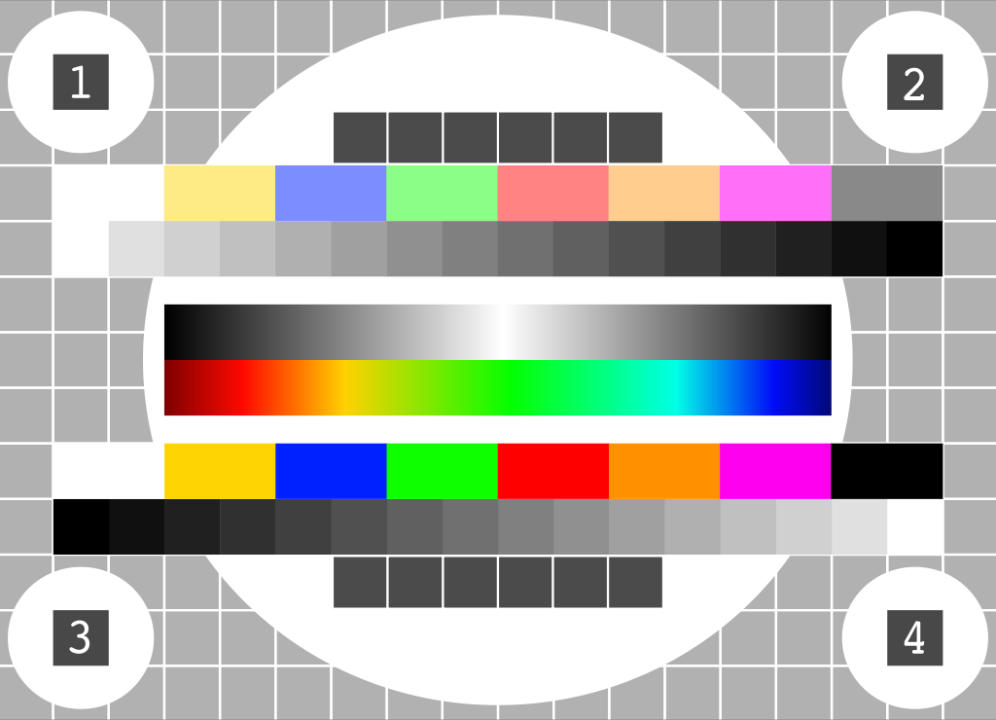
A NICE way to test
OpenFlow Applications
Marco Canini, Daniele Venzano,
Peter Perešíni, Dejan Kostić, Jennifer Rexford†
EPFL
†Princeton University
2
5
A
p
r
’12

Slide 2
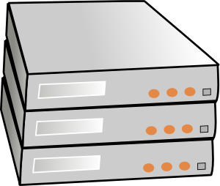


Software-Defined Networking (SDN)
Third-party
program
Enables new functionality through programmability …

Slide 3


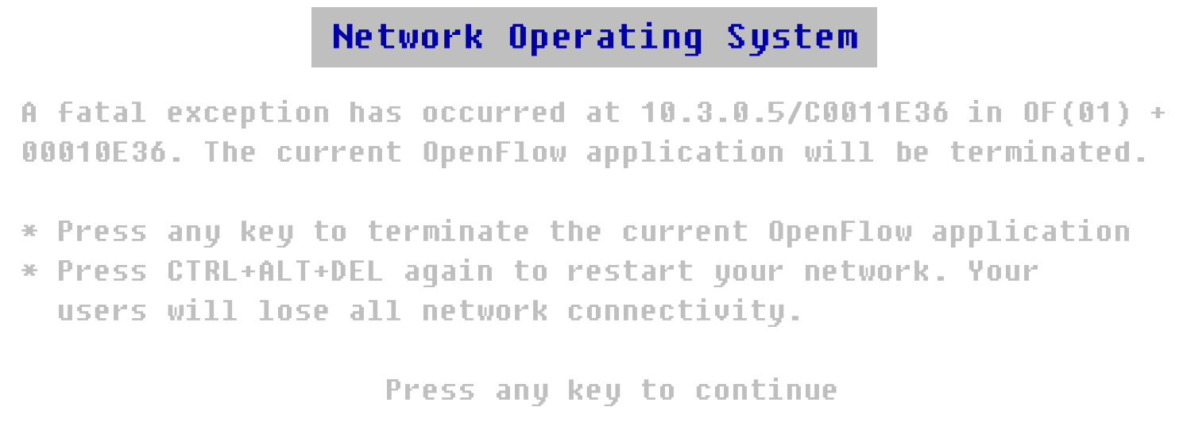
… at the risk of bugs

Slide 4


Software Faults
Will make communication unreliable
Major hurdle for success of SDN
We need effective ways to test SDN networks
This talk: automatically testing OpenFlow Apps

Slide 5

Quick OpenFlow 101
Controller
Execute packet_in event handler
OpenFlow
program
Default: forward
to controller
Install rule;
forward packet
Host A
Host B
Packet
Switch 1
Switch 2
Flow Table
Rule 1
System is distributed and asynchronous →
can misbehave under corner cases
Match
Actions
Counters
Rule 2
Dst: Host B
Fwd: Switch 2
pkts / bytes
Rule N

Slide 6
Bugs in OpenFlow Apps
Drop packet
Controller
?
OpenFlow
program
Install rule
Install
rule
Delayed!
Inconsistent distributed state!
Host A
Host B
Packet
Goal: systematically test possible behaviors to detect bugs
Switch 1
Switch 2

Slide 7
Systematically Testing OpenFlow Apps
  Carefully-crafted streams of packets
  Many orderings of packet arrivals
  and events
State-space exploration
via Model Checking (MC)
Target
system
Unmodified
OpenFlow
program
Environment model
Switch
1
Switch
2
Complex
environment
Host A
Host B

Slide 8
Scalability Challenges
Data-plane driven
Complex network behavior
Huge space of
possible
packets
Huge space of
possible
event orderings
Equivalence
classes of
packets
Domain-specific search strategies
Enumerating all inputs and event orderings is intractable

Slide 9
Input
NICE
Output
No bugs
In
Controller
Execution
Unmodified
OpenFlow
program
Traces of property violations
State-space
search
Network
topology
Correctness
properties (e.g., no loops)
NICE found 11 bugs in 3 real OpenFlow Apps

Slide 10
Input
NICE
Output
No bugs
In
Controller
Execution
Unmodified
OpenFlow
program
Traces of property violations
State-space
search
Network
topology
Correctness
properties (e.g., no loops)

Slide 11
State-Space Model
Model Checking
State
0
State
1
State
3
State
2
State
4
State
5
State
6
State
7
State
8
State
9

Slide 12
System State
Controller (global variables)
Environment:
Switches (flow table, OpenFlow agent)
Simplified switch model
State
End-hosts (network stack)
Simple clients/servers
Communication channels (in-flight pkts)

Slide 13
Transition System
State
0
host
send
Data-dependent
transitions!
Run actual packet_in handler
switch
process_pkt
State
1
State
3
State
2
switch
process_of
ctrl
packet_in(pkt A)
ctrl
packet_in(pkt B)
State
4
State
5
State
6
State
7
State
8
State
9

Slide 14
Combating Huge Space of Packets
pkt
is dst
broadcast?
Equivalence classes of packets:
Broadcast destination
Unknown unicast destination
Known unicast destination
yes
no
dst in
mactable?
Packet arrival handler
no
yes
Flood packet
Install rule and forward packet
Code itself reveals equivalence classes of packets

Slide 15
Code Analysis: Symbolic Execution (SE)
Symbolic packet
λ
1 path =
1 equivalence class of packets =
1 packet to inject
is λ.dst
broadcast?
Infeasible from initial state
λ .dst ∈ {Broadcast}
λ .dst ∉ {Broadcast}
yes
no
λ.dst in
mactable?
Packet arrival handler
no
λ .dst ∉ {Broadcast}
∧
λ .dst ∉ mactable
yes
λ .dst ∉ {Broadcast}
∧
λ .dst ∈ mactable
Flood packet
Install rule and forward packet

Slide 16
Combining SE with Model Checking
host
send(pkt A)
host
discover_packets
host
send(pkt B)
State
0
State
1
State
2
State
3
host
send(pkt C)
Controller state changes
State
4
discover_packets transition:
Controller state 1
Symbolic
execution
of packet_in
handler
New packets
Enable new transitions:
host / send(pkt B)
host / send(pkt C)

Slide 17
Combating Huge Space of Orderings
OpenFlow-specific search strategies for
up to 20x state-space reduction:
FLOW-IR
PKT-SEQ
NO-DELAY
MC
+
SE
UNUSUAL

Slide 18
Input
NICE
Output
No bugs
In
Controller
Execution
Unmodified
OpenFlow
program
Traces of property violations
State-space
search
Network
topology
Correctness
properties (e.g., no loops)

Slide 19
Specifying App Correctness
Library of common properties
  No forwarding loops
  No black holes
  Direct paths (no unnecessary flooding)
  Etc…
Correctness is app-specific in nature

Slide 20
API to Define App-Specific Properties
ctrl
packet_in(pkt A)
State
0
State
1
Execute after
transitions
Register callbacks to
observe transitions
def init():
init local vars
register(“packet_in”)
def on_packet_in():
check system-wide state

Slide 21
Prototype Implementation
Built a NICE prototype in Python
Target the Python API of NOX
NICE
Unmodified
OpenFlow
program
Stub NOX API
Controller state &
transitions

Slide 22
Experiences
Tested 3 unmodified NOX OpenFlow Apps
  MAC-learning switch
  LB: Web server load balancer [Wang et al., HotICE’11]
  TE: Energy-aware traffic engineering [CoNEXT’11]
Setup
  Iterated with 1, 2 or 3-switch topologies; 1,2,… pkts
  App-specific properties
    LB: All packets of same request go to same server replica
    TE: Use appropriate path based on network load

Slide 23
Results
NICE found 11 property violations → bugs
  Few secs to find 1st violation of each bug (max 30m)
  Few simple mistakes (not freeing buffered packets)
  3 insidious bugs due to network race conditions
    NICE makes corner cases as likely as normal cases

Slide 24
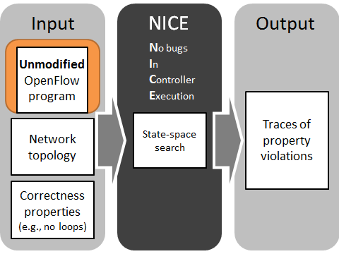
Conclusions
Thank you! Questions?
NICE automates the testing of OpenFlow Apps
http://code.google.com/p/nice-of/
Explores state-space efficiently
Tests unmodified NOX applications
Helps to specify correctness
Finds bugs in real applications
SDN: a new role for software tool chains
to make networks more dependable.
NICE is a step in this direction!

Slide 25
Backup slides

Slide 26
Related Work (1/2)
Model Checking
  SPIN [Holzmann’04], Verisoft [Godefroid’97],
  JPF [Visser’03]
  Musuvathi’04, MaceMC [Killian’07], MODIST [Yang’09]
Symbolic Execution
  DART [Godefroid’05], Klee [Cadar’08],
  Cloud9 [Bucur’11]
MC+SE: Khurshid’03

Slide 27
Related Work (2/2)
OpenFlow programming
  Frenetic [Foster’11], NetCore [Monsanto’12]
Network testing
  FlowChecker [Al-Shaer’10]
  OFRewind [Wundsam’11]
  Anteater [Mai’11]
  Header Space Analysis [Kazemian’12]

Slide 28
Micro-benchmark of full state-space search
Single 2.6 GHz core
64 GB RAM
Pyswitch
MAC-learning switch
Compared with
SPIN: 7 pings → out of memory
JPF is 5.5 x slower
Switch
1
Switch
2
Host A
Host B
Concurrent
“Layer-2 ping”
Pings | Transitions | Unique states | Time
2 | 470 | 268 | 0.94 [s]
3 | 12,801 | 5,257 | 47.27 [s]
4 | 391,091 | 131,515 | 36 [m]
5 | 14,052,853 | 4,161,335 | 30 [h]

Slide 29
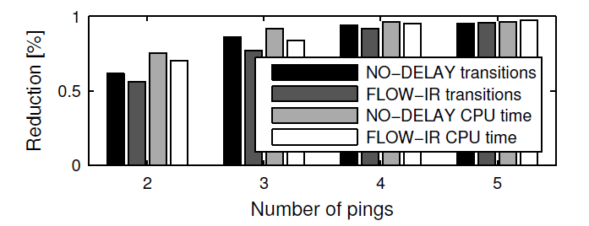
State space reduction by heuristics
Single 2.6 GHz core
64 GB RAM
Pyswitch
MAC-learning switch
Compared to base
model checking
Switch
1
Switch
2
Host A
Host B

Slide 30
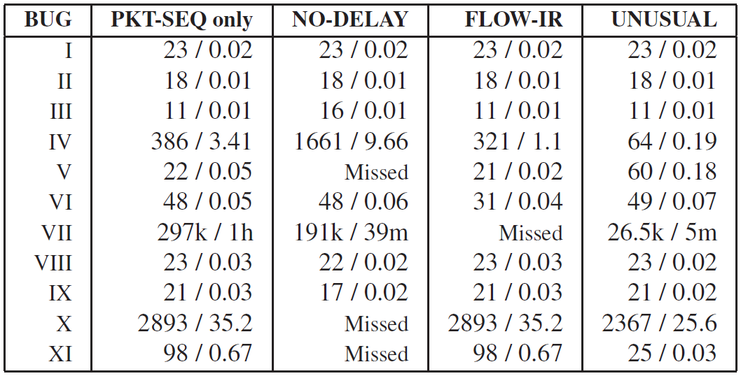
Transitions # / run time [s] to 1st property violation of each bug

Slide 31
OpenFlow Switch Model
Example: adding Rule 1 and Rule 2
switch
process_of
State
1
1)
Flow Table
install
Rule 1
install
Rule 2
State
2
State
4
2)
Flow Table
Flow Table
(4
Rule 1
Rule 2
install
Rule 2
install
Rule 1
State
3
≠
State
5
3)
Flow Table
Flow Table
(5
Rule 1
Rule 2
Rule 2
Rule 1

Slide 32
MAC-learning switch (3 bugs)
OpenFlow
program
Host A
1
2
2
1
Host B
3
A->B | port 2
A->B | port 1
BUG-I: Host unreachable after moving

Slide 33
MAC-learning switch (3 bugs)
OpenFlow
program
Host A
1
2
2
1
Host B
3
B->A | port 1
B->A | port 2
A->B | port 2
A->B | port 1
BUG-I: Host unreachable after moving
BUG-II: Delayed direct path

Slide 34
MAC-learning switch (3 bugs)
OpenFlow
program
Host A
1
2
2
1
3
2
1
3
BUG-I: Host unreachable after moving
BUG-II: Delayed direct path
BUG-III: Excess flooding

Slide 35
Web Server Load Balancer (4 bugs)
OpenFlow
program
Host A
1
3
Server 1
Host B
Server 2
2
4
Custom property: all packets of same request go to same server replica
BUG-IV: Next TCP packet always dropped after reconfiguration
BUG-V: Some TCP packets dropped after reconfiguration
BUG-VI: ARP packets forgotten during address resolution
BUG-VII: Duplicate SYN packets during transitions

Slide 36
Energy-Efficient TE (4 bugs)
Precompute 2 paths per <origin,dest.>
  Always-on and on-demand
Make online decision:
  Use the smallest subset of network elements that satisfies current demand
BUG-VIII: The first packet of a new flow is dropped
BUG-IX: The first few packets of a new flow can be dropped
BUG-X: Only on-demand routes used under high load
BUG-XI: Packets can be dropped when the load reduces

Slide 37
Results
Why were mistakes easy to make?
  Centralized programming model only an abstraction
Why the programmer could not detect them?
  Bugs don’t always manifest
  TCP masks transient packet loss
  Platform lacks runtime checks
Why NICE easily found them?
  Makes corner cases as likely as normal cases

Slide 38
Example: MAC-learning Switch
1 ctrl_state = {} # State of the controller is a global variable (a hashtable)
2 def packet_in(sw_id, inport, pkt, bufid): # Handles packet arrivals
3 mactable = ctrl_state[sw_id]
4 is_bcast_src = pkt.src[0] & 1
5 is_bcast_dst = pkt.dst[0] & 1
6 if not is_bcast_src:
7 mactable[pkt.src] = inport
8 if (not is_bcast_dst) and (mactable.has_key(pkt.dst)):
9 outport = mactable[pkt.dst]
10 if outport != inport:
11 match = {DL SRC: pkt.src, DL DST: pkt.dst, DL TYPE: pkt.type, IN PORT: inport}
12 actions = [OUTPUT, outport]
13 install_rule(sw_id, match, actions, soft_timer=5, hard_timer=PERMANENT)
14 send_packet_out(sw_id, pkt, bufid)
15 return
16 flood_packet(sw_id, pkt, bufid)

Slide 39
Causes of Corner Cases
(Examples)
Multiple packets of a flow reach controller
No atomic update across multiple switches
Previously-installed rules limit visibility
Composing functions that affect same packets
Assumptions about end-host protocols & SW

